Slide 1

AstroSage Analysis
Pyla Pavan Kumar Reddy
April batch 2025

Slide 2
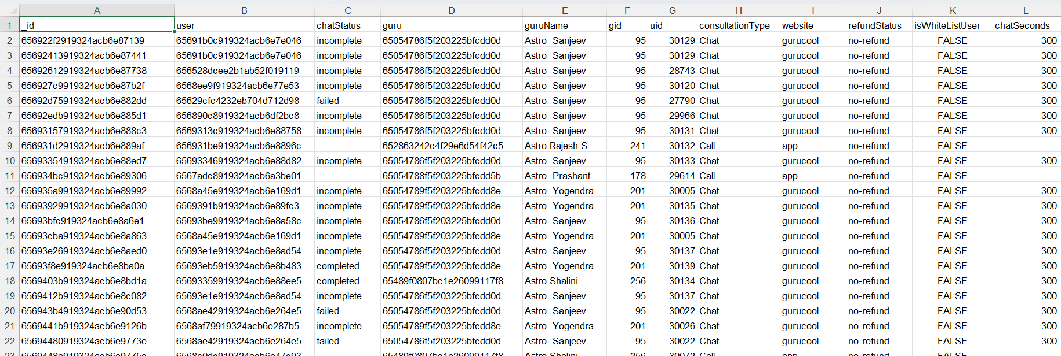
Problem Statement
AstroSage has received a 1 crore investment and aims to optimize its call center operations. The goal is to determine how to allocate this investment to maximize operational efficiency, customer satisfaction, and profitability. The analysis will consider historical call data, performance metrics, and market trends to make informed decisions.

Slide 3

Data Overview
2,790 unique users served by 305 gurus.
Covers 34 days of data from India.
8,512 total calls (41% completed, 14% failed, 10% incomplete).
Data used to analyze customer trends and optimize operations.

Slide 4

Data Cleaning and Pre-processing
Handle missing values and blank data cells across the dataset.
Normalized date values in day, month and year for daily, monthly and yearly reports.
This dataset allows for an in- depth understanding of AstroSage market presence and operational scope.
A good dataset is important to understand the operational cost , customer satisfaction and trend in the sales of call center.
This dataset enable us to predict and suggest future investments to grow the sales Turnover.

Slide 5

Analytical Approach
Data Cleaning - Used spreadsheets functions like trim and Removing duplicates for data cleaning.
Data Enrichment - Added new variables using Date functions for better analysis .
Customer Segmentation - Used Sorting and Filtering to classify customers based on consultation type and summarizing key metrics and Identifying connection patterns across different metrics and product categories.
Visualization -:Created interactive dashboard using different charts for detailed view of dataset.

Slide 6
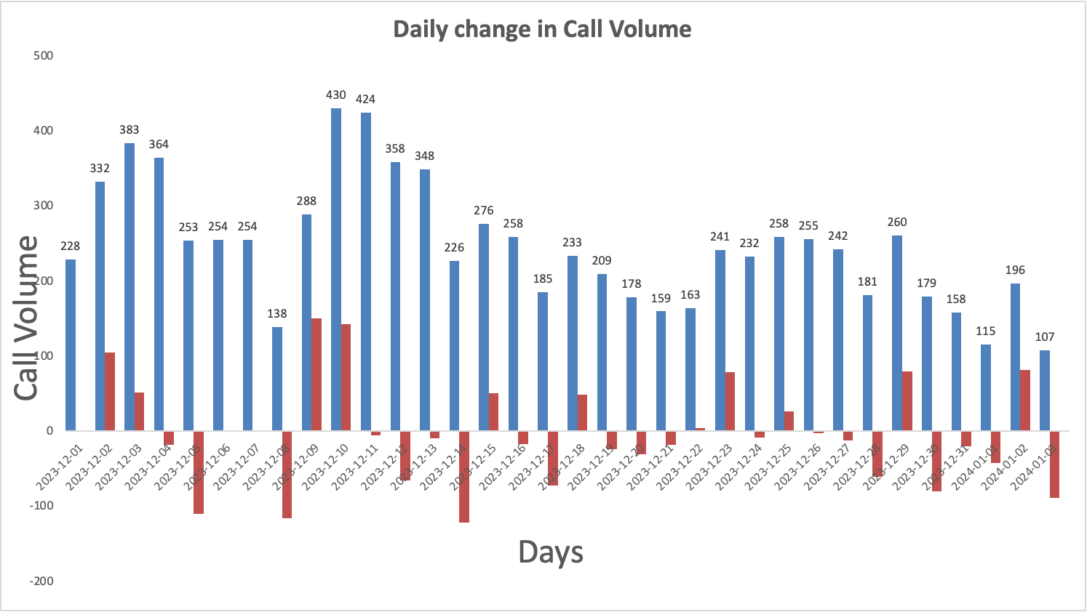
Day Wise Change in Call Volume
The column chart shows the Day-wise call distribution.
430 calls is the maximum amount of call received on a single day.
On an average the call center receives around 250 calls on a daily basis.
It also shows the change in call volume day by day.

Slide 7
Revenue Generated By Each Category
Product-wise revenue Pie Chart , presents a detailed insight about the revenue generated by different consultation-types as per the percentage of total revenue.
The majority of sales occur through call segments, with a smaller share coming from chat interactions.
AstroSage should consider adopting advanced technologies and hiring skilled agents to boost the share of complementary and public live calls.
💰 Call product dominates with 79% of total revenue, clearly the primary driver of business income.
📡 Public live call contributes 21%, showing secondary but meaningful revenue impact.
🛑 Chat and Complementary products are either underperforming or excluded, suggesting negligible or zero revenue.

Slide 8
Website Distribution
The website distribution pie chart is presented with the different websites showing count consultations through different website channels.
The least amount of consultations appear from dashboard.
The most amount consultations are from gurucool.
Dashboard usage dominates at 72%, indicating it is the preferred interface for users.
App accounts for 28%, showing moderate engagement but significantly lower than the dashboard.
The chart suggests users find more value, functionality, or ease of use in the dashboard experience.

Slide 9
Call Status Distribution
The call-status pie chart is presented with the different responses by the user i.e. the end result of consultation.
The completed calls are 25% and there are the most amount of failed calls.
The NA represents the consultations done on any other consultation-type than calls.
✅ Completed calls dominate at 70%, indicating strong operational success.
❌ Failed (4%), incomplete (3%), and no-answer (5%) together form a small but notable portion of unsuccessful attempts.
📞 Busy calls account for 6%, suggesting some congestion or timing issues.
⚠️ N/A status makes up 12%, which may reflect unclassified or system-level gaps needing review.

Slide 10
Chat Status Distribution
The chat-status pie chart is presented with the different responses by the user i.e. the end result of consultation.
The completed chats are 20% and most amount of failed chats 37%.
The On call represents the consultations done on any other consultation-type than calls.
N/A status leads at 30%, indicating a large portion of chats are either unclassified or missing proper status tracking.
Failed chats (26%) and Incomplete chats (24%) together make up half of all interactions, signaling serious performance or process issues.
Only 20% of chats were completed, showing low success in chat resolution.
Pending and Started statuses are both at 0%, suggesting either data gaps or inactive chat initiation processes.

Slide 11
Hourly User Volume
Given column chart shows hourly call distribution ,according to chart we can see that highest call peak hours starts from 6AM to 4PM.
More investment can be done in hiring skilled agents and also on implementing Ai-powered chat-bots and CRM technology.
Also a well-designed and systematic feedback system and automatic call routing system will attract more users for calls and overall engagements.

Slide 12
Guru Rating on the scale of 8
The column chart represents the rating-wise user distribution.
The calls consultation needs to be worked on and improve to increase the quality of consultation.
The ratings given by users that consulted on chats is better than on calls.

Slide 13

Strategic Recommendations
Upgrade Technology Infrastructure: Address the severe 59% call and 71% chat failure rates by implementing a cloud-based omnichannel platform with smart routing and callbacks.
Implement Advanced Workforce Management (WFM): Counter the workload imbalance and agent fatigue caused by the prolonged 6 AM–5 PM peak using data-driven scheduling and dynamic staffing tools.
Introduce Targeted Training Programs: Correct the critically low 2.93/8 service rating by providing specialized, regular training focused on communication, technology usage, and engagement skills.

Slide 14

Strategic Recommendations
Optimize Channel Strategy for Revenue Growth: Since calls generate 79% of total revenue while chats underperform with high failure rates, the strategy must be dual-focused:.
Adopt AI-Powered Chatbots and Analytics Tools: To combat existing manual inefficiencies in handling both calls and chats, deploy AI for initial customer interactions and sentiment analysis.
Implement Performance-Based Incentives: Address the critical workload imbalance where the top 10 agents handle 44% of total calls by introducing performance-based incentives tied to customer satisfaction and efficiency metrics.

Slide 15
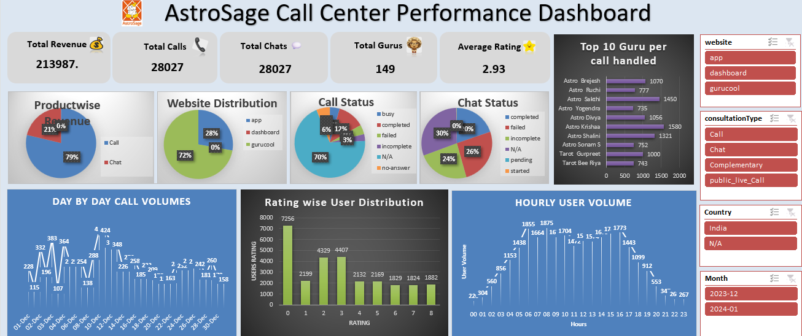

Slide 16
Conclusion
Summary of Findings
High system failure rates and workload imbalances were key operational challenges.
Average customer satisfaction (2.93/8) indicates an urgent need for service quality improvement.
Calls remain the primary revenue driver (79%), but chat performance lags behind.

Slide 17
Conclusion
Strategic Takeaways
Technology upgrade is essential to fix foundational inefficiencies.
Training and AI integration will empower agents to deliver consistent, high-quality service.
Data-driven workforce management ensures optimal performance during peak hours.
Incentive-based motivation will balance workloads and enhance productivity.

Slide 18


