Slide 1


Deepfake detection using Deep Learning
Subject Code: CM461
Batch No :-
C20
Guided By :-
Prof. G. Rama Mohan Babu
Professor & Head, CSE(AIML)
        Presented By : -
Shaik Munwar Basha L23CM210
Yeruva Koushik Reddy L23CM215
Yeruva Srinivas Reddy L23CM216
DEPARTMENT OF COMPUTER SCIENCE AND ENGINEERING (AIML)
R.V.R & J.C COLLEGE OF ENGINEERING , CHOWDAVARAM, GUNTUR
MAY 2026

Slide 2
CONTENTS
INTRODUCTION
PROBLEM STATEMENT
LITERATURE SURVEY
  RESEARCH GAP
PROJECT OBJECTIVES
DATASET USED
PROPOSED METHODOLOGY
  SYSTEM ARCHITECTURES
  ALGORITHMS/ MODELS USED
IMPLEMENTATION
  TOOLS & TECHNOLOGIES
RESULTS AND ANALYSIS
CONCLUSION
FUTURE SCOPE
REFERENCES

Slide 3
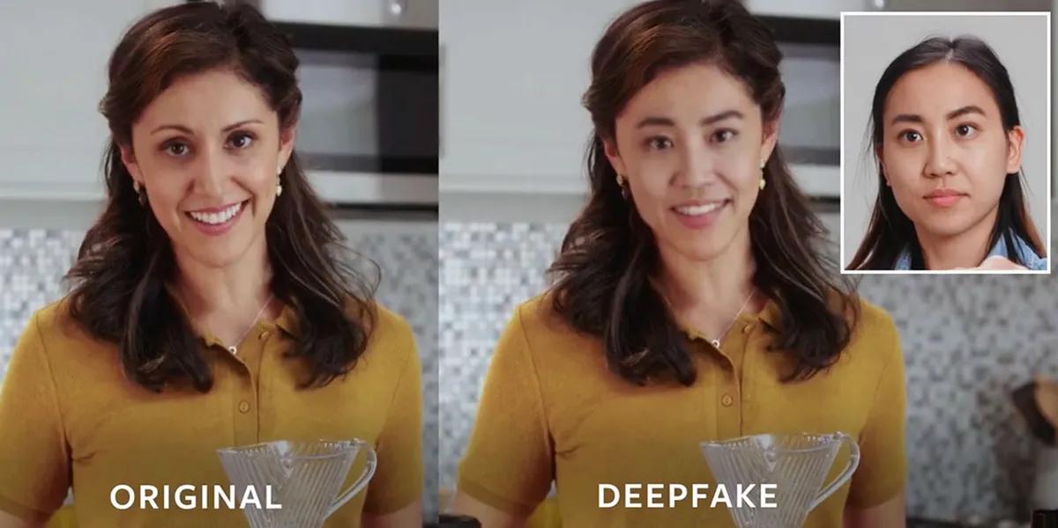
INTRODUCTION
Rapid advancements in Artificial Intelligence (AI), Machine Learning, and Deep Learning have led to powerful tools for manipulating multimedia content.
These manipulations, known as deepfakes, are highly realistic and difficult for humans to detect.
With the development of Generative Adversarial Networks (GANs) and diffusion models, deepfake content has become more advanced and widespread.
Deepfakes pose serious threats to:
  Digital security
  Information integrity
  Social media trust
  Personal privacy
  Democratic processes

Slide 4
PROBLEM STATEMENT
The increasing availability of deepfake tools has made it easy to create highly realistic fake content.
Existing detection methods struggle to identify high-quality deepfakes.
Traditional machine learning approaches rely on manual feature engineering, while deep learning models often require high computational resources.
Deepfakes look almost real, making them hard to detect.
There is a need for a system that:
Provides high accuracy
Works for both images and videos
Project Goal:
To develop an intelligent system that can accurately distinguish between real and deepfake images and videos.

Slide 5
LITERATURE SURVEY
S.No | Method/Model | Dataset Used | Technique Used | Accuracy
1 | SVM | Real & Fake Face Dataset | Handcrafted Features | 65%
2 | Random Forest | Real & Fake Face Dataset | Statistical Feature-Based | 70%
3 | CNN (Basic) | FaceForensics++ | Convolutional Neural Network | 75%
4 | VGG16 | Celeb-DF | Deep CNN | 78%
5 | ResNet-50 | Real & Fake Face Dataset | Residual Learning | 80%
6 | GAN + ResNet Hybrid | Real & Fake Face Dataset (2041 Images) | Generative + CNN Hybrid | 83%

Slide 6
RESEARCH GAP
Existing Models (Literature) | Research Gap (Identified Problem)
Use traditional ML (SVM, RF) with handcrafted features | Low accuracy and poor feature representation
CNN models (VGG, ResNet) focus on spatial features | Lack of temporal feature learning for videos
ResNet-based models are computationally heavy | Need for lightweight and efficient architectures
GAN-based hybrid models improve accuracy | Training instability and high complexity
Models detect only image-based deepfakes | No unified system for both images and videos
Limited focus on important regions (no attention) | Need for attention mechanisms to detect subtle artifacts

Slide 7
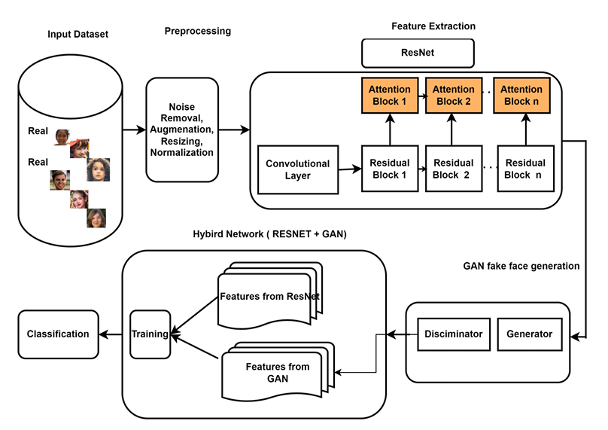
EXISTING WORKFLOW DIAGRAM
The existing system uses a hybrid model combining GAN and ResNet for deepfake detection.
ResNet50 is used to extract deep spatial and texture features from images.
GAN generates realistic fake images and helps improve detection capability.
The discriminator learns to distinguish between real and fake faces.

Slide 8
PROJECT OBJECTIVES
To develop a highly accurate deepfake detection system.
To detect both fake images and fake videos.
To use EfficientNet models for parameter-efficient feature extraction.
To apply attention mechanisms (CBAM & Temporal Attention) for better feature focus.
To capture both spatial and temporal features using deep learning models.
To improve overall detection performance compared to existing models

Slide 9
DATASET USED
Image Dataset: 140k Real and Fake Faces with ELA (Error Level Analysis).
Video Dataset: Celeb-DF-v2 (Sequence Analysis).
Data Breakdown: 5,299 fake videos (Celeb-synthesis) and 712 real videos (Celeb-real & YouTube-real).
Split | Total Samples | Fake Samples | Real Samples
Training | 100,000 | 50,000 | 50,000
Validation | 20,000 | 10,000 | 10,000
Testing | 20,000 | 10,000 | 10,000
Total | 1,40,000 | 70,000 | 70,000
Split | Total Videos | Fake Videos | Real Videos
Training | 4,808 | 4,238 | 570
Validation | 1,203 | 1,061 | 142
Testing | 518 | - | -
Total | 6,011 | 5,299 | 712

Slide 10
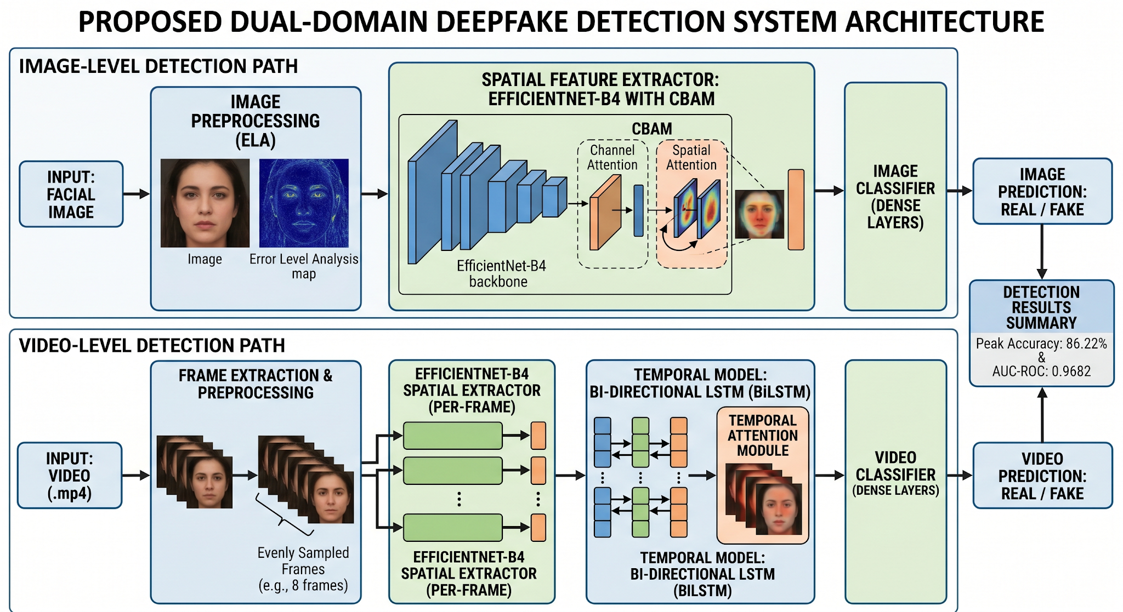
PROPOSED MODEL

Slide 11
Approach
A dual-domain deepfake detection system is proposed for both images and videos.
Uses EfficientNet with attention mechanisms instead of heavy ResNet models.
Image-Based Detection
Model: EfficientNet-B4 + CBAM
Steps:
  Image preprocessing (ELA)
  Feature extraction using EfficientNet-B4
  CBAM highlights important regions
  Dense layers
  Real/Fake classification
Video-Based Detection
Model: EfficientNet-B0 + BiLSTM + Temporal Attention
Steps:
  Extract frames from video
  Feature extraction (EfficientNet-B0)
  Sequence learning using BiLSTM
  Temporal attention selects key frames
  Final classification

Slide 12
PROPOSED SYSTEM WORKFLOW
Data Collection
Real and Fake Face dataset containing real images, deepfake images, and videos.
Pre-Processing
Image resizing, normalization, data augmentation, and frame extraction for videos.
Feature Extraction
EfficientNet-B4 extracts high-level spatial features from images.
EfficientNet-B0 extracts frame-level features from video sequences.
Attention Mechanisms
CBAM highlights important spatial and channel features in images.
Temporal Attention selects important frames in videos.

Slide 13
Model Selection
Hybrid deep learning model using EfficientNet + Attention + BiLSTM.
Train–Test Split and Model Fitting
Dataset split into training and testing sets.
Model trained using binary cross-entropy loss and Adam optimizer.
Temporal Modeling (Video)
BiLSTM captures temporal dependencies between video frames.
Model Evaluation and Deployment
Performance evaluated using accuracy, precision, recall, and F1-score.
Trained model used for real-time deepfake detection of images and videos.

Slide 14
TOOLS & TECHNOLOGIES
Programming Language: Python
Deep Learning Frameworks: TensorFlow/Keras, PyTorch
Data Processing & Visualization: Pandas, NumPy, Matplotlib, Seaborn, PIL
Hardware Accelerator: Dual Kaggle GPUs (Tesla T4 x2 / Tesla P100)
Deployment & Hosting: Hugging Face Spaces (for building a web-based interactive interface).

Slide 15
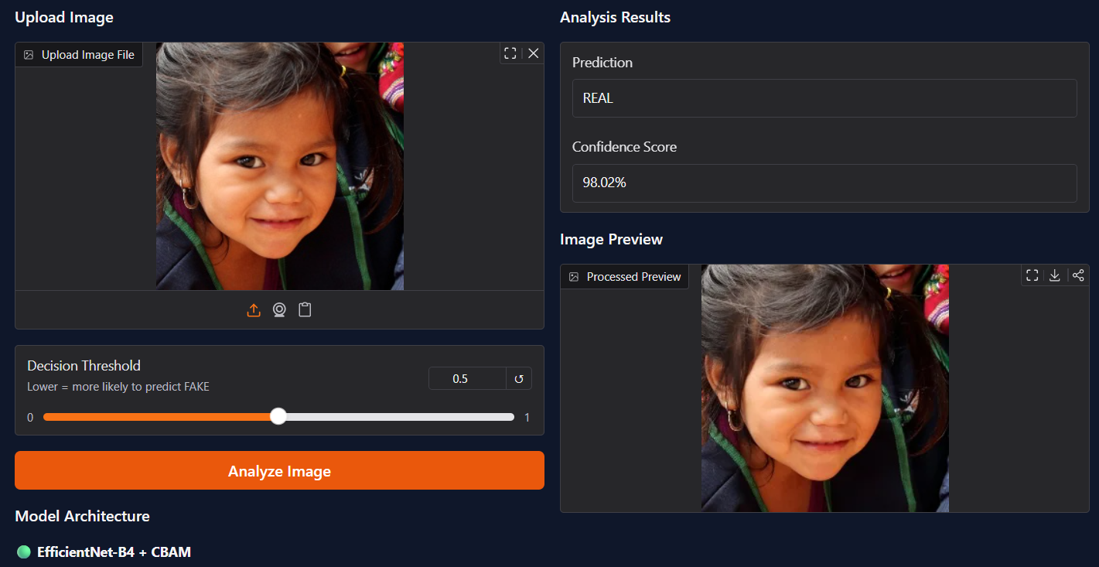
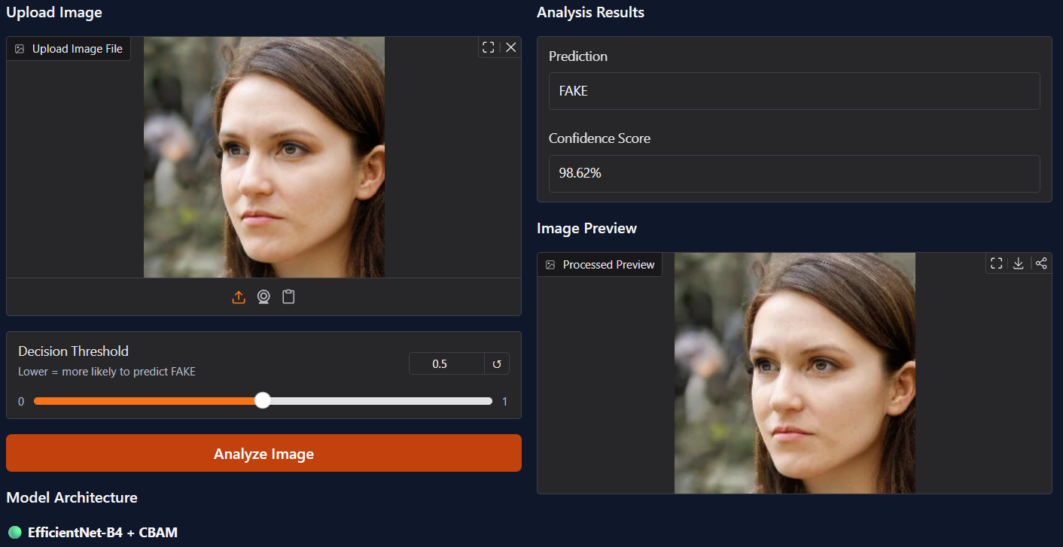
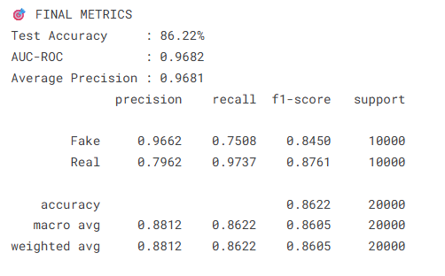
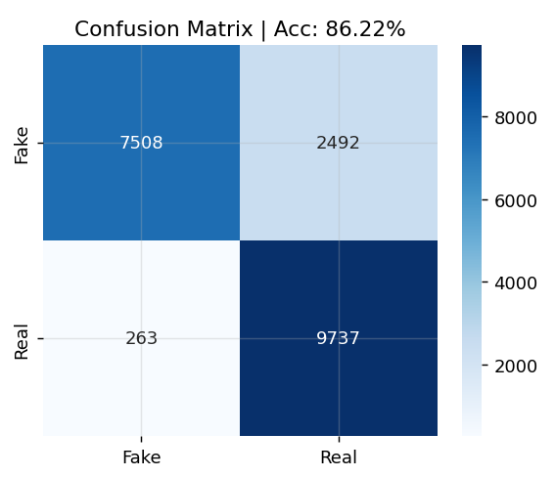
RESULTS AND ANALYSIS

Slide 16
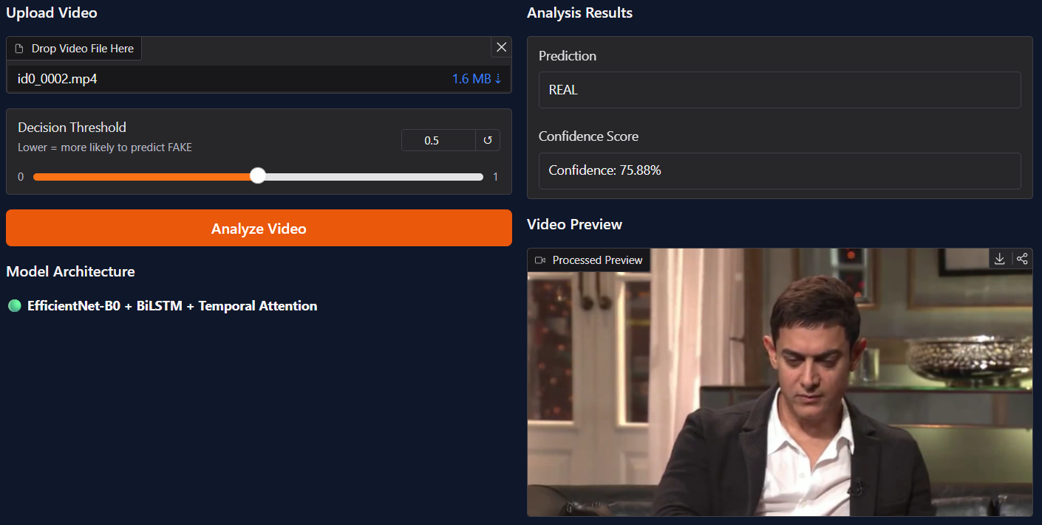
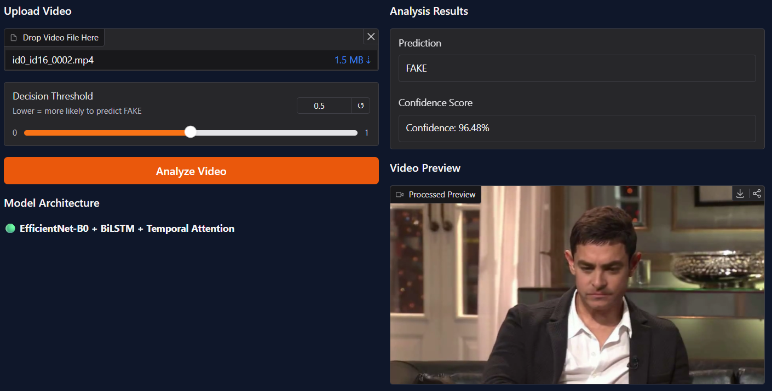
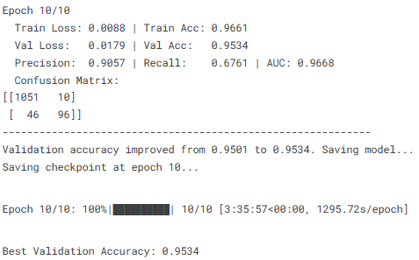
View

Slide 17
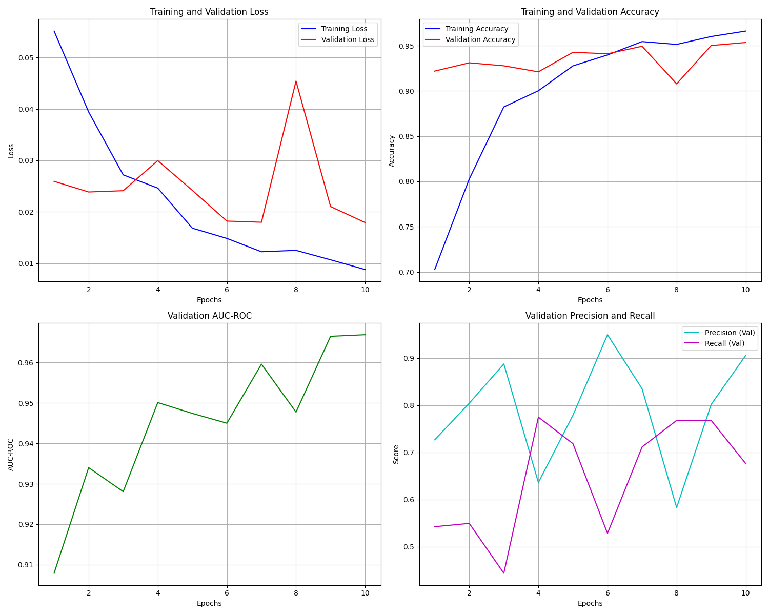

Slide 18
CONCLUSION
This project presents an effective deepfake detection system using EfficientNet and attention mechanisms.
The model successfully captures both spatial features (images) and temporal patterns (videos).
Compared to traditional methods, it provides better accuracy with lower computational cost.
Attention modules help in focusing on manipulated facial regions, improving detection performance.
The system demonstrates strong potential for real-world applications like cybersecurity and media verification.
Overall, the proposed approach offers a robust, scalable, and efficient solution for deepfake detection.

Slide 19
FUTURE SCOPE
Develop a real-time deepfake detection system for instant analysis.
Deploy the model as a web extension or API for social media platforms.
Expand the framework for multimodal forgery detection, including synthetic media, generated text, and digitally manipulated identity documentsUse advanced architectures like transformers for improved performance.
Optimize the model using quantization for deployment on mobile and edge devices.
Expand datasets to include audio-visual and multimodal deepfake detection for better generalization.

Slide 20
REFERENCES
[1] N. A. S. Eldien, R. E. Ali, and F. A. Moussa, "Real and fake face detection: Acomprehensive evaluation of machine learning and deep learning techniques for improved performance“, in IEEE MTT-S Int. Microw. Symp. Dig., Jul. 2023, pp. 315 320.
[2] S. Safwat, A. Mahmoud, I. E. Fattoh, and F. Ali, "Hybrid Deep Learning Model Based on GAN and RESNET for Detecting Fake Faces," IEEE Access, vol. 12, pp. 86391–86402, 2024. DOI:10.1109/ACCESS. 2024. 3416910.
[3] B. Chesney and D. Citron, "Deep fakes: A looming challenge for privacy, democracy, and national security," Calif. L. Rev., vol. 107, p. 1753, Jan. 2019. [4] M. Tan and Q. Le, "EfficientNet: Rethinking Model Scaling for Convolutional Neural Networks," in Proc. Int. Conf. Machine Learning (ICML), 2019.

Slide 21


