Slide 1

SMARTPHONE MARKET DATA ANALYSIS
Data Collection, Data Cleaning & Exploratory Data Analysis
— A Comprehensive Data-Driven Study —

Slide 2

About Group
Name : Vinjamuri Pavan Mallesh
Batch : Data Analytics (495)
Program : B.Tech, CSE – Data Science
LinkedIn : www.linkedin.com/in/pavanmallesh4466

Slide 3

CASE STUDY SELECTION
Why the Smartphone Market?
The smartphone market is one of the fastest-growing and most competitive industries, with many brands offering products across different price ranges, features, and specifications. This makes it an ideal case study for data analysis because it combines pricing, customer ratings, reviews, and technical features in one market.
.
🏆 High Competition
📊 Rich Variables
Many smartphone brands compete in budget, mid-range, and premium segments, creating clear differences in pricing and market strategy.
Price, RAM, storage, ratings, reviews, discounts — a multidimensional dataset ideal for EDA and business modeling.
🌍 Real-World Relevance
The insights from this analysis can help understand customer preferences, pricing strategies, and brand positioning in the real smartphone market.

Slide 4
PROBLEM STATEMENT
What Are We Solving For?
This study investigates the structural and behavioral dynamics of the Indian smartphone market as listed on Flipkart. By systematically analyzing pricing, ratings, discount patterns, and hardware specifications, we aim to decode what drives consumer preference and product performance at scale.
Target Variables
Primary:
Price — the central economic signal in any market. Influenced by brand, specs, and perception.
Analyze Price Structures
Secondary:
Rating — a proxy for consumer satisfaction and product-market fit.
Decode how price tiers are distributed across brands, RAM, and storage configurations.
Understand Customer Preferences
Supporting:
Discount %, Review Count, RAM, Storage — contextual variables that refine interpretation.
Identify which specifications correlate with higher ratings and review volumes.
Evaluate Brand Competition
Map brand-level positioning and pricing power in a crowded marketplace.

Slide 5

DATA SOURCE & COLLECTION
Web Scraping Flipkart at Scale
All data was programmatically extracted from Flipkart's smartphone listings using a custom Python-based web scraping pipeline. The scraper navigated multiple listing pages, parsing structured HTML to capture all key product attributes in a single, clean workflow.
400+
Rows Scraped
HTTP Requests
Product listings across multiple Flipkart pages
1
Used the requests library to fetch raw HTML from Flipkart listing pages with proper headers to bypass bot detection.
8+
Variables
HTML Parsing
2
Price, rating, reviews, discount, RAM, storage, brand
BeautifulSoup extracted structured product data by targeting CSS class selectors for price, title, rating, and reviews.
Tech Stack: Python 3 · Requests · BeautifulSoup4 · Pandas · Regex · Jupyter Notebook
Data Storage
3
Scraped records were loaded into a Pandas DataFrame and exported to CSV for downstream cleaning and analysis.

Slide 6
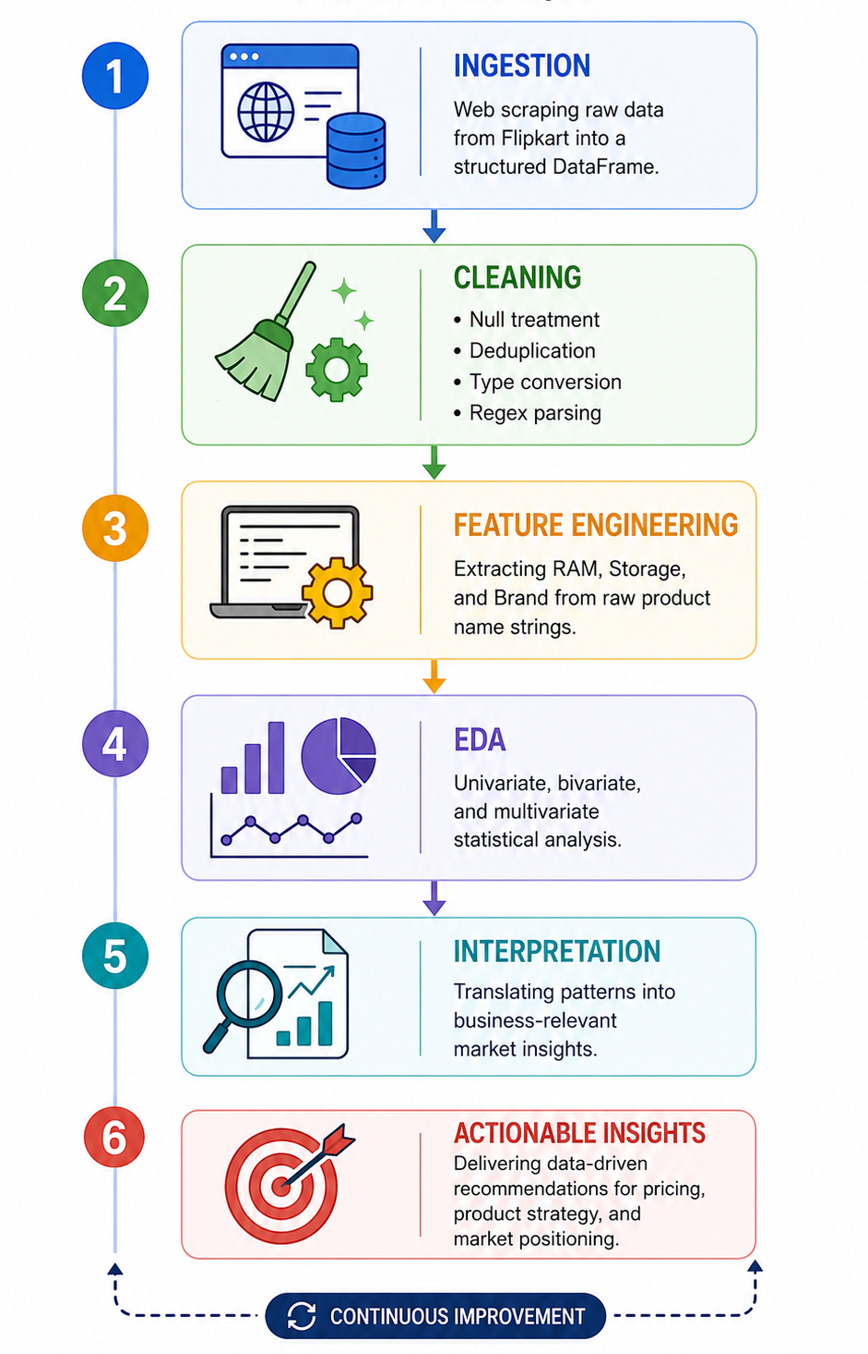





METHODOLOGY
End-to-End Data Analysis Pipeline
A structured, six-phase workflow — from raw HTML data to actionable market intelligence.
1. Ingestion
Web scraping raw data from Flipkart into a structured DataFrame
2. Cleaning
Null treatment, deduplication, type conversion, regex parsing
3. Feature Engineering
Extracting RAM, Storage, and Brand from raw product name strings
4. EDA
Univariate, bivariate, and multivariate statistical analysis
5. Interpretation
Translating patterns into business-relevant market insights

Slide 7


DATASET OVERVIEW
Dataset Attributes
The final cleaned dataset contains 11 structured attributes per smartphone listing, covering pricing, consumer sentiment, hardware specifications, and product metadata. This multidimensional structure enables rich cross-variable analysis across all three levels of EDA.
Attribute
Type
Description
Product Name
String
Full listing title from Flipkart
Price (₹)
Numeric
Current selling price
Original Price (₹)
Numeric
MRP before discount
Discount (%)
Numeric
Percentage markdown applied
Rating
Float
Average customer star rating (1–5)
Reviews
Numeric
Total number of customer reviews
RAM (GB)
Numeric
RAM extracted via Regex
Storage (GB)
Numeric
Internal storage extracted via Regex
Brand
String
Brand derived from product name
Note:
RAM, Storage, and Brand were not available as separate fields — they were systematically extracted from the raw Product Name string using Python Regex patterns post-scraping.
Features
String
Key product feature snippet
Page Number
Integer
Source listing page (for scraping audit)

Slide 8
DATA CLEANING
From Raw Scrape to Analysis-Ready Dataset
Raw HTML data extracted from Flipkart contains significant noise — currency symbols, inconsistent string formats, null placeholders, and entangled multi-attribute fields. A rigorous seven-step cleaning protocol transformed this into a structured, analysis-ready dataset.
Symbol Stripping
Null Treatment
Deduplication
Removed ₹ signs, commas, and % characters using str.replace() and Regex to enable numeric conversion.
Identified missing values per column; imputed or dropped based on field criticality and missingness threshold.
Applied drop_duplicates() to remove redundant listings caused by paginated scraping overlap.
Type Conversion
Regex Extraction
Converted price, rating, reviews, RAM, and storage from object strings to appropriate numeric datatypes.
Used re.search() patterns to extract RAM (e.g., "8 GB"), Storage (e.g., "128 GB"), and Brand from the product name.

Slide 9
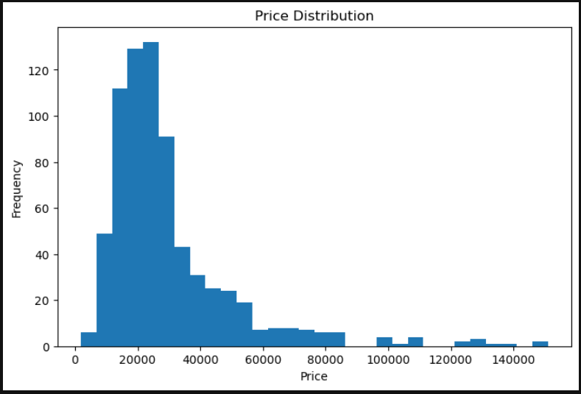
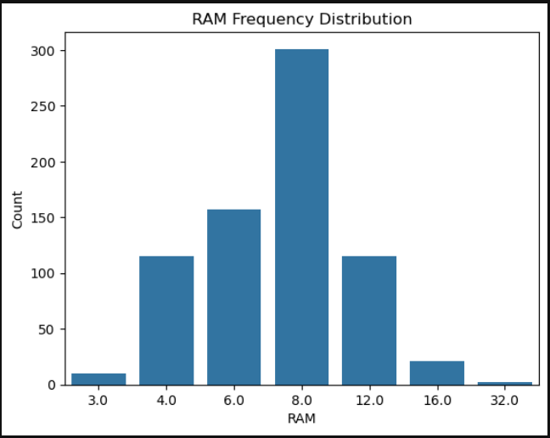
EXPLORATORY DATA ANALYSIS
Univariate Analysis
— Understanding Distributions
Single-variable analysis reveals the natural distribution of each key attribute, exposing skewness, outliers, and concentration patterns in the smartphone market.
Price Distribution
RAM Distribution
Clustered heavily around 6GB–8GB configurations, with 8GB RAM dominating the majority of smartphone listings. This indicates that mid-to-high performance devices are the most common in the market
The price distribution is positively skewed, with most smartphones concentrated in the budget to mid-range segment.

Slide 10
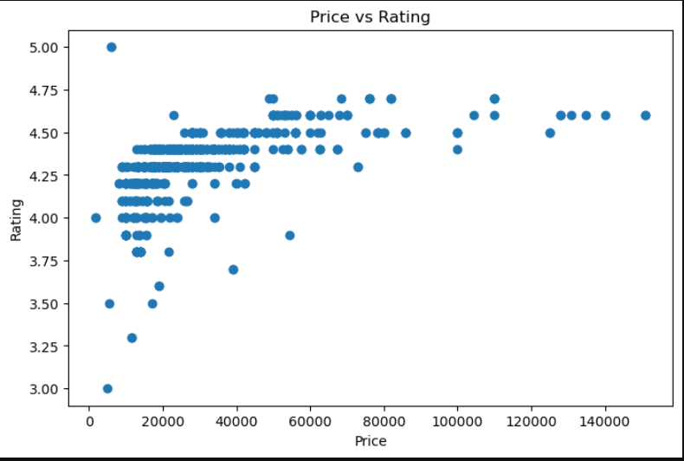
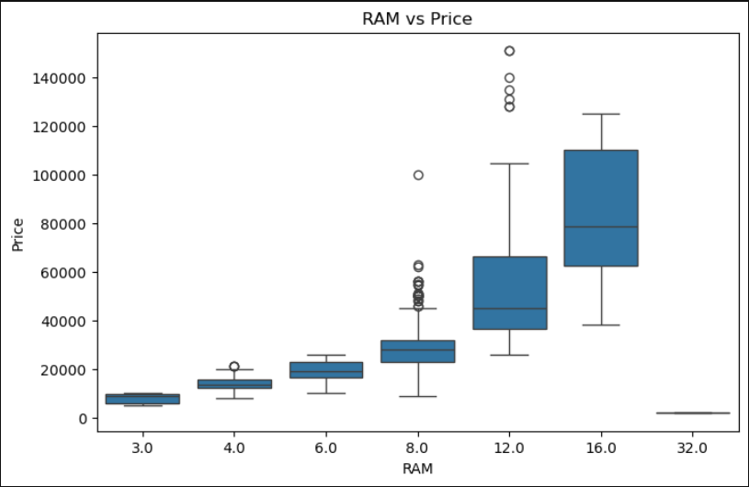
Bivariate Analysis
— Relationships Between Variables
Two-variable analysis uncovers how specifications and brand identity interact with the target variables: Price and Rating.
Price vs. Rating (Scatterplot)
RAM vs. Price (Boxplot)
Higher smartphone prices do not always mean better ratings, as customer satisfaction remains fairly similar across price ranges.
Smartphones with higher RAM generally have higher prices, making RAM a strong factor in pricing.

Slide 11
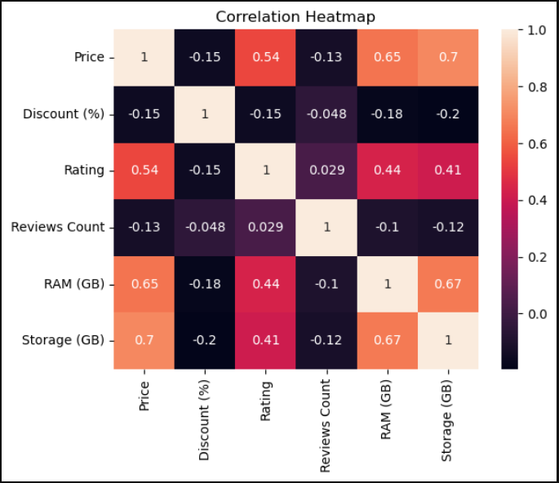
Multivariate Analysis
Multivariate Techniques Applied
Moving beyond pairwise relationships, multivariate analysis reveals how combinations of variables jointly influence pricing and perception —
the foundation of data-driven market strategy.
Correlation Heatmap
The heatmap shows that smartphone price has a strong positive relationship with storage and ratings.
Discount percentage has a weaker and mostly negative correlation with price and rating.
This indicates that specifications and product quality influence value more than discounts.

Slide 12
STRATEGIC INSIGHTS
Market Intelligence Summary & Conclusion
The analysis of 400+ Flipkart smartphone listings surfaces four high-confidence strategic signals that carry direct implications for brand managers, product strategists, and market researchers.
Mid-Range Dominance
Specs Drive Price
The ₹10,000–₹20,000 segment accounts for the plurality of listings and reviews, confirming volume leadership and strong consumer pull in value tiers.
RAM and storage are the most powerful numeric predictors of price. Brands use configuration laddering — 4/64GB to 12/256GB — as the primary price-step mechanism.
Brand Equity Is Real
Discounts ≠ Ratings
Premium brands (Apple, Samsung flagship) command price premiums that exceed their specification gap — brand perception creates quantifiable pricing power.
Discount percentage shows no meaningful correlation with customer rating, disproving the assumption that aggressive discounting improves perceived value or satisfaction.
🔥 Key Finding #1
🎯 Key Finding #2
RAM + Storage together explain ~60% of price variance — the strongest combined specification predictor.
Brand positioning is non-linear — premium brands occupy isolated pricing clusters, separated from volume brands by perception, not just specs.

Slide 13
Questions ?
THANK YOU FOR YOUR ATTENTION
SMARTPHONE MARKET DATA ANALYSIS

Slide 14
Thank You!

