Slide 1

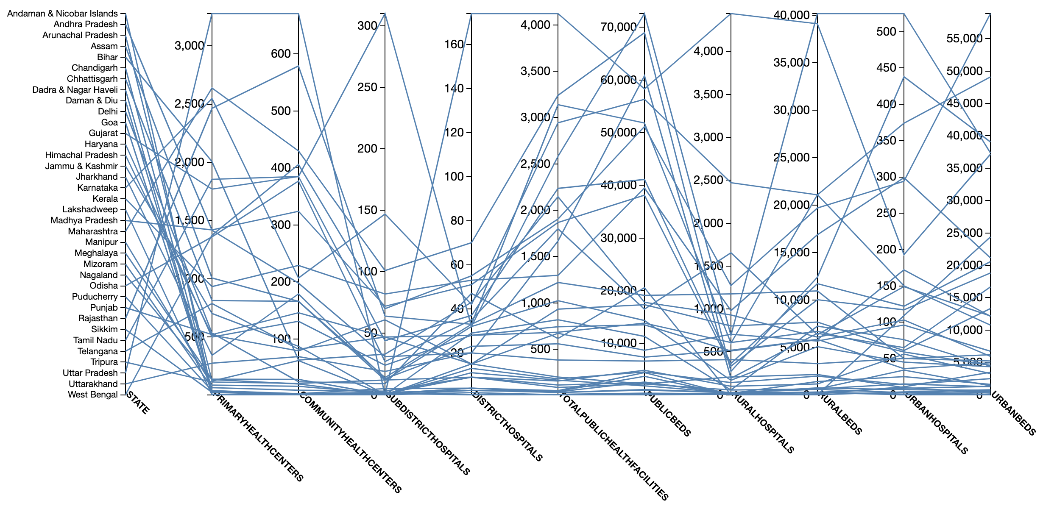
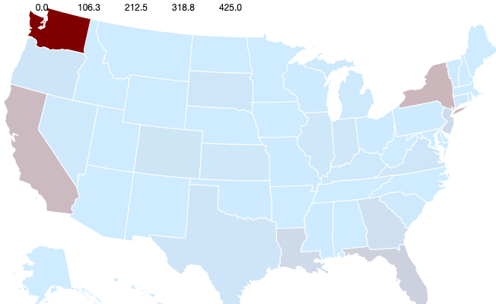
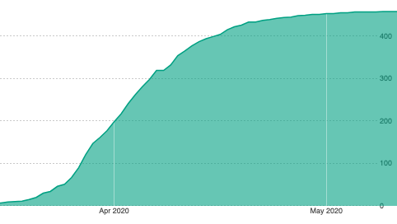
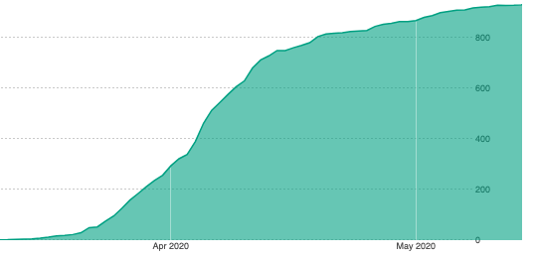
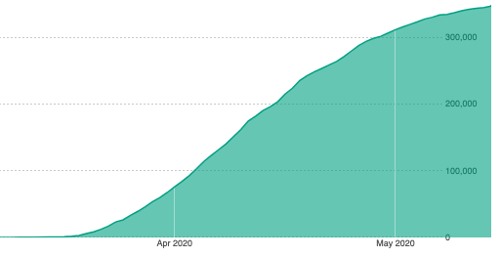
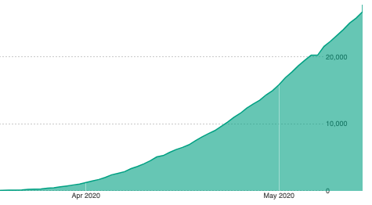
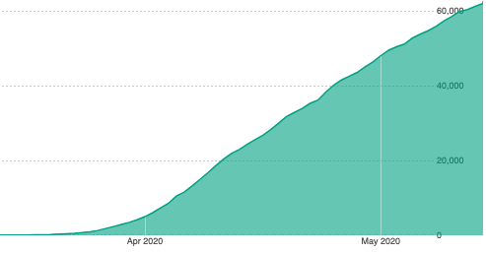
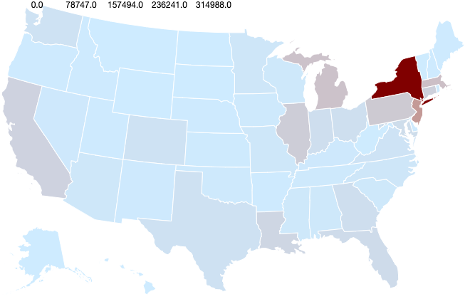
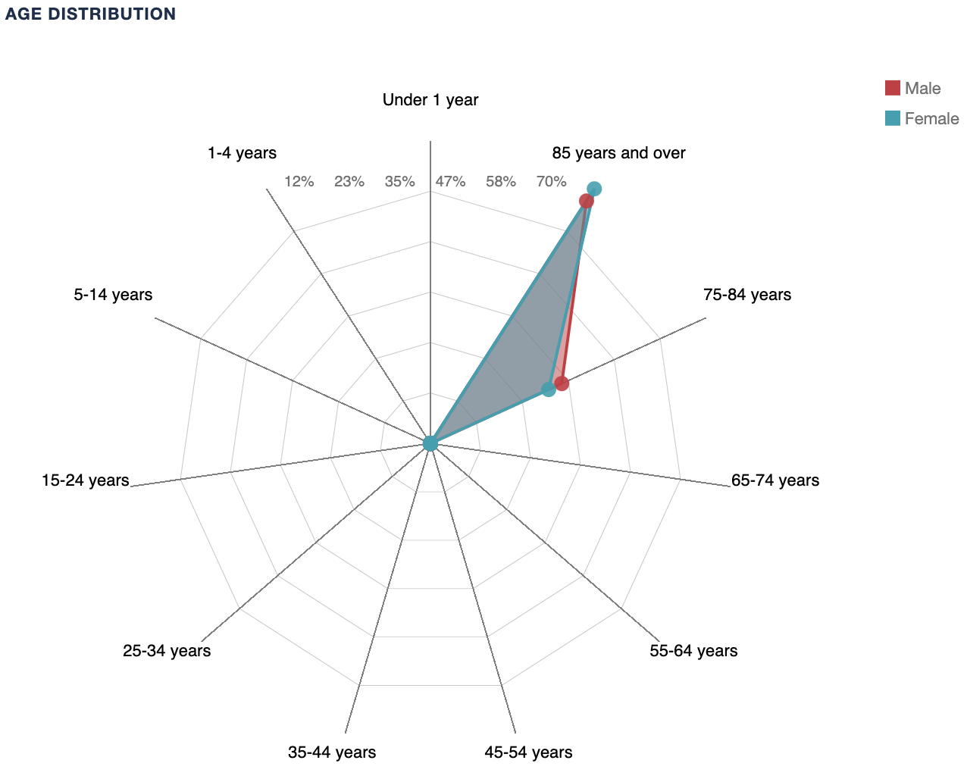
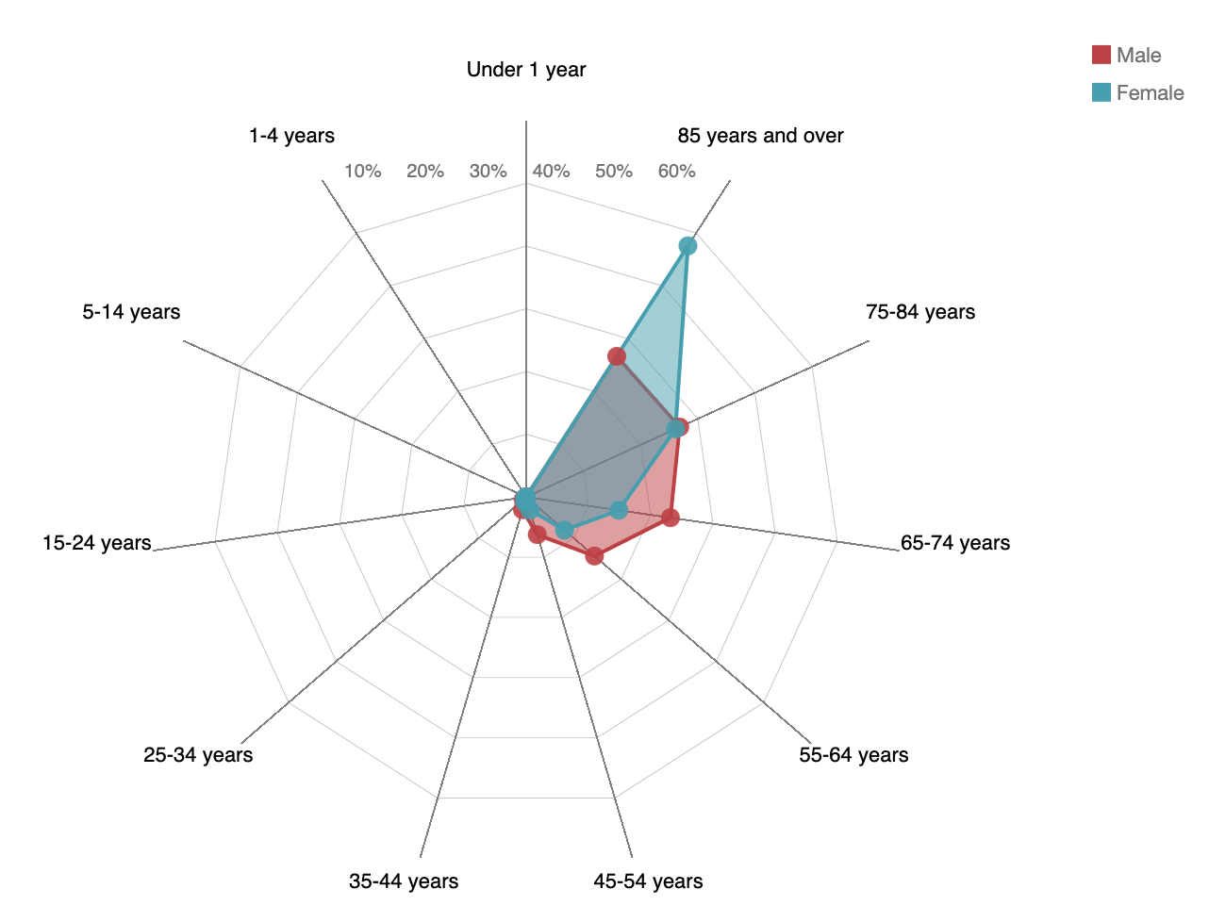
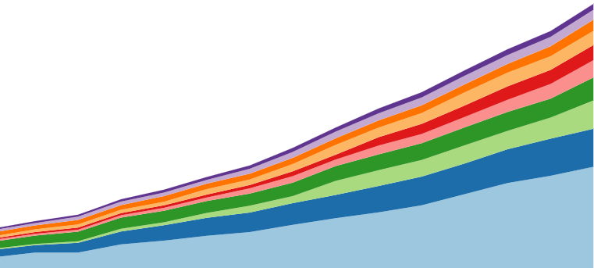
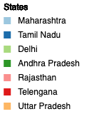
COVID Data Analysis
Pavan Gangakhed, Abhishek Kumar
Stony Brook University
Introduction
Analysis
COVID-19 is an infectious disease caused by severe acute respiratory syndrome coronavirus 2 (SARS-CoV-2) which was first identified in Wuhan and is now spread across the globe. The number of new cases are increasing everyday around the world. Through the tough times we are going currently, we realize the significance of health care and research. The robustness with which a health care system performs and responds to ever changing needs is critical to saving lives during such a pandemic.
Well-designed Dashboards would help COVID-19 response teams to chart out strategic plans by understanding how different measures and policies implemented in other countries were effective in slowing the spread of the disease. It also helps them to better understand the data and derive insights from them and at the same time informing the public about the ongoing situation in their areas. So our aim here is to design a real-time dashboard with data visualization tools to better grasp the current status of COVID-19 as the situation unfolds.
The below comparison helps us understand how the crisis unfolded across various states in the US
How the crisis unfolded in US?
Hotspots
Parallel Coordinates
-To understand, plan and utilize hospital resources and medical need
And be better prepared for the surge in cases
Observations and Analysis
Flattening of the Curve
March first week : Washington
Results and Conclusion
Effects of Lockdown:
States such as New York, Washington, Montana has flattened the curve after enforcing the lockdown.
Fatality rate across different age groups and sex
- 65+ age groups account for more than 75% of fatality
- Hospital resources should be prioritized for 65+ years age group
- Females have less fatality rate for age group < 65 years than male counterparts
Montana
Vermont
New York
Virginia
Pennsylvania
Distribution of deaths across age and sex in USA
May first week : New York
Share of covid cases in India
United States
New York
Younger females are less susceptible than males of same age group
Very less fatality (< 0.5 %) for both males and females < 35 years
> 65 years – 75.3% for males, 85.9%
In states like Vermont and New Mexico (0% for age < 75 years) deaths in age group > 65 years is far more skewed
Top 8 states in India(April to May 15)
- Maharashtra is leading with Tamil Nadu as 2nd hotspot.

