Slide 1
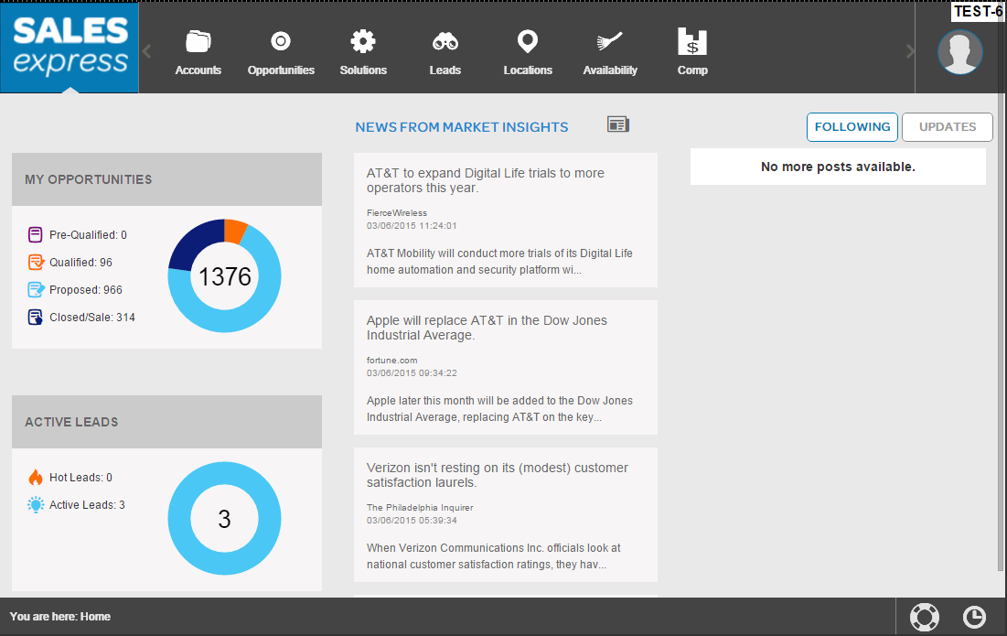
Project Spotlight : Sales Express
Sales Express
Cross Platform Dynamic Application
By
Capgemini AT&T Sales Express Team
Notes:
600mb across 6 sites in contract, here break apart to 150, 150, 100, 100, 50, 50

Slide 2
Project Spotlight : Sales Express
Introduction
The Sales Express Application is the AT&T marketers portal developed to facilitate the process of Sales and Marketing.
Sales Express is the ios iPad Mobile Application built on top of HTML5, CSS3, Javascript, Jquery, Java - Spring Framework and Siebel Rome.
Sales Express is the Collaboration project involving Capgemini, IBM, Tech mahindra, ATT.
We Capgemini has currently transited Sales Express from static ios iPad Mobile Application to the Dynamic Hybrid Mobile Application to be rendered across multiple platforms from Desktop(Web App on Major browsers) to iPad to Mobile.
Notes:
600mb across 6 sites in contract, here break apart to 150, 150, 100, 100, 50, 50

Slide 3
Project Spotlight : Sales Express
Types of Mobile Application Development
Native Mobile Apps
Mobile Web Apps
Hybrid Apps
Notes:
600mb across 6 sites in contract, here break apart to 150, 150, 100, 100, 50, 50

Slide 4
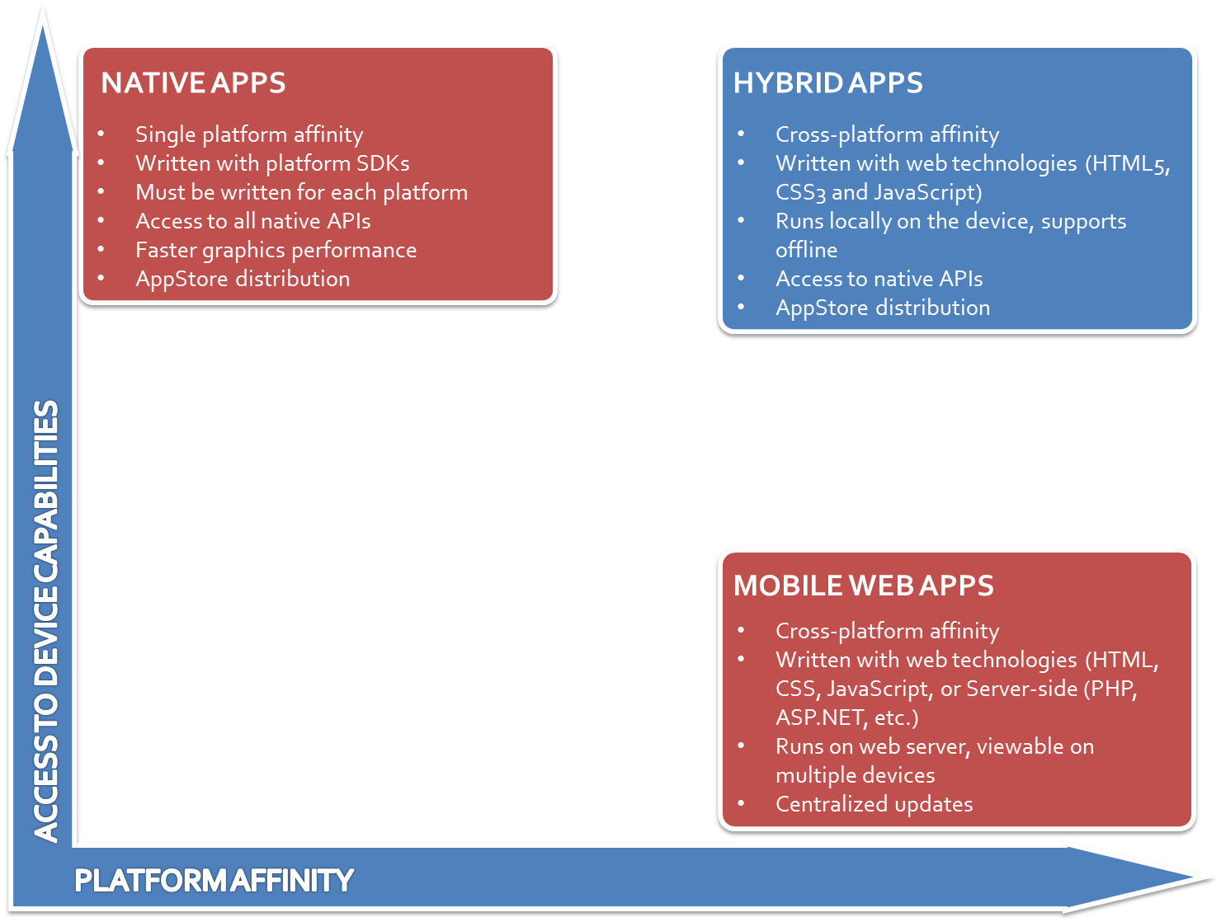
Project Spotlight : Sales Express
Notes:
600mb across 6 sites in contract, here break apart to 150, 150, 100, 100, 50, 50

Slide 5
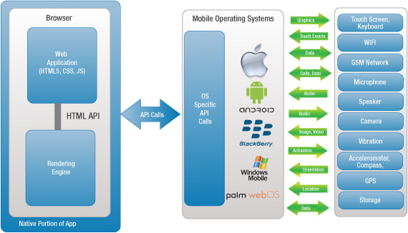
Project Spotlight : Sales Express
Hybrid Mobile Apps General Architecture
Notes:
600mb across 6 sites in contract, here break apart to 150, 150, 100, 100, 50, 50

Slide 6
Sales Express Architecture
Web & Application Server
UI Layer
External Services
UI Components
Rome / Siebel IO
HTML , CSS , JS , Jquery , HandlebarJS
Ajax
MVC View Controller (Spring)
AWF DB
Security & Load Balancer Layer
Service Layer
Web Services / amind/ JSON REST service
SSDF DB
Database Access Layer
Backend Interface Layer
DAO API (Hibernate)
CSI
SE Transaction Database
Others
Notes:
600mb across 6 sites in contract, here break apart to 150, 150, 100, 100, 50, 50

Slide 7
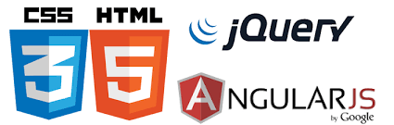

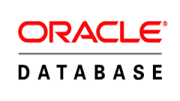













Technology Stack
UI/View
Model
DB
DynamicUI
Controller / Webservices / Email
Java 1.7+
IDE
Server
Dev
OR
Test / Prod
Unit Testing
Version Control
Continuous Integration & Delivery
Notes:
600mb across 6 sites in contract, here break apart to 150, 150, 100, 100, 50, 50

Slide 8

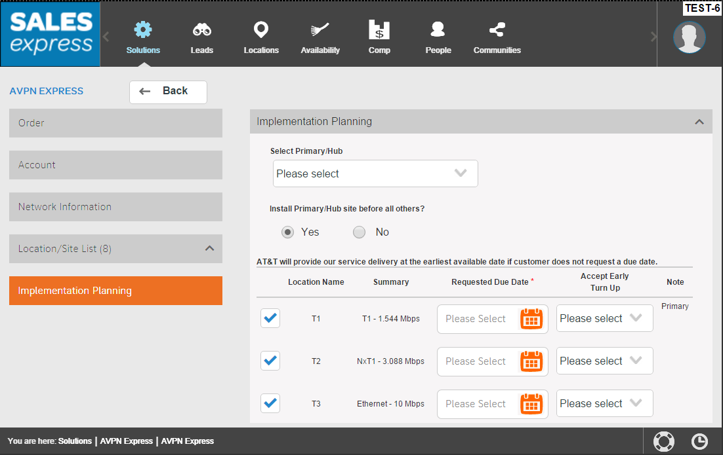
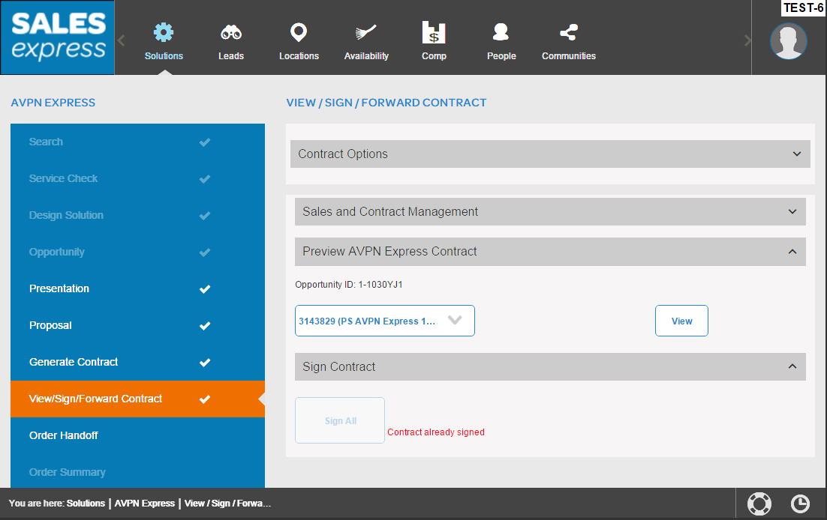
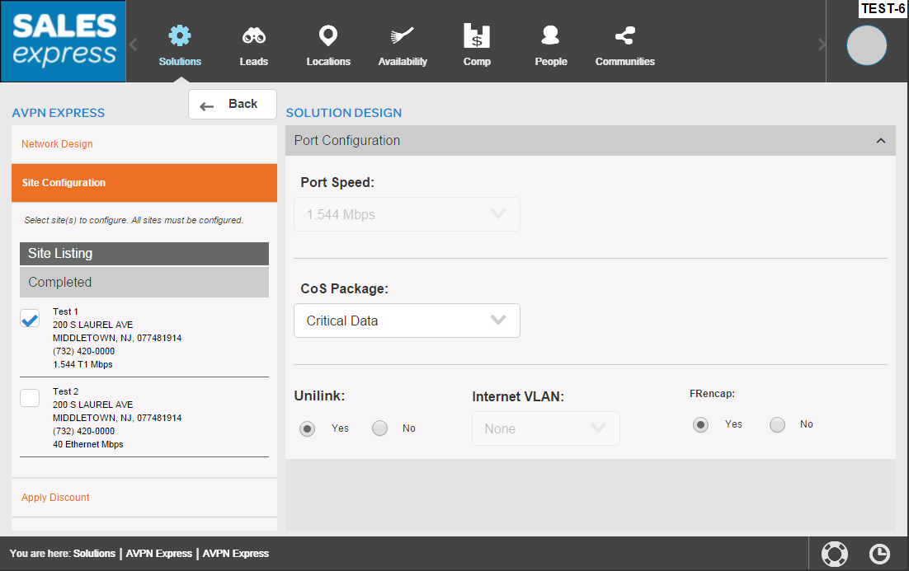
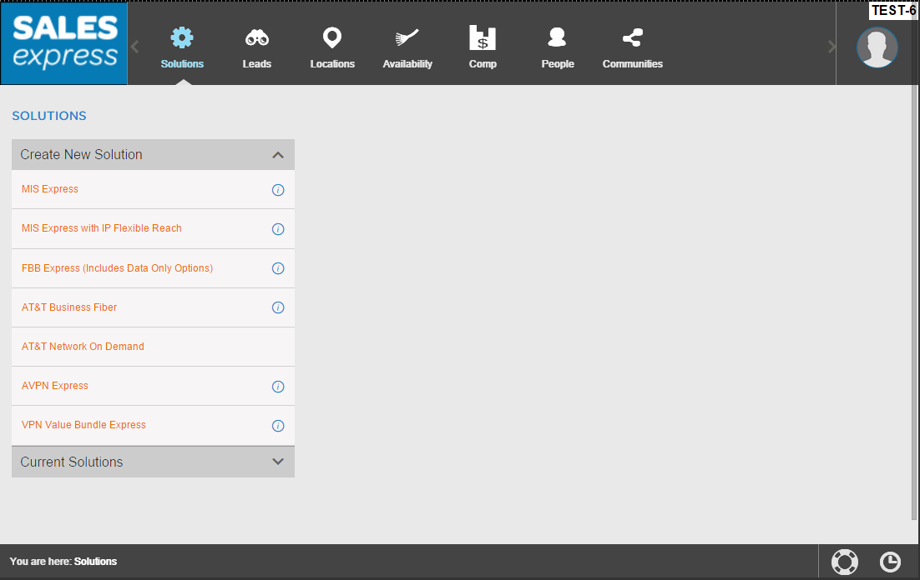
Project Spotlight: AT&T Sales Transformation
~~ View in Slide Show mode for animation ~~
Product selection: Identifying products for the solution. Products and functionality resides in Sales Express DB.
User aligns solution to an opportunity >> generates contract >> presents contract to customer
iOS iPad mobile application built on JavaScript jQuery, jSON objects, and AngularJS
Design Solution (network and site): Widget and API configured data. Seller configures the product features by site.
Order Handoff: capture additional data necessary for provisioning
Future: Extend to social media platforms and entire application to desktop and device agnostic
View/Sign/ Forward: Customer views and “eSigns” Contract; Seller can display the contract for the customer on the iPad or email
Future: Enterprise Product Catalog will drive product features for each site
Future: Direct flow through to HALO
Future:
Enterprise Product Catalog (EPC) drives Sales Express products and functionality. Boosts ability for feature and product bundling – faster time to market and increased options for customers
Allows customer to provide input on which sites to provision immediately
Customer can sign electronically on iPad
Capgemini has supported 4 out of 7 products and actively engaged to support 2 out of 4 new products for 2015
Seller Dashboard: provides status on opportunities and leads, along with market insights that they can subscribe to.
Selected sites and features sent to provisioning
In the background, signed contract sent to billing systems to provision customer account, if necessary
Notes:
600mb across 6 sites in contract, here break apart to 150, 150, 100, 100, 50, 50

Slide 9
Project Spotlight : Sales Express
Sales Express Complexities
Inconsistent UI.
Static hbs file driven UI. No MVC View Model Architecture.
Redundant and non-reusable code.
No Built-in Validation or Business Rule processing engine. Require 3rd party library like Jquery Validation
Slower Development cycles
Testing and Debugging is complex.
Options before us
Existing JS Frameworks like Backbonejs, Knockoutjs, EmberJS.
Creating a customizable Front-end Framework that answer the requirement needs.
Notes:
600mb across 6 sites in contract, here break apart to 150, 150, 100, 100, 50, 50

Slide 10
Introduction – Dynamic UI
What is Dynamic UI?
Data Model Driven UI
Built in Validation and Rule Integration
Two-way data binding feature
Re-Usable, consistent UI
Faster Development Cycles
Architecture Board approved – No additional 3rd Party Libraries – Leveraged Existing Framework

Slide 11
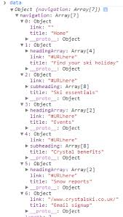
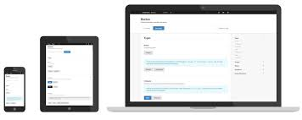
Introduction – Dynamic UI
How Do we Implement it?
Nested JSON
.hbs files for each element
DynamicUI Framework
Cross Platform
Responsive UI
Table
CSS
DataModel Engine
Div
Business Rule Engine
+
+
input
Validator Engine
select
Domain Specific Language Engine
Group
Data Model - JSON
Templating - Handlebars ( n a way it can support any complex nested layouts)
Validations – Jquery Validator & Custom
Business Rules – Extending Jquery Validator & Custom
Core Library - JQuery

Slide 12
Introduction – Dynamic UI
Current Status
UI Generation supported for most common controls
Text Box, Select, Check Box, Tables, Panels, Buttons, Tool Tips, UI Component grouping
Custom Rule Validation Supported.
JSON Data Model Base-Line Completed
Sand-box environment created for rapid prototyping and business rule simulation.
Commenced integration discussions with VVB, Anira and Trinity.
Next Steps
Enhance/Evolve Dynamic UI to support (based on business specific needs) additional
Complex UI Patterns
Complex Business Rules
Integrate additional products and applications using Dynamic UI
We believe with wider adoption, this is now ready for PRIME TIME

Slide 13
Project Spotlight : Sales Express
Thank you

