Slide 1
AGENDA
JASMINE – Overview
JASMINE – Environment Setup
JASMINE – BDD Architecture
JASMINE – Learning the Syntax
JASMINE – beforeEach() and afterEach()
JASMINE – Fixtures
JASMINE – Matchers
JASMINE – Writing custom matchers
JASMINE – Setting up a Project with examples

Slide 2
JASMINE - OVERVIEW
Jasmine is an open-source JavaScript framework
Capable of testing any kind of JavaScript application
Platform independent
Easily extended
Easy to learn
It follows Behavior Driven Development (BDD) procedure that ensure each line of JavaScript unit tested.

Slide 3
JASMINE - Environment Setup
Go to the official website of jasmine
Go to download section of the home page then click on standalone release page
http://jasmine.github.io/
https://jasmine.github.io/2.1/introduction
https://github.com/jasmine/jasmine/releases

Slide 4
Setting up a Project with examples
Create Web application
Include Jasmine lib files
Create JavaScript file
Create test case
Execute by running Output file
/src : contains the JavaScript source files that you want to test
/lib : contains the framework files
/spec: contains the JavaScript testing files
SpecRunner.html: is the test case runner HTML file

Slide 5
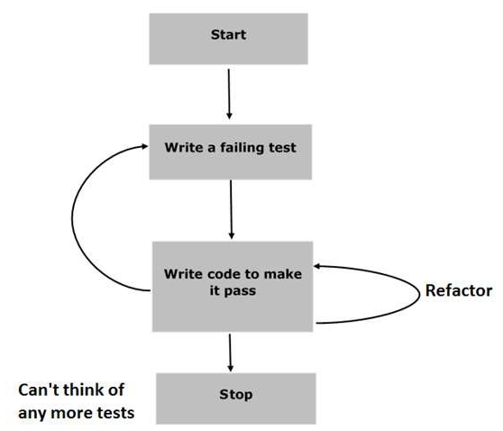
JASMINE - BDD Architecture
Notes:
Start: in this phase will make sure jasmine application is ready
Write failing test : test is going to fail because there is no such file or function to be tested
Write a code to make it pass: In this phase, we will prepare our JavaScript file or function that needs to be tested.
Retractor: we need to prepare as many test cases as we can for that particular application or function.
Stop/Repeat: everything is going well then your application must be ready and up. So we can consider this step as an end of our BDD application

Slide 6

JASMINE - Learning the Syntax
Suite Block: is the basic building block of Jasmine framework.
Suite Block have two blocks “describe()” and "it()"
describe() is nothing but “name of that suite”
it() is nothing but “Function declaration”.
expect() allows you to write your expectation from the required function
describe("toBe", function () {
it("should be a div", function () {
expect($('<div />')).toBe('div');
});
});

Slide 7

JASMINE - beforeEach() and afterEach()
beforeEach function is called once before each spec in the describe is run and the afterEach function is called once after each spec
describe("toBeChecked", function () {
beforeEach(function () {
setFixtures('\
<input type="checkbox" id="checked" checked="checked" />\n\
<input type="checkbox" id="not-checked" />');
});
it("should pass on checked element", function () {
expect($('#checked')).toBeChecked();
});
it("should pass negated on not checked element", function () {
expect($('#not-checked')).not.toBeChecked();
});
});

Slide 8

Fixtures (jasmine-jQuery)
loadFixtures('myfixture.html'): We can load the html to be tested
setFixtures(html)
var fixture = setFixtures('<div class="post">foo</div>')
describe("toBeChecked", function () {
beforeEach(function () {
setFixtures('\
<input type="checkbox" id="checked" checked="checked" />\n\
<input type="checkbox" id="not-checked" />');
});
it("should pass on checked element", function () {
expect($('#checked')).toBeChecked();
});
it("should pass negated on not checked element", function () {
expect($('#not-checked')).not.toBeChecked();
});
});

Slide 9
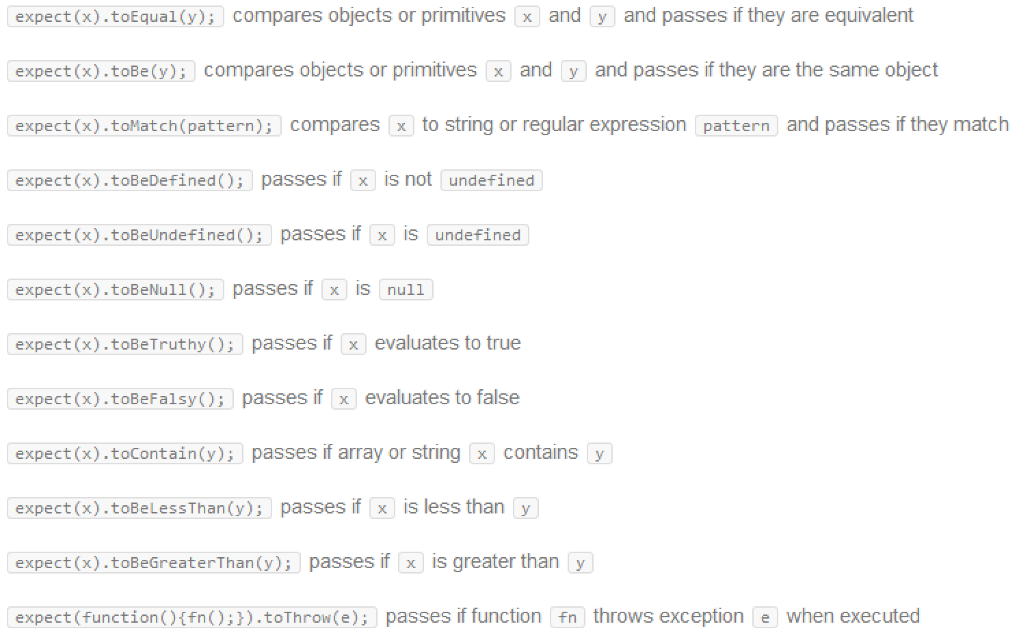
JASMINE Matchers

Slide 10
JASMINE Matchers
toBe(): It compares with === operator
toEqual(): works for simple literals and variables and objects too
toMatch(): to check whether a value matches a string or a regular expression
toBeDefined(): to ensure that a property or a value is defined
toBeUndefined(): to ensure that a property or a value is undefined
toBeNull(): to ensure that a property or a value is null.
toBeTruthy(): to ensure that a property or a value is "true"
ToBeFalsy(): to ensure that a property or a value is "false"
toContain(): to check whether a string or array contains a substring or an item.
toBeLessThan(): or mathematical comparisons of less than
toBeGreaterThan(): for mathematical comparisons of greater than
toBeCloseTo(): for precision math comparison
toThrow(): for testing if a function throws an exception
toThrowError(): for testing a specific thrown exception

Slide 11
JASMINE – jQuery Matchers
toBeChecked(): only for tags that have checked attribute
e.g. expect($('<input type="checkbox" checked="checked"/>')).toBeChecked()
toBeDisabled(): only for tags that have disabled attribute
expect('<input type="submit" disabled="disabled"/>').toBeDisabled()
toBeSelected(): only for tags that have selected attribute
expect($('<option selected="selected"></option>')).toBeSelected()
toBeEmpty(): Checks for child DOM elements or text.
toBeFocused(): expect($('<input type="text" />').focus()).toBeFocused()

Slide 12
JASMINE – jQuery Matchers
toBeHidden(): Elements can be considered hidden for several reasons like display:none
toBeVisible(): Elements are considered visible if they consume space in the document. Visible elements have a width or height that is greater than zero.
toContain(string):
expect($('<div><span class="some-class"></span></div>')).toContain('some-class')
toHaveClass(className):
e.g. expect($('<div class="some-class"></div>')).toHaveClass("some-class")

Slide 13
JASMINE – jQuery Matchers
toHaveCss(css):
e.g. expect($('<div style="display: none; margin: 10px;"></div>')).toHaveCss({display: "none", margin: "10px"})
toHaveHtml(string)
e.g. expect($('<div><span></span></div>')).toHaveHtml('<span></span>')
toHaveId(id)
e.g. expect($('<div id="some-id"></div>')).toHaveId("some-id")
toHaveLength(value)
e.g. expect($('ul > li')).toHaveLength(3)
toHaveText(string): accepts a String or regular expression
e.g. expect($('<div>some text</div>')).toHaveText('some text')

Slide 14

JASMINE – Writing Custom Matchers
this.addMatchers({
toBeBetween: function (rangeFloor, rangeCeiling) {
if (rangeFloor > rangeCeiling) {
var temp = rangeFloor;
rangeFloor = rangeCeiling;
rangeCeiling = temp;
}
return this.actual > rangeFloor && this.actual < rangeCeiling;
}
});

Slide 15
Getting started with Karma
Karma is a test runner for JavaScript that runs on Node.js.
Karma is a simple tool that allows you to execute JavaScript code in multiple real browsers.
The main purpose of Karma is to make your test-driven development easy and fast.
The main goal for Karma is to bring a productive testing environment.
You can execute your test on each and every save.

Slide 16
Installing Karma
Install Node.js
install the Karma tool via the NPM package manager
npm install karma --save-dev
Install Karma Globally
npm install -g karma-cli
install karma plug-ins to enable us to use the Jasmine test framework and Chrome as browser
npm install karma-jasmine karma-chrome-launcher --save-dev
Configuring the Test Runner
karma init , karma start

Slide 17
Thank you!

