Slide 1

CABS Quality Management System
End-user training — inspection requests, workflow, and administration
CABS Quality Management System

Slide 2
What is QMS?
Web application for CABS Request for R&QA Inspection/Testing records.
Replaces paper-based movement with a role-based digital workflow.
Covers request creation, approval, QA review, inspector assignment, reporting, and closure.
Includes notifications, printable CABS forms, and summary reports.
Access via the URL provided by your administrator (modern browser recommended).

Slide 3
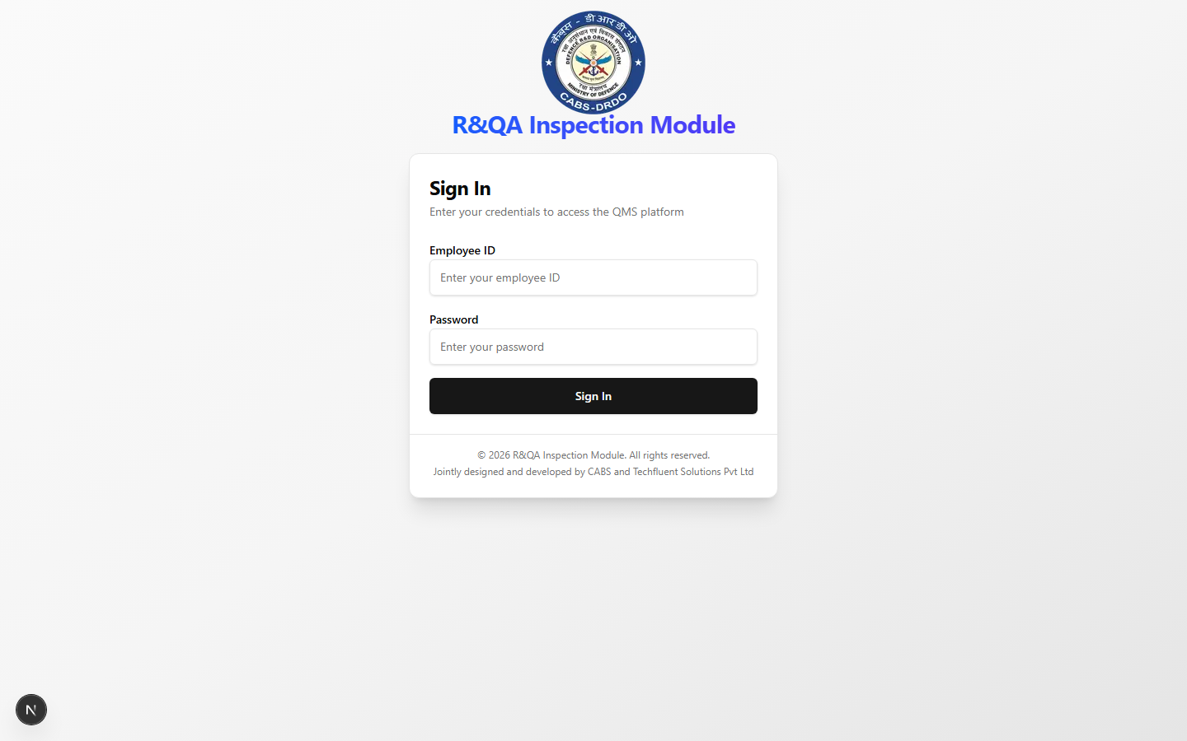
Signing In
Sign In screen — use your Employee ID and password
Notes:
Enter Employee ID and password. IDs are normalized to uppercase. Contact admin if account is deactivated.

Slide 4
Application Layout
Header: branding, search, theme toggle, notifications, profile menu.
Sidebar: Dashboard, Inspection Request, Reports, Profile, and admin menus by role.
Main content: the page or form you selected.
Session timeout: 5 minutes of inactivity (warning at 4 minutes).

Slide 5
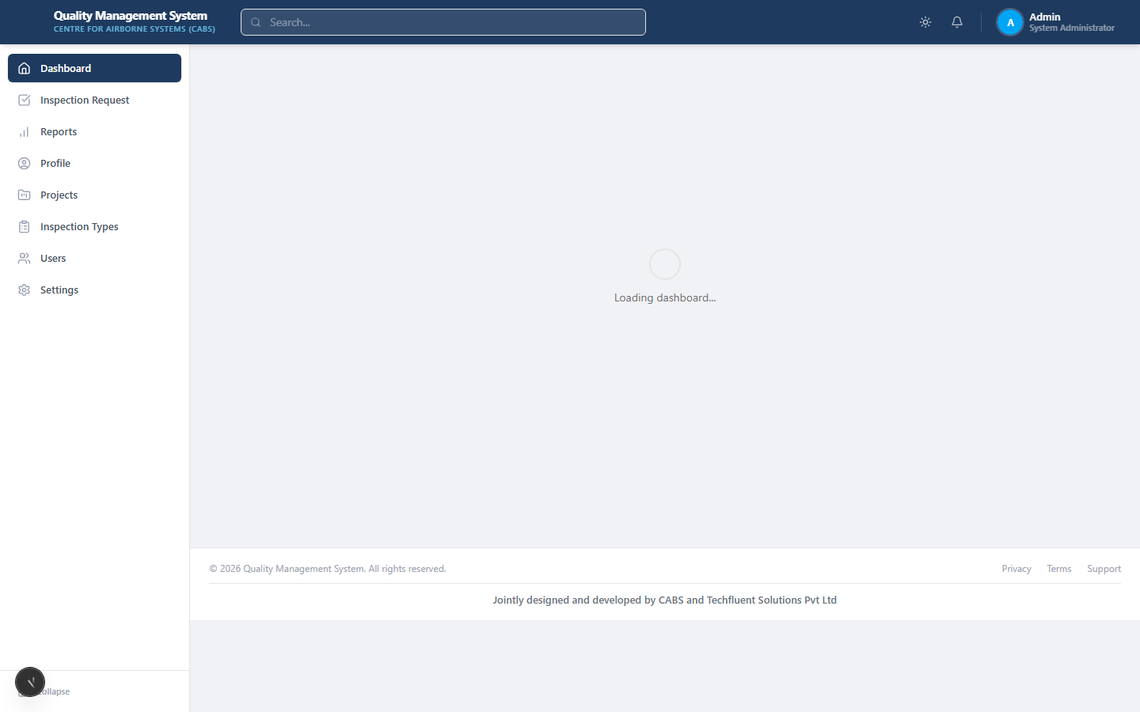
Dashboard (Administrator)
Home page after login — overview tailored to your role
Notes:
Role-specific statistics, recent inspections, notifications, and Action Required / Review Now when workflow items are pending.

Slide 6
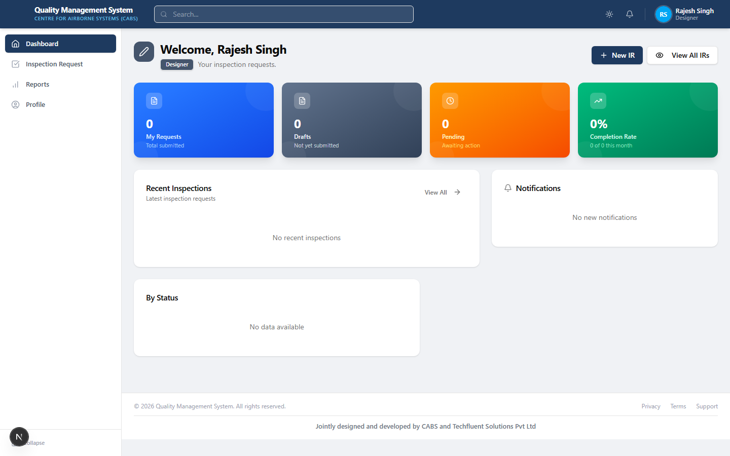
Dashboard (Initiator / Designer)
Designer view — focused on own inspection requests
Notes:
Initiators see their requests, drafts, pending items, and shortcuts to create a new IR.

Slide 7
Inspection Request Workflow
1. Initiator — Create & submit Part I
2. Request Approver — Forward, send back, or reject
3. QA Head — Part II Step 1, nominate Team Head
4. Team Head QA — Assign inspectors, start inspection
5. Inspector — Record Part IV findings & checklists
6. Team Head QA — Complete, approve & close
Key statuses
Draft → Pending → Pending Request Approval
Forwarded → Assigned → In Progress
Inspection Completed → Completed (closed)
Returned to Designer — corrections needed
Rejected — workflow ends with reason
Notes:
Use Send back when the initiator can correct Part I. Use Reject when the request must not continue. Closed requests are read-only.

Slide 8
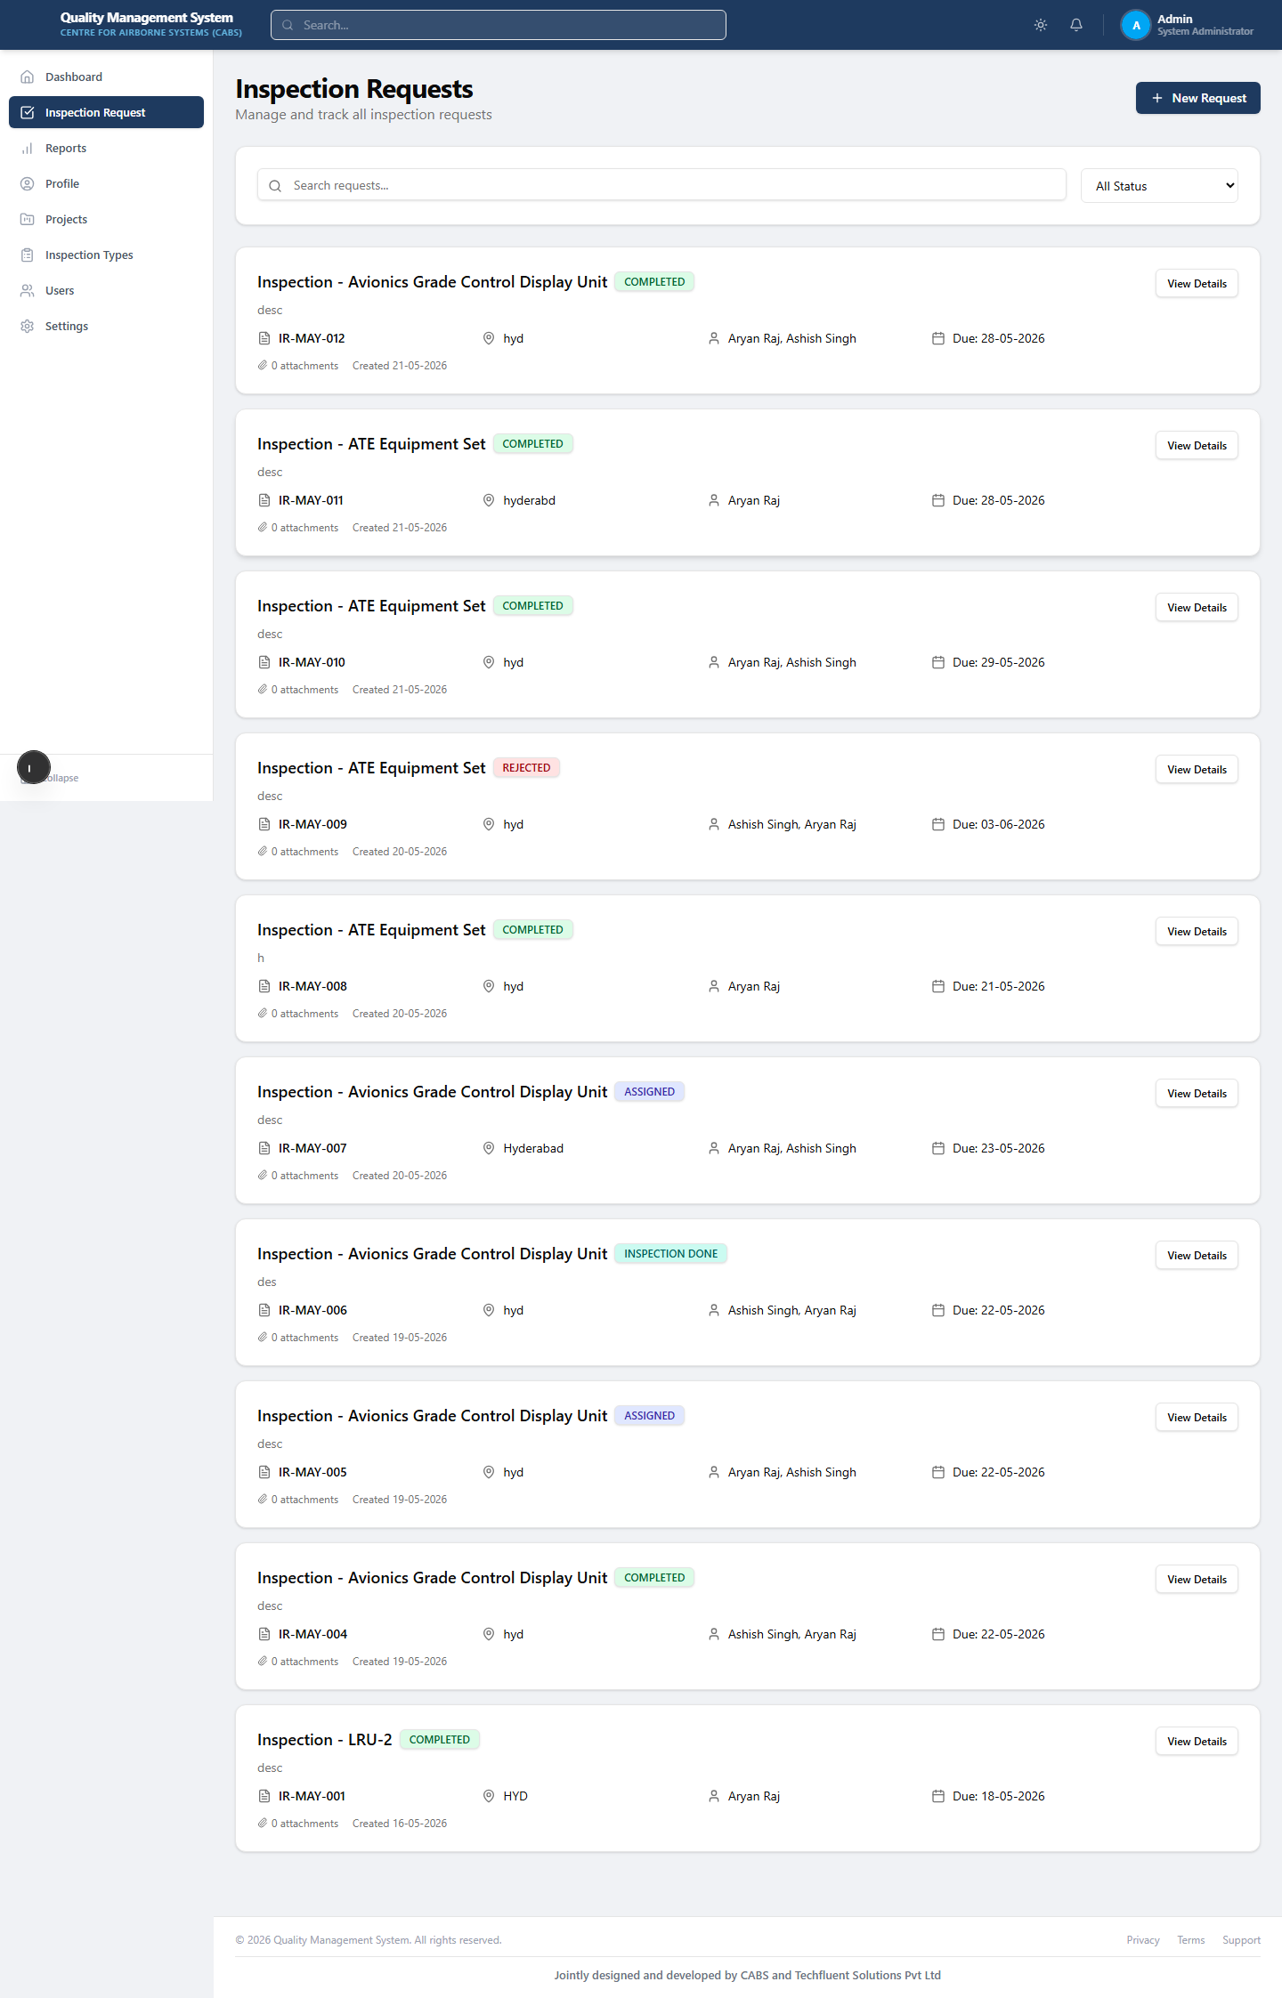
Inspection Request List
All inspection requests visible to your role
Notes:
Filter and search requests. Open a row to view or act on workflow steps permitted for your role.

Slide 9
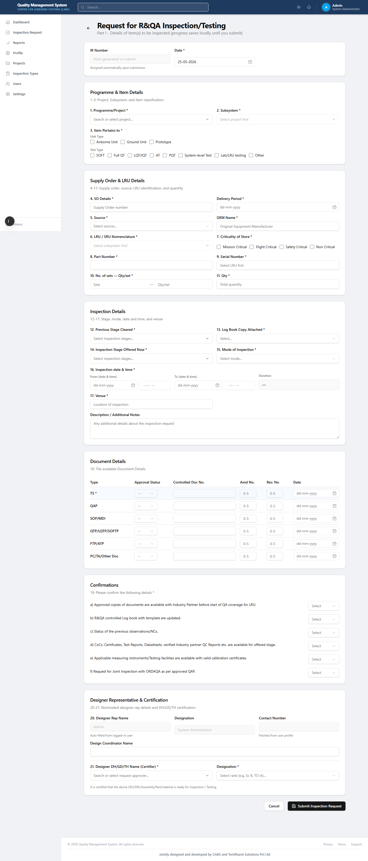
Create New Inspection Request (Part I)
Request for R&QA Inspection/Testing — Part I form
Notes:
Part I captures programme, item details, SO/equipment data, inspection details, and certifying approver. IR number is auto-generated.

Slide 10
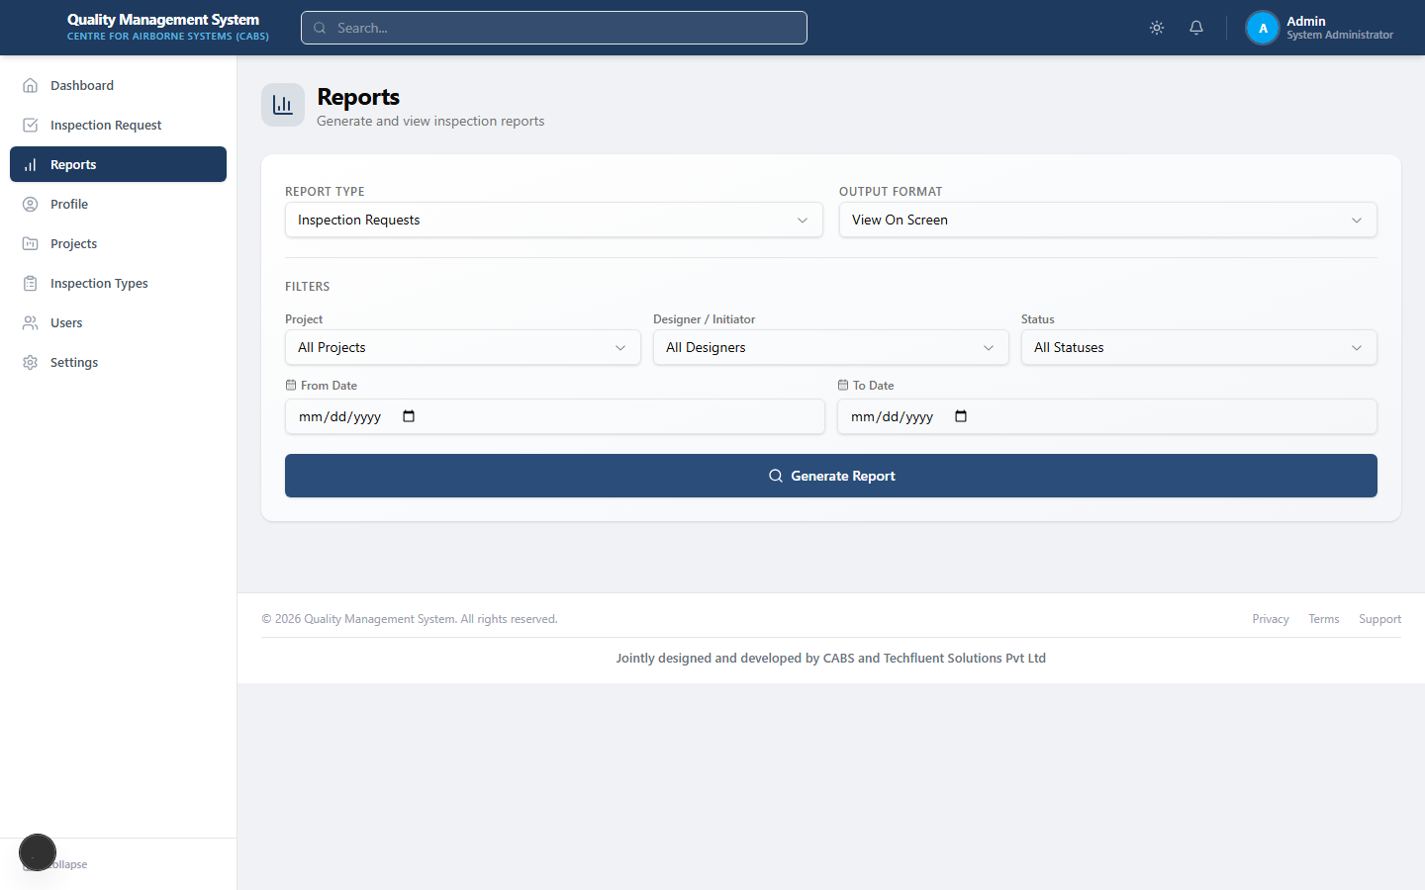
Reports
Reports module
Notes:
Generate printable CABS inspection forms and summary reports from completed or in-progress requests as allowed.

Slide 11
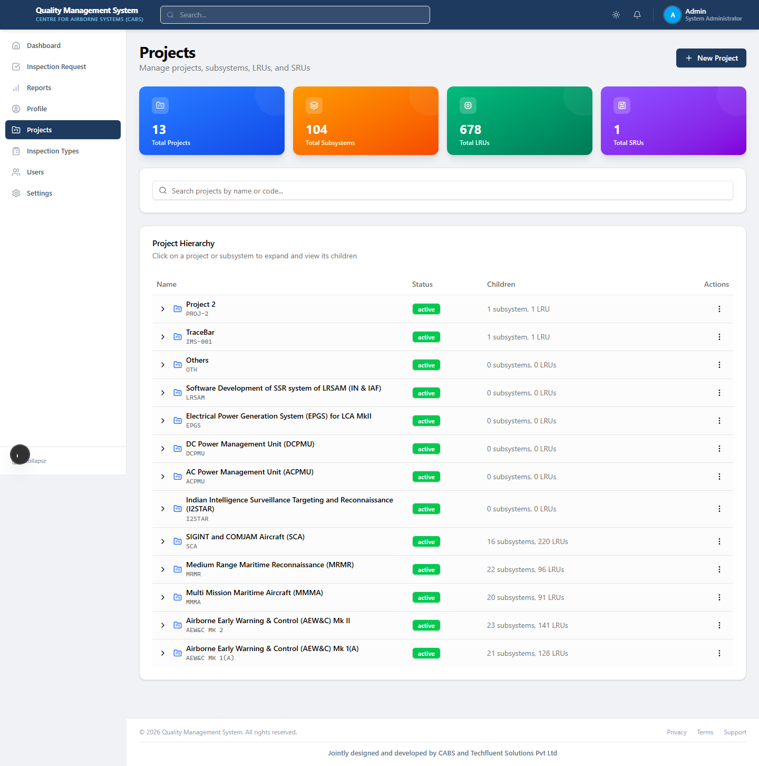
Projects & Equipment Hierarchy
Admin — project / LRU master data
Notes:
Administrators maintain programmes, subsystems, LRUs, SRUs, and serial numbers used on inspection forms.

Slide 12
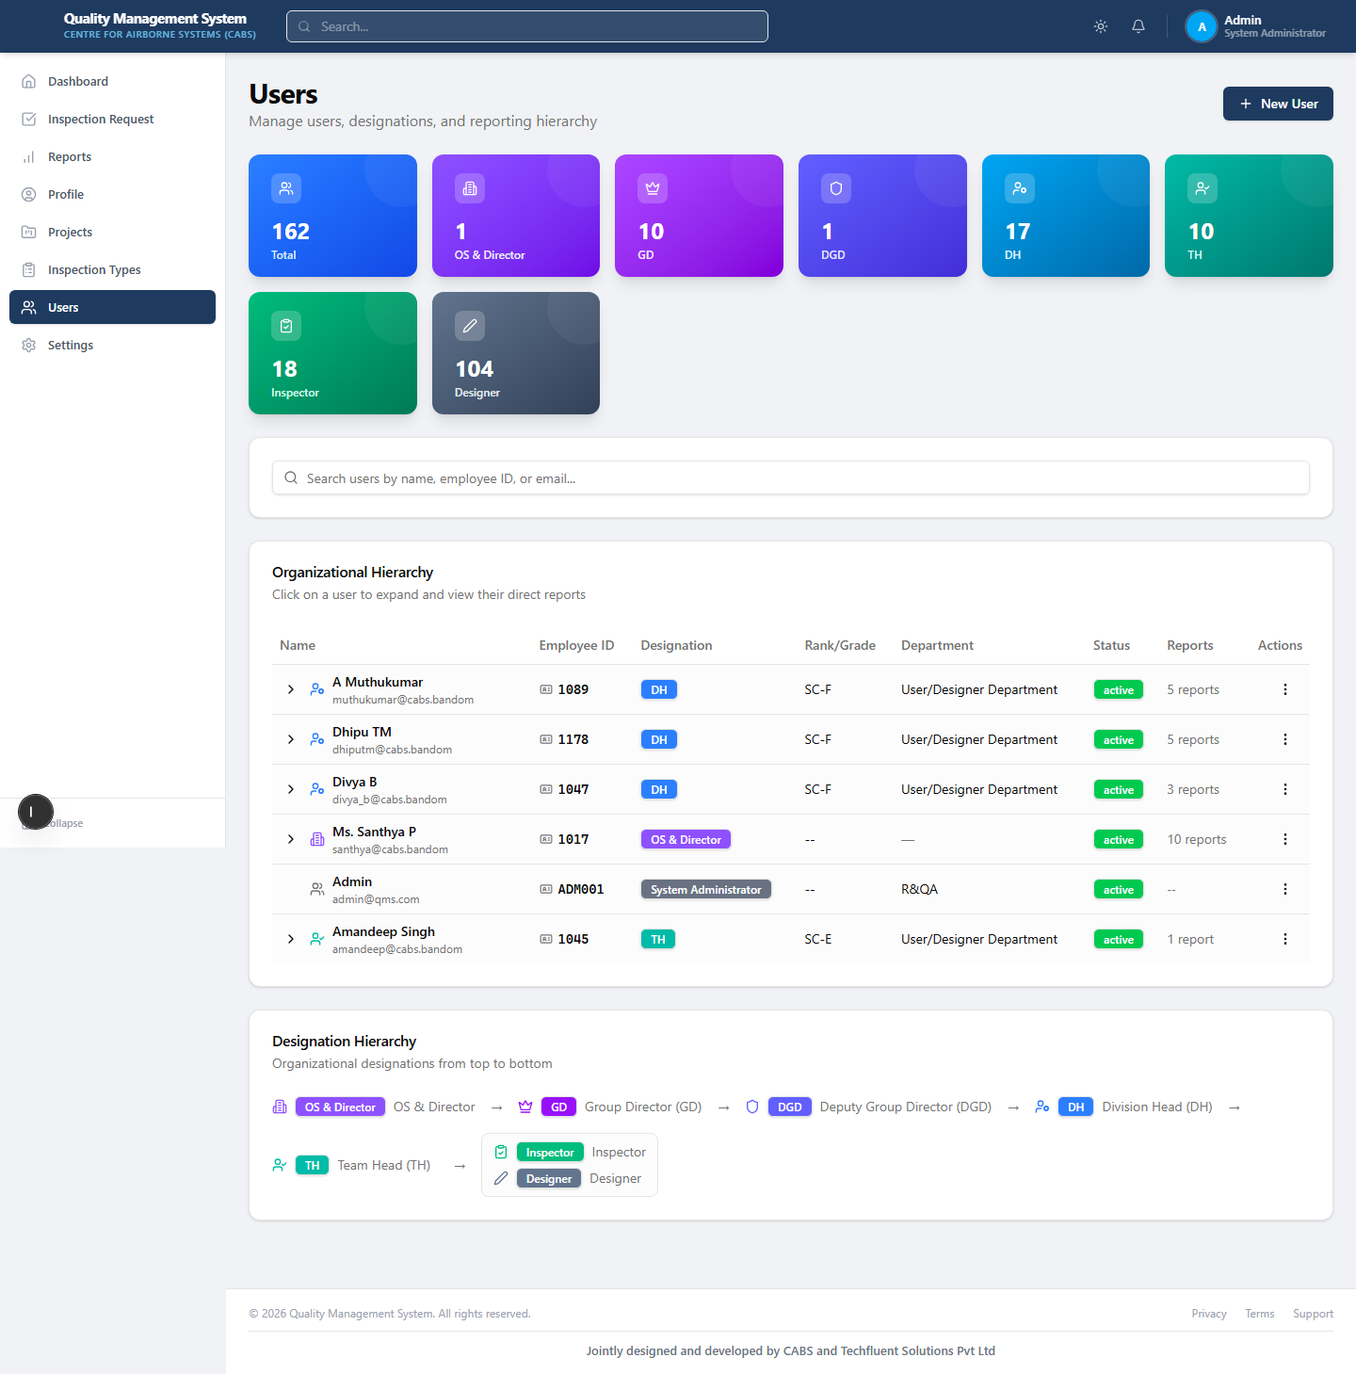
User Management
Admin — users and roles
Notes:
Administrators manage users, roles, reporting hierarchy, designations, and signatures.

Slide 13
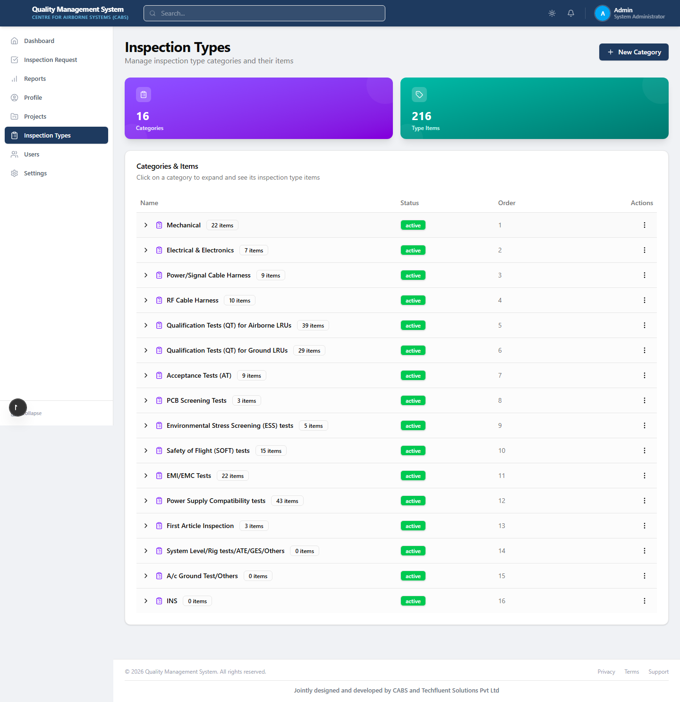
Inspection Types & Checklists
Admin — inspection type configuration
Notes:
Configure inspection type groups and checklist items used during inspection.

Slide 14
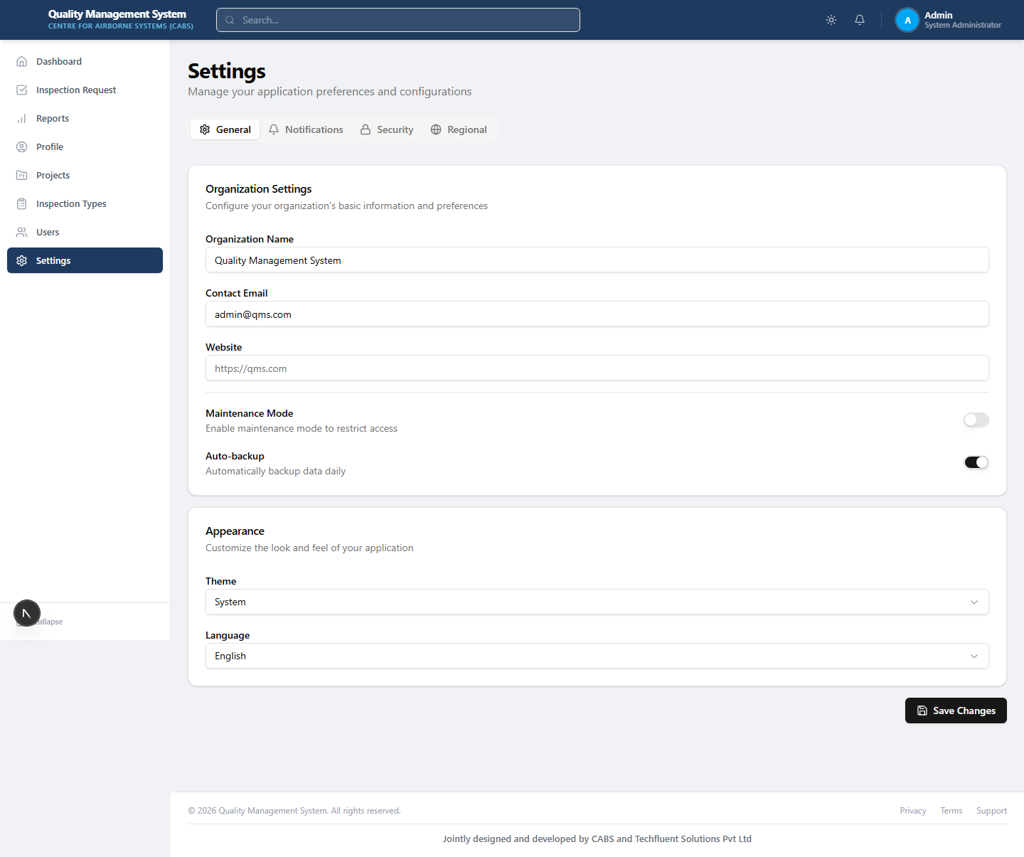
System Settings
Admin — settings
Notes:
System-wide configuration (deployment-specific options).

Slide 15
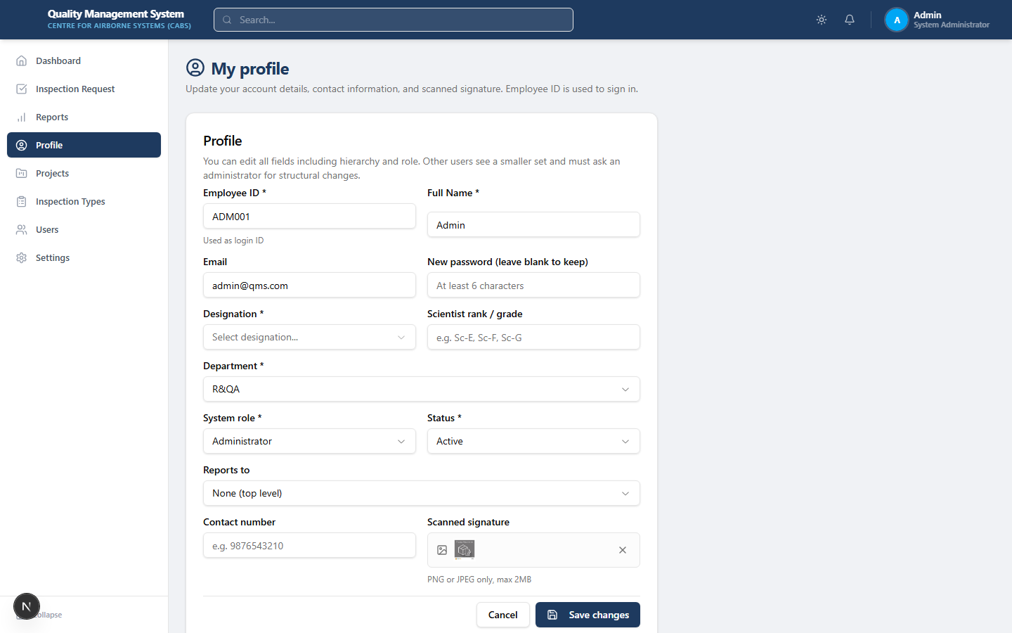
Profile & Password
Profile — account and password
Notes:
Users can update profile details and change password from the Profile page or profile menu.

Slide 16
Roles at a Glance
Initiator / Designer — create and submit Part I; correct when sent back.
Request Approver — forward, send back, or reject in reporting chain.
QA Head — Part II Step 1; nominate Team Head - QA.
Team Head - QA — assign inspectors, start/complete inspection, close.
Inspector / QA Rep — Part IV findings and checklists.
ORDAQA roles — when ORDAQA involvement is required.
Administrator — full access including master data and users.

Slide 17
Thank You
Questions? Contact your QMS administrator or refer to the Complete User Manual.

