Slide 1
AUTOSAR
AUTOMOTIVE OPEN SYSTEM ARCHITECTURE

Slide 2
WHAT IS AUTOSAR
The AUTOSAR or Automotive Open System Architecture was developed to create a common standardized software architecture for designing automotive electronic control units (ECUs).
AUTOSAR was founded in 2003 by a consortium of companies, including the BMW Group, Bosch, Continental, Daimler, Ford, General Motors, PSA Group, Toyota, and Volkswagen and Other.

Slide 3
AUTOSAR ARCHITECTURE
AUTOSAR architecture is based on a 3-layered architecture model, developed jointly by the stakeholders of the automotive industry including – the automobile manufacturers, the suppliers, and the tool developers.
The AUTOSAR specifies a three-layer architecture, which are categorized into following modules:
1. Application layer
2. Runtime environment (RTE)
3. Basic software (BSW)

Slide 4
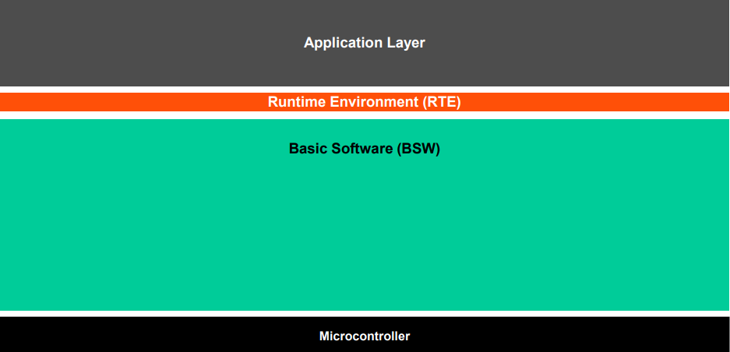
The AUTOSAR Architecture distinguishes on the highest abstraction level between three software layers: Application, Runtime Environment and Basic Software which run on a Microcontroller.

Slide 5

APPLICATION LAYER
The AUTOSAR application layer includes various application specific software components that are designed to execute specific set of tasks, as per the use-case.
The AUTOSAR Application layer constitutes the topmost layer within an AUTOSAR software architecture and is identified to be critical for all the vehicle applications.

Slide 6

RUNTIME ENVIRONMENT
Acts as a middleware between the AUTOSAR application layer and the lower layers. Basically, the RTE layer manages the inter- and intra-ECU communication between application layer components as well as between the BSW and the application layer.
The main purpose of this is to make AUTOSAR Software Components independent from the mapping to a specific ECU.

Slide 7
BASIC SOFTWARE
Basic software can be defined as standardized software module offering various services necessary to run the functional part of the upper software layer. This layer consists of the ECU specific modules along with the generic AUTOSAR modules.
The AUTOSAR Basic Software is further divided in the layers:
Services layer
ECU Abstraction layer
Microcontroller Abstraction layer
Complex Drivers

Slide 8

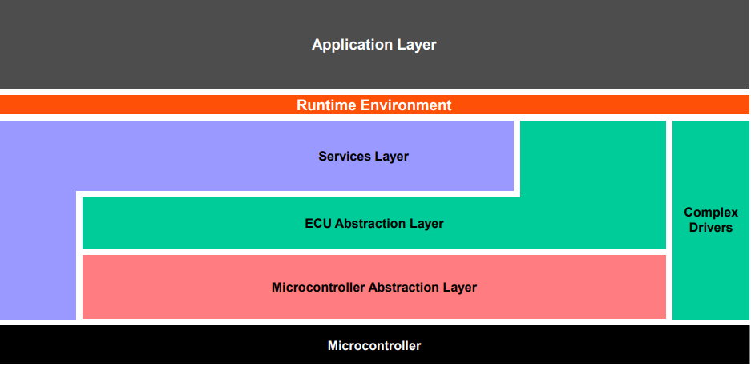

Slide 9
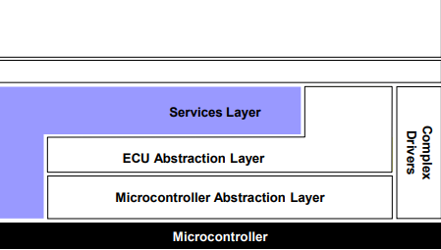
SERVICES LAYER
The service layer is the top most layer of AUTOSAR Basic Software Architecture. The service layer constitutes an operating system, which runs from the application layer to the microcontroller at the bottom. The OS has an interface between the microcontroller and the application layer and can schedule application tasks. The service layer in BSW is responsible for services like network services, memory services, diagnostics service,communication service, ECU state management, and more.

Slide 10
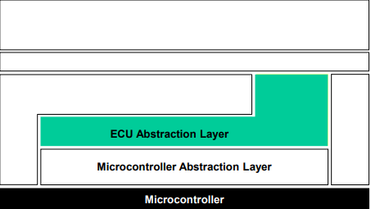
ECU ABSTRACTION LAYER
The prime task of the ECU abstraction layer is to deliver higher software layers ECU specific services. This layer and its drivers are independent of the microcontroller and dependent on the ECU hardware and provide access to all the peripherals and devices of ECU, which supports functionalities like communication, memory, I/O, etc.
Make higher software layers independent of ECU hardware layout.

Slide 11
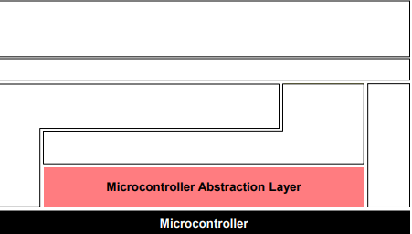
MICROCONTROLLER ABSTRACTION LAYER
The Microcontroller Abstraction Layer is the lowest software layer of the Basic Software. It contains internal drivers, which are software modules with direct access to the µC and internal peripherals.
Make higher software layers independent of µC

Slide 12
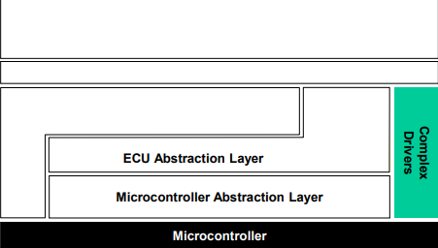
COMPLEX DRIVERS LAYER
The Complex Drivers Layer spans from the hardware to the RTE.
Provide the possibility to integrate special purpose functionality, e.g. drivers for devices:
which are not specified within AUTOSAR
with very high timing constrains
for migration purposes etc.

Slide 13
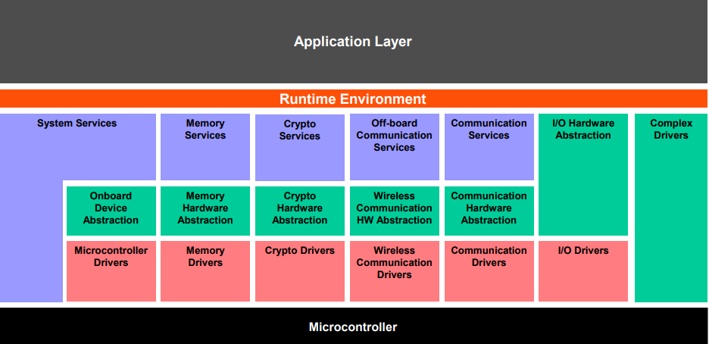
The Basic Software Layers are further divided into functional groups. Examples of Services are System, Memory and Communication Services.

Slide 14
INTRODUCTION TO TYPES OF SERVICES
The Basic Software can be subdivided into the following types of services:
Input/Output (I/O) : Standardized access to sensors, actuators and ECU onboard peripherals .
Memory : Standardized access to internal/external memory (non volatile memory) .
Crypto : Standardized access to cryptographic primitives including internal/external hardware accelerators
Communication : Standardized access to: vehicle network systems, ECU onboard communication systems and ECU internal SW .
Off-board Communication: Standardized access to: Vehicle-to-X communication, in vehicle wireless network systems, ECU off-board communication systems .
System : Provision of standardizeable (operating system, timers, error memory) and ECU specific (ECU state management, watchdog manager) services and library functions.

Slide 15
BASIC SOFTWARE MODULE TYPES DRIVER (INTERNAL)
A driver contains the functionality to control and access an internal or an external device.
Internal devices are located inside the microcontroller. Examples for internal devices are:
Internal EEPROM
Internal CAN controller
Internal ADC
A driver for an internal device is called internal driver and is located in the Microcontroller Abstraction Layer.

Slide 16
BASIC SOFTWARE MODULE TYPES DRIVER (EXTERNAL)
External devices are located on the ECU hardware outside the microcontroller. Examples for external devices are:
External EEPROM
External watchdog
External flash
A driver for an external device is called external driver and is located in the ECU Abstraction Layer. It accesses the external device via drivers of the Microcontroller Abstraction Layer.

Slide 17
ADAPTIVE AUTOSAR
The new AUTOSAR Adaptive software standard enables more powerful and more flexible E/E architectures in the vehicle.
Ethernet-based ECUs can now be used as central application servers in an AUTOSAR Adaptive architecture.
The big advantage is Adaptive ECUs make it possible to update applications over a vehicle’s entire life cycle and add new software functions at a later time.

Slide 18
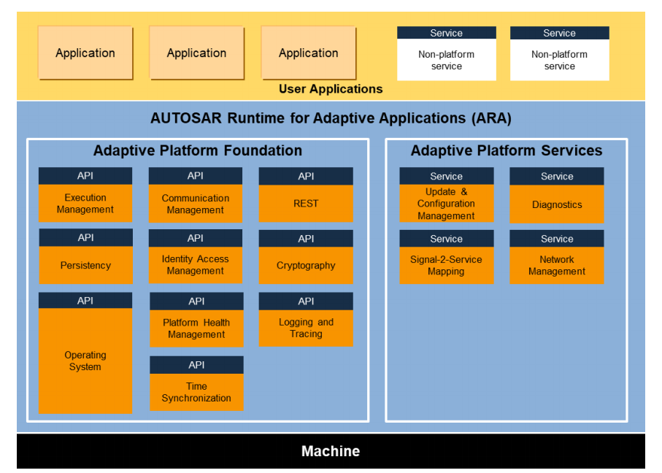
ADAPTIVE AUTOSAR ARCHITECTURE

Slide 19
ARCHITECTURE
The Adaptive Platform is a distributed computing and service-oriented architecture (SOA). The platform provides high-performance computing, message-based communication mechanisms, and flexible software configuration for supporting applications, such as automated driving and infotainment systems.
The AUTOSAR specifies a three-layer architecture, which are categorized into following modules:
1. Application layer
2. AUTOSAR Runtime for Adaptive Application(ARA).
3. Basic software (BSW)

Slide 20
ARCHITECTURE
The adaptive applications can be integrated at runtime. This implies that different software can be developed and distributed for an ECU, completely independent of each other. At the heart of an AUTOSAR adaptive platform, there is an POSIX operating system and each adaptive application is implemented as a process in this OS.
The RTE layer of the software architecture includes the C++ standard library. It supports communication between the Application layer and the Basic Software layer.
The Basic Software layer consists of system foundation software and services. Software components interact with software in the Basic Software layer by using C++ application programming interfaces (APIs).

Slide 21
SYSTEM FOUNDATION SOFTWARE AND SYSTEM SERVICES
Foundation software
Execution management
Communication management
Time synchronization
Identity access management
Logging and tracing
POSIX operating system
cryptography, REST , PHM, persistency .
system services
Update and configuration management
Diagnostics
Signal-to-service mapping
Network management

Slide 22
SALIENT FEATURES OF ADAPTIVE AUTOSAR
Adaptive AUTOSAR platform has been designed considering these requirements. So, you get more computing prowess, highly flexible software configurations and communication managers.
AUTOSAR adaptive is based on POSIX operating system.
The adaptive applications can be integrated at runtime. As a result, software can be added or replaced at runtime.
AUTOSAR AP is able to achieve this two major technology - Ethernet/SOMEIP and Multicore Processors to take care of the bandwidth for faster communication.
5.Complex ECU operations in applications such as ADAS and Over-the-Air (OTA) update require higher bandwidth; something that conventional CAN protocol cannot achieve. Ethernet solves this issue by offering higher bandwidth which enables accurate transfer of large messages and point-to-point communication, among others.

Slide 23
CLASSIC ADAPTIVE
It is Signal based communication. Using CAN and LIN.
Implementation of deeply embedded functionalities.
Software update at run time is not possible, communication between the software components are hard-wired.
classic AUTOSAR are written in C Language.
An OS is not required for Classic AUTOSAR implementation.
Update in a Classic Platform implies replacement of the entire ECU code.
does not support such multicore processors.
It is configured in a static manner .
Examples of future systems: Engine Control, Braking systems, Airbag Control Unit, etc.
It is Service based communication. Using Ethernet and SOME/IP.
Implementation of high-performance functionalities.
Adaptive AUTOSAR RTE is independent of the applications and hence, Over-The-Air update is possible.
Adaptive AUTOSAR are written in C++ Language
Adaptive AUTOSAR is based on POSIX operating system.
Adaptive platforms provide the options to remove/update individual applications in an ECU.
does support such multicore processors.
It is configured in a Dynamically manner .
Examples of future systems: Over-The-Air updates (OTA), Sensor fusion Data processing, Persistence, Dynamic choosing of application packages over run-time of vehicle, etc.

Slide 24
APPLICATIONS OF AUTOSAR
Sensors like LIDAR and RADAR
Electrification
ADAS Functions with a Camera
v2x
Map Updates
Automotive Apps

Slide 25
ADVANTAGES AND DISADVANTAGES OF AUTOSAR
The advantages of AUTOSAR include the following:
Reusability of software component
Software code can be reused.
Design flexibility is more
Cost and development time will be reduced
The disadvantages of AUTOSAR include the following:
Complexity
Initial Investment
Learning Curve

Slide 26
DEFINITIONS:
Service-Oriented-Architecture: It is the SOA that allows dynamic integration of a new software at run-time. And that’s what makes AUTOSAR AP so flexible.
POSIX (Portable Operating System Interface) : It is one of the pre-requisites of using complex processors and offers developers the necessary building blocks to create high-performance automotive applications.
Parallel Processing: multicore processors running in a heterogeneous computing environment, it is the capability of parallel processing that keeps the applications running.
Ethernet and Some/IP:. While the ethernet is the physical medium used for the communication, SOME/IP is the network protocol that acts as the middle layer. It defines the way in which the applications communicate with each other. SOME/IP also takes care of the serialization of the data sent over the Ethernet network.
C++ as the coding language: The virtues of object-oriented programming, dynamic memory management, and an extensive set of standard libraries. All these attributes make C++ a language of choice in performance-intensive algorithm development.

