Slide 1
Exploring Toronto Neighbourhoods - to open a Gym L V Pavan Kumar Maddula IBM Capstone Project

Slide 2
1. Introduction
Objective
General perception is populated area means there is more chance of subscription to gym and hence more Profitable.
Verify this assumption by consolidating data in to this format population Vs gyms correlate with existing gyms
Find best neighbourhood area to open a gym where there is less competition and more populous area

Slide 3
2. Data acquisition and cleaning
2.1 Data sources
2.1.1) https://en.wikipedia.org/wiki/List_of_postal_codes_of_Canada:_M - this wiki page contains information about the neighborhoods present in Toronto. This page has the postal code, borough & the name of all the neighborhoods present in Toronto.
2.1.2) “https://cocl.us/Geospatial_data” csv file to get all the geographical coordinates of the neighborhoods.
2.1.3 ) Location (latitude and longitude) and other information about various venues in Toronto (https://developer.foursquare.com/docs), Following information collected from this API ,- Name, category, Latitude, Longitude

Slide 4
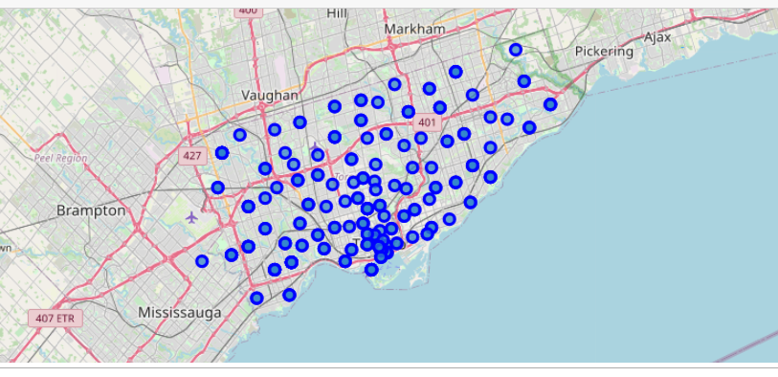
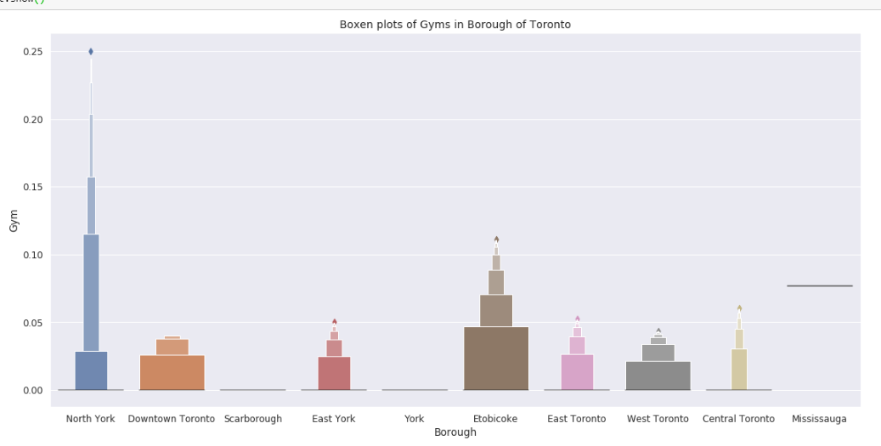
3. Exploratory data analysis
All Neighbourhood areas Toronto city
Boroughs Vs number of gyms
Boroughs Vs number of gyms shows north York, Etobicoke, Mississauga are having more gyms in comparison with other boroughs

Slide 5
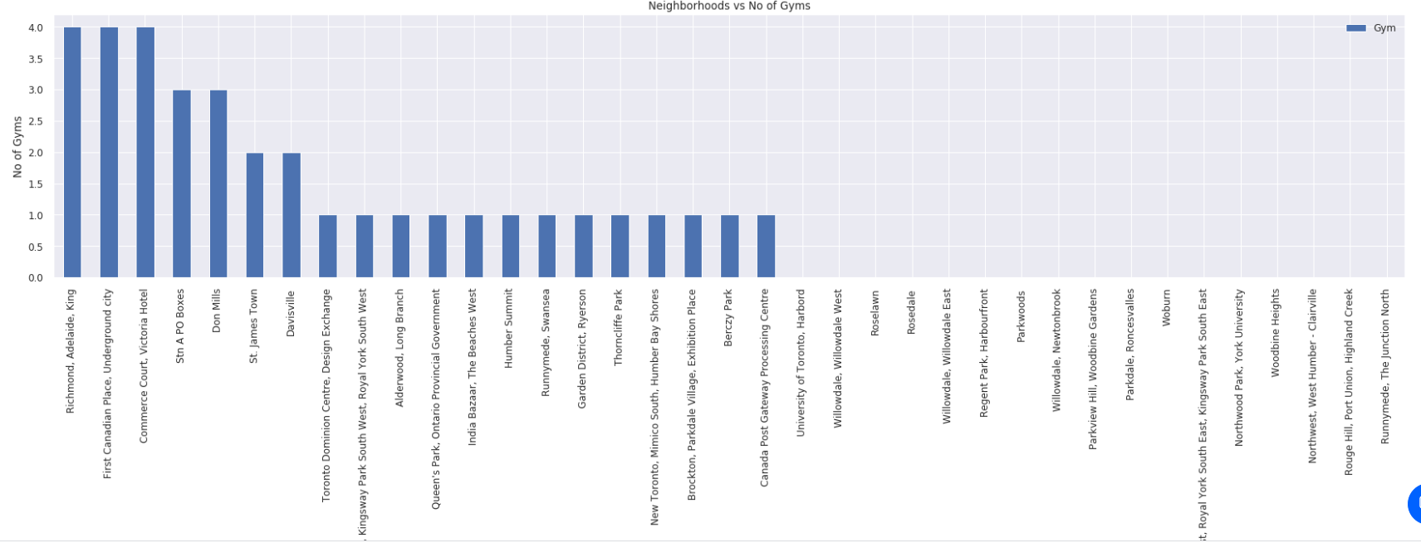
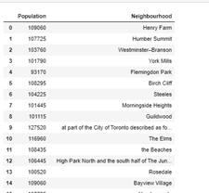
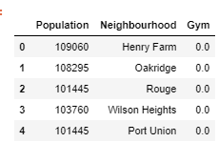
Neighbourhood Vs Number of gyms
Neighbourhood Vs Population
Neighbourhood Vs Population Vs Number of gyms
From above table we can see that their no correlation between population & Number of gyms

Slide 6
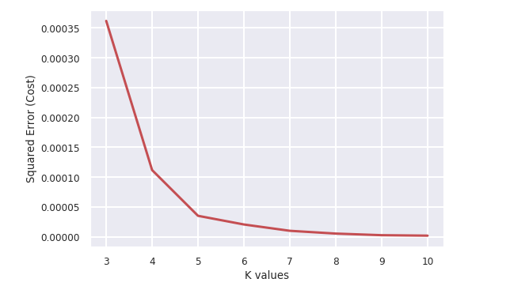
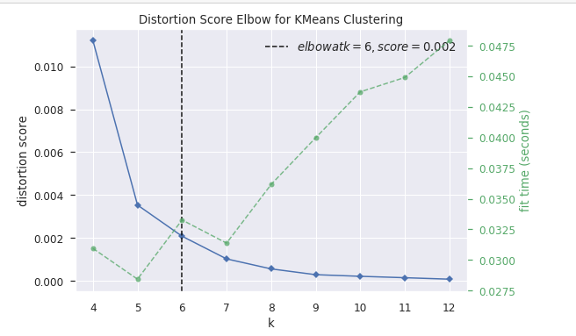
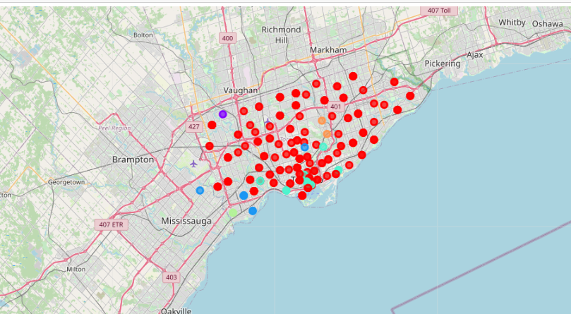
4. Predictive Modelling
Elbow method and distortion score shows to use 6 clusters is optimum number of clusters
Clusters examination shows cluster 0 red in colour shows where there are less number of gyms. Combining this with populous area could give the best place to open a gym

Slide 7
5. Results and discussion
According to this analysis, Scarborough borough will provide least competition for the new upcoming Gym as there are very less gyms in neighbourhoods. Also looking at the population distribution looks like it is densely populated which helps the new gyms by providing high customer visit possibility. So, this region could potentially be a perfect place for starting a gym.
Since population distribution of in each neighbourhood & number of gyms are the major feature in this analysis and it is not fully up-to date data, this analysis is definitely not far from being conclusory & it has lot of areas where it can be improved.
6. Conclusion:
We have used many python libraries to fetch the data , to manipulate the contents & to analyse and visualize those datasets. We have made use of Foursquare API to explore the venues in neighbourhoods of Toronto, then get good amount of data from Wikipedia which we scraped with help of Wikipedia python library and visualized using various plots present in seaborn & matplotlib. We also applied machine learning technique to predict the output given the data and used Folium to visualize it on a map. Also, some of the drawbacks or areas of improvements shows us that this analysis can further be improved with help more data and different machine learning technique. Similarly we can use this project to analysis any scenario such opening a different cuisine etc. Hopefully, this project helps acts as initial guidance to take more complex real-life challenges using data-science.

