Slide 1

ENHANCING HAND GESTURE RECOGNITION THROUGH DEEP LEARNING ARCHITECTURES
SIR CR REDDY COLLEGE OF ENGINEERING
DEPARTMENT OF INFORMATION TECHNOLOGY
BATCH B8
TEAM MEMBERS:
D.MOUNIKA(20B81A1279)
R.NAVEEN CHOWDARY(20B81A12A1)
V.PAVAN KUMAR(20B81A12B7)
P.DHATRI(20B81A1296)
PROJECT GUIDE:
SRI V.GOPINADH
ASSISTANT PROFESSOR

Slide 2
Agenda
Abstract
Introduction
Existing System
Proposed System
Software Requirements
Problem Statement
Advantages
Methodology
Implementation
Result
Conclusion

Slide 3
Abstract
This project focuses on creating a robust hand gesture recognition system using deep learning. This model is trained to process image as input, accurately identifying and classifying hand gestures. The project emphasizes simplicity and effectiveness, using deep learning to address challenges and improve human-computer interaction.The system is optimized for real-time responsiveness, and techniques like data augmentation and fine-tuning are applied to enhance its adaptability and overall performance.

Slide 4
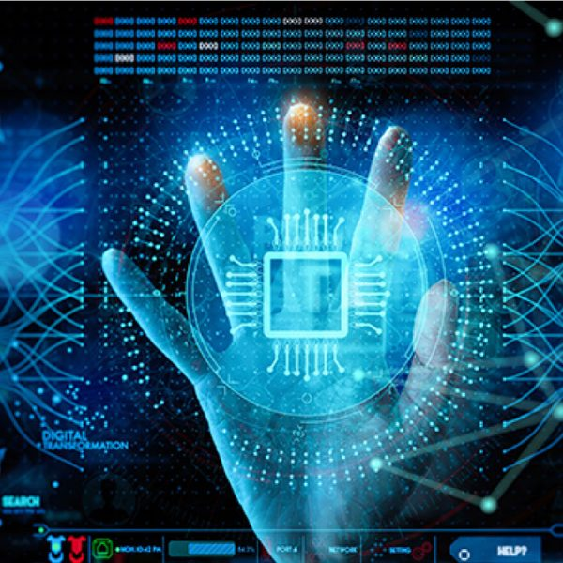
Introduction
Hand gesture recognition for human-computer interaction is an area of active research in computer vision and deep learning. One of the primary goals of gesture recognition research is to create systems, which can identify specific gestures and use them to convey information or to control a device. Hand-posing is one of the most important communication tools in human’s daily life and with the continuous advances in image and video processing techniques.

Slide 5
Existing System
Several hand gesture recognition systems exist, ranging from simple applications to complex ones. Microsoft's Kinect, for instance, utilizes depth-sensing cameras to track hand movements. Leap Motion is another example, using infrared cameras for high-precision hand tracking. Additionally, OpenPose is an open-source library that can recognize and track various body parts, including hands. These systems find applications in virtual reality, gaming, and healthcare, among other fields.

Slide 6
Proposed System
Gesture Recognition methods usually contain three major stages. The first stage is the object detection. The target of this stage is to detect hand objects in digital images or videos. The second stage is object recognition. The detected hand objects are recognized to identify the gestures. At this stage, differentiated features and effective classifier selection are a major issue in most research. The third stage is to analyze sequential gestures to identify users’ instructions or behaviors.

Slide 7
Software Requirements
Deep Learning Framework: Choose a deep learning framework such as Tensorflow, MediaPipe or Pytorch to develop and train convolutional neural networks (CNNs) for hand gesture recognition.
Computer Vision Library: Incorporate a computer vision library like OpenCV to handle image processing, video capture, and feature extraction, crucial for preprocessing and real-time analysis.
Programming Language: Use a programming language, preferably Python, for its extensive support in the deep learning and computer vision communities, enabling seamless integration with frameworks and libraries.

Slide 8
Problem Statement
The problem statement for hand gesture recognition using deep learning involves creating a model that can accurately recognize and interpret hand gestures from input data, such as images or video frames. The objective is to develop a robust and efficient system capable of classifying a wide range of gestures, considering factors like variations in hand shapes, orientations, and environmental conditions. The challenge is to design a deep learning architecture, train it on diverse datasets, and optimize it for real-time or near-real-time performance. The application areas can include sign language translation, human-computer interaction, and immersive technologies, with the goal of enhancing accessibility and user experience.

Slide 9
Advantages
Non-verbal cues: Gestures add another layer of meaning to spoken language, emphasizing points, clarifying ideas, and conveying emotions more effectively.
Universality: Many gestures transcend cultural and language barriers, promoting understanding across diverse populations.
Accessibility: People with speech or hearing impairments can rely heavily on gestures for communication, making interaction more inclusive.

Slide 10
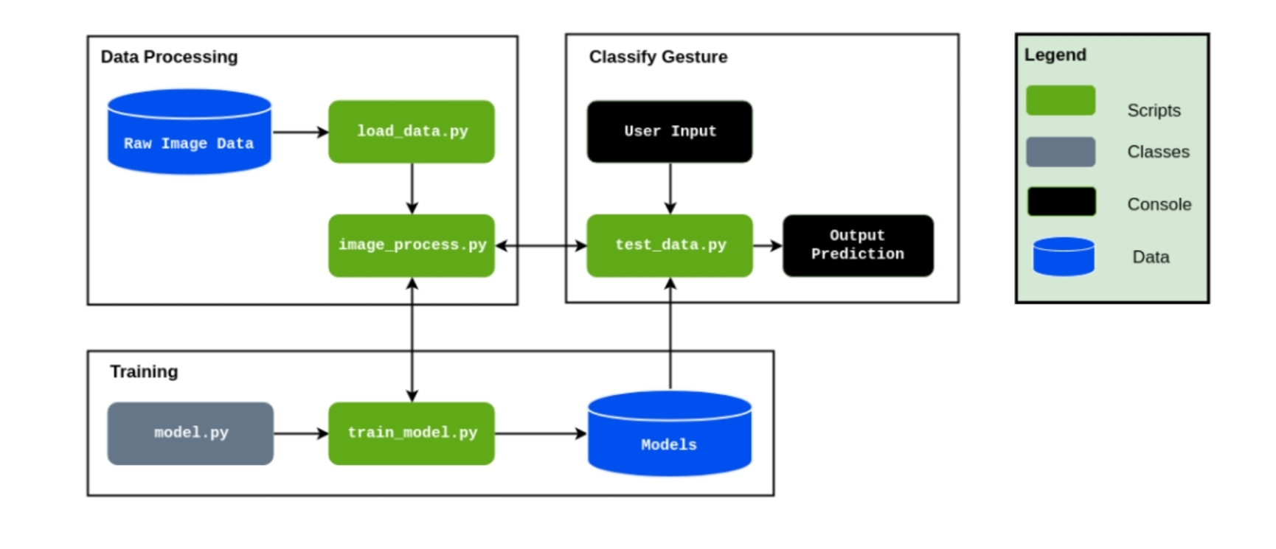
System Architecture

Slide 11
Methodology
Dataset Collections
Data Preprocessing
Model Selection
Model Training
Model Deployment

Slide 12
Dataset Collection
For hand gesture recognition, we collect a variety of gestures from different people, making sure to include different hand shapes, sizes, angles, and lighting conditions. We may use special sensors or cameras for accuracy. Ensuring high-quality data involves reducing noise and accurately labeling the gestures. This careful process sets a strong foundation for training reliable hand gesture recognition models.

Slide 13
Data Preprocessing
Data preprocessing is the process of converting raw data into a format that can be used for analysis and modeling.
Data Acquisition : Collect a diverse dataset of hand gesture images or videos, ensuring variability in hand shapes, sizes, orientations, and lighting conditions.
Data Cleaning : Remove any irrelevant or noisy data from the dataset, such as images with poor quality or unclear gestures.
Image Resizing : Resize the images to a standardized resolution to ensure consistency and reduce computational complexity during training.

Slide 14
Normalization : Normalize the pixel values of the images to a common scale (e.g., [0, 1]) to improve convergence and stability during model training.
Feature Extraction : Extract relevant features from the preprocessed images, such as hand shape, finger positions, or motion trajectories, to capture important information for gesture recognition.

Slide 15
Model Selection
Choose an appropriate deep learning model for hand gesture recognition, considering factors such as complexity, performance, and computational resources. Common models include convolutional neural networks (CNNs).
Convolutional Neural Networks (CNNs): A popular choice due to their effectiveness in capturing spatial relationships within images, making them well-suited for image-based tasks like gesture recognition.

Slide 16
Training
Training for hand gesture recognition using deep learning involves choosing a model type, preparing the dataset, designing the model, setting up parameters, selecting a loss function and optimizer, iterating through training to minimize loss, validating to avoid overfitting, tuning hyperparameters, and finally testing the trained model to ensure it can accurately recognize hand gestures.

Slide 17
Model Deployment
we'll explore the final stage of bringing our gesture recognition system to life: model deployment. This crucial step involves transitioning the trained model from the development environment to a real-world setting where it can interact with users and perform gesture recognition tasks.

Slide 18
IMPLEMENTATION
Importing Libraries:
OpenCV (cv2): Utilized for computer vision tasks such as image processing, video capture, and manipulation. In this implementation, it's employed for background subtraction, image segmentation, and webcam feed processing.
Keras: A high-level deep learning library that acts as an interface for TensorFlow, Theano, or other deep learning frameworks. In this project, Keras is employed for building, training, and deploying the convolutional neural network (CNN) model for hand gesture recognition.

Slide 19
NumPy: A fundamental package for scientific computing with Python, used extensively for array manipulation and mathematical operations. It's used for data preprocessing, especially in handling image data arrays in CNNs.
Tkinter: A standard GUI toolkit for Python, used to create the graphical user interface for the hand gesture recognition application. It provides widgets for buttons, labels, and text boxes.

Slide 20

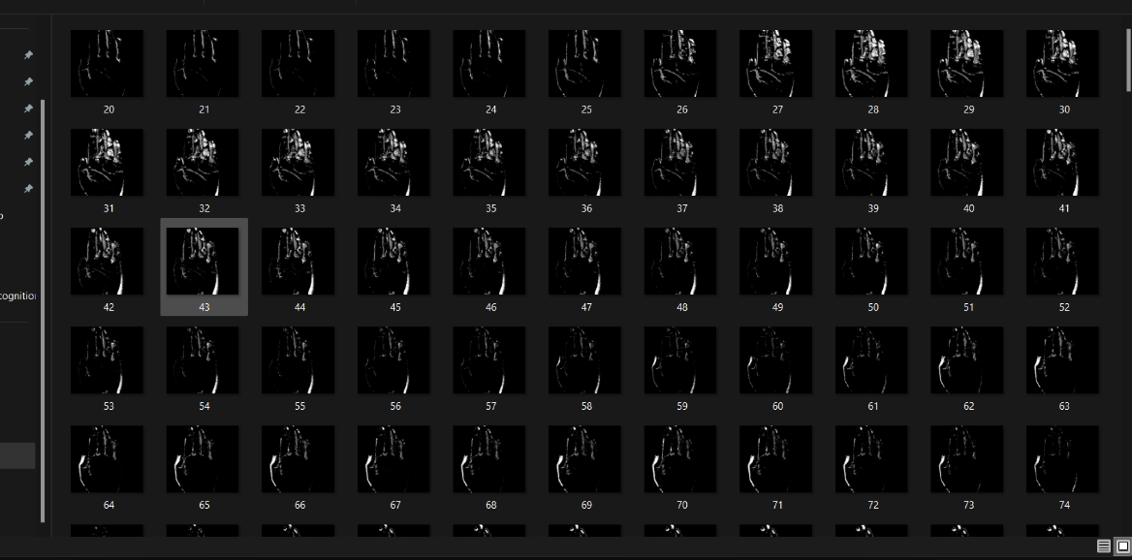
Load Dataset
Loading a comprehensive dataset is crucial for training a robust hand gesture recognition model.

Slide 21
ALGORITHMS
CNN ALGORITHM
A convolutional neural network (CNN or ConvNet) is a network architecture for deep learning that learns directly from data. CNNs are particularly useful for finding patterns in images to recognize objects, classes, and categories.

Slide 22
The layers used in the provided code for hand gesture recognition with CNNs include convolutional layers, pooling layers, flatten layers, fully connected layers (dense layers), activation functions, and the output layer.
Convolutional layers perform convolutions to extract features, while pooling layers down sample feature maps. Flatten layers convert the output into a 1D vector for dense layers, which perform classification. Activation functions introduce non-linearity, and the output layer produces final predictions.

Slide 23
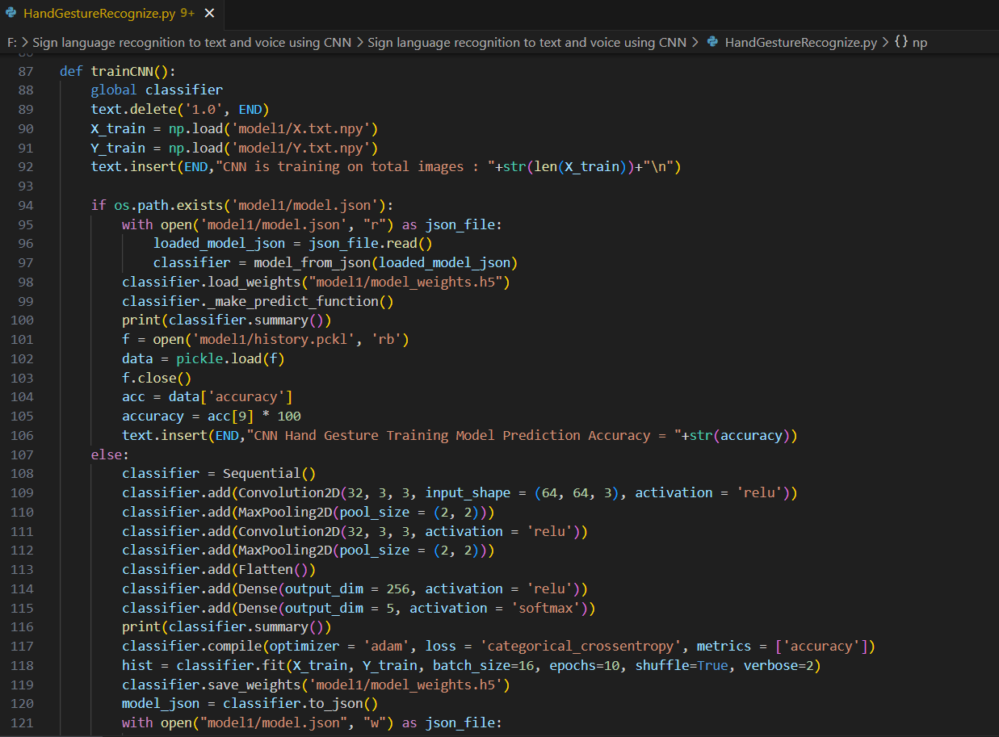
MODEL TRAINING
A custom CNN is built to recognize features in hand gesture images. The model is prepared for training with optimization and loss settings. Training adjusts the model's parameters to enhance accuracy, while evaluation verifies its effectiveness across different scenarios.

Slide 24
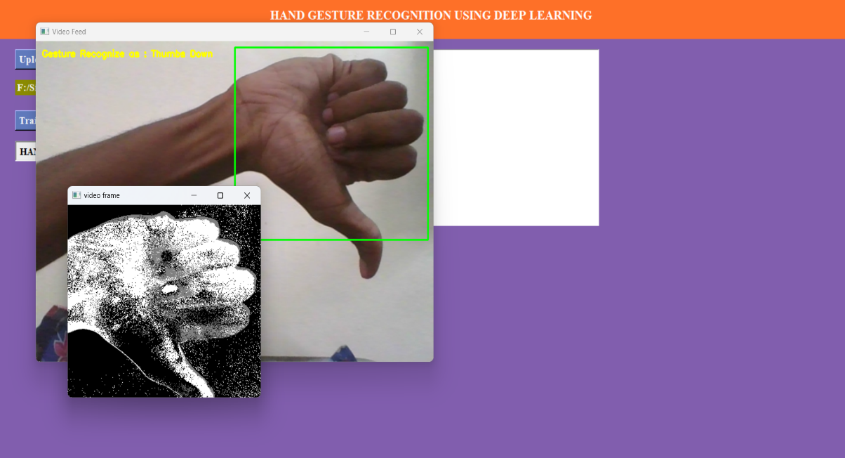
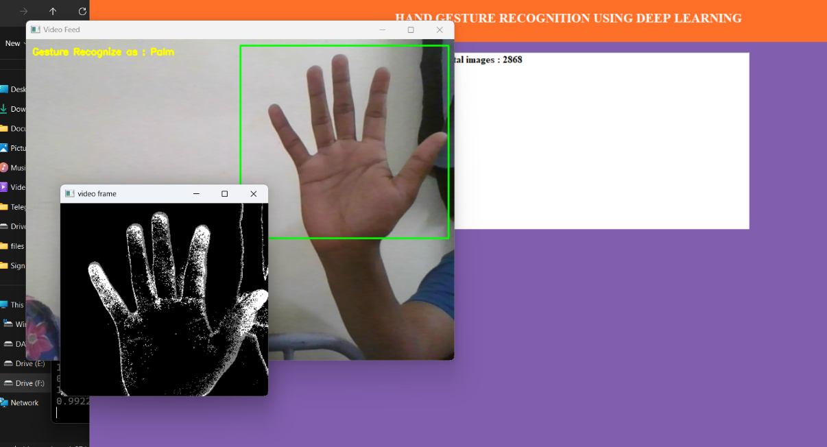
RESULT

Slide 25
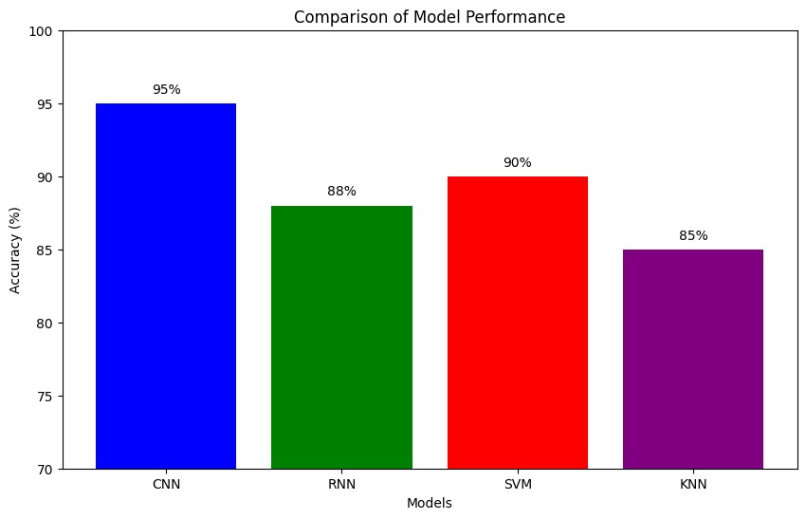
COMPARISION OF MODEL PERFORMANCE

Slide 26
CONCLUSION
In conclusion, our implementation of a Convolutional Neural Network (CNN) for hand gesture recognition showcases superior accuracy and reliability compared to traditional methods. By effectively capturing both spatial and temporal features through 3D convolutions, our CNN architecture excels in accurately identifying diverse hand gestures from consecutive input frames. This advancement holds significant promise for enhancing human-computer interaction, accessibility, and assistive technologies, offering more intuitive and efficient user interfaces for various applications.

Slide 27


