Slide 1

Library Database Analysis
Using MYSQL
Project Submitted By:
V.Raja Sekhar Reddy
Ch.Pavan Kumar

Slide 2
Table and Description
S.No | Table Name | Description
1 | tbl_publisher | Stores publisher information such as name, address, and phone number.
2 | tbl_book | Contains book details including Book ID, Title, and Publisher reference.
3 | tbl_book_authors | Stores author details for each book and links authors to books.
4 | tbl_library_branch | Contains details of library branches such as branch name and address.
5 | tbl_book_copies | Maintains the number of copies of each book available at each branch.
6 | tbl_borrower | Stores borrower information including card number, name, address, and phone.
7 | tbl_book_loans | Records book loan transactions including book ID, branch ID, borrower card number, issue date, and due date.
Page No:1

Slide 3
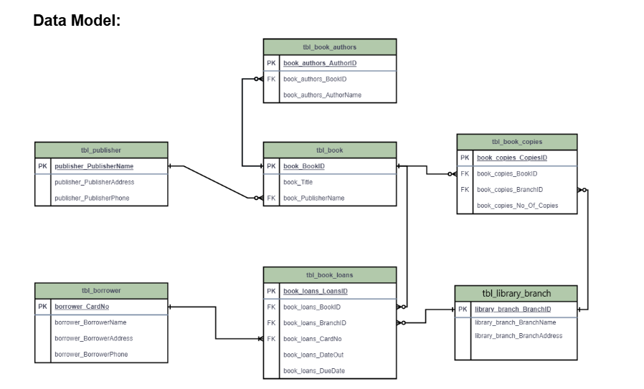
ER Diagram
visually shows how all tables are related using Primary Keys and Foreign Keys before implementing them in SQL.
Page No:2

Slide 4
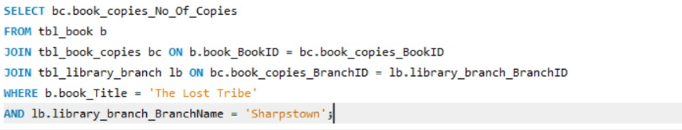

Task Questions
1.How many copies of the book titled "The Lost Tribe" are owned by the library branch whose name is "Sharpstown"?
Page No:3

Slide 5
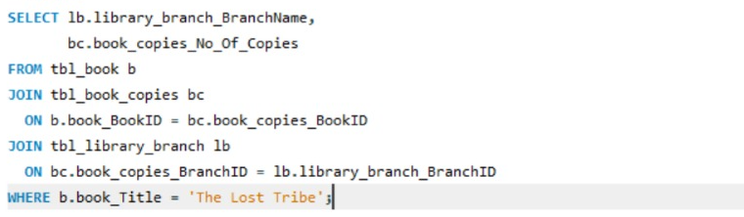
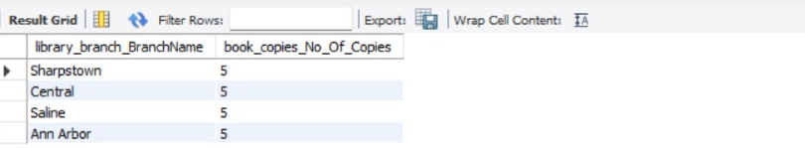
Task Questions
2.How many copies of the book titled "The Lost Tribe" are owned by each library branch?
Page No:4

Slide 6


Task Questions
3.Retrieve the names of all borrowers who do not have any books checked out.
Page No:5

Slide 7
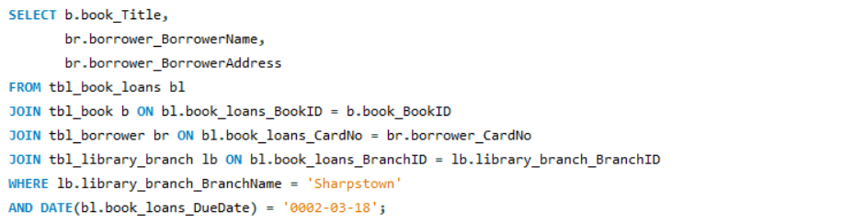
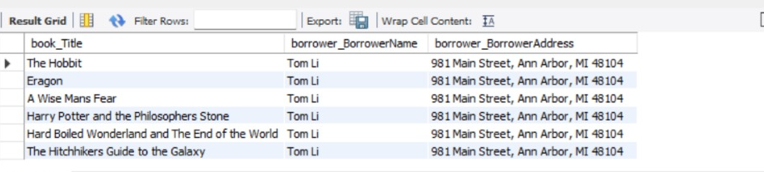
Task Questions
4.For each book that is loaned out from the "Sharpstown" branch and whose DueDate is 2/3/18, retrieve the book title, the borrower's name, and the borrower's address.
Page No:6

Slide 8

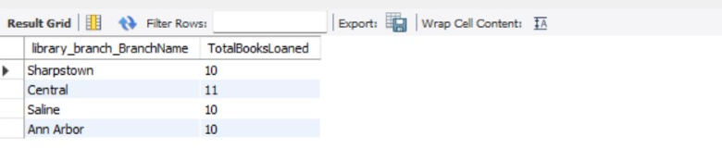
Task Questions
5.For each library branch, retrieve the branch name and the total number of books loaned out from that branch.
Page No:7

Slide 9

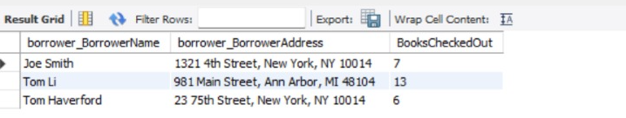
Task Questions
6.Retrieve the names, addresses, and number of books checked out for all borrowers who have more than five books checked out.
Page No:8

Slide 10
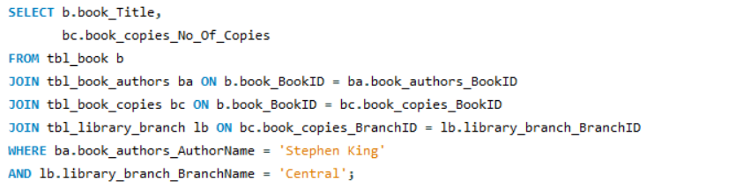

Task Questions
7.For each book authored by "Stephen King", retrieve the title and the number of copies owned by the library branch whose name is "Central".
Page No:9

Slide 11
Conclusion – Library Data Analysis
🔹 Successfully designed a structured relational database for library management.
🔹 Created 7 interconnected tables using Primary Keys and Foreign Keys to maintain data integrity.
🔹 Established clear relationships between books, authors, publishers, branches, borrowers, and loans.
🔹 Performed analytical SQL queries to track book availability, loan records, and borrower activity
.
🔹 Improved understanding of real-world database design and SQL operations like JOIN, GROUP BY, and COUNT().
Page No:10

Slide 12

THANK YOU

