Slide 1
R as an interface to C++: exchanging convenience for speed
<May, 2018>
https://github.com/pgurazada

Slide 2

Who am I?
Sales guy
Right of the middle in $y=f(X)$

Slide 3
Agenda
R is an interface
R might be fast
Mapping R objects to C++ with Rcpp
(Interesting) Examples
Starting today…

Slide 4
This is a highly opinionated talk!

Slide 5
Agenda
R is an interface
R might be fast
Mapping R objects to C++ with Rcpp
(Interesting) Examples
Starting today…

Slide 6
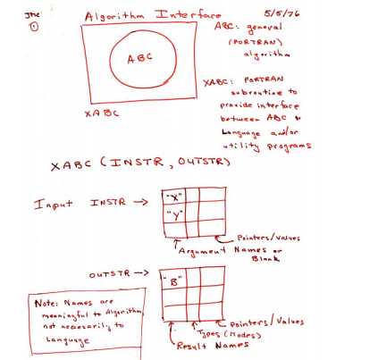
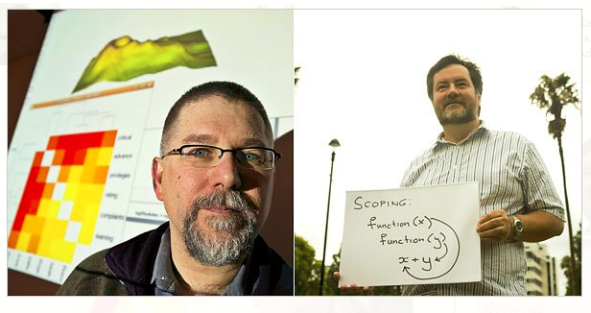
When S came before R…

Slide 7
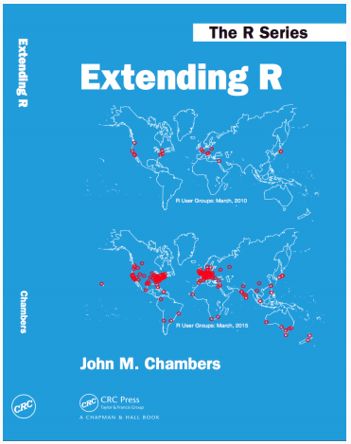
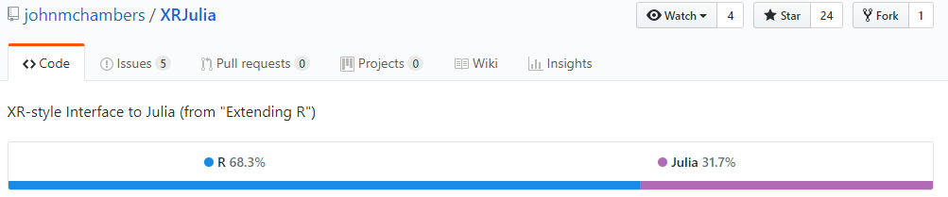
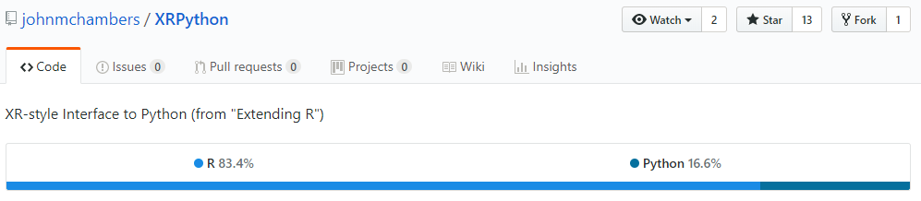

Slide 8
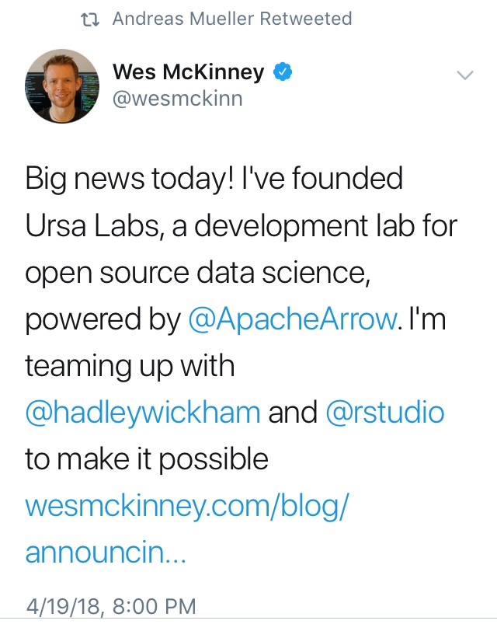
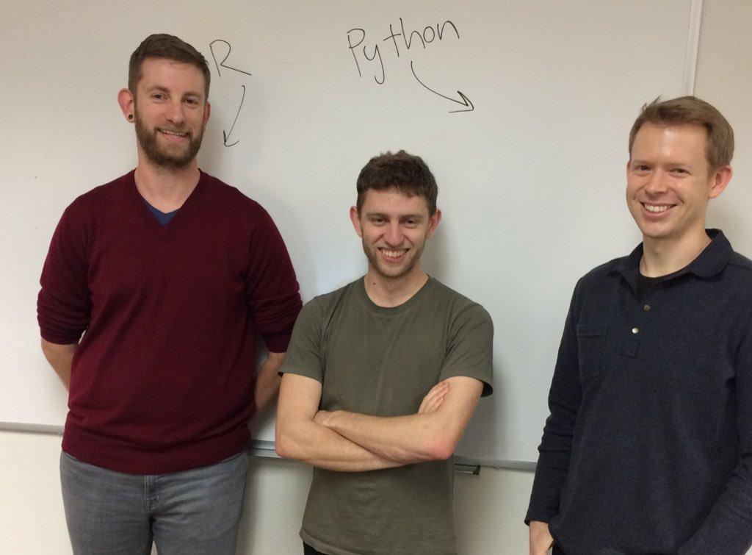

Slide 9
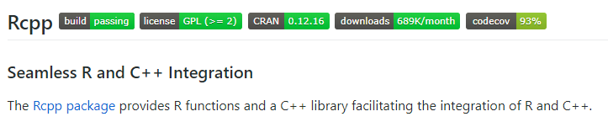
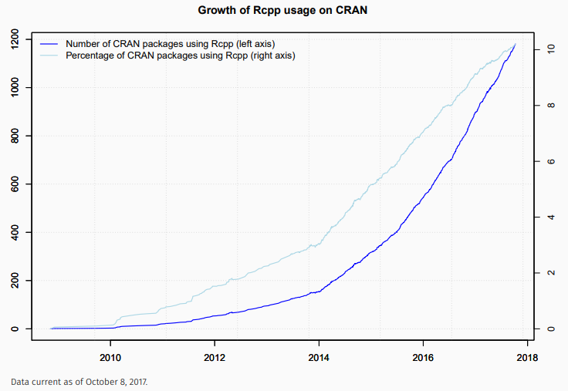

Slide 10
Agenda
R is an interface
R might be fast
Mapping R objects to C++ with Rcpp
(Interesting) Examples
Starting today…

Slide 11
Look before you leap…
Use R 3.4+
ALTREP
microbenchmark
Vectorize

Slide 12
Agenda
R is an interface
R might be fast
Mapping R objects to C++ with Rcpp
(Interesting) Examples
Starting today…

Slide 13
Start thinking about types

Slide 14
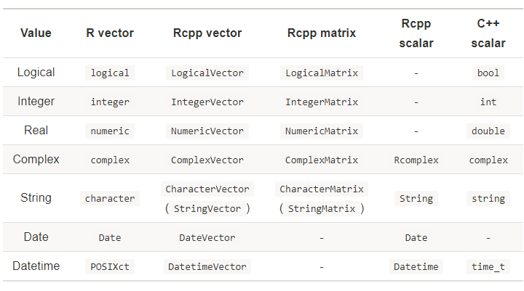
(Masaki, 2018)

Slide 15
Agenda
R is an interface
R might be fast
Mapping R objects to C++ with Rcpp
(Interesting) Examples
Starting today…

Slide 16
I promise… No pointers

Slide 17
Agenda
R is an interface
R might be fast
Mapping R objects to C++ with Rcpp
(Interesting) Examples
Starting today…

Slide 18
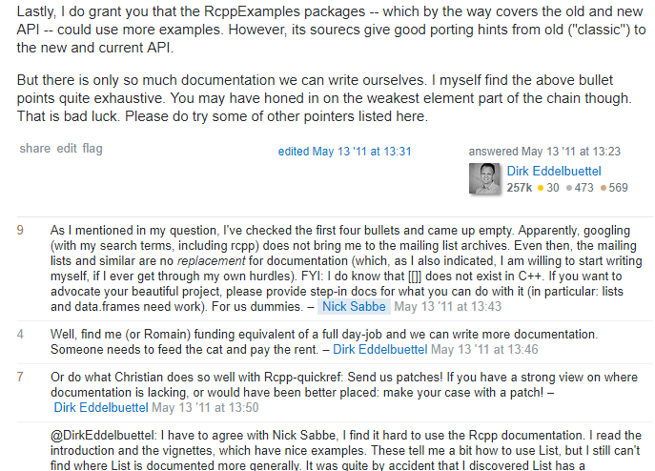
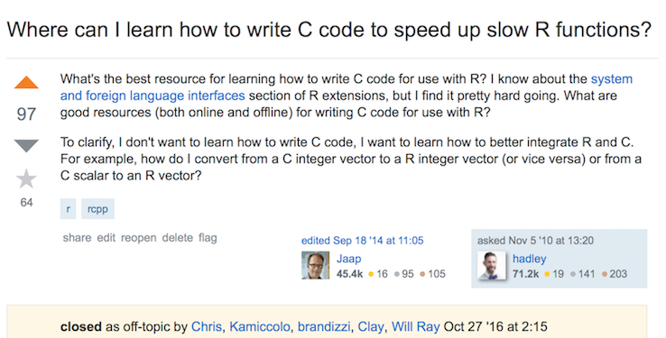
If you are starting out today…

Slide 19
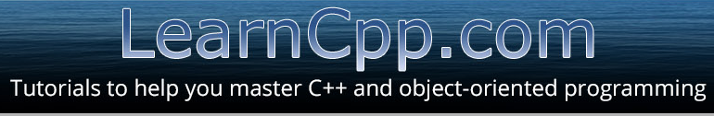
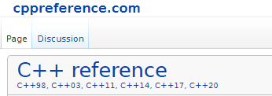
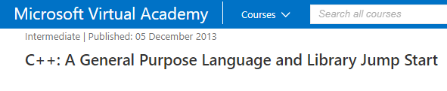
If you are starting out today…

Slide 20
Questions?

