Slide 1
R as an interface to C++: exchanging convenience for speed
<May, 2018>
https://github.com/pgurazada

Slide 2
Agenda
R is an interface
R might be fast
Mapping R objects to C++ with Rcpp
(Interesting?) Examples

Slide 3
This is a highly opinionated talk!

Slide 4
Agenda
R is an interface
R might be fast
Mapping R objects to C++ with Rcpp
(Interesting?) Examples

Slide 5
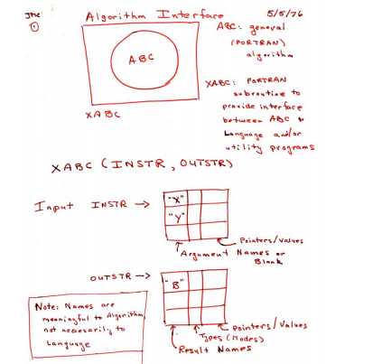
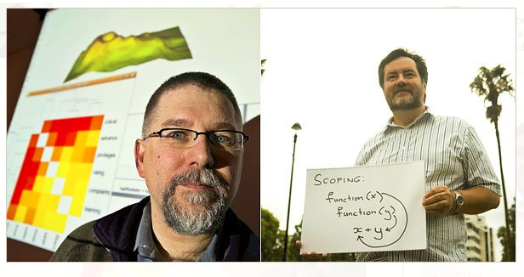
When S came before R…

Slide 6
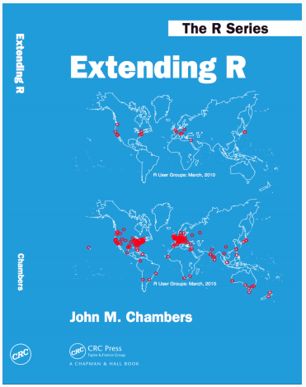
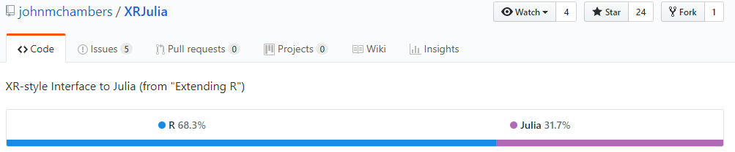
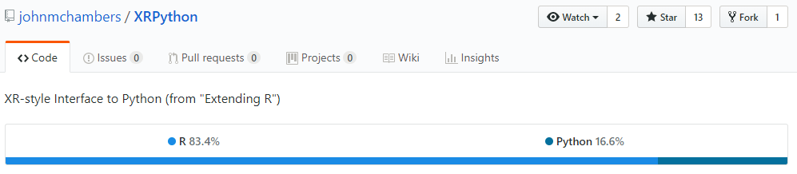

Slide 7
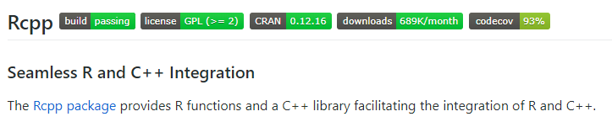
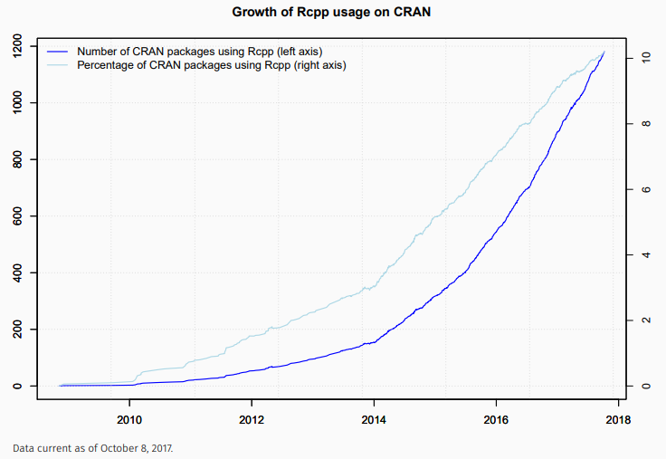

Slide 8
Agenda
R is an interface
R might be fast
Mapping R objects to C++ with Rcpp
(Interesting?) Examples

Slide 9
Look before you leap…
Use R 3.4+
microbenchmark
Vectorize

Slide 10
Agenda
R is an interface
R might be fast
Mapping R objects to C++ with Rcpp
(Interesting?) Examples

Slide 11
Start thinking about types

Slide 12
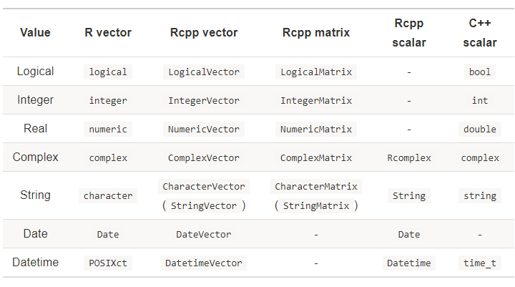
(Masaki, 2018)

Slide 13
Agenda
R is an interface
R might be fast
Mapping R objects to C++ with Rcpp
(Interesting?) Examples

Slide 14
I promise… No pointers

Slide 15
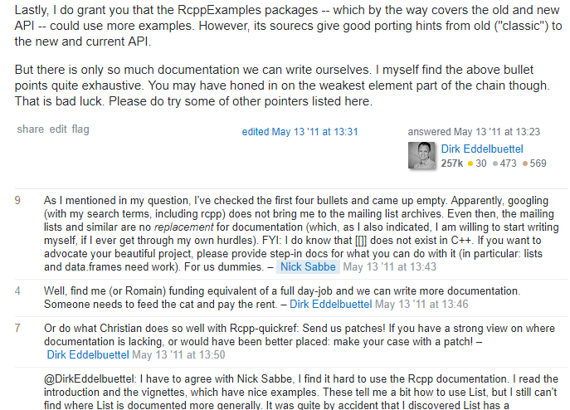
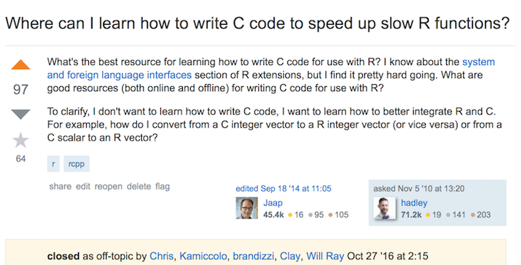
If you are starting out today…

Slide 16
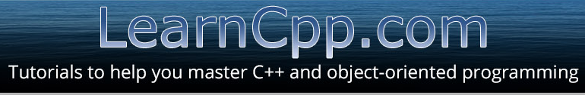
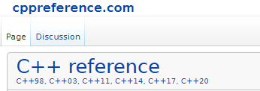
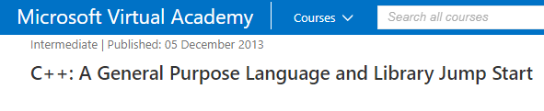
If you are starting out today…

Slide 17
Questions?

