Slide 1
Streamlining Student Maintenance Complaints: Building an Intuitive Application for Efficient Resolution and Progress Tracking
Presented by:
Sayannagari pavan kumar
Surabhi vinay rao
Gundla hrithik

Slide 2
Introduction:
Improving the management of maintenance-related issues within educational institutions is imperative for fostering a conducive learning environment.
Effective allocation of maintenance staff, feedback mechanisms, preventive maintenance, and ongoing training are vital components of a successful maintenance management system.

Slide 3
Existing system:
Typically, students and staff may report issues through various channels, such as verbal requests, emails, or paper forms, leading to a fragmented and disorganized process.
The reporting procedures may not be well-communicated or standardized.
In summary, the existing system tends to be disjointed, lacking in transparency, and inefficient in addressing maintenance concerns, causing confusion.

Slide 4
Existing system drawbacks:
Lack of Standardization.
Inefficient Prioritization.
Variable Response Times.
Budget Constraints.
Suboptimal Staff Allocation.

Slide 5
Proposed system:
The proposed system for addressing maintenance-related issues within educational institutions represents a comprehensive overhaul aimed at elevating the efficiency and transparency of the existing processes.
At its core is the establishment of a centralized reporting portal, accessible through web or mobile, empowering students to submit maintenance requests with ease.

Slide 6
Real-time tracking and transparency features provide requestors with instant updates on the status of their requests, enabling them to monitor progress and receive timely notifications upon resolution.
Prioritization will play a pivotal role, categorizing requests based on urgency to ensure that critical matters receive immediate attention.

Slide 7
Advantages:
Standardized Reporting Procedure.
Priority-Based Categorization.
Response Time Targets.
Optimized Staff Allocation.
Budget Allocation.

Slide 8
Technologies used:
HTML
CSS
Javascript

Slide 9
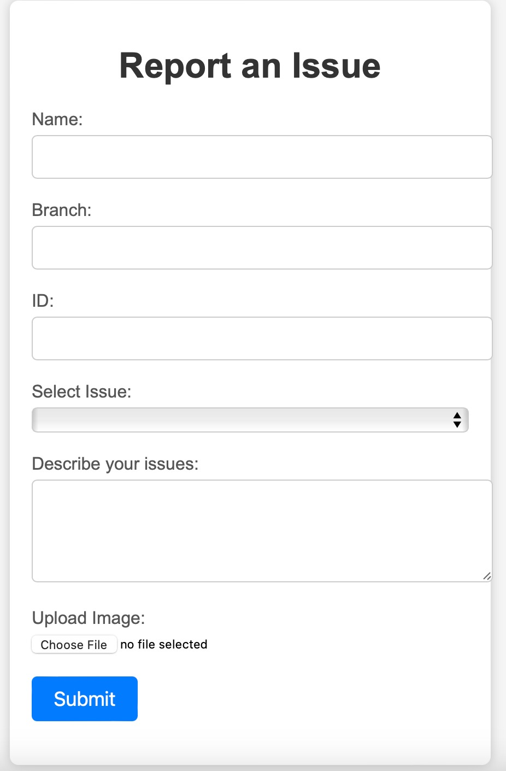
Out look:

Slide 10
Thank You

