Slide 1
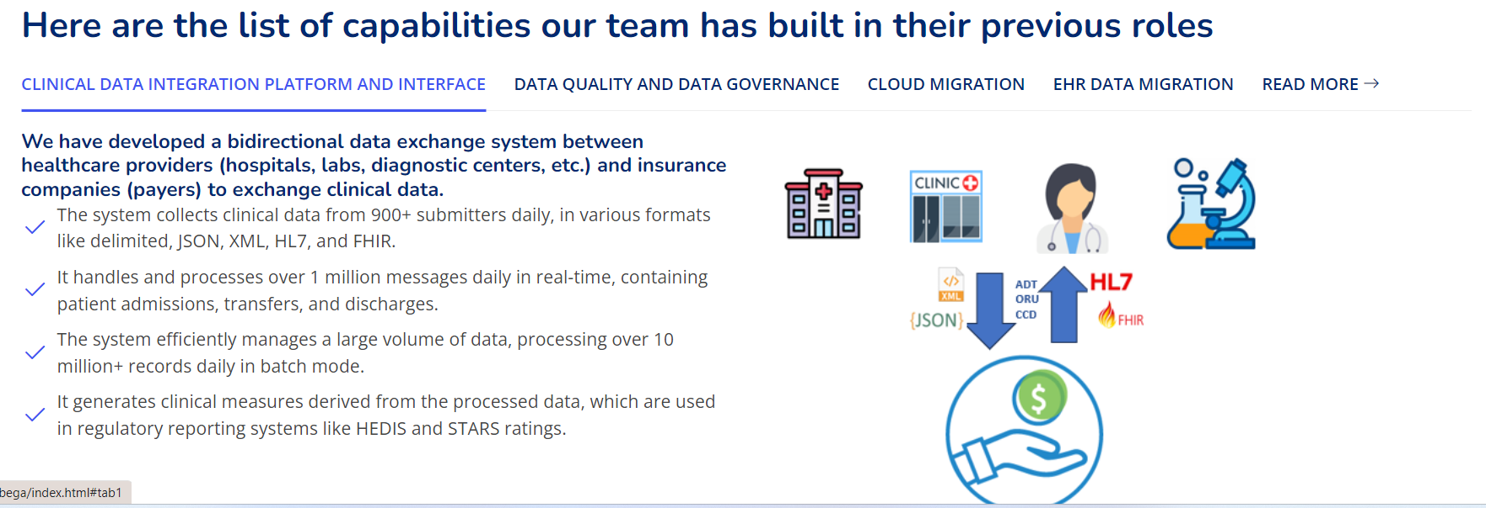
We have developed a bidirectional data exchange system between healthcare providers (hospitals, labs, diagnostic centers, etc.) and insurance companies (payers) to exchange clinical data.
The system collects clinical data from 900+ submitters daily, in various formats like delimited, JSON, XML, HL7, and FHIR.
It handles and processes over 1 million messages daily in real-time, containing patient admissions, transfers, and discharges.
The system efficiently manages a large volume of data, processing over 10 million+ records daily in batch mode.
It generates clinical measures derived from the processed data, which are used in regulatory reporting systems like HEDIS and STARS ratings.

Slide 2
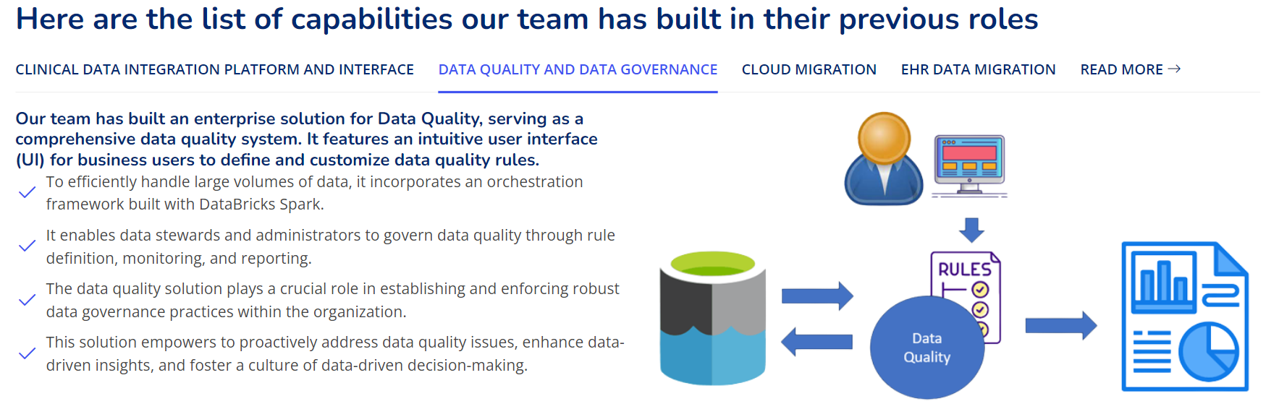
Our team has built an enterprise solution for Data Quality, serving as a comprehensive data quality system. It features an intuitive user interface (UI) for business users to define and customize data quality rules.
To efficiently handle large volumes of data, it incorporates an orchestration framework built with DataBricks Spark.
It enables data stewards and administrators to govern data quality through rule definition, monitoring, and reporting.
The data quality solution plays a crucial role in establishing and enforcing robust data governance practices within the organization.
This solution empowers to proactively address data quality issues, enhance data-driven insights, and foster a culture of data-driven decision-making.

Slide 3
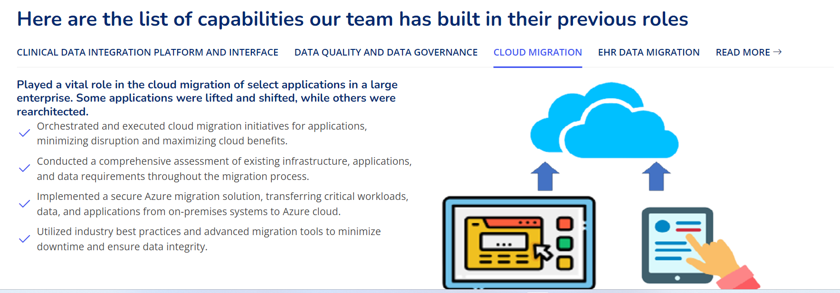
Played a vital role in the cloud migration of select applications in a large enterprise. Some applications were lifted and shifted, while others were rearchitected.
Orchestrated and executed cloud migration initiatives for applications, minimizing disruption and maximizing cloud benefits.
Conducted a comprehensive assessment of existing infrastructure, applications, and data requirements throughout the migration process.
Implemented a secure Azure migration solution, transferring critical workloads, data, and applications from on-premises systems to Azure cloud.
Utilized industry best practices and advanced migration tools to minimize downtime and ensure data integrity.

Slide 4
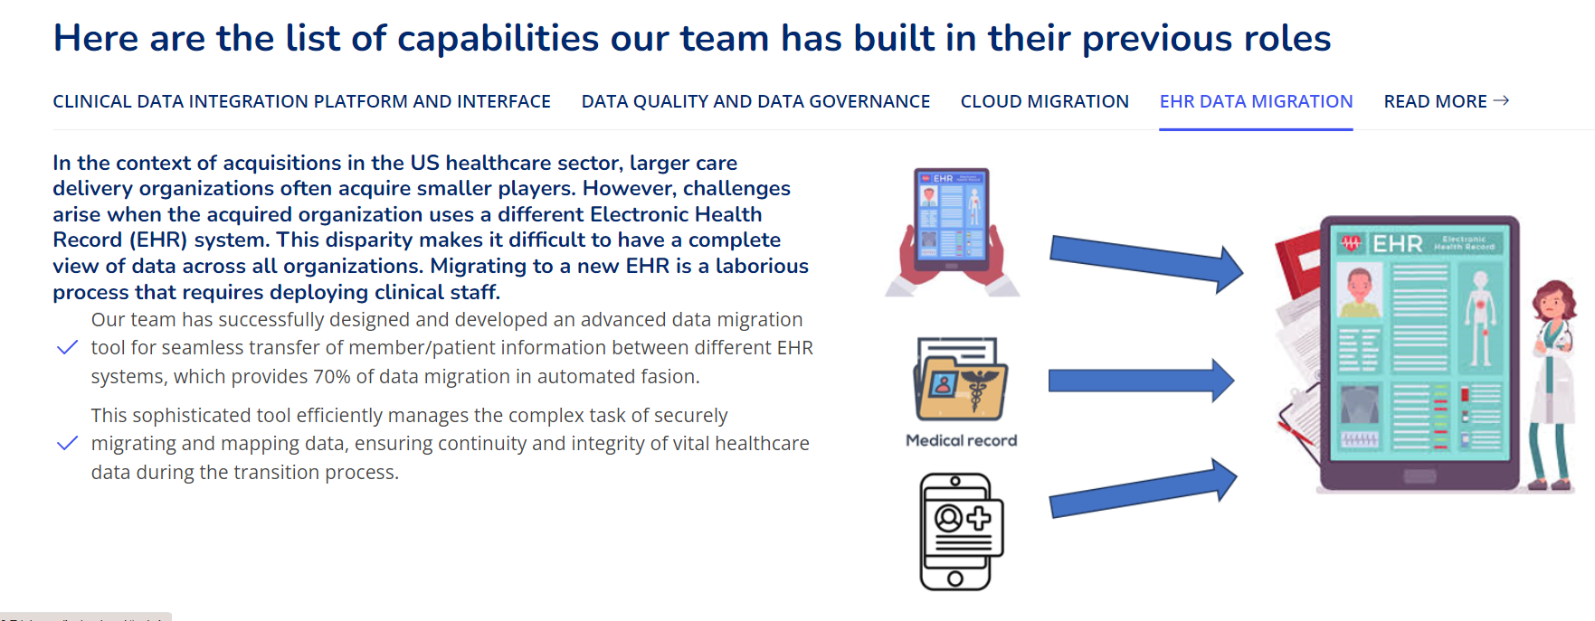
In the context of acquisitions in the US healthcare sector, larger care delivery organizations often acquire smaller players. However, challenges arise when the acquired organization uses a different Electronic Health Record (EHR) system. This disparity makes it difficult to have a complete view of data across all organizations. Migrating to a new EHR is a laborious process that requires deploying clinical staff.
Our team has successfully designed and developed an advanced data migration tool for seamless transfer of member/patient information between different EHR systems, which provides 70% of data migration in automated fasion.
This sophisticated tool efficiently manages the complex task of securely migrating and mapping data, ensuring continuity and integrity of vital healthcare data during the transition process.

Slide 5
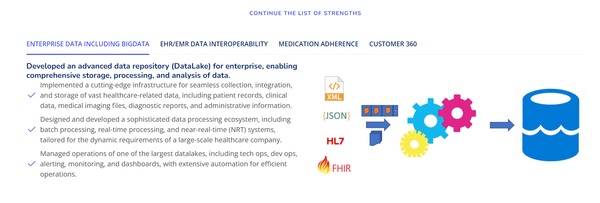
Developed an advanced data repository (DataLake) for enterprise, enabling comprehensive storage, processing, and analysis of data.
Implemented a cutting-edge infrastructure for seamless collection, integration, and storage of vast healthcare-related data, including patient records, clinical data, medical imaging files, diagnostic reports, and administrative information.
Designed and developed a sophisticated data processing ecosystem, including batch processing, real-time processing, and near-real-time (NRT) systems, tailored for the dynamic requirements of a large-scale healthcare company.
Managed operations of one of the largest datalakes, including tech ops, dev ops, alerting, monitoring, and dashboards, with extensive automation for efficient operations.

Slide 6
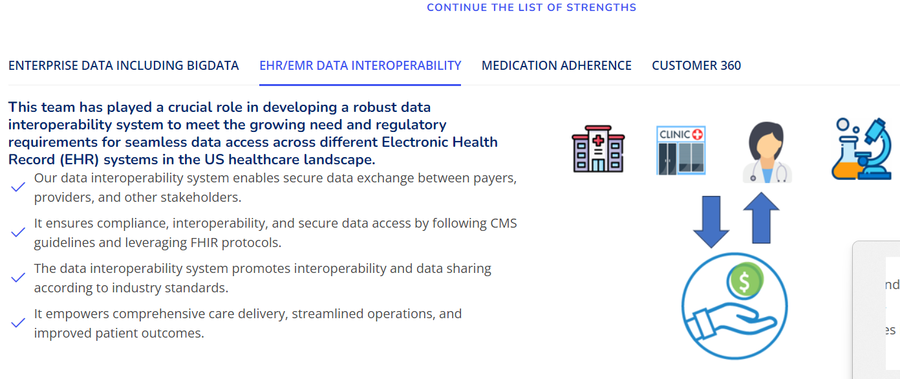
This team has played a crucial role in developing a robust data interoperability system to meet the growing need and regulatory requirements for seamless data access across different Electronic Health Record (EHR) systems in the US healthcare landscape.
Our data interoperability system enables secure data exchange between payers, providers, and other stakeholders.
It ensures compliance, interoperability, and secure data access by following CMS guidelines and leveraging FHIR protocols.
The data interoperability system promotes interoperability and data sharing according to industry standards.
It empowers comprehensive care delivery, streamlined operations, and improved patient outcom

Slide 7
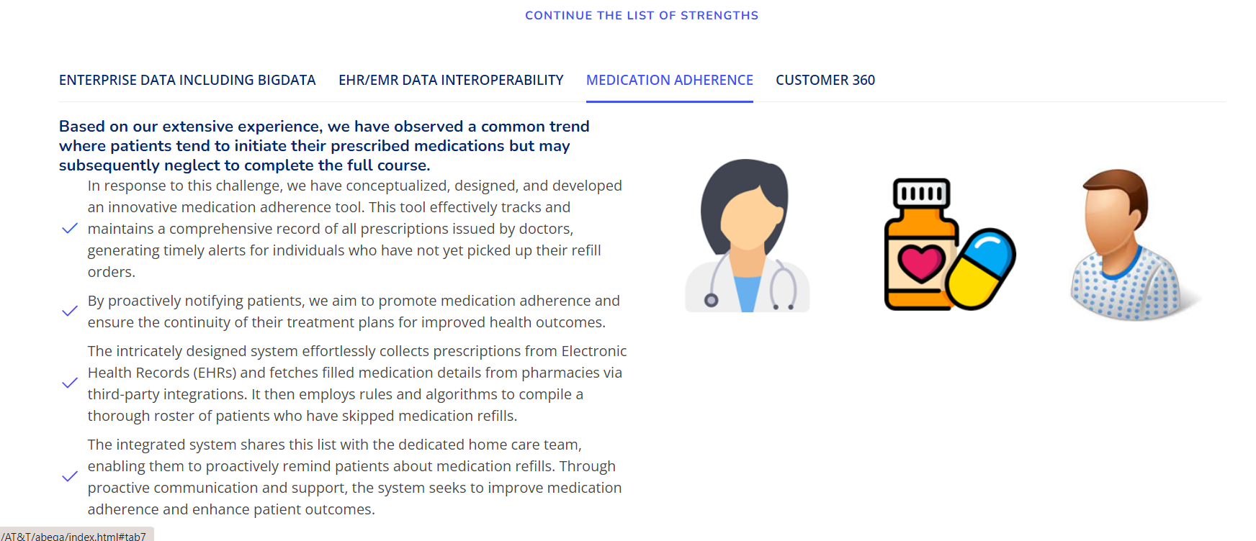
Based on our extensive experience, we have observed a common trend where patients tend to initiate their prescribed medications but may subsequently neglect to complete the full course.
In response to this challenge, we have conceptualized, designed, and developed an innovative medication adherence tool. This tool effectively tracks and maintains a comprehensive record of all prescriptions issued by doctors, generating timely alerts for individuals who have not yet picked up their refill orders.
By proactively notifying patients, we aim to promote medication adherence and ensure the continuity of their treatment plans for improved health outcomes.
The intricately designed system effortlessly collects prescriptions from Electronic Health Records (EHRs) and fetches filled medication details from pharmacies via third-party integrations. It then employs rules and algorithms to compile a thorough roster of patients who have skipped medication refills.
The integrated system shares this list with the dedicated home care team, enabling them to proactively remind patients about medication refills. Through proactive communication and support, the system seeks to improve medication adherence and enhance patient outcomes.

Slide 8
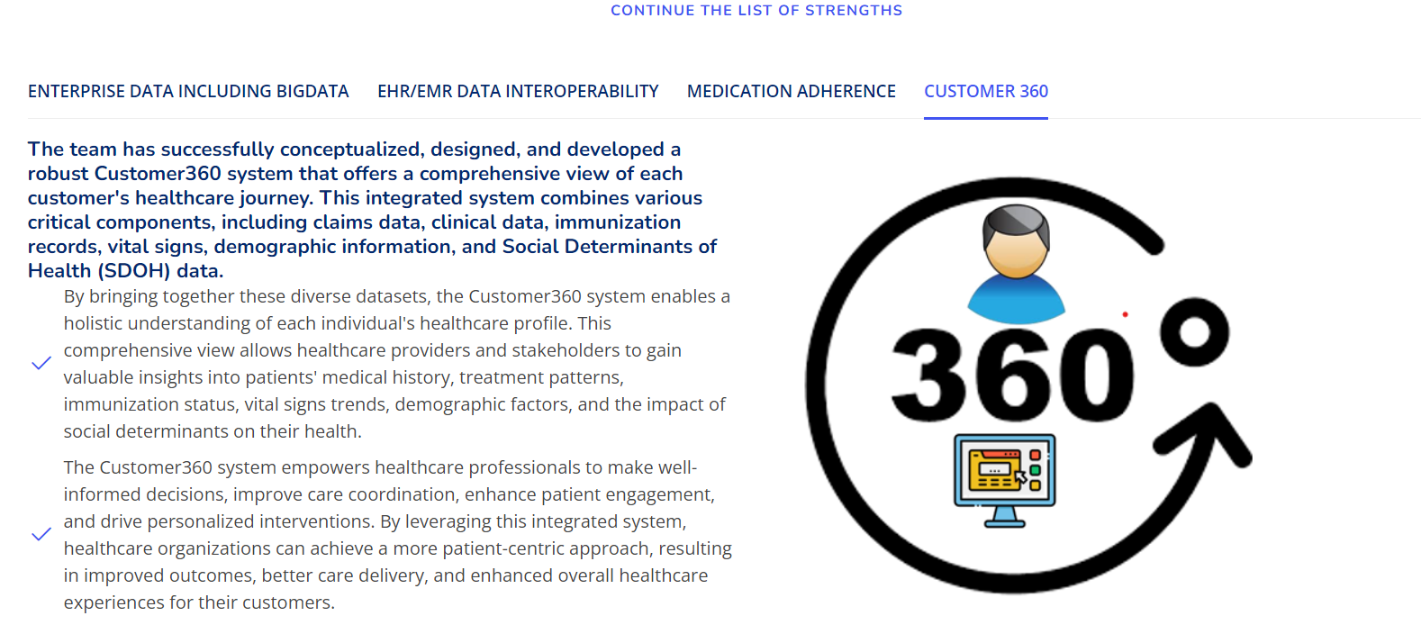
The team has successfully conceptualized, designed, and developed a robust Customer360 system that offers a comprehensive view of each customer's healthcare journey. This integrated system combines various critical components, including claims data, clinical data, immunization records, vital signs, demographic information, and Social Determinants of Health (SDOH) data.
By bringing together these diverse datasets, the Customer360 system enables a holistic understanding of each individual's healthcare profile. This comprehensive view allows healthcare providers and stakeholders to gain valuable insights into patients' medical history, treatment patterns, immunization status, vital signs trends, demographic factors, and the impact of social determinants on their health.
The Customer360 system empowers healthcare professionals to make well-informed decisions, improve care coordination, enhance patient engagement, and drive personalized interventions. By leveraging this integrated system, healthcare organizations can achieve a more patient-centric approach, resulting in improved outcomes, better care delivery, and enhanced overall healthcare experiences for their customers.

