Slide 1
ASP.NET Core
- Pavan Aghera

Slide 2
Introduction
First ASP.NET Core 1.0 was launched in 17th May 2016 then, v 1.1 and then v2.0 was released in 14th August 2017 which is last release.
ASP.NET Core is a cross-platform, high-performance, open-source framework for building modern, cloud-based, Internet-connected applications.
With ASP.NET Core we can build web apps and services , IoT apps. It can be develop on any platform like Windows , Linux or macOS.
Apps build with ASP.NET Core can be deploy on cloud or on-premises.
ASP.NET Core is more modular framework as compared to ASP.NET 4.X
ASP.NET Core Apps can target .NET Core or .NET Framework. ASP.NET Core apps targeting .NET Framework aren't cross-platform—they run on Windows only. While Apps targeting .Net Core Framework is cross – platform it can be run on any platform.

Slide 3
Benefits
A unified story for building web UI and web APIs.
Integration of modern, client-side frameworks like Angular , React JS, Redux JS
and development workflows.
A cloud-ready, environment-based configuration system.
Built-in dependency injection.
A lightweight, high-performance, and modular HTTP request pipeline.
Ability to host on IIS, Nginx, Apache, Docker, or self-host in your own process.
Side-by-side app versioning when targeting .NET Core.
Tooling that simplifies modern web development.
Ability to build and run on Windows, macOS, and Linux.
Open-source and community-focused.
Reference :
http://www.mithunvp.com/difference-between-asp-net-mvc6-asp-net-mvc5/

Slide 4
Build web APIs and web UI
ASP.NET Core MVC provides features to build web APIs and web apps:
The Model-View-Controller (MVC) pattern helps make your web APIs and web apps testable.
Razor Pages (new in ASP.NET Core 2.0) is a page-based programming model that makes building web UI easier and more productive.
Razor markup provides a productive syntax for Razor Pages and MVC views.
Tag Helpers enable server-side code to participate in creating and rendering HTML elements in Razor files.
Built-in support for multiple data formats and content negotiation lets your web APIs reach a broad range of clients, including browsers and mobile devices.
Model binding automatically maps data from HTTP requests to action method parameters.
Model validation automatically performs client- and server-side validation.

Slide 5
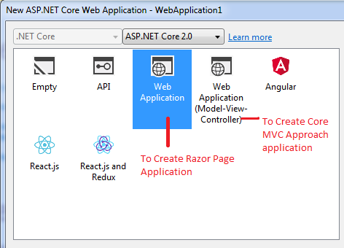
Add New Project
To Create New Project : File - > Add -> New Project -> Select .Net Core from left pane

Slide 6
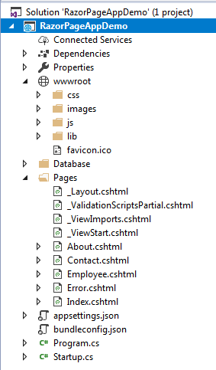
Introduction to Razor Pages in ASP.NET Core
Razor Pages is a new feature of ASP.NET Core 2.0 that makes coding page-focused scenarios easier and more productive.
Application Structure :

Slide 7
wwwroot :
By default, the wwwroot folder in the ASP.NET Core project is treated as a web root folder. Static files can be stored in any folder under the web root and accessed with a relative path to that root.
In the standard ASP.NET application, static files can be served from the root folder of an application or any other folder under it. This has been changed in ASP.NET Core. Now, only those files that are in the web root - wwwroot folder can be served over an http request. All other files are blocked and cannot be served by default.
You can access static files with base URL and file name. For example, we can access above site.css file in the css folder by http://HOSTNAME/css/site.css.
Reference : http://www.tutorialsteacher.com/core/aspnet-core-static-file
Program.cs :
In ASP.NET Core app starts executing from Main method of this class which will create a host for this application and uses a Startup class.
Reference: http://www.tutorialsteacher.com/core/aspnet-core-program
Startup.cs :
ASP.NET Core application must include Startup class. It is like Global.asax in the traditional .NET application. As the name suggests, it is executed first when the application starts.
Reference : http://www.tutorialsteacher.com/core/aspnet-core-startup

Slide 8
"Why Razor Page instead of MVC?". To answer this question in one line, we can say "When focusing on UI or giving priority to UI rather than complex structure or data logic, we can go with Razor Page rather than MVC".
Razor Page is much like MVC and has most of the features of MVC, however, unlike MVC focusing on the controller, it focuses on UI implementation.
But Razor Page is only for small applications where you have to mainly focus on View. If you make any changes, then you have to manipulate your Razor Page [.cshtml]. Server-side logic can be written on the Razor Page as well. If you want to make a separate file to your logic, then you can create code-behind file which inherits PageModel.
Reference :
https://www.c-sharpcorner.com/article/getting-started-with-razor-pages-in-asp-net-core-2-0/
https://docs.microsoft.com/en-us/aspnet/core/mvc/razor-pages/?tabs=visual-studio
https://github.com/pavanaghera/aspnetcore/blob/master/RazorPagesDemo.rar

Slide 9
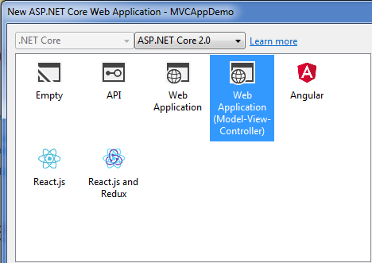
Introduction to ASP.NET Core MVC
ASP.NET Core MVC web development with controllers and views.

Slide 10
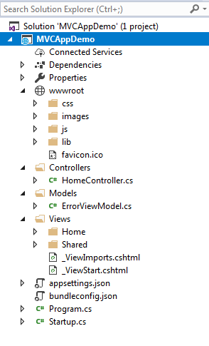
Application Structure :
It Contains Models , Views, and Controller folders instead of Pages folder, appsettings.json file is for application configuration related same like web.config file.

