Slide 1

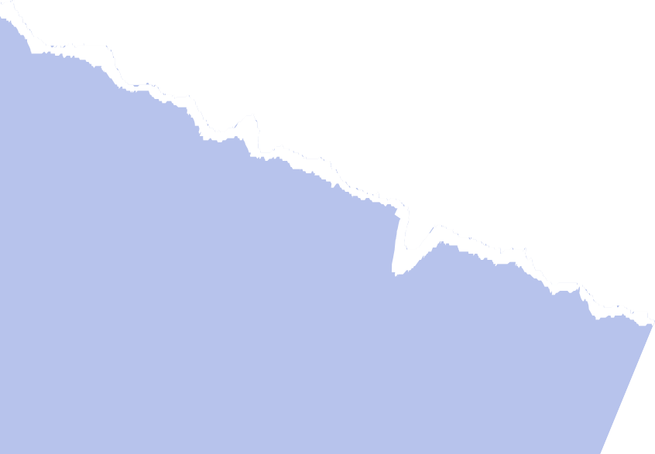
Enhancing User Experience: Developing a GUI Calculator with Tkinter Library

Slide 2


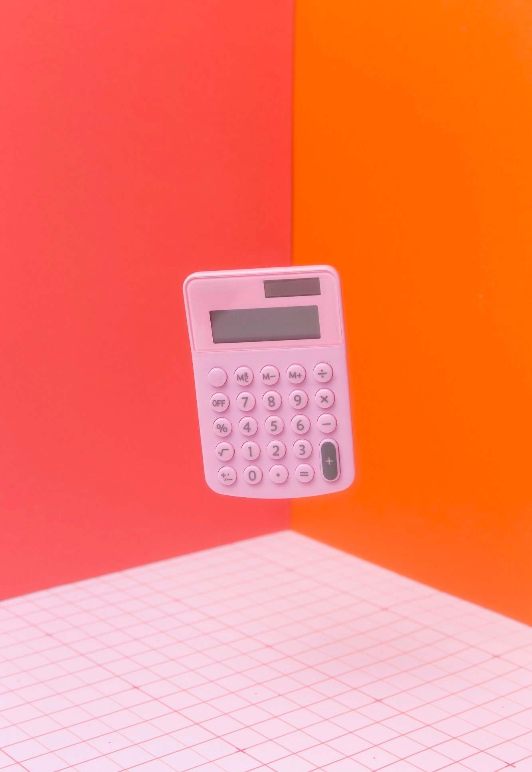

Introduction
Creating a Graphical User Interface by using the Tkinter library in python .By using this caluclator we can perform additions, subtractions, Multiplications, divisions. It is friendly GUI interface where we can play with the calculations.

Slide 3


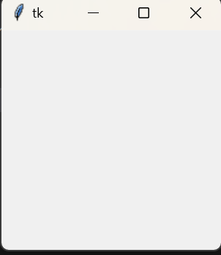

STEPS FOR CREATING GUI CALUCLATOR
STEP 1 :
import Tkinter library & from that import all modules as (*) .
STEP 2:
Create a widget for the calculator & display the window by using mainloop function
clc = tk.TK() clc.mainloop()

Slide 4

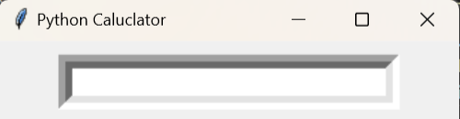

STEP 3
Creating the entry widget for taking the input and
displaying the output. display=Entry(clc, width="value") display.grid(row=0, column=0)
Grid function is used for for arranging the buttons in speciﬁed position
Width is used to increase the length of the entry box.

Slide 5
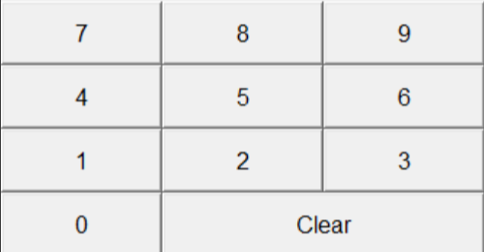
STEP 4
Creating the buttons From 0 to 9 , for that we have
the use the Button function
Numbers=Button(clc,text="number")
Numbers.grid(row=0,column=0)
Grid function is used for for arranging the buttons in speciﬁed position

Slide 6
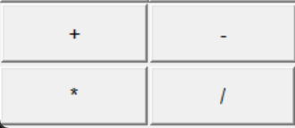
STEP-5
Creating buttons for performing Mathematical operations :
To perform mathematical operators like "
+, - , * , / ". To perform this operators ﬁrst we have to create button and then deﬁne
a function and add this function to the button by using command key.
ope=Button(clc,text="value", command=lamba : function call)
ope.grid(row=3,column=3)

Slide 7
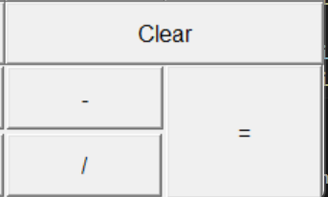
STEP 6
Creating EqualTo(=) & Clear Buttons:
For creating eualto and clear buttons ﬁrst we have ti create normal buttons by using Button function after that we have to deﬁne seperate functions for equalto and clear buttons we have to add the functions to their respective buttons.
ass=Button(clc,text="value", command=
"function call")
ass.grid(row=4,column=2)

Slide 8
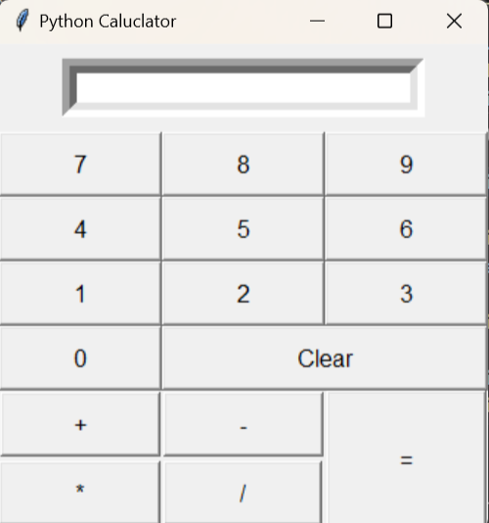
By Combaning all the above steps we can create the GUI caluclator

Slide 9

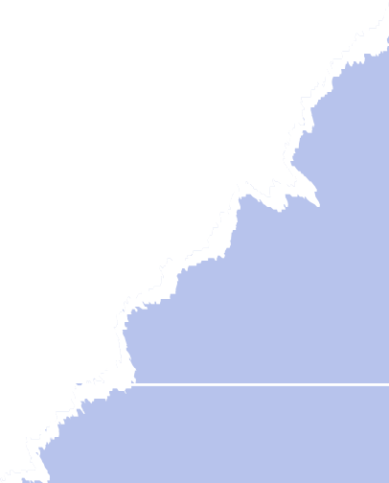
Thanks!

