Slide 1

Job Market Analysis and Recommendation System By Pavan Kumar

Slide 2
INDEX 1. Objective 2. Importing Dataset 3. Handling Missing Values.. 4. Job Opportunities Detailing. 5. Feature Engineering. 6. Correlation. 7. Prediction.

Slide 3
Objective The job market is dynamic and influenced by various factors including technological advancements, economic shifts, and cultural trends. This project aims to harness the power of data analytics to understand these dynamics and provide actionable insights through a recommendation system. By analyzing historical and current job postings data, the project will provide predictions and recommendations that help job seekers and recruiters make informed decisions.

Slide 4
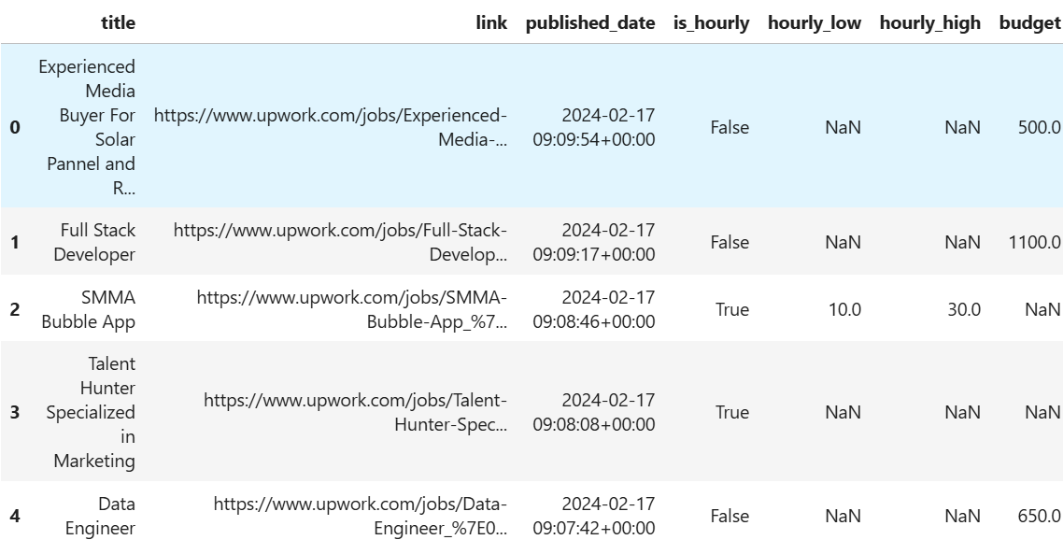
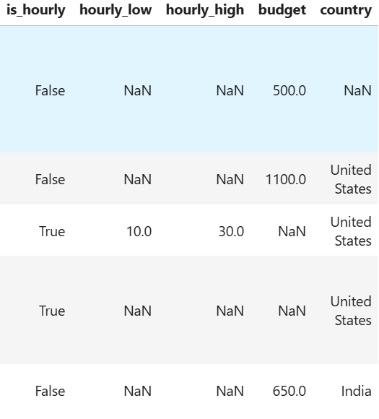
Importing Data Set: 1) Importing the Data Set: a) In This we have Three Dataset Training, Test , Store Dataset as shown as above. import pandas as pd d1=pd.read_csv(r"E:\DIGI chrome\Data sets\Job_Market_Data.csv")

Slide 5
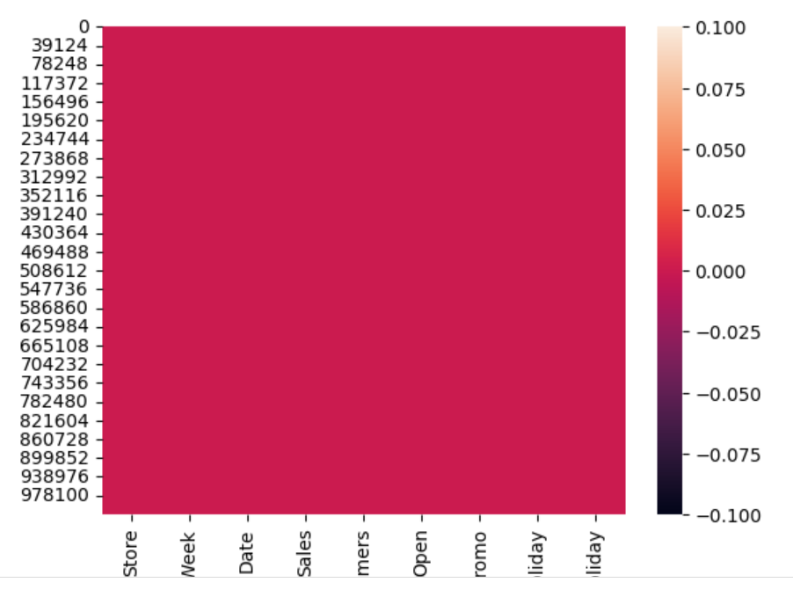
Handling Missing Values 1) Handling Missing Values : We have checked any missing values are present but there is no missing values. Import seaborn as sns sns.heatmap(d1.isnull()) 2) Duplicated data: And also we have checked any duplicates are there but there are no duplicates. d1.duplicated().any()

Slide 6
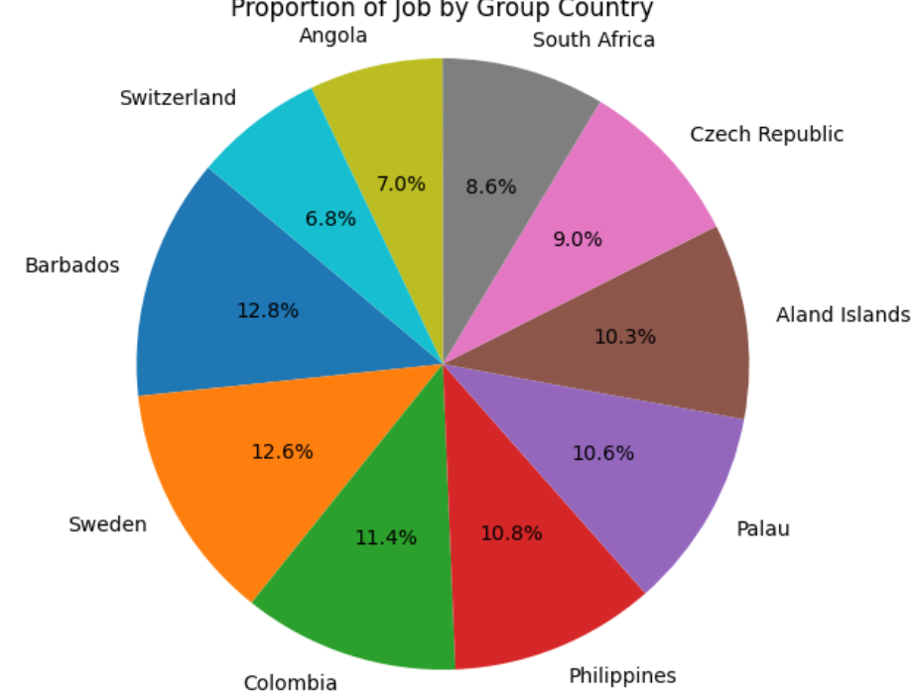
Job Distribution In this diagram it tells about which country has more job opportunities , by seeing the diagram we can clearly say that Barbados has more job opportunities than other countries.

Slide 7
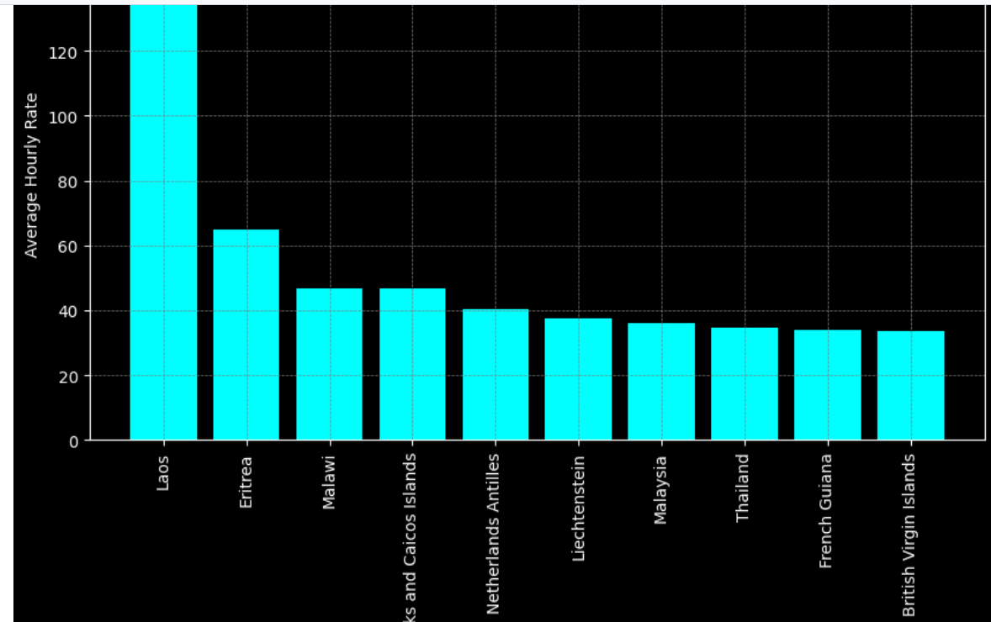
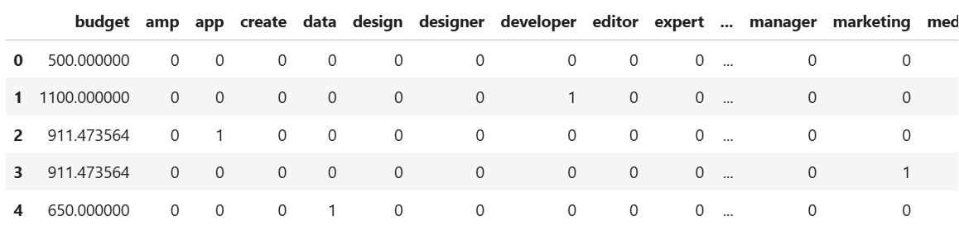
Analysis: If you see above two diagrams : 1) In first diagram we have created new column named average _hourly working rate. 2) In the second diagram we have calculated most frequently repeated words.

Slide 8
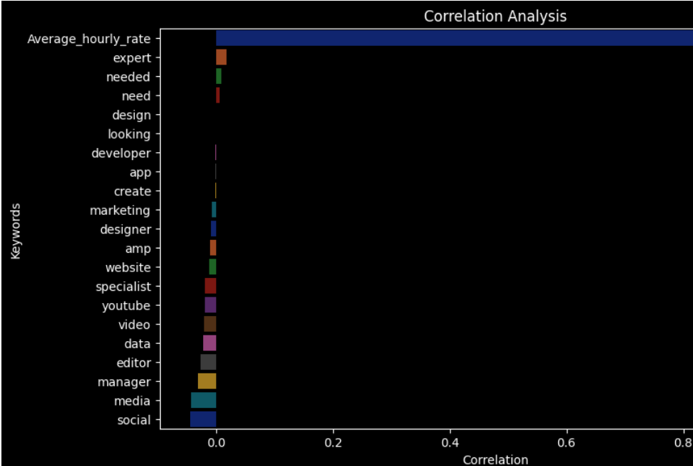
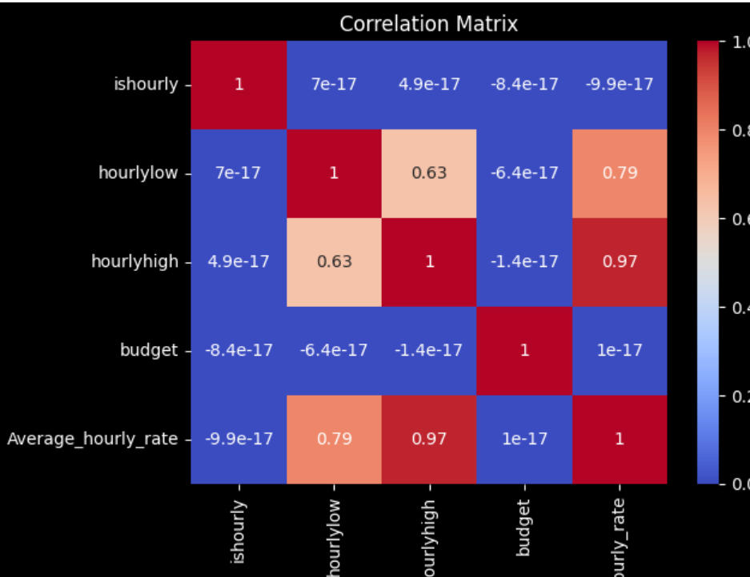
Analysis: The above two diagrams tells about the correlation between them: 1) In the first diagram it cleary tells that Average_hour _ working rate has higher correlation then all other columns.

Slide 9
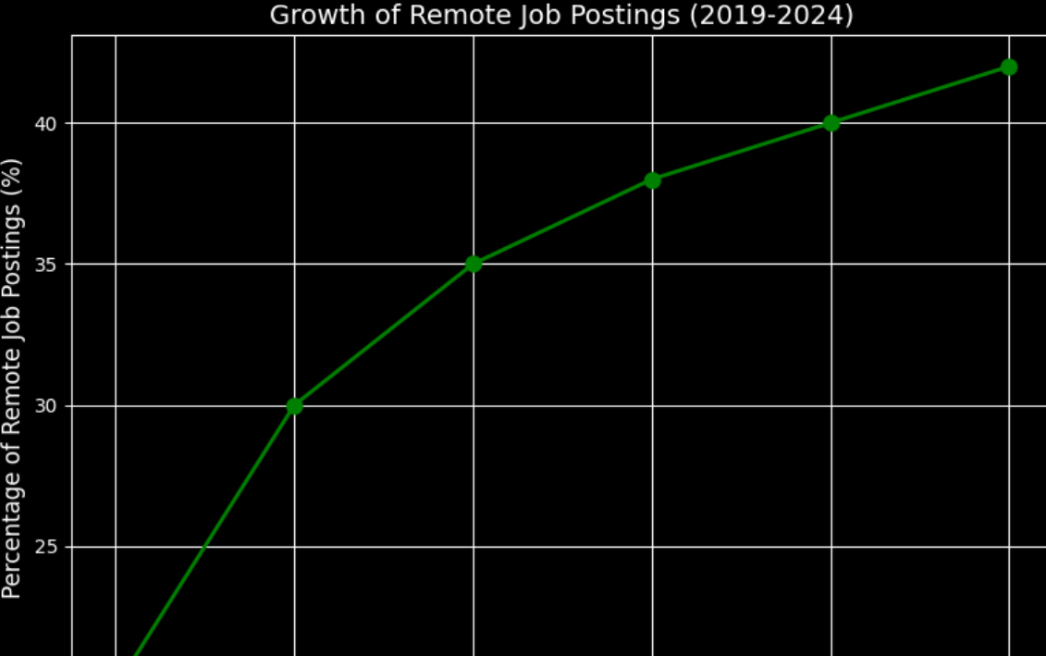
Analysis: The above diagram tells that the remote jobs has been increasing every year.

Slide 10
Thank You!

