Slide 1
Movie Recommendation System based on User Preferences
Batch No. A8

Slide 2
Abstract
A Recommendation System is a filtering program whose primary goal is to predict the “rating” or “preference” of a user towards a domain-specific element.
In our project, this domain-specific element is a movie. Hence the main focus of our recommendation system is to provide a total of ten movie recommendations to users who searched for a movie that they like.
These results are based on similar traits/demographics of the movie that has been searched. Content based filtering is a technique that is used to recommend movies.
Apart from providing recommendations the system also provides posters of the Movies along with Release Date, Budget, Revenue, Popularity, Similarity between selected Movie and an Overview as well.
The System uses the concept of vectorization based on common features and uses Cosine Similarity with respect to each other vectors to determine the most similar movies.

Slide 3
Chapter 1

Slide 4
1.1 Introduction
A recommendation system is a type of suggesting system which makes suggestions based on the user’s liking. These systems can be applied to various data. These systems can retrieve, and filter data based on user's preferences to give suggestions or recommendations in the upcoming period.
To watch a movie the first step is to select a movie that matches the user’s liking. Users often waste a lot of time selecting a movie to watch. Here comes the need for a recommendation system. It can recommend popular movies based on their rating, but what makes the system useful is its ability to recommend movies based on users’ liking and preferences. The purpose of this system is to search for content that would be interesting to an individual.

Slide 5
Since the number of users and the movies are increasing day by day, computing the recommended movies list in a single node machine takes a very large time. When we deal with huge volumes of data coming from various sources and in a variety of formats as we see in the case of movies where there is a huge amount of data to be computed and then recommended to a user, it involves many aspects that must be taken into consideration while recommending movies to the user.
Our recommending system uses cosine similarity which is a type of content-based filtering method to recommend similar movies to the user. Additional information about the searched movie will also be provided. The additional information includes a Movie Poster, an Overview of the movie, a Rating of the movie, Genres, the Run time of the movie, and its status which can either be released or unreleased.
This system will also provide the user with sentiment analysis on the reviews of the movie

Slide 6
1.2 Objective
The two major categories of recommender approaches are collaborative and content-based filters. Content-based filtering makes use of a set of definite and distinctive features of an item to recommend added items with identical characteristics, whereas, collaborative filtering denotes creating systems from client’s previous action, following that the system is implemented to predict results that the client may possibly be attracted to. Content-based movie recommender systems doesn’t respond for a new user who has not rated any movie so far, as plenteous ratings are necessary for content-based recommender to assess the user likings and give fair suggestions. Since the feature characterization of the items are designed to a limited extent, this system demands plenty of field learning. As a result, the content-based system could only be close to the designed feature. Collaborative filtering is a methodology that can categorize out movies that a user may enjoy based on ratings by alike users.

Slide 7
1.3 EXISTING SYSTEM
Recommender systems are information altering tools that aspire to predict the rating for users and items, predominantly from big data to recommend their likes. Movie recommendation systems provide a mechanism to assist users in classifying users with similar interests. This makes recommender systems essentially a central part of websites and e-commerce applications.
This article focuses on the movie recommendation systems whose primary objective is to suggest a recommender system through data clustering and computational intelligence. In this research article, a novel recommender system has been discussed which makes use of k-means clustering by adopting cuckoo search optimization algorithm applied on the Movie lens dataset

Slide 8
1.3.1 Existing System Disadvantages
The slow rate of convergence
It has trouble clustering data where clusters are of varying sizes and density
Centroids can be dragged by outliers, or outliers might get their own cluster instead of being ignored. Consider removing or clipping outliers before clustering.

Slide 9
1.3.2 Literature Survey
S.No. | Title | Author(s) | Year | Inference
1. | A Comprehensive Survey on Movie Recommendation Systems | R. Lavanya, Utkarsh Singh, Vibhor Tyagi | 2021 | The Paper gives a walkthrough of the various techniques used in Recommendation Systems & Why Certain Aspects are to be considered for each use case. Explicitly pointing out on the issue of why Movie Recommendation Systems Failures.
2. | Career Recommendation Systems using Content based Filtering | Tanya V Yadalam, Vaishnavi M Gowda, Vanditha Shiva Kumar, Disha Girish | 2020 | Why Content based recommendation system isn’t really a bad idea for mapping of several instances for comparison.
3. | Recommendation of Indian Cuisine Recipes based on Ingredients | Nilesh Nilesh, Madhu Kumari, Pritom Hazarika, Vishal Raman | 2019 | Considering several ingredients for cooking a dish. We could consider several genres and keywords for mapping the recipe. In a Movie Recommendation System, we can go with Genres or Keywords for Ingredients for cooking up the best title.

Slide 10
S.No. | Title | Author(s) | Year | Inference
4. | The Cosine Similarity Technique for Removing the Redundancy Sample | Worasak Rueangsirarak, Teeravisit Laohapensaeng, Suppakarn Chansareewittay, Anusorn Yodjaiphet | 2019 | Cosine Similarity is an uncanny algorithm when it comes to handling large datasets. Especially such a huge collection of our Data. That most other algorithms fail to workaround with. Making it a very good choice when it comes to big data.
5. | Recommendation system for property search using content based filtering method | Tessy Badriyah, Sefryan Azvy, Wiratmoko Yuwono, Iwan Syarif | 2018 | Recommendation systems using content-based filtering can be incorporated with the user’s recent activity and analyzing user’s activity and providing recommendations based on characteristic properties of content user has surfed through and vectorizing similar features thereby providing the recommendation on those grounds.

Slide 11
Title: A Comprehensive Survey on Movie Recommendation Systems
Author: R. Lavanya, Utkarsh Singh, Vibhor Tyagi
2021
Description:
Internet technology has occupied an important part of human lives. Users often face the problem of the available excessive information. Recommendation system (RS) are deployed to help users cope up with the information explosion. RS is mostly used in digital entertainment, such as Netflix, prime video, and IMDB, and e-commerce portals such as Amazon, Flipkart, and eBay. The two traditional methods namely, collaborative filtering (CF) and content-based approaches consist of few limitations individually. Some fundamental issues faced by movie recommendation systems such as scalability, cold start problem, data sparsity and practical usage feedback and verification based on real implementation are still neglected. Other issues that require significant research attention are accuracy and time complexity problem, which could make RS, a bad candidate for real-world recommendation systems. This literature survey aims to consolidate and structurally categorize all the major drawbacks present in the most common and popular commercial movie recommendation systems.

Slide 12
Title: Career Recommendation Systems using Content based Filtering
Author: Tanya V Yadalam, Vaishnavi M Gowda, Vanditha Shiva Kumar, Disha Girish
2020
Description:
Presently recommendation frameworks are utilized to take care of the issue of the overwhelming amount of information in every domain and enables the clients to concentrate on information that is significant to their area of interest. One domain where such recommender systems can play a significant role to help college graduates to fulfil their dreams by recommending a job based on their interest and skillset. Currently, there are a plethora of websites which provide heaps of information regarding employment opportunities, but this task is extremely tedious for students as they need to go through large amounts of information to find the ideal job. Simultaneously, existing job recommendation systems only take into consideration the domain in which the user is interested while ignoring their profile and skillset.

Slide 13
Title: Recommendation of Indian Cuisine Recipes based on Ingredients
Author: Nilesh Nilesh, Madhu Kumari, Pritom Hazarika, Vishal Raman
2019
Description:
There are lots of varieties of Indian cuisine available with same ingredients. In India, Traditional cuisines consist of wide varieties due to locally available spices, herbs, vegetables, and fruits. In this paper, we purposed a method that recommends recipes of Indian cuisine on the basis of available ingredients and liked cuisine. For this work, we did web scraping to make a collection of recipes' varieties and after that apply the content-based approach of machine learning to recommend the recipes. This system gives the recommendation of Indian Cuisines based on ingredients.

Slide 14
Title: The Cosine Similarity Technique for Removing the Redundancy Sample
Author: Worasak Rueangsirarak, Teeravisit Laohapensaeng, Suppakarn Chansareewittay, Anusorn Yodjaiphet
2019
Description:
The k-nearest neighbor algorithm is one of the basic and simple classification algorithms that share a common limitation of the algorithm which requires more computation cost when the size of training data is enlarged. To solve this problem, a new method applied to the cosine similarity for reducing the size of the training data set is proposed. This method reduces the data points that close to a decision boundary and retains the important points which affect classification accuracy. For the data far from the decision boundary and not affect the classification, these points will be removed from the training data set. The proposed method is evaluated its accuracy and reduction performance on the state of the art mechanisms, categorized as prototype selection algorithms. The 20 real-world data set are used to evaluate the proposed method.

Slide 15
Title: Recommendation system for property search using content based filtering method
Author: Tessy Badriyah, Sefryan Azvy, Wiratmoko Yuwono, Iwan Syarif
2018
Description:
Development of technology causes many business industries to migrate from offline business systems to the e-commerce world. One of the most popular e-commerce frequented by potential buyers is the property site. Considering that the property is one of the essential requirements for living, and furthermore it is also one of the most prized assets one can have. In this research, we develop a web-based recommendation system in choosing a property using content-based filtering method. The recommendation system provides property information based on user behavior by searching advertising content previously searched by the user. Each time the user selects the contents of the ad to display, this information will be stored into the database to be processed further in order to provide a recommendation.

Slide 16
1.4 Proposed System
The main purpose to develop a movies recommendation system is to provide users with recommendations that are not based on popularity or purely rating but based on the movies that the user likes. This will lead to a highly personalized recommendation, which will increase the accuracy of the recommendation system.
The sentiment analysis and the additional information of the searched movie will help the user make an informed decision while selecting a movie. The user won’t have to surf the internet for finding a movie that he/she likes as all the information needed will be provided on a single platform. The user won’t have to rely on friends for a movie suggestion as the recommendation system will provide the user with the top ten movies that are most like the searched movie.

Slide 17
1.4.1 Proposed System Advantages
The cosine similarity is beneficial because even if the two similar data objects are far apart by the Euclidean distance because of the size, they could still have a smaller angle between them. Smaller the angle, higher the similarity.
When plotted on a multi-dimensional space, the cosine similarity captures the orientation (the angle) of the data objects and not the magnitude.
With cosine Cosine Similarity not being affected by Sparse Data it becomes a great tool for comparison between objects.
It is fairly quicker and stable

Slide 18
Chapter 2
Project Description

Slide 19
2.1 General
The main purpose to develop a movies recommendation system is to provide users with recommendations that are not based on popularity or purely rating but based on the movies that the user likes. This will lead to a highly personalized recommendation, which will increase the accuracy of the recommendation system. The additional information of the searched movie will help the user make an informed decision while selecting a movie. The user won’t have to surf the internet for finding a movie that he/she likes as all the information needed will be provided on a single platform. The user won’t have to rely on friends for a movie suggestion as the recommendation system will provide the user with the Top 10 movies that are most like the searched movie.

Slide 20
2.2 METHODOLOGIES
MODULES NAME:
The Implementation mainly consists of six steps. They are as follows:
Step 1: Finding and loading suitable data
Appropriate data sets are shortlisted and downloaded from Kaggle. To keep the data up to date, the data for the previous three years is fetched from Wikipedia. The Reviews of various movies are fetched for IMDb (Internet Movie Database) to perform Sentiment Analysis. Additionally, TMDB (The Movie Database) API is used to fetch other data and images cast and movie posters.

Slide 21
Step 2: Data Cleaning
The data sets were taken from Kaggle, and the data fetched from Wikipedia, both are processed in Jupyter Notebooks to clean the data. The cleaned data is then loaded into the main CSV file which will be used whenever the data needs to be accessed.
Step 3: Creating data managing
API stands for “Application Programming Interface.” An API is a software intermediary that allows two applications to talk to each other.
In other words, an API is a messenger that delivers your request to the provider that you are requesting it from and then delivers the response back to you. In our case the provider is TMDB. TMDB has a huge collection of movies data, from which the system can fetch the information that it needs. To use TMDB API, an API key has to be generated after creating an account on TMDB.

Slide 22
Step 4: Performing Sentiment Analysis & Applying ML Algorithm for Recommendation
The Tfidf vectorizer or Bag of Words will tokenize the data, learn the vocabulary and inverse document frequency weightings. Multinomial Naive Bayes algorithm is used for classification and analysis of the data which is then divided into training and testing data in the ratio of 4:1. The Count Vectorizer function is used to transform the data into a vector based on the frequency(count) of each word that occurs in the data set. NLTK (Natural Language Toolkit) library is imported in python to perform various functions on the reviews data. NLTK corpus is imported to go through all kinds of Natural Language data sets. Here we are using it to remove redundancy in similar word patterns. Then Cosine Similarity is performed on those vectors to find the Euclidean Distance to recommend the top ten movies which are like the searched movie.

Slide 23
Step 5: Creating user interface
For the system to be useful and easy to use, the GUI must be good. This would help the user to communicate with the software. For this to be accomplished we first made a pickle of the model and then used streamlit for creating a web application.
Step 6: Containerization and Deploying of Model on Azure
Further to deploy the model on the internet such that it becomes readily available for real-time usage we used Docker to first create images and composed up into the Docker Registry for building containers then created a registry in the Azure Portal and pushed the latest then with the help of Azure App Service we were able to deploy it.

Slide 24
2.3 TECHNIQUE USED OR ALGORITHM USED 2.3.1 EXISTING TECHNIQUE
K-means & cuckoo search optimization
We use K-means as clustering algorithm and cuckoo search as optimization algorithm and then apply to Movie lens dataset for improved efficient recommender systems Initially k-means clustering algorithm is applied to Movie lens dataset for clustering of users into different clusters. The clusters are selected randomly at ﬁrst then users are inspected one by one by calculating the differences in their ratings and the centric of the clusters, and if their difference is smallest, then the user gets allocated to the cluster to which they are closest. However, at this moment not assure that each user has been assigned to the real cluster with a minimum difference of centric. So, each user’s distance is compared to its cluster mean and with other clusters mean and relocate the users according to the smallest distance from any cluster’s mean. Next cuckoo search optimization algorithm is applied to the resultant of the k-means algorithm for optimizing the results.

Slide 25
2.3.2 PROPOSED TECHNIQUE
Cosine Similarity Technique
The movies are recommended based on a simple algorithm called Cosine Similarity. Cosine similarity is a measure used to determine the similarity between two items. Mathematically it can be determined as the cosine angle between two vectors in a three-dimensional plane. We can also check the Euclidean distance between the two vectors to determine how different or similar they are from each other. In our case, one of the vectors is the movie that is searched and the rest of the movies in the database are checked as the second vector. The top ten movies which have the least Euclidean distance corresponding to the searched movie are shown as recommendations. Cosine Similarity is a type of Content-based filtering approach. It is one of the most popular techniques used in recommendation systems. The attributes of a thing are termed as ”content”. Based on these attributes we can classify whether the two things are similar or not. The attributes can be words specified in the database such as genre, cast names, director names, description, and so on. If the attributes match or have a high similarity, then the two movies can be classified as similar movies. The intuition behind this sort of recommendation system is that if a user liked a particular movie or show, he/she might like a movie or a show like it.

Slide 26
Chapter 3
Requirements Engineering

Slide 27
3.1 GENERAL
Pedestrian detection is integral for comprehending pedestrian response and recognition with pedestrian profiling. One of the most influential pedestrian detection system comes from the work of Dalal a proponent of histogram of gradient alongside support vector machine algorithm.
3.2 HARDWARE REQUIREMENTS
The hardware requirements may serve as the basis for a contract for the implementation of the system and should therefore be a complete and consistent specification of the whole system. They are used by software engineers as the starting point for the system design. It should what the system do and not how it should be implemented.

Slide 28
HARDWARE REQUIREMENTS
PROCESSOR : Pentium Processor
RAM : 2GB DDR3 RAM
HARD DISK : 5 GB

Slide 29
SOFTWARE REQUIREMENTS
The software requirements document is the specification of the system. It should include both a definition and a specification of requirements. It is a set of what the system should do rather than how it should do it. The software requirements provide a basis for creating the software requirements specification. It is useful in estimating cost, planning team activities, performing tasks and tracking the teams and tracking the team’s progress throughout the development activity.
Operating System : Windows 7/8/10
Platform : Azure
Programming Language : Python
Front End : Streamlit

Slide 30
3.4 FUNCTIONAL REQUIREMENTS
Recommendation Systems are considered as one of effective knowledge management engines that helps us filter out unwanted data and provide targeted data based on the feedbacks from old data and similar data from user’s search. Many Recommendation Systems have been introduced till date following different approaches for the computation like CBF, CF and hybrid models for recommendation. Sentiment Analysis is also used to improve the recommendation efficiency.

Slide 31
3.5 NON-FUNCTIONAL REQUIREMENTS
Usability
The system is designed with completely automated process hence there is no or less user intervention.
Reliability
The system is more reliable because of the qualities that are inherited from the chosen platform java. The code built by using java is more reliable.
Performance
This system is developing in the high-level languages and using the advanced front-end and back-end technologies it will give response to the end user on client system with in very less time.
Supportability
The system is designed to be the cross platform supportable. The system is supported on a wide range of hardware and any software platform, which is having JVM, built into the system.
Implementation
The system is implemented in web environment using Streamlit framework. Azure is used as the cloud provider and Linux is used as the platform. Interface the user interface is based on Streamlit.

Slide 32
Chapter 4
Design Engineering

Slide 33
4.1 GENERAL
Design Engineering deals with the various UML [Unified Modelling language] diagrams for the implementation of project. Design is a meaningful engineering representation of a thing that is to be built. Software design is a process through which the requirements are translated into representation of the software. Design is the place where quality is rendered in software engineering. Design is the means to accurately translate customer requirements into finished product.

Slide 34
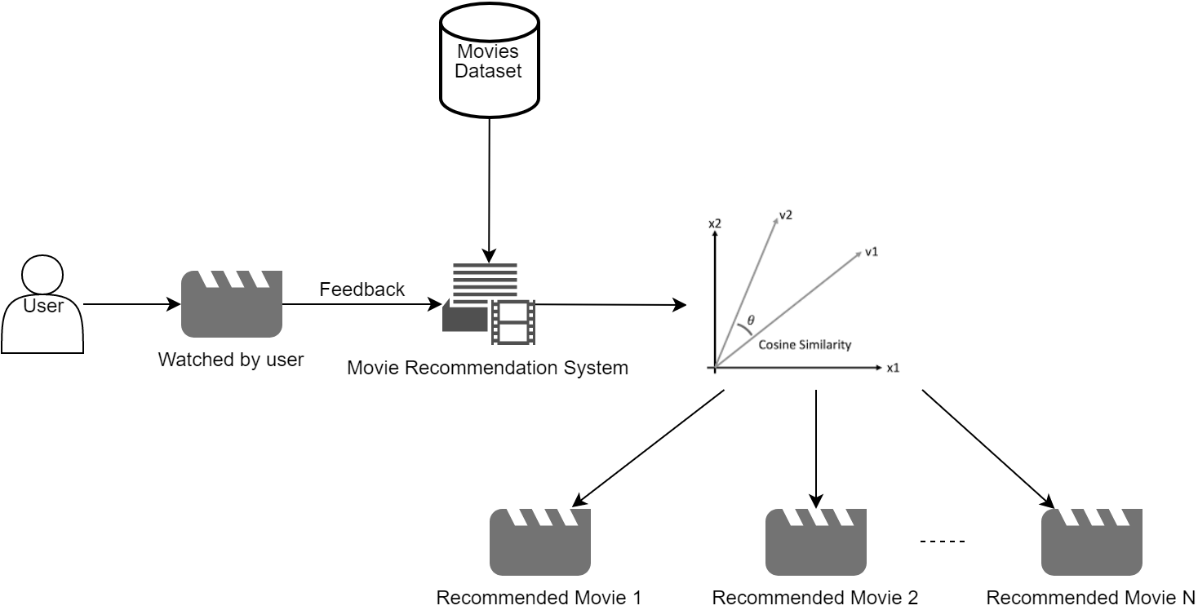
4.2 System Architecture

Slide 35
4.3 Data Flow Diagram
Level 0
Define path
Level 1
Analysis
Dataset Input
Pre-processing
select Movie
Cosine Similarity Technique
Movie dataset
User Input
Movies Recommendation

Slide 36
4.4 UML DIAGRAMS
UML stands for Unified Modeling Language. UML is a standardized general-purpose modeling language in the field of object-oriented software engineering. The standard is managed, and was created by, the Object Management Group.
The goal is for UML to become a common language for creating models of object-oriented computer software. In its current form UML is comprised of two major components: a Meta-model and a notation. In the future, some form of method or process may also be added to; or associated with, UML.
The Unified Modeling Language is a standard language for specifying, Visualization, Constructing and documenting the artifacts of software system, as well as for business modeling and other non-software systems.
The UML represents a collection of best engineering practices that have proven successful in the modeling of large and complex systems.
The UML is a very important part of developing objects-oriented software and the software development process. The UML uses mostly graphical notations to express the design of software projects.

Slide 37
USE CASE DIAGRAM

Slide 38
CLASS DIAGRAM

Slide 39
OBJECT DIAGRAM

Slide 40
SEQUENCE DIAGRAM

Slide 41
COLLABRATION DIAGRAM

Slide 42
ACTIVITY DIAGRAM

Slide 43
STATE DIAGRAM

Slide 44
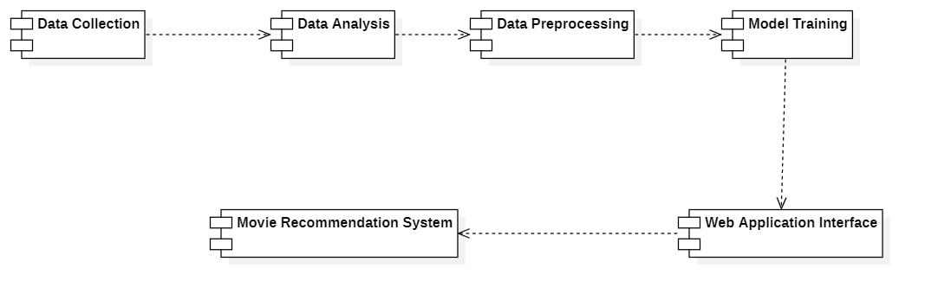
COMPONENT DIAGRAM

Slide 45
DEPLOYMENT DIAGRAM

Slide 46
Chapter 5
Development Tools

Slide 47
Python
Python is a high-level, interpreted, interactive and object-oriented scripting language. Python is designed to be highly readable. It uses English keywords frequently whereas other languages use punctuation, and it has fewer syntactical constructions than other languages.
History of Python
Python was developed by Guido van Rossum in the late eighties and early nineties at the National Research Institute for Mathematics and Computer Science in the Netherlands.
Python is derived from many other languages, including ABC, Modula-3, C, C++, Algol-68, SmallTalk, and Unix shell and other scripting languages.
Python is copyrighted. Like Perl, Python source code is now available under the GNU General Public License (GPL).
Python is now maintained by a core development team at the institute, although Guido van Rossum still holds a vital role in directing its progress.

Slide 48
Importance of Python
Python is Interpreted − Python is processed at runtime by the interpreter. You do not need to compile your program before executing it. This is like PERL and PHP.
Python is Interactive − You can sit at a Python prompt and interact with the interpreter directly to write your programs.
Python is Object-Oriented − Python supports Object-Oriented style or technique of programming that encapsulates code within objects.
Python is a Beginner's Language − Python is a great language for the beginner-level programmers and supports the development of a wide range of applications from simple text processing to WWW browsers to games.

Slide 49
Features of Python
Easy-to-learn − Python has few keywords, simple structure, and a clearly defined syntax. This allows the student to pick up the language quickly.
Easy-to-read − Python code is more clearly defined and visible to the eyes.
Easy-to-maintain − Python's source code is fairly easy-to-maintain.
A broad standard library − Python's bulk of the library is very portable and cross-platform compatible on UNIX, Windows, and Macintosh.
Interactive Mode − Python has support for an interactive mode which allows interactive testing and debugging of snippets of code.
Portable − Python can run on a wide variety of hardware platforms and has the same interface on all platforms.
Extendable − You can add low-level modules to the Python interpreter. These modules enable programmers to add to or customize their tools to be more efficient.
Databases − Python provides interfaces to all major commercial databases.
GUI Programming − Python supports GUI applications that can be created and ported to many system calls, libraries and windows systems, such as Windows MFC, Macintosh, and the X Window system of Unix.
Scalable − Python provides a better structure and support for large programs than shell scripting.

Slide 50
Apart from the mentioned features, Python has a big list of good features, few are listed below −
It supports functional and structured programming methods as well as OOP.
It can be used as a scripting language or can be compiled to byte-code for building large applications.
It provides very high-level dynamic data types and supports dynamic type checking.
IT supports automatic garbage collection.
It can be easily integrated with C, C++, COM, ActiveX, CORBA, and Java.
Libraries of python used in the project:
NumPy - mainly useful for its N-dimensional array objects.
pandas - Python data analysis library, including structures such as data frames.
matplotlib - 2D plotting library producing publication quality figures.
scikit-learn - the machine learning algorithms used for data analysis and data mining tasks.

Slide 51


Slide 52
Chapter 5
Sample Source Code
#importing dependences
import numpy as np
import pandas as pd
#Creating a Pandas Data Frame by reading the dataset using read_csv from Pandas Library
movies = pd.read_csv('C:\\Users\\pavan\\Desktop\\Project\\Movie Recommendation System based on User Preferences\\Datasets\\tmdb_5000_movies.csv')
credits = pd.read_csv('C:\\Users\\pavan\Desktop\\Project\\Movie Recommendation System based on User Preferences\\Datasets\\tmdb_5000_credits.csv’)
#Merging of two DataFrames on title
movies = movies.merge(credits,on='title’)
#Creating a new data frame with only the attributes which are having a significance in our model
movies = movies[['movie_id','title','overview','genres','keywords','cast','crew']]

Slide 53
#Data Preprocessing
# Determining the total no of null values in each attribute
movies.isnull().sum()
#If the total count seems insignificant or negligible then you could drop those records
movies.dropna(inplace=True)
#Determing the total number of duplicate records
movies.duplicated().sum()
#Preprossing to convert list of dictionaries into List of elements
#But to do that we have to first make it a list from a string
#This can be done via importing ast library
# From: '[{"id": 28, "name": "Action"}, {"id": 12, "name": "Adventure"}, {"id": 14, "name": #"Fantasy"}, {"id": 878, "name": "Science Fiction"}]'
# To: '["Action","Adventure","Fantasy",...]’
#Helper function to convert from string to list of dictionaries and from list of dictionaries to list of #elements
def convert(obj):
L = []
for i in ast.literal_eval(obj):
L.append(i['name'])
return L

Slide 54
#Sending genres,keywords, object to convert function
movies['genres'] = movies['genres'].apply(convert)
movies['keywords'] = movies['keywords'].apply(convert)
#Helper function to convert from string to list of dictionaries and from list of dictionaries to list of #elements and only select 3 Main Actors
def convert3(obj):
L=[]
counter=0
for i in ast.literal_eval(obj):
if counter!=3:
L.append(i['name'])
counter+=1
else:
break
return L
#Sending cast object to convert3 function
movies['cast'] = movies['cast'].apply(convert3)

Slide 55
#Helper function to Only Selecting director from crew
def fetch_director(text):
L = []
for i in ast.literal_eval(text):
if i['job'] == 'Director':
L.append(i['name'])
return L
#Sending crew object to fetch_director function
movies['crew'] = movies['crew'].apply(fetch_director)
#In order to make things easy convert the “Overview” into List
movies['overview'] = movies['overview'].apply(lambda x : x.split())
#Inorder to reduce confusion associated with tags we will be transforming all spaces in between names
def collapse(L):
L1 = []
for i in L:
L1.append(i.replace(" ",""))
return L1

Slide 56
#Sending the cast, crew, genres, keywords objects to collapse function
movies['cast'] = movies['cast'].apply(collapse)
movies['crew'] = movies['crew'].apply(collapse)
movies['genres'] = movies['genres'].apply(collapse)
movies['keywords'] = movies['keywords'].apply(collapse)
#Creating a new attribute by concatenating overview, genre, keywords, cast, crew attributes
movies['tags'] = movies['overview'] + movies['genres'] + movies['keywords'] + movies['cast'] + movies['crew']
#Creating a new Data Frame with just movie_id, title, tags attributes
new_df = movies[['movie_id','title','tags']]
#Now converting list into a string by joining the elements in the list
new_df['tags'] = new_df['tags'].apply(lambda x: " ".join(x))
new_df.head()
#converting tags into lowercase
new_df['tags'] = new_df['tags'].apply(lambda x:x.lower())

Slide 57
#Now using the Count Vectorizer function which is used to transform the data into a vector based #on the frequency(count) of each word that occurs in the data set.
from sklearn.feature_extraction.text import CountVectorizer
cv = CountVectorizer(max_features=5000,stop_words='english')
#Converting to NumPy array
vector = cv.fit_transform(new_df['tags']).toarray()
#importing nltk
import nltk
#Here we are using it to remove redundancy in similar word patterns for which we have #PorterStemmer
from nltk.stem.porter import PorterStemmer
ps = PorterStemmer()
#Helper function to pass the porterstemmer with required objects for stemming
def stem(text):
y = []
for i in text.split():
y.append(ps.stem(i))
return " ".join(y)

Slide 58
#Passing the tags object to stem function to perform stemming
new_df['tags'] = new_df['tags'].apply(stem)
#Importing Cosine similarity from sklearn
from sklearn.metrics.pairwise import cosine_similarity
#Cosine Similarity is performed on those vectors to find the Euclidean Distance to recommend the top ten movies which are like the searched movie.
similarity = cosine_similarity(vector)
#Importing the Pickle
#Making pickle of movies data frame
pickle.dump(new_df.to_dict(),open('movie_list.pkl','wb'))
#Making pickle of Model
pickle.dump(similarity,open('similarity.pkl','wb'))

Slide 59
#Code for User Interface App.py
#importing dependences
import streamlit as st
import pickle
import pandas as pd
import requests
#Function for fetching the posters of movies based on users input
def fetch_poster(movie_id):
response = requests.get(f'https://api.themoviedb.org/3/movie/{movie_id}?api_key=44726ef95f4d79cb7001a4947fca7f53&language=en-US')
data = response.json()
return "https://image.tmdb.org/t/p/w500/" + data['poster_path']

Slide 60
#Recommending with the help of cosine similarity
def recommend(movie):
index = movies[movies['title'] == movie].index[0]
distances = sorted(list(enumerate(similarity[index])), reverse=True, key=lambda x: x[1])
recommended_movies = []
recommended_posters = []
for i in distances[1:6]:
movie_id = movies.iloc[i[0]].movie_id
recommended_movies.append(movies.iloc[i[0]].title)
# fetching poster via api
recommended_posters.append(fetch_poster(movie_id))
return recommended_movies,recommended_posters
#Using the pickle of our movies dataframe
movies_list = pickle.load(open('movie_list.pkl', 'rb'))
movies = pd.DataFrame(movies_list)
#Using the pickle of our cosine similarity algorithm
similarity = pickle.load(open('similarity.pkl', 'rb'))

Slide 61
st.title("Movie Recommendation System based on User Preferences")
selected_movie_name = st.selectbox('Looking for Similar Movies?', movies['title'].values)
if st.button('Recommend'):
names, posters = recommend(selected_movie_name)
col1, col2, col3, col4, col5 = st.columns(5)
with col1:
st.text(names[0])
st.image(posters[0])
with col2:
st.text(names[1])
st.image(posters[1])
with col3:
st.text(names[2])
st.image(posters[2])
with col4:
st.text(names[3])
st.image(posters[3])
with col5:
st.text(names[4])
st.image(posters[4])

Slide 62
Chapter 5
Snapshots

Slide 63
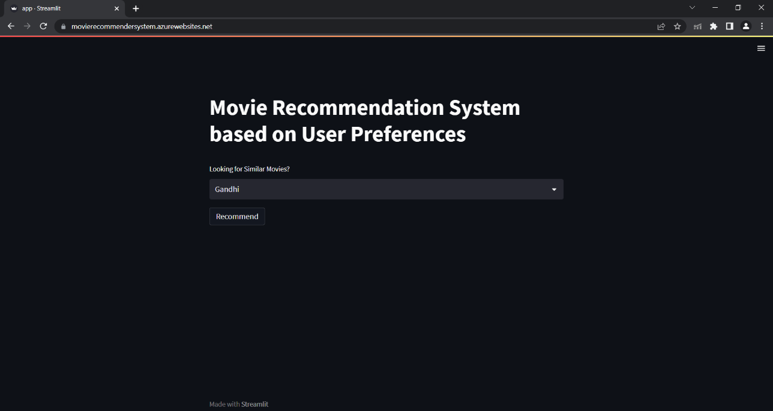
Figure 1: Interface Before Recommending

Slide 64
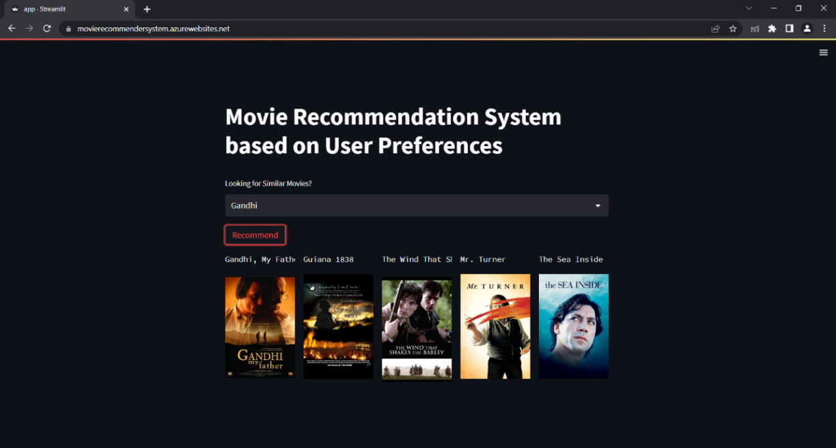
Figure 1: After Clicking Recommend

Slide 65
Chapter 8
Software Testing

Slide 66
8.1 GENERAL
The purpose of testing is to discover errors. Testing is the process of trying to discover every conceivable fault or weakness in a work product. It provides a way to check the functionality of components, sub assemblies, assemblies and/or a finished product It is the process of exercising software with the intent of ensuring that the Software system meets its requirements and user expectations and does not fail in an unacceptable manner. There are various types of test. Each test type addresses a specific testing requirement.
8.2 DEVELOPING METHODOLOGIES
The test process is initiated by developing a comprehensive plan to test the general functionality and special features on a variety of platform combinations. Strict quality control procedures are used. The process verifies that the application meets the requirements specified in the system requirements document and is bug free. The following are the considerations used to develop the framework from developing the testing methodologies.

Slide 67
8.3.1 Test Cases (Internal)
S.No | Test Description | Test Date | Expected Result | Actual Result | Remarks
1. | Recommendation System Model | 01/10/2022 | Recommend Ten Movies | Recommended Ten Movies | Pass
2. | Containerization of Web Application | 20/10/2022 | Composing Up Images and Pushing to Docker Registry. | Successful Composing Up of Images and Pushing to Docker Registry with Logs. | Pass
3. | Docker Container on Azure Container Registry and Deploying Image via Azure Web App | 24/10/2022 | Azure Container Registry Creation and Deploying of Web App. | Successful Azure Container Registry Creation and Deploying of Web App. | Pass
4. | API Communication & Web App Service Recommendation System | 26/10/2022 | API Connection & Displaying of Ten Similar Movies with Necessary Details. | Successful API Connection & Displaying of Ten Similar Movies with Necessary Details. | Pass
5. | Redeploying Web App Service | 30/11/2022 | Redeploying of Web App. | Successful Redeploying of Web App. | Pass

Slide 68
8.3.2 Test Cases (External)
S.No | Test Description | Test Date | Expected Result | Actual Result | Remarks
1. | Web App Service Recommendation System | 01/11/2022 | Displaying of Ten Similar Movies with Necessary Details. | Displaying of Ten Similar Movies with Necessary Details. | Pass
2. | User Input: The Matrix Recommend Button: Not Pressed | 2/11/2022 | No Action | No Action | Pass
3. | User Input: The Matrix Recommend Button: Pressed | 2/11/2022 | Similar Movie Recommendations | Ten Movie Recommendations with Similarity Index Ranging from 0.51 to 0.19. | Pass
4. | User Input: Sherlock Holmes Recommend Button: Pressed | 5/11/2022 | Similar Movie Recommendations | Ten Movie Recommendations with Similarity Index Ranging from 0.51 to 0.22. | Pass
5. | User Input: Harry Potter and the Philosopher's Stone Recommend Button: Pressed | 7/11/2022 | Similar Movie Recommendation (Might Include Other Harry Potter Movies) | Ten Movie Recommendations with Similarity Index Ranging from 0.46 to 0.23. | Pass

Slide 69
8.3.3 System Test
System testing ensures that the entire integrated software system meets requirements. It tests a configuration to ensure known and predictable results. An example of system testing is the configuration-oriented system integration test. System testing is based on process descriptions and flows, emphasizing pre-driven process links and integration points.
8.3.4 Performance Test
The Performance test ensures that the output be produced within the time limits, and the time taken by the system for compiling, giving response to the users and request being send to the system for to retrieve the results.
8.3.5 Integration Testing
Software integration testing is the incremental integration testing of two or more integrated software components on a single platform to produce failures caused by interface defects.
The task of the integration test is to check that components or software applications, e.g. components in a software system or – one step up – software applications at the company level – interact without error.

Slide 70
8.3.6 Acceptance Testing
User Acceptance Testing is a critical phase of any project and requires significant participation by the end user. It also ensures that the system meets the functional requirements.
Acceptance testing for Data Synchronization:
The Acknowledgements will be received by the Sender Node after the Packets are received by the Destination Node
The Route add operation is done only when there is a Route request in need
The Status of Nodes information is done automatically in the Cache Updating process
8.3.7 Build the test plan
Any project can be divided into units that can be further performed for detailed processing. Then a testing strategy for each of this unit is carried out. Unit testing helps to identity the possible bugs in the individual component, so the component that has bugs can be identified and can be rectified from errors.

Slide 72
Chapter 9
Future Enhancement

Slide 73
9.1 FUTURE ENHANCEMENT
For future we wish to make it a Content-based Hybrid Model and not just push a few details about the movie and trailers we wish to convert now microservice to a big web application. With increase in queries, we wish to reduce the time complexity by caching results. Use more search optimization techniques as well and real time API interaction with any Streaming Platform.

Slide 74
Chapter 10
CONCLUSION & REFERENCE

Slide 75
10.1 CONCLUSION
When the user searches for a movie that he/she has already watched and liked the Movies Recommendation System will recommend the top ten movies that are most similar to that movie. Moreover, the system will show a poster, related background trailer or videos of those movies. All these features will save user’s time which otherwise would have been wasted on finding a movie that he/she may or may not like.
Every month several movies are being released, the movies database only gets bigger and bigger. This would help the system to provide a more accurate recommendation to the user and in turn increase customer satisfaction.

Slide 76
References
[1.] Authors: R. Lavanya, Utkarsh Singh, Vibhor Tyagi; A Comprehensive Survey on Movie Recommendation Systems, IEEE 2021
[2.] Authors: Tanya V Yadalam, Vaishnavi M Gowda, Vanditha Shiva Kumar, Disha Girish; Career Recommendation Systems using Content based Filtering; IEEE 2020
[3.] Authors: Nilesh Nilesh, Madhu Kumari, Pritom Hazarika, Vishal Raman; Recommendation of Indian Cuisine Recipes based on Ingredients; IEEE 2019
[4.] Authors: Worasak Rueangsirarak, Teeravisit Laohapensaeng, Suppakarn Chansareewittay, Anusorn Yodjaiphet; The Cosine Similarity Technique for Removing the Redundancy Sample; IEEE 2019
[5.] Authors: Tessy Badriyah, Sefryan Azvy, Wiratmoko Yuwono, Iwan Syarif; Recommendation system for property search using content based filtering method; IEEE 2018
[6.] Authors: Bagher Rahimpour Cami, Hamid A; Content-based based on Temporal Movie User Recommender Preferences System; IEEE 2017
[7.] Educator, StatQuest, Chapel Hill, North Carolina, United States
[8.] An effective collaborative movie recommender system with cuckoo search ; Rahul Katarya ; Om Prakash Verma ; Department of Computer Science Engineering, Delhi Technological University, Delhi, India.
[9.] Ehsan Aslanian, Mohammadreza Radmanesh, and Mahdi Jalili. Hybrid recommender systems based on content feature relationship. IEEE Transactions on Industrial Informatics, IEEE 2016
[10.] Minara P Anto, Mejo Antony, KM Muhsina, Nivya Johny, Vinay James, and Aswathy Wilson. Product rating using sentiment analysis. In International Con-ference on Electrical, Electronics, and Optimization Techniques, pages 3458– 3462. IEEE 2016.

Slide 77
[11.] Erik Cambria. Affective computing and sentiment analysis. IEEE Intelligent Systems, 31(2):102–107, 2016
[12.] Fabian Abel, Qi Gao, Geert-Jan Houben, and Ke Tao. Twitter-based user mod-eling for news recommendations. In International Joint Conference on Artificial Intelligence, volume 13, pages 2962–2966, 2013.
[13.] Fabian Abel, Qi Gao, Geert-Jan Houben, and Ke Tao. Analyzing user modeling on twitter for personalized news recommendations. In International Conference on User Modeling, Adaptation, and Personalization, pages 1–12. Springer, 2011.
[14.] Jesus Bobadilla, Fernando Ortega, Antonio Hernando, and Javier Alcala´. Im-proving collaborative filtering recommender system results and performance us-ing genetic algorithms. Knowledge-based systems, 24(8):1310–1316, 2011.
[15.] Ivan´ Cantador, Alejandro Bellog´ın, and David Vallet. Content-based recommen-dation in social tagging systems. In Proceedings of the Fourth Conference on Recommender systems, pages 237–240. ACM, 2010.
[16.] Paolo Cremonesi, Yehuda Koren, and Roberto Turrin. Performance of recom-mender algorithms on top-n recommendation tasks. In Proceedings of the Fourth Conference on Recommender Systems, pages 39–46. ACM, 2010. ISBN 978-1-60558-906-0.
[17.] Gediminas Adomavicius and Alexander Tuzhilin. Toward the next generation of recommender systems: A survey of the state-of-the-art and possible extensions. IEEE Transactions on Knowledge and Data Engineering, 17(6):734–749, 2005.
[18.] Mukund Deshpande and George Karypis. Item-based top-n recommendation algorithms. ACM Transactions on Information Systems, 22(1):143–177, 2004. ISSN 1046-8188.
[19.] Robin Burke. Hybrid recommender systems: Survey and experiments. User modeling and user-adapted interaction, 12(4):331–370, 2002.

Slide 78
Thank you

