Slide 1

INTRODUCTION
THE HUMAN IMMUNE SYSTEM: HOW OUR BODY FIGHTS DISEASES
A comprehensive exploration of your body's defense mechanisms

Slide 2
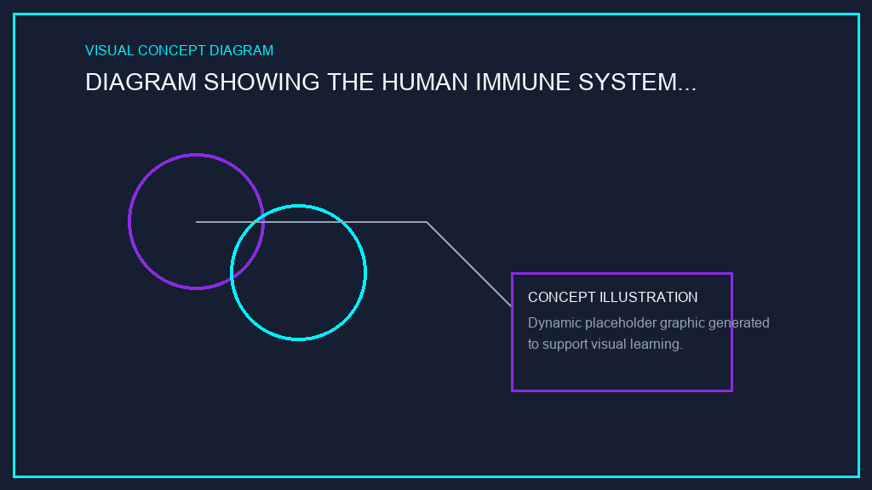
IMMUNE SYSTEM FUNDAMENTALS
What is the Immune System?
• A complex network of organs, cells, proteins, and chemicals
• Primary function: Protect the body from pathogens and invaders
• Distinguishes between self and non-self
• Supports healing and tissue repair

Slide 3

IMMUNE SYSTEM FUNDAMENTALS
Two Lines of Defense
• Innate Immunity: Rapid, non-specific, first responder
• Adaptive Immunity: Specific, slower, long-lasting memory
• Both systems work together in coordinated defense
• Together they provide comprehensive protection

Slide 4

IMMUNE DEFENSE MECHANISMS
Innate Immunity: First Line of Defense
• Physical barriers: Skin, mucous membranes, stomach acid
• Immediate response to any pathogen
• Non-specific recognition of foreign invaders
• Includes inflammation and fever responses

Slide 5

IMMUNE DEFENSE MECHANISMS
Adaptive Immunity: Specific Defense
• Highly specific recognition of particular pathogens
• Develops memory of encountered pathogens
• Faster response on re-exposure (vaccination principle)
• Primary and secondary immune responses

Slide 6
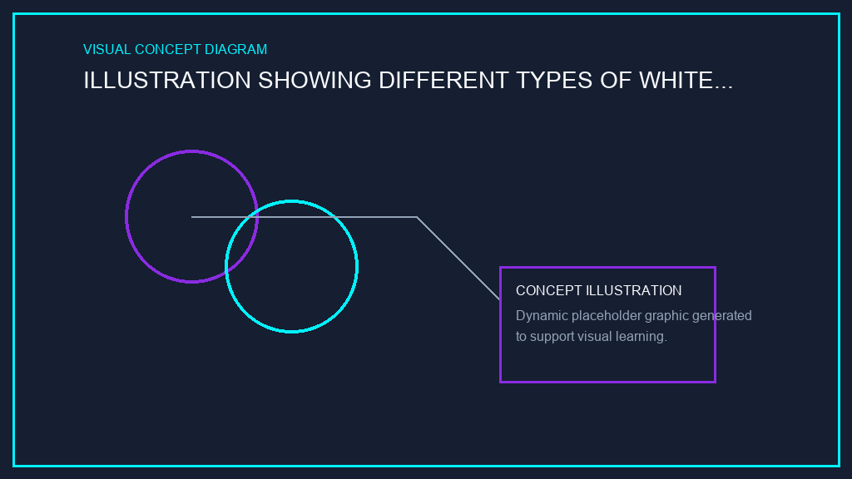
CELLULAR IMMUNITY
Key Immune Cells: White Blood Cells
• Neutrophils: Most abundant, first responders
• Lymphocytes: B cells and T cells for specific immunity
• Monocytes/Macrophages: Engulf and destroy pathogens
• Eosinophils & Basophils: Combat parasites and allergies

Slide 7
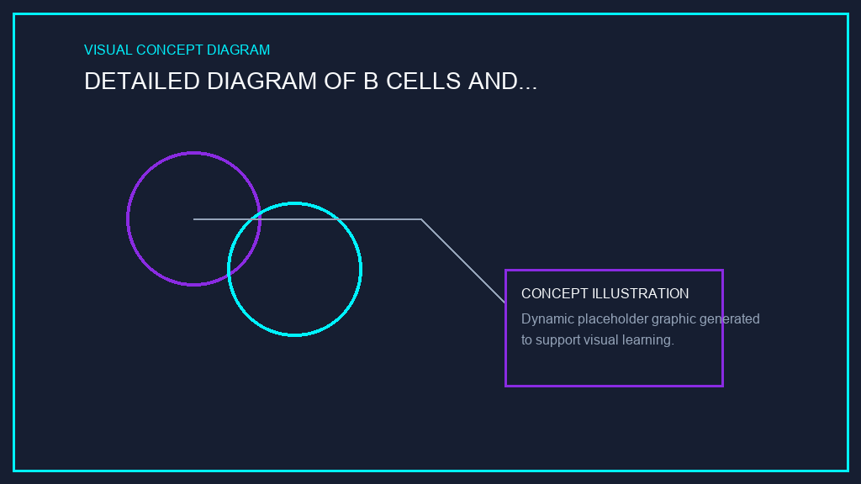
CELLULAR IMMUNITY
Lymphocytes: B Cells and T Cells
• B Cells: Produce antibodies for humoral immunity
• T Helper Cells: Coordinate immune response
• Cytotoxic T Cells: Kill infected or abnormal cells
• Regulatory T Cells: Prevent excessive immune response

Slide 8
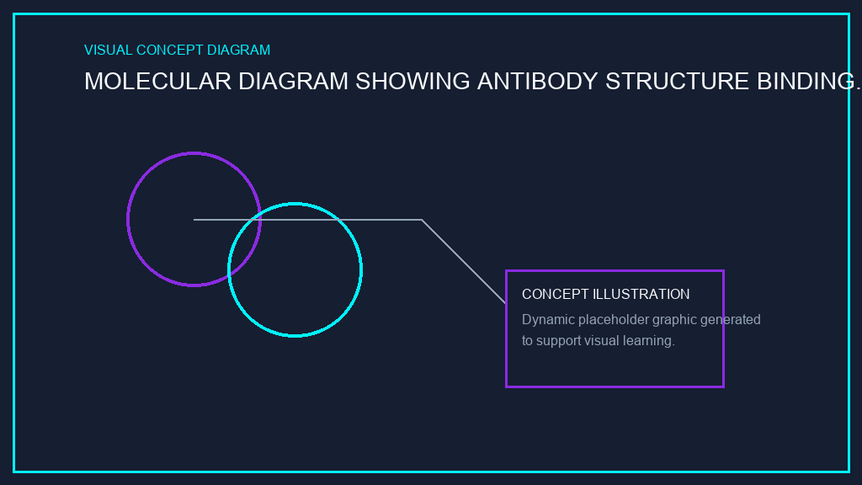
MOLECULAR IMMUNITY
Antibodies and Antigens
• Antibodies: Y-shaped proteins produced by B cells
• Antigens: Foreign molecules that trigger immune response
• Specific binding: Each antibody recognizes specific antigen
• Functions: Neutralization, opsonization, complement activation

Slide 9
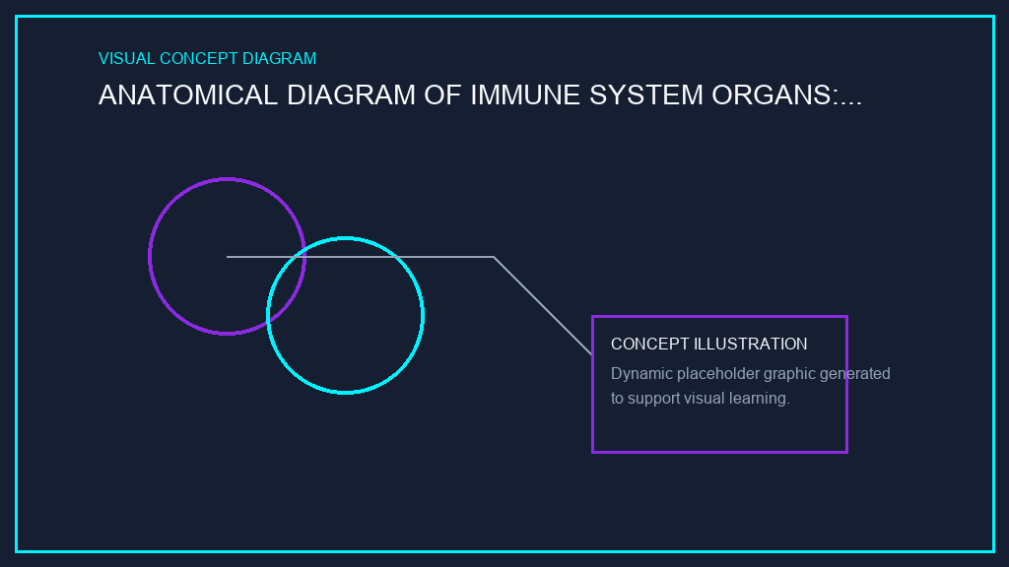
IMMUNE SYSTEM ORGANIZATION
Immune System Organs
• Primary organs: Bone marrow and thymus (cell production/maturation)
• Secondary organs: Lymph nodes, spleen (immune response sites)
• Lymphatic vessels: Transport immune cells throughout body
• Gut-associated lymphoid tissue: MALT, tonsils, appendix

Slide 10

ADVANCED DEFENSE SYSTEMS
The Complement System
• Group of blood proteins enhancing immune response
• Cascade activation: Sequential protein activation
• Functions: Mark pathogens, create inflammation, lyse cells
• Bridges innate and adaptive immunity

Slide 11
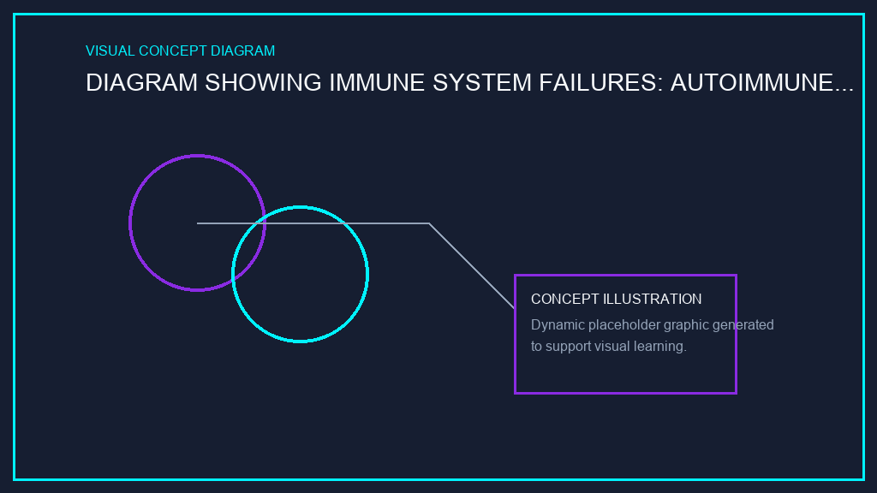
IMMUNE CHALLENGES
When Immunity Fails: Immune Disorders
• Autoimmune Diseases: Immune system attacks self (lupus, rheumatoid arthritis)
• Immunodeficiency: Weak immune response (HIV/AIDS, primary immunodeficiency)
• Allergies: Excessive immune response to harmless substances
• Modern treatments: Monoclonal antibodies, CAR-T cell therapy

Slide 12
SUMMARY & DISCUSSION
• Your immune system is a sophisticated, multi-layered defense network
• Innate and adaptive immunity work together seamlessly
• Healthy lifestyle supports optimal immune function
• Ongoing research continues to improve immune-based therapies
Ready for Labs
Review loaded notebooks in your workspace. Test code inference endpoints, verify cross-region configurations, and execute agent runs.

