Slide 1

01 // INTRODUCTION
The Human Immune System: Innate vs. Adaptive Defense Architecture
Understanding Our Body's Complex Defense Mechanisms
AUTONOMOUS AI PRESENTATION ARCHITECTURE • 6 SLIDES • GEMINI 2.5 FLASH VISUALS

Slide 2

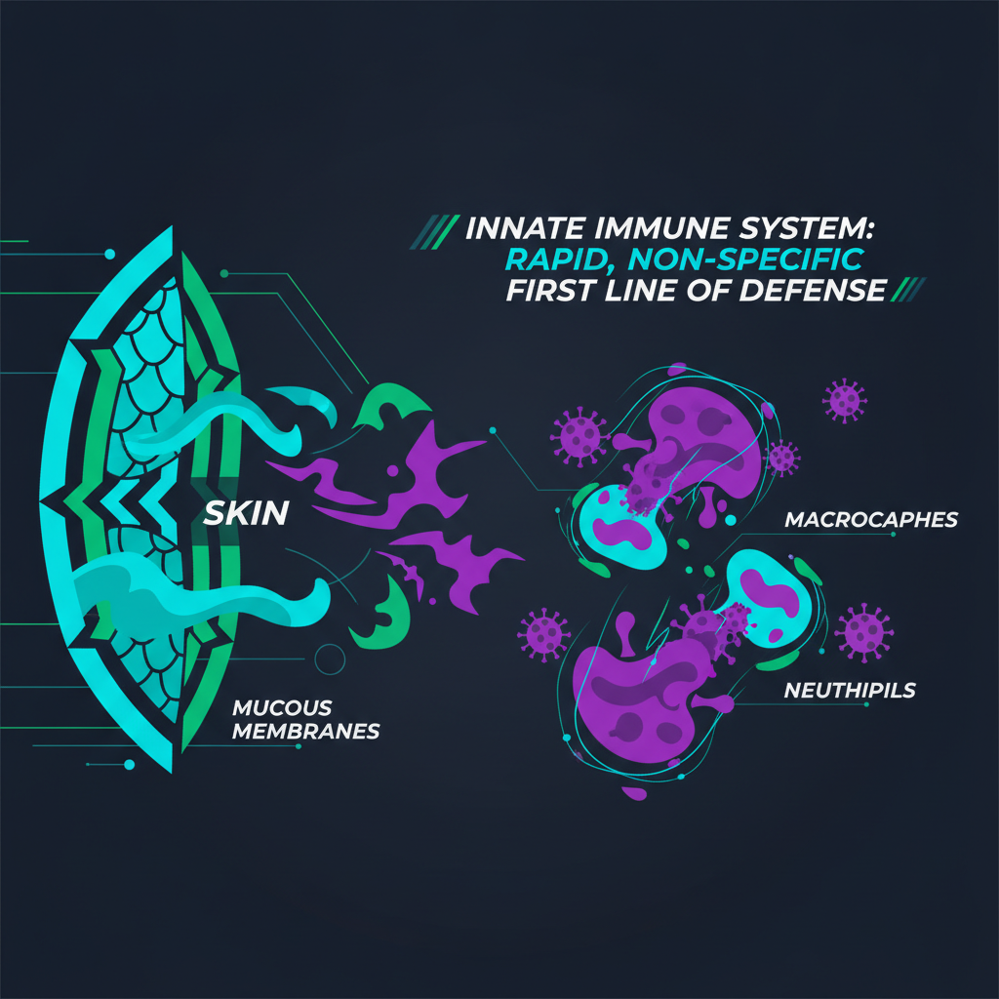
02 // INNATE IMMUNITY
SLIDE 02 / 06
Innate Immunity: Our First Line of Defense
01
Physical & Chemical Barriers
Epithelial tight junctions, mucosal membranes, and antimicrobial defensins block 99% of pathogen entry.
◆ VISUAL ARCHITECTURE // RIGHT PANEL
02
Cellular Defenders
Phagocytes like macrophages and neutrophils rapidly engulf and destroy foreign invaders through non-specific recognition.
03
Inflammation Response
Localized tissue damage triggers a cascade of events, increasing blood flow and recruiting immune cells to the infection site.
04
Fever & Antimicrobial Proteins
Systemic responses include elevated body temperature and circulating proteins that inhibit microbial growth.
Innate Immunity: Our First Line of Defense
KEY INSIGHT
The innate immune system provides immediate, non-specific protection, acting as the body's rapid response unit against common threats.

Slide 3
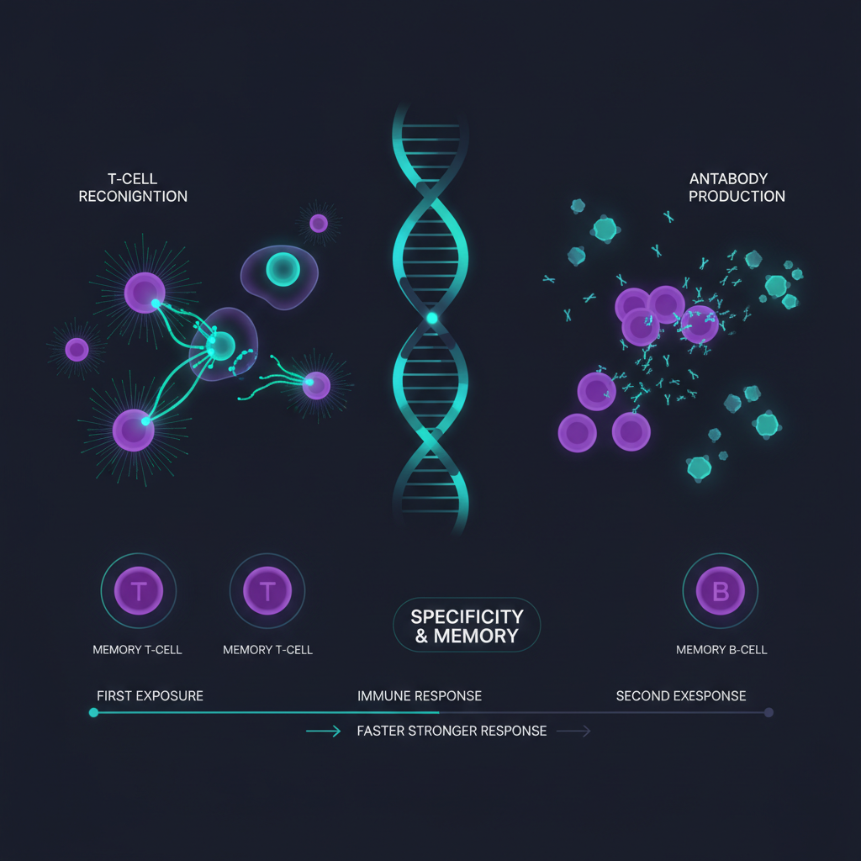
03 // ADAPTIVE IMMUNITY
SLIDE 03 / 06
Adaptive Immunity: Targeted & Memory-Driven Response
◆ VISUAL ARCHITECTURE // LEFT PANEL
01
T-Cell Activation
Helper T-cells coordinate responses, while Cytotoxic T-cells directly eliminate infected or cancerous cells with high specificity.
02
B-Cell Antibody Production
B-cells differentiate into plasma cells, secreting highly specific antibodies that neutralize pathogens and mark them for destruction.
03
Antigen Presentation
Specialized cells present pathogen fragments to lymphocytes, initiating a precise and tailored immune response.
04
Immunological Memory
Upon re-exposure, memory B and T cells mount a faster, stronger, and more effective defense, preventing recurrent illness.
Adaptive Immunity: Targeted & Memory-Driven Response
KEY INSIGHT
Adaptive immunity offers highly specific, long-lasting protection, learning and adapting to new pathogens through memory cells.

Slide 4

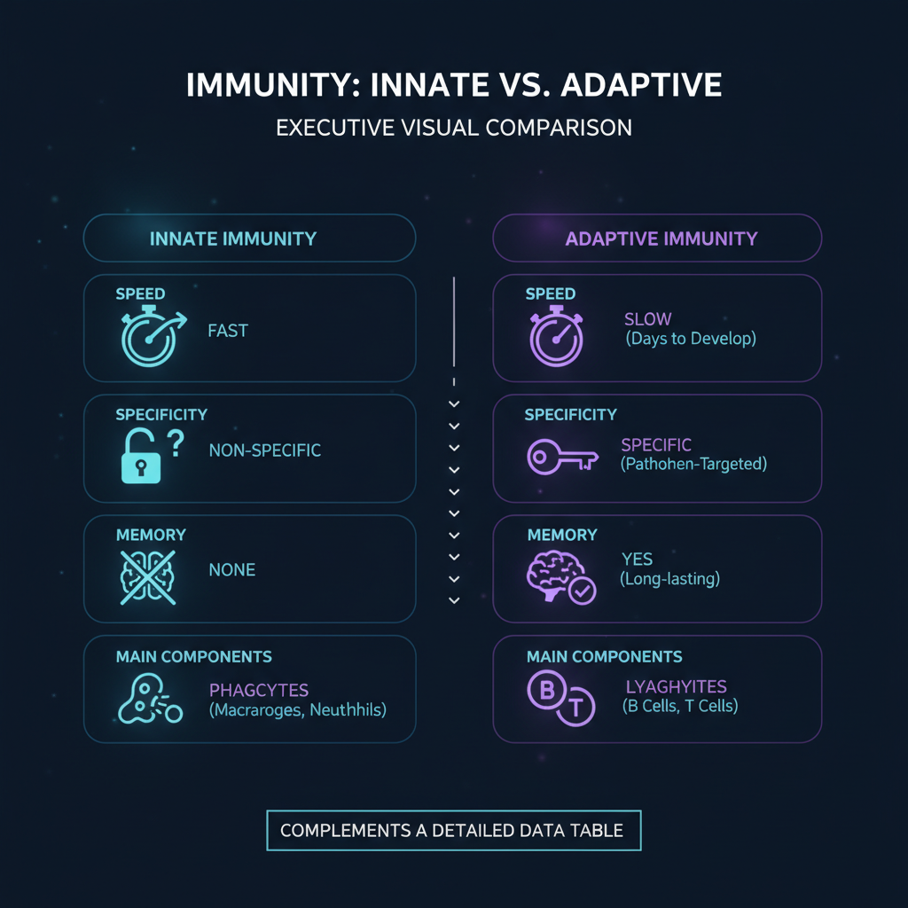
04 // COMPARISON
SLIDE 04 / 06
Innate vs. Adaptive: Key Differentiators
Feature | Innate Immunity | Adaptive Immunity
Response Time | Immediate (minutes to hours) | Delayed (days to weeks)
Specificity | Non-specific (recognizes common patterns) | Highly specific (targets unique antigens)
Memory | No immunological memory | Develops long-term memory
Components | Physical barriers, phagocytes, NK cells, inflammation | T-cells, B-cells, antibodies, antigen-presenting cells
◆ COMPARISON INFOGRAPHIC
Visual Comparison Matrix generated via Gemini 2.5 Flash Image
KEY INSIGHT
While innate immunity provides rapid, broad protection, adaptive immunity offers precise, memory-driven defense crucial for long-term pathogen resistance.

Slide 5
05 // APPLICATIONS
SLIDE 05 / 06
Immunological Memory & Vaccine Mechanisms
01
Memory Cell Function
Long-lived B and T memory cells persist after initial infection, enabling rapid and robust secondary immune responses.
STRATEGIC SYNTHESIS
Harnessing immunological memory through vaccination is a cornerstone of public health, providing durable protection against infectious diseases.
02
Vaccine Principles
Vaccines introduce attenuated or inactivated pathogens/antigens to safely stimulate adaptive immunity and generate memory without causing disease.
03
Herd Immunity
Widespread vaccination protects vulnerable populations by reducing pathogen transmission, making outbreaks less likely.
04
Booster Doses
Periodic boosters reinforce immunological memory, ensuring sustained protection against evolving pathogens.

Slide 6

06 // CONCLUSION
SLIDE 06 / 06
Executive Summary & Clinical Outlook
Executive Takeaways & Strategic Outlook
01
Dual Defense System
The immune system operates as a sophisticated network of innate and adaptive components, each with distinct roles and synergistic actions.
EXECUTIVE SUMMARY & NEXT STEPS
A comprehensive understanding of innate and adaptive immunity is vital for developing next-generation diagnostics, therapeutics, and preventative strategies in global health.
02
Precision & Speed
Innate immunity offers immediate, broad protection, while adaptive immunity provides targeted, memory-driven defense.
03
Therapeutic Innovations
Understanding these mechanisms drives advancements in immunotherapies, vaccine development, and autoimmune disease treatments.
04
Future Frontiers
Ongoing research explores personalized immunology, leveraging individual immune profiles for tailored health interventions.

