Slide 1

01 // INTRODUCTION
The Human Immune System: Innate vs. Adaptive Defense Architecture
Understanding Our Body's Complex Defense Mechanisms
AUTONOMOUS AI PRESENTATION ARCHITECTURE • 8 SLIDES • GEMINI 2.5 FLASH VISUALS

Slide 2

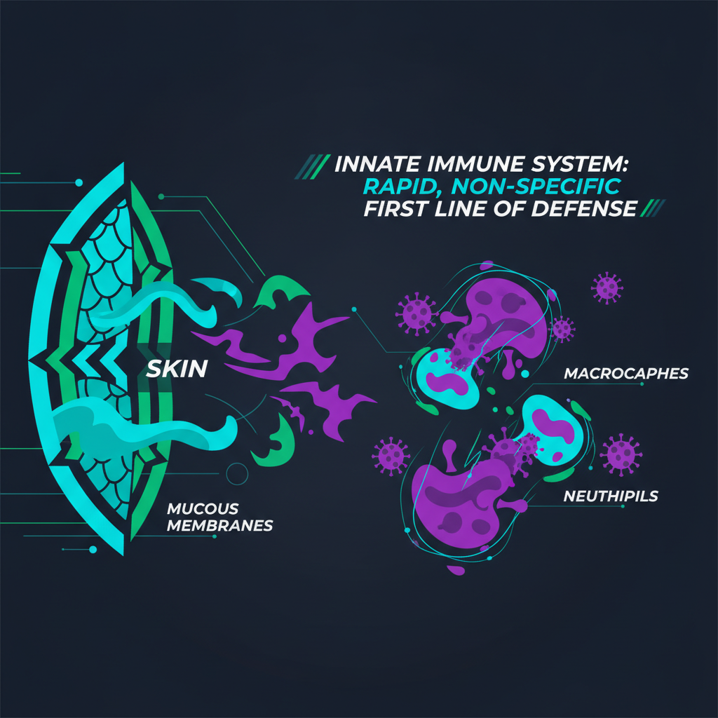
02 // INNATE IMMUNITY
SLIDE 02 / 08
Innate Immunity: Our First Line of Defense
01
Physical & Chemical Barriers
Epithelial tight junctions, mucosal membranes, and antimicrobial defensins block 99% of pathogen entry.
◆ VISUAL ARCHITECTURE // RIGHT PANEL
02
Cellular Defenders
Phagocytes like macrophages and neutrophils rapidly engulf and destroy foreign invaders through non-specific recognition.
03
Inflammation Response
Localized tissue damage triggers a cascade of events, increasing blood flow and recruiting immune cells to the infection site.
04
Fever & Antimicrobial Proteins
Systemic responses include elevated body temperature and circulating proteins that inhibit microbial growth.
Innate Immunity: Our First Line of Defense
KEY INSIGHT
The innate immune system provides immediate, non-specific protection, acting as the body's rapid response unit against common threats.

Slide 3
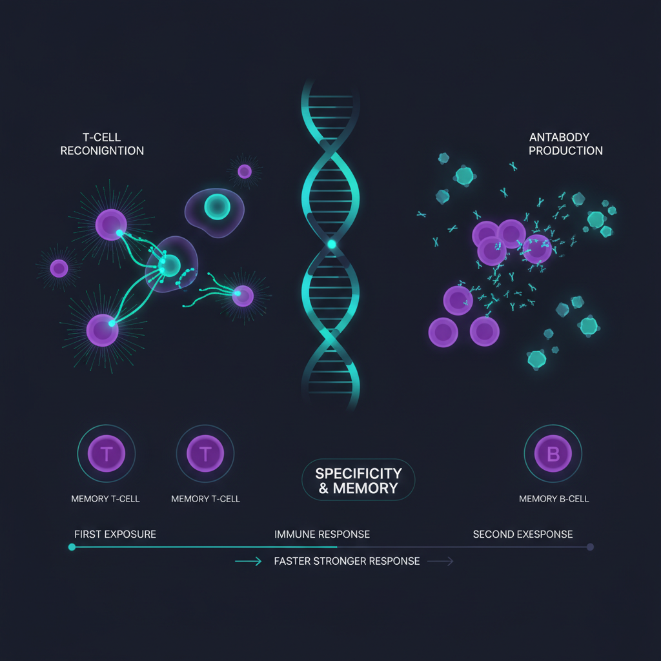
03 // ADAPTIVE IMMUNITY
SLIDE 03 / 08
Adaptive Immunity: Targeted & Memory-Driven Response
◆ VISUAL ARCHITECTURE // LEFT PANEL
01
T-Cell Activation
Helper T-cells coordinate responses, while Cytotoxic T-cells directly eliminate infected or cancerous cells with high specificity.
02
B-Cell Antibody Production
B-cells differentiate into plasma cells, secreting highly specific antibodies that neutralize pathogens and mark them for destruction.
03
Antigen Presentation
Specialized cells present pathogen fragments to lymphocytes, initiating a precise and tailored immune response.
04
Immunological Memory
Upon re-exposure, memory B and T cells mount a faster, stronger, and more effective defense, preventing recurrent illness.
Adaptive Immunity: Targeted & Memory-Driven Response
KEY INSIGHT
Adaptive immunity offers highly specific, long-lasting protection, learning and adapting to new pathogens through memory cells.

Slide 4

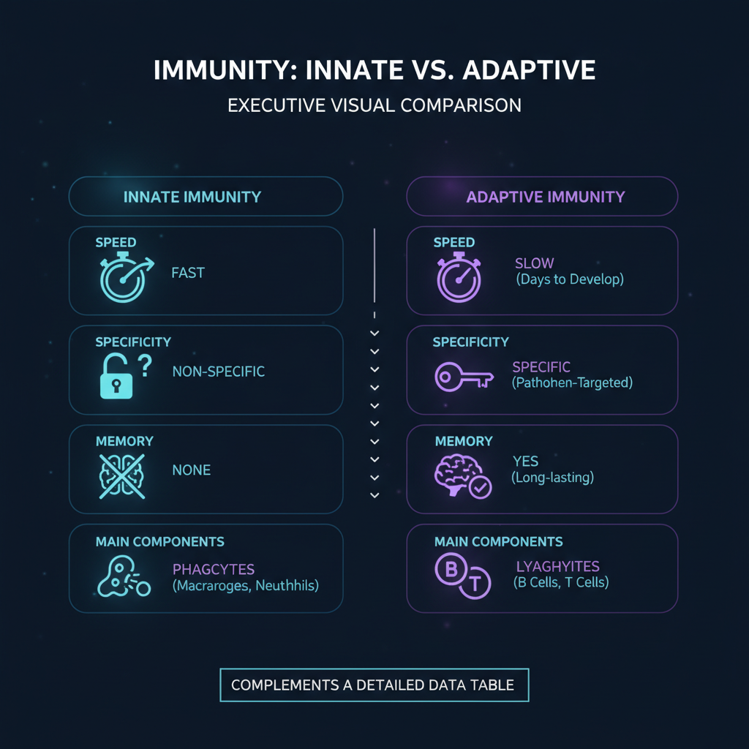
04 // COMPARISON
SLIDE 04 / 08
Innate vs. Adaptive: Key Differentiators
Feature | Innate Immunity | Adaptive Immunity
Response Time | Immediate (minutes to hours) | Delayed (days to weeks)
Specificity | Non-specific (recognizes common patterns) | Highly specific (targets unique antigens)
Memory | No immunological memory | Develops long-term memory
Components | Physical barriers, phagocytes, NK cells, inflammation | T-cells, B-cells, antibodies, antigen-presenting cells
◆ COMPARISON INFOGRAPHIC
Visual Comparison Matrix generated via Gemini 2.5 Flash Image
KEY INSIGHT
While innate immunity provides rapid, broad protection, adaptive immunity offers precise, memory-driven defense crucial for long-term pathogen resistance.

Slide 5
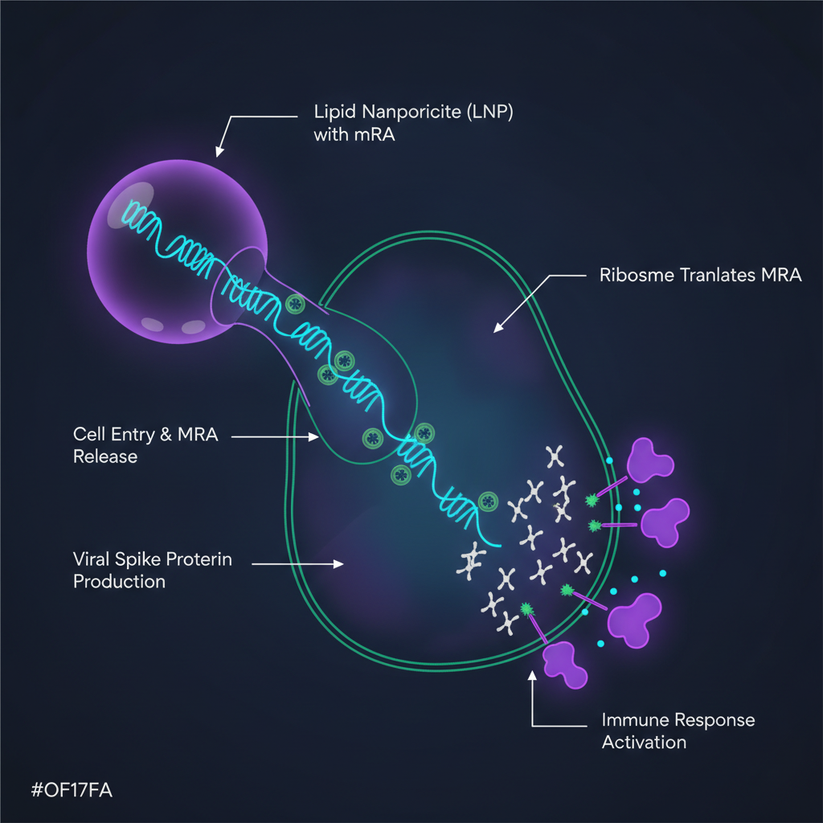
05 // VACCINE INNOVATION
SLIDE 05 / 08
mRNA Vaccines: Precision Delivery & Immune Activation
◆ VISUAL ARCHITECTURE // LEFT PANEL
01
mRNA Encapsulation
Messenger RNA (mRNA) encoding viral antigens is encased in lipid nanoparticles (LNPs) for stability and efficient cellular uptake.
02
Cellular Uptake & Translation
LNPs deliver mRNA into host cells, which then translate the mRNA into harmless viral proteins.
03
Antigen Presentation
Host cells present these viral proteins on their surface, triggering a robust adaptive immune response without viral replication.
04
Rapid Development & Flexibility
mRNA technology allows for faster vaccine development and easier adaptation to new viral variants.
mRNA Vaccines: Precision Delivery & Immune Activation
KEY INSIGHT
mRNA vaccines leverage cellular machinery to produce antigens, initiating a potent immune response with unprecedented speed and adaptability.

Slide 6
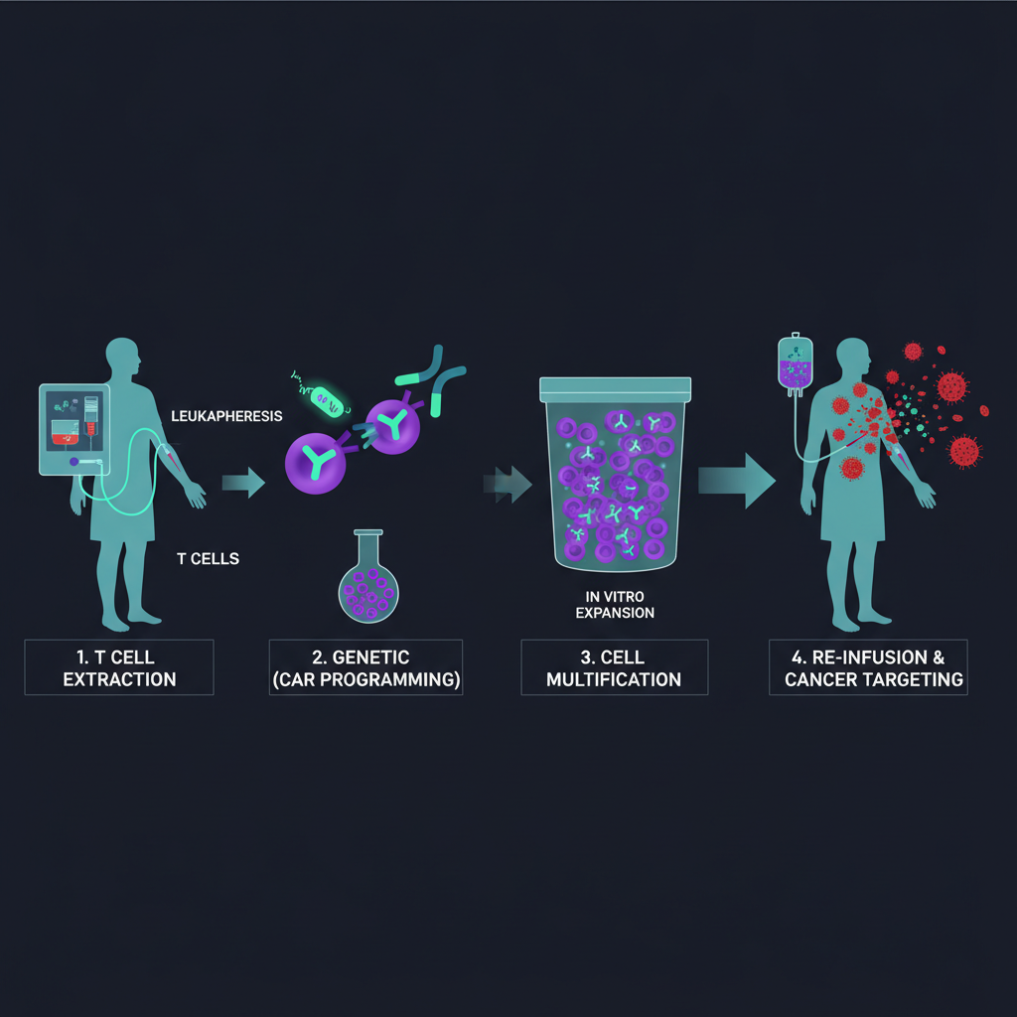
06 // IMMUNOTHERAPY FRONTIERS
SLIDE 06 / 08
CAR-T Cell Therapy: Engineering Immunity Against Cancer
01
T-Cell Collection & Reprogramming
Patient's own T-cells are extracted and genetically modified to express Chimeric Antigen Receptors (CARs).
◆ VISUAL ARCHITECTURE // RIGHT PANEL
02
CAR Gene Insertion
The CARs are designed to specifically recognize and bind to antigens present on the surface of cancer cells.
03
Expansion & Infusion
Engineered CAR-T cells are multiplied in the lab and then infused back into the patient.
04
Targeted Cancer Killing
Once re-infused, CAR-T cells seek out and destroy cancer cells expressing the target antigen, offering a highly personalized treatment.
CAR-T Cell Therapy: Engineering Immunity Against Cancer
KEY INSIGHT
CAR-T cell therapy represents a revolutionary approach, re-engineering a patient's immune cells to precisely target and eliminate cancer.

Slide 7
07 // IMMUNOLOGICAL MEMORY
SLIDE 07 / 08
Immunological Memory & Vaccine Principles
01
Memory Cell Function
Long-lived B and T memory cells persist after initial infection, enabling rapid and robust secondary immune responses.
STRATEGIC SYNTHESIS
Harnessing immunological memory through vaccination is a cornerstone of public health, providing durable protection against infectious diseases.
02
Vaccine Principles
Vaccines introduce attenuated or inactivated pathogens/antigens to safely stimulate adaptive immunity and generate memory without causing disease.
03
Herd Immunity
Widespread vaccination protects vulnerable populations by reducing pathogen transmission, making outbreaks less likely.
04
Booster Doses
Periodic boosters reinforce immunological memory, ensuring sustained protection against evolving pathogens.

Slide 8

08 // CONCLUSION
SLIDE 08 / 08
Executive Summary & Clinical Outlook
Executive Takeaways & Strategic Outlook
01
Dual Defense System
The immune system operates as a sophisticated network of innate and adaptive components, each with distinct roles and synergistic actions.
EXECUTIVE SUMMARY & NEXT STEPS
A comprehensive understanding of innate and adaptive immunity is vital for developing next-generation diagnostics, therapeutics, and preventative strategies in global health.
02
Precision & Speed
Innate immunity offers immediate, broad protection, while adaptive immunity provides targeted, memory-driven defense.
03
Therapeutic Innovations
Understanding these mechanisms drives advancements in immunotherapies, vaccine development, and autoimmune disease treatments.
04
Future Frontiers
Ongoing research explores personalized immunology, leveraging individual immune profiles for tailored health interventions.

