Slide 1

Implementing Flexible Threading Support in Open MPI
Jan Ciesko, Sandia National Laboratories, Albuquerque, NM
Coauthors: Noah Evans, Stephen Olivier, Howard Pritchard, Shintaro Iwasaki, Ken Raffanetti and Pavan Balaji

Slide 2
Agenda
1: Motivation
2: Implementation
3: Evaluation
4: What’s next?
5: Conclusion

Slide 3
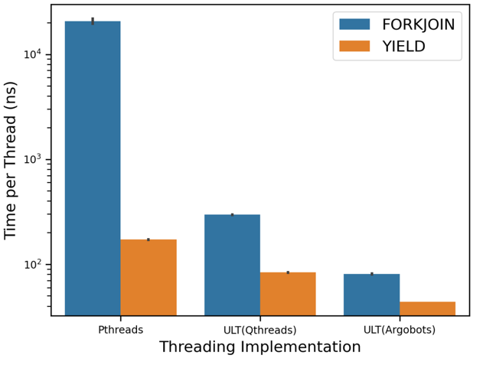
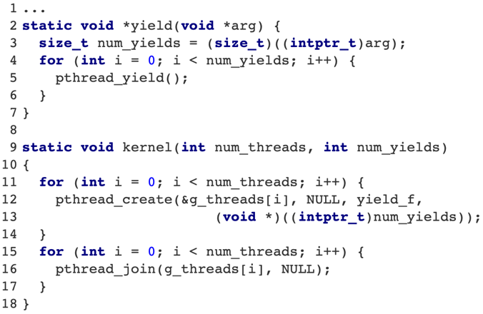
1. Motivation: Threading Implementations Differ
Threading libraries differ in performance.
Ptheads vs ULTs
MPI implementations depend on the underlying threading implementation
ThreadOps-bench
Blake.sandia.gov
Intel(R) Xeon(R) Platinum 8160 CPU @ 2.10GHz
16 threads, normalized to 1 thread
pthread_yield()…relinquish CPU
1st run:
num_yields = 0;
num_theads = 16;
2nd run:
num_yields=4000;
num_threads=16;
https://github.com/janciesko/ThreadOpsBench.git
Notes:
Better performance with OMPI_THREAD_MULTIPLE
Q: Can Open MPI benefit from threading?
Can we improve threading cooperation of MPI with X in MPI+X scenarios?
Maybe! We need the ground work first.

Slide 4
2. Implementation: Objective
Add generic threading support to Open MPI
Add a new MCA base framework
Add particular MCA components for Pthreads, Qthreads and Argobots
Define a generic interface for threading
Break MCA and add a configure-time option ☺
Remove calls to Pthreads and use generic interface throughout the Open MPI code base
Adjust configuration and build process
Add configuration option --with-threads=<threading model>
Take-aways: What is MCA, how threading fits into into MCA and how you can select a threading implementation.
Notes:
Used prrte pmix

Slide 5
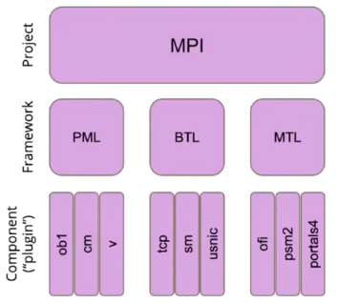
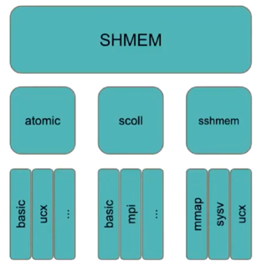
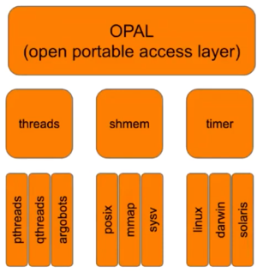


2. Implementation: MCA in Open MPI
Modular Component Architecture (MCA)
Open MPI organized into projects, frameworks and components
Components are loaded at runtime.
Open MPI software package
Examples:
* From EasyBuild Tech Talk, Jeff Squyres and Ralph Castain
Note: MCAs are specified by providing a key-value pair and are loaded at runtime (dlopen).
Notes:
Used prrte pmix

Slide 6

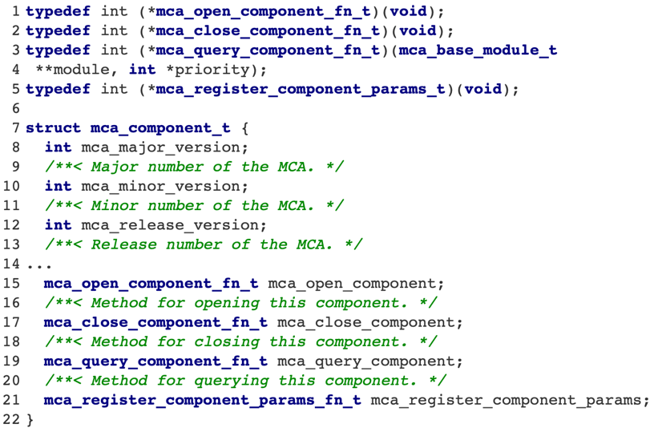
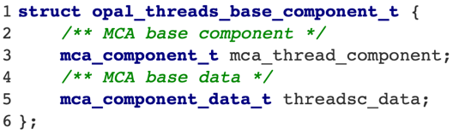
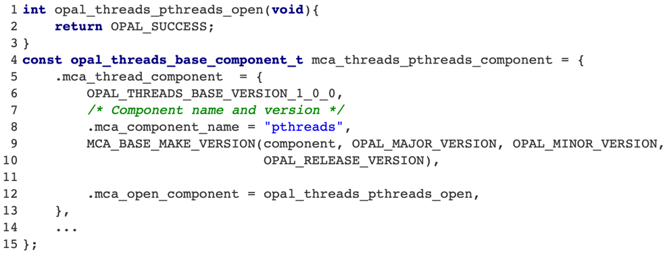
2. Implementation: Add new MCA component
MCA defines a set of useful APIs
Threads MCA implements those as
Let’s create a Pthread MCA component
Note: ompi_info lists the component. Can we dlopen this? Yes, but…
Notes:
Used prrte pmix

Slide 7
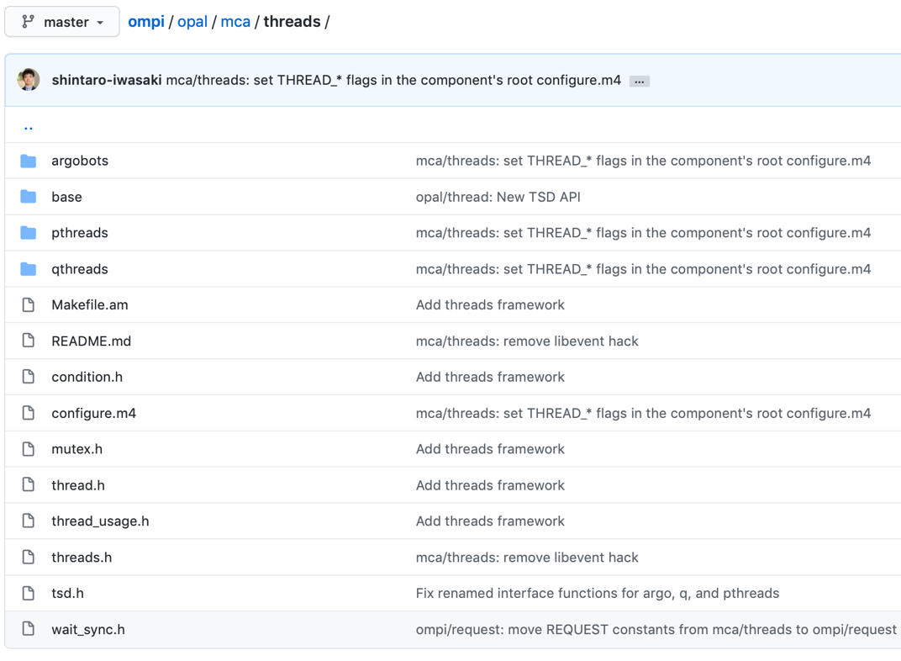
2. Implementation: Define Generic APIs
Generic Threading API implements
TLS
Synchronization
Management
Mutex
Atomics
Definitions
Declarations

Slide 8
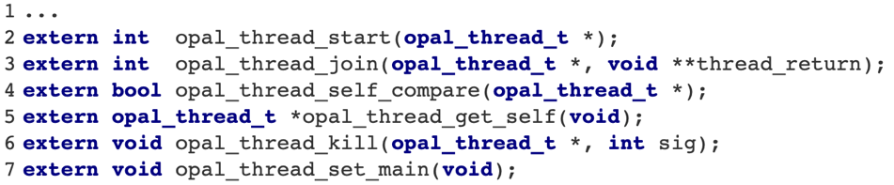
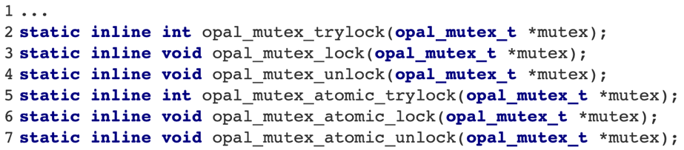
2. Implementation: Declarations of Members
Generic Threading API implements
Management
Synchronization
TLS
Mutexes
Atomics
Management:
Note: Open MPI currently implements threading in a hybrid approach. Only management functions are implemented in a shared library.
Mutexes (hot path):
Note: These are declarations that need the definition at compile time!

Slide 9
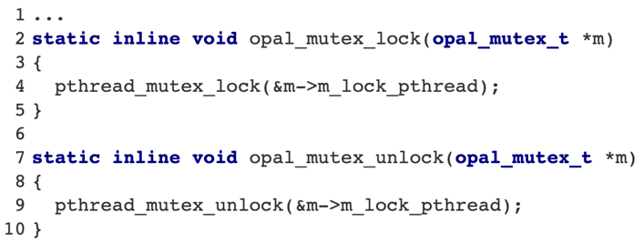
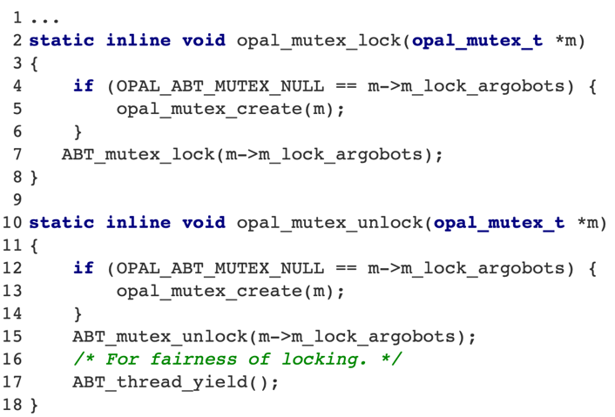
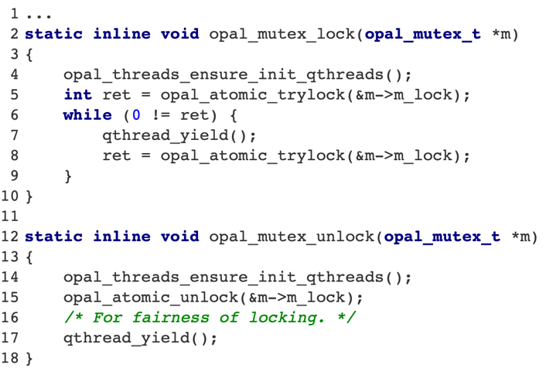
2. Implementation: Implementations of Static Members
Pthreads:
Mutexes implementations in hot path
Pthreads
Qthreads
Argobots
Argobots:
Qthreads:

Slide 10
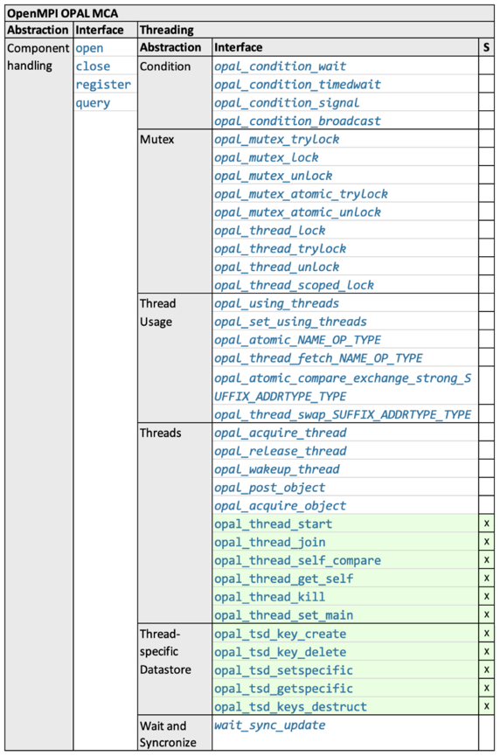
2. Implementation: Only a handful of APIs follow MCA
Current state
Only a subset of the API is implemented in the generic API and would support exchangeable threading at runtime
Hot-path functionality is statically in-lined, thus must be selected at configure time
Hybrid approach to minimize impact
Note: Even though we can load the MCA threading library and runtime, we must select the threading library at compile time using --with-theads=<threading library>.

Slide 11
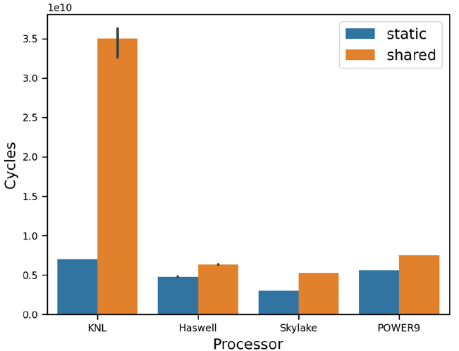
3. Evaluation: Function Call Overhead
FNbench
Approximately 20-30% increase in cycles
KNL misses 49% branch predictions
PLT* look-up for PIC adds 30% of instructions per iteration
https://github.com/npe9/fnbench
*Procedure Linkage Table **IBM Power9 RDTSC counter data adjusted to reflect polling frequency

Slide 12
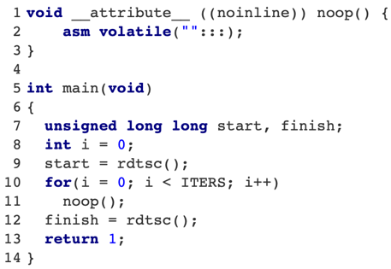

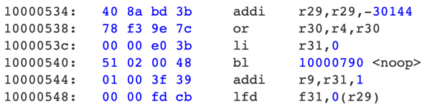
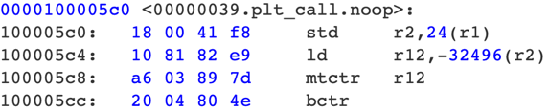
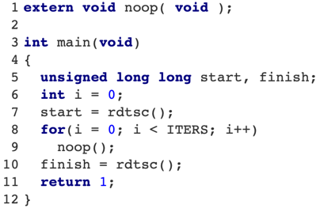
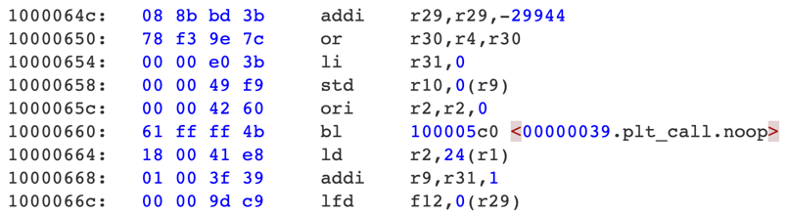
3. Evaluation: Function Call Overhead
FNbench
As Static library:
./objdump bin.static
gcc -Wall -O3 src/testfn.c -c -o src/testfn.c.so
gcc -fPIC -shared src/testfn.c.so -o libtestfn.so
gcc -Wall -O3 -L./ ./src/fnbenchso.c -o main.exe.dynamic -ltestfn
https://github.com/npe9/fnbench
./objdump bin.shared
As Shared library:
Notes:
Global Offset Table. This is the actual table of offsets as filled in by the linker for external symbols..pltThis is the PLT, or Procedure Linkage Table. These are stubs that look up the addresses in the .got.plt section, and either jump to the right address, or trigger the code in the linker to look up the address. (If the address has not been filled in to .got.plt yet.)

Slide 13
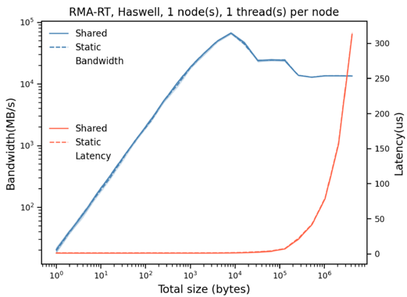
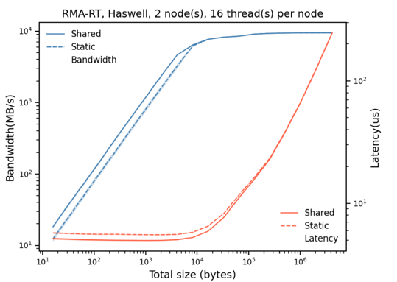
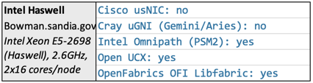
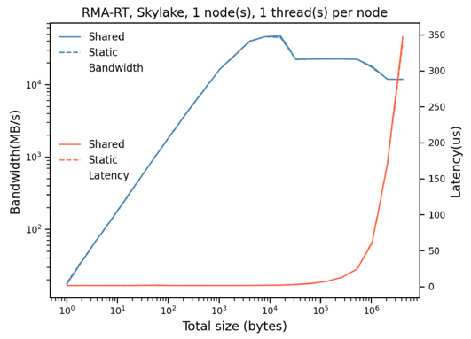
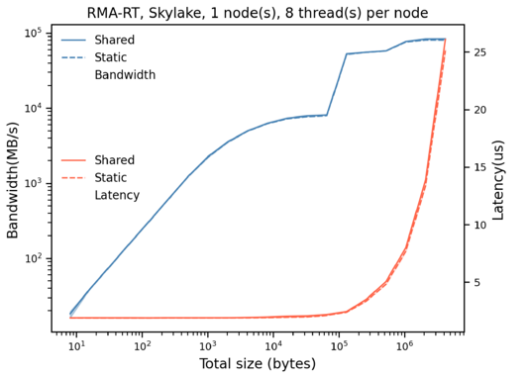
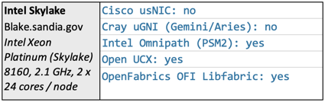
3. Evaluation: Performance Overhead
RMA-MT
Experimental implementation
Shared threading API
Intel Haswell and Skylake
Static versus shared library
All function declared as extern
Using Pthreads
mpirun --np 2 --map-by ppr:<1,2>:node --bind-to socket rmamt_<bw,lat> -x -t <num_threads> -o put -s fence

Slide 14
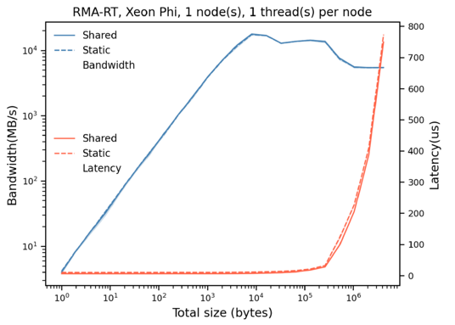
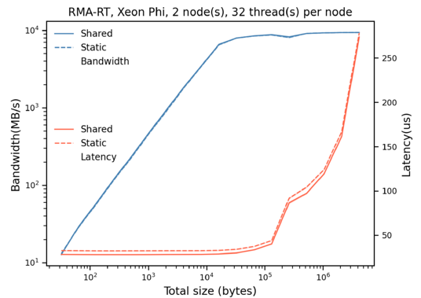
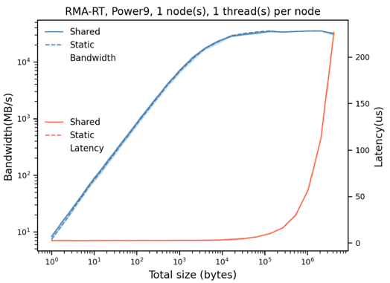
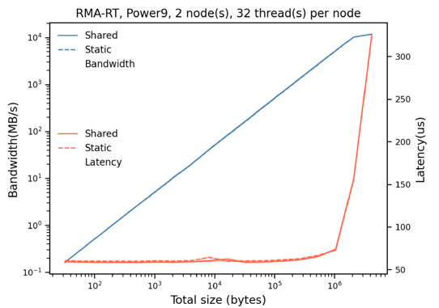
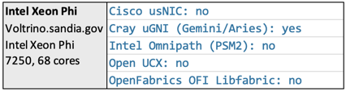
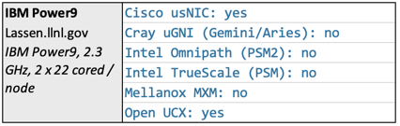
3. Evaluation: Performance Overhead
RMA-MT
Experimental implementation
Shared threading API
Intel Xeon Phi and IBM Power9
Static versus shared library
All function declared as extern
Using Pthreads
mpirun --np 2 --map-by ppr:<1,2>:node --bind-to socket rmamt_<bw,lat> -x -t <num_threads> -o put -s fence

Slide 15
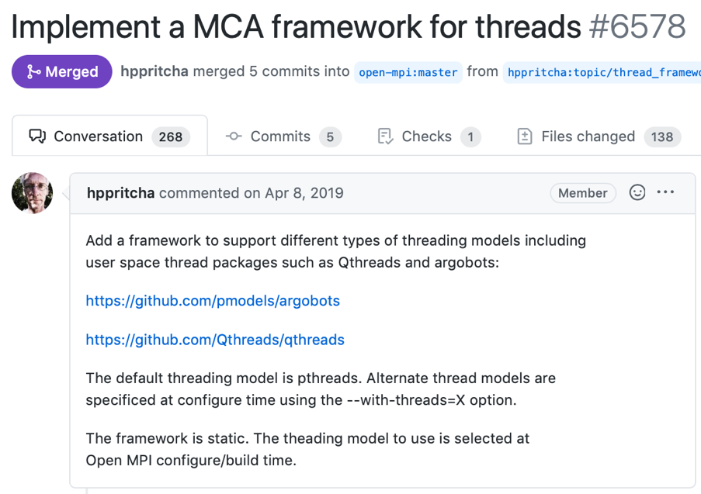
4. What’s next?
Show and quantify benefits of ULTs in Open MPI and MPI+X
Optimize the use of ULT in the Open MPI threading API
Investigate usefulness and implications of an “at run-time” selection of threading library (no static linking or static variables)
Resolve correctness issue in regard to ULT-to-Pthread mapping (deadlock)
Libevent support for ULTs
https://github.com/open-mpi/ompi/pull/6578

Slide 16


5. Summary
Threading support in Open MPI is a hybrid approach.
Management functionality implemented following MCA .
Hot-path functionality statically defined and in-lined.
Use --with-threads=<threading model>.
Evaluation shows no significant performance differences.
Base work for a lot of interesting future work.
Find us on Slack!
https://qthreads.slack.com/
https://github.com/open-mpi
https://github.com/qthreads
https://github.com/argobots

