Slide 1
Impact of High Performance Sockets on Data Intensive Applications
Pavan Balaji, Jiesheng Wu,
D.K. Panda,
CIS Department
The Ohio State University
Tahsin Kurc, Umit Catalyurek,
Joel Saltz,
BMI Department
The Ohio State University

Slide 2
Presentation Layout
Motivation and Background
Sockets Implementations
DataCutter Library
Experimental Results
Conclusions and Future Work

Slide 3
Background
Data Intensive Applications
Communication Intensive; I/O Intensive
Require Guarantees in Performance
Scalability with guarantees
Adaptability to Heterogeneous Networks
Several of them are built over TCP/IP
Times have changed
Faster networks available (cLAN, InfiniBand)
Faster protocols available (VIA, EMP)

Slide 4
Motivation
High Performance Sockets Layers
Take advantage of faster networks [balaji02, shah99]
No changes to the applications
Bottleneck: Design of Applications based on TCP/IP Communication
Questions
Can a high performance substrate allow the implementation of a scalable interactive data-intensive application with performance guarantees to the end user?
Can a high performance substrate improve the adaptability of data-intensive applications to heterogeneous environments?
“High Performance User-Level Sockets over Gigabit Ethernet”, Pavan Balaji, Piyush Shivam, Pete Wyckoff and D. K. Panda, Cluster 2002, Chicago
“High Performance Sockets and RPC over Virtual Interface (VI) Architecture”, H. V. Shah, C. Pu and R. S. M., CANPC workshop 1999.

Slide 5
Latency with Bandwidth Constraint
TCP
Bandwidth
VIA
λ₀
TCP
Latency
VIA
Reqd BW
λ₁
λ₂
μ₁
μ₀
μ₁
μ₀
Message Size
Message Size
Latency Vs Message Size is studied
Latency Vs Bandwidth is relevant for performance guarantees

Slide 6
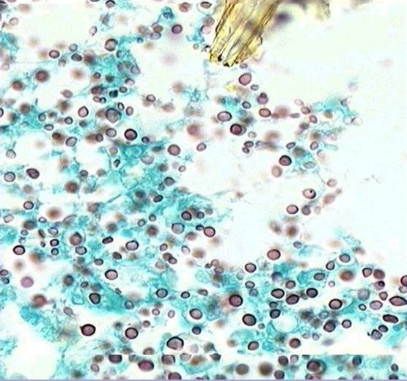
An Example…
TCP
VIA
TCP
VIA
Reqd BW
μ₁
μ₀
μ₁
μ₀
Image rendering should be interactive
Response times should be small

Slide 7
Pipelining: Computation/Communication Overlap
Root Node
Computation
TCP
Latency
Compute Nodes
VIA
μ₁
μ₀
Linear Computation with Message Size
Message Size (log Scale)

Slide 8
An Example…
Consider for perfect pipelining
TCP requires 16KB message size
VIA requires 2KB message size
Say the computation function takes 1 sec/KB
Each computation step takes
16 secs for TCP
2 secs for VIA
Root Node
Compute Nodes
Say, a node becomes slower by a factor of 2
Time taken by compute node
(16 * 2) = 32 secs for TCP
Increases by 16 seconds
(2 * 2) = 4 secs for VIA
Increases by 2 seconds
Linear Computation with Message Size

Slide 9
Presentation Layout
Motivation and Background
Sockets Implementations
DataCutter Library
Experimental Results
Conclusions and Future Work

Slide 10
Sockets Implementations
Traditional Berkeley Sockets
GigaNet Sockets (LANE)
SocketVIA
Application
Application
Application or Library
Sockets
Sockets over VIA
Sockets
TCP
VIPL
TCP
IP
IP
OS Agent
IP-to-VI layer
NIC
“VI aware” NIC
GigaNet cLAN NIC
Pros
High Compatibility
Cons
Kernel Context Switches
Multiple Copies
CPU Resources
Kernel Context Switches
Multiple Copies
CPU Resources
High Performance

Slide 11
Experimental Setup
16 Dell Precision 420 Nodes
Dual 1 GHz PIII Processors
32bit 33MHz PCI bus
512MB SDRAM and 256K L2-level cache
Linux kernel version 2.2.17
GigaNet cLAN NICs
cLAN 1000 Host Adapters
cLAN 5300 Cluster switches

Slide 12
Performance of SocketVIA Vs TCP
Latency: TCP (45us), VIA (9us), SocketVIA (9.5us)
Bandwidth: TCP (510Mbps), VIA (790Mbps), SocketVIA (763Mbps)

Slide 13
Presentation Layout
Motivation and Background
Sockets Implementations
DataCutter Library
Experimental Results
Conclusions and Future Work

Slide 14
DataCutter Software Support for Data Driven Applications
Component Framework for Combined Task/Data Parallelism
User defines sequence of pipelined components (filters and filter groups)
Stream based communication
User directive tells preprocessor/runtime system to generate and instantiate copies of filters
Flow control between transparent filter copies
Replicated individual filters
Transparent: single stream illusion
http://www.datacutter.org

Slide 15
DataCutter Library
Applications
Applications
DataCutter Library
DataCutter Library
Sockets over VIA
Sockets
VIPL
TCP
IP
OS Agent
NIC
GigaNet cLAN NIC

Slide 16
Virtual Microscope Server
View
read
decompress
clip
subsample
Pipelining of various stages: data reading, decompress, clipping, sub-sampling operations can be realized as a chain of filters.
Replication of filters to obtain parallelism

Slide 17
Software Load Balancing Data Reading
Load Balancer
Slower Node

Slide 18
Presentation Layout
Motivation and Background
Sockets Implementations
DataCutter Library
Experimental Results
Conclusions and Future Work

Slide 19
Experiments Conducted
Optimal Block Size
Guarantee on Updates per Second (Complete Image)
Guarantee on Latency of Partial Update (Moving the Image)
Round Robin Load Balancing
Demand Driven Load Balancing

Slide 20
Effects of Guarantees on Updates per Second (Complete Images)
SocketVIA performs better
TCP can’t give guarantees > 3.25
but…
Limited improvement
Design Decisions are bottlenecks
Re-sizing of data blocks
Try to alleviate the bottlenecks
Only concern is Updates per Second
Achievable at low block sizes
No application changes (in this case)
Significant performance improvement

Slide 21
Effects of Guarantees on Latency of Partial Updates (Moving the Image)
For High latency guarantees…
Blindly using is good enough
Bandwidth Saturation
Pre-tuned applications
For Low latency guarantees…
TCP is no longer in the picture
Blindly using SocketVIA is not OK
Resizing of blocks can help

Slide 22
Effect of Heterogeneous Clusters on Round Robin (RR) Scheduling
Dynamic Heterogeneity
Shared Processors
Process Swapping
Perfect Pipelining
Complete overlap of comm. with comp.
Occurs at 16KB for TCP
At 2KB for VIA
Scope of Error
A larger chunk to a slower node
More time for complete the chunk
More time for the load balancer to react

Slide 23
Effect of Heterogeneous Clusters on Demand Driven (DD) Scheduling
Demand Driven Scheduling
Additional Latency Cost
SocketVIA should perform better (?)
Natural overlap of comm. with comp.
Use of SocketVIA or TCP makes no diff.

Slide 24
Presentation Layout
Motivation and Background
Sockets Implementations
DataCutter Library
Experimental Results
Conclusions and Future Work

Slide 25
Conclusions and Future Work
High Performance Sockets are good !
It’s your friend
But, use it wisely
Minor changes can make a major impact
Order of magnitude performance improvement
Sustained Performance Guarantees
Fine grained Load-Balancing
Higher Adaptability to Heterogeneous Networks
Benefits of Parallelization over Pipelining with SocketVIA for large clusters
High Performance Sockets Implementations
TCP Termination (for the DataCenter environment)
Use in DSM, DataCenter and Storage Server environments

Slide 26
Thank You!
For more information, please visit the
http://nowlab.cis.ohio-state.edu
Network Based Computing Group,
The Ohio State University
NBC
Home Page

