Slide 1
QoPS: A QoS based Scheme for Parallel Job Scheduling
M. Islam P. Balaji
P. Sadayappan and D. K. Panda
Computer and Information Science
The Ohio State University
Presented by Gerald Sabin

Slide 2
Job Schedulers Today
Independent Parallel Job Scheduling Model
Dynamically arriving Independent Parallel Jobs
Resource mapping: Submitted Jobs to Resources present
Number of Techniques studied over the years
Backfilling (Ex: Conservative, EASY, No Guarantee)
Priority based scheduling
Differentiated service to different classes of jobs
Soft Real-time or Best Effort guarantees to the completion time
Hard Real-Time or “Deadline-based” scheduling
Allow Users to specify the deadline they desire
Cost model based on Resources Used AND Deadline Specified
Requires a deadline-based scheduling algorithm: LONG OVERDUE !

Slide 3
QoS for Job Scheduling
Two Components in providing QoS
Cost Model Component
Based on Resources Used AND Deadline Specified
More urgent jobs are charged more
Guarantees the service requested
Job Scheduling Component
Admission Control
Can we meet the specified deadline?
Once admitted, cannot miss the specified deadline
We only deal with the Job Scheduling Component

Slide 4
Overview
Related Work
The QoPS Algorithm
Simulation Approach
Experimental Results
Conclusions and Future Work

Slide 5
Related Work
Feitelson’s Slack-Based (SB) Scheduling [feit97]
Focused on improving Utilization and Turnaround time
Jobs have an associated slack, based on their priority
This determines how much they can be delayed
Ramamritham’s Real-Time (RT) Scheduling [krithi90]
Deadline-based scheduling algorithm
Non-periodic Single Processor Jobs
Statically available at start time
[feit97]: “Supporting Priorities and Improving Utilization of the IBM SP2 Scheduler using Slack based Backfilling”, D. Talby, D. G. Feitelson, IPPS, Apr ’97
[krithi90]: “Efficient Scheduling Algorithms for Real-Time Multiprocessor Systems”, K. Ramamritham, J. A. Stankovic, P-F. Shiah, TPDS, Apr ‘90

Slide 6
Slack-Based (SB) Scheduling Algorithm
When a job (J_{N+1}) arrives
Calculate its slack (based on its priority)
If J₁, J₂, …, J_{N} are already present and scheduled in that order
Try placing the job (J_{N+1}) in each possible position in this list
For each of the N+1 schedules feasible, calculate a cost function ‘f’
A schedule is feasible if no job exceeds the slack given to it
Choose the schedule with the “best cost function value”
f_{best}
f₀
f₁
f₂
f₃
f₄
f₅
f₆
J₇
Cost Function Evaluation
Cost Function Evaluation
Cost Function Evaluation
J₆
J₆
J₆
J₆
J₅
J₅
J₅
J₅
J₄
J₄
J₄
J₄
J₃
J₃
J₃
J₃
J₂
J₂
J₂
J₇
J₁
J₁
J₇
J₂
J₇
J₁
J₁

Slide 7
Real-Time (RT) Scheduling Algorithm
Static Scheme, so there’s no concept of new jobs arriving
Sort jobs based on a heuristic function
Start from a NULL schedule
For each of the jobs
If placing the job in the current schedule misses its deadline
Backtrack to the last known feasible schedule
If (number of backtracks > p) Discard the Schedule
If all jobs have been placed within their deadlines
Accept the Schedule

Slide 8
Working of the RT Algorithm
J_{N} J_{N-1} J_{N-2} . . . J₃ J₂ J₁
Sorted by Earliest Deadline first (EDF)
NULL
J₁
J₂
J₃
J₂
J₄
J₃
J₄

Slide 9
Modified Slack-Based (MSB) Algorithm
Modified Slack-Based (MSB) Algorithm
Motivation of SB: To improve Utilization and Response Time
SB assigns slack to jobs based on job priorities
MSB assigns slack to jobs based on the deadline specified
Rest of the algorithm is unchanged

Slide 10
Modified Real-Time (MRT) Algorithm
Modified Real-Time (MRT) Algorithm
RT was designed for non-periodic uni-processor jobs
All jobs are Statically available at the start of the execution
MRT involves two modifications to RT
To allow dynamically arriving jobs
Run the algorithm every time a job arrives
To allow scheduling of parallel jobs
Allowing backfilling of jobs

Slide 11
Overview
Related Work
The QoPS Algorithm
Simulation Approach
Experimental Results
Conclusions and Future Work

Slide 12
The Basic QoPS Algorithm
Similar to the MSB algorithm, but…
Provides more flexibility in reordering scheduled jobs
When a job (J_{N+1}) arrives
If J₁, J₂, …, J_{N} are already present and scheduled in that order
Place the job (J_{N+1}) at the start of all jobs
Try scheduling the jobs in that order
If all jobs are able to meet their deadlines, Great ! Admit it !
If some job fails, we have two options:
Option1:
Consider the failed job as a critical job
Push the failed job to the start of the schedule and retry
‘k’ number of such re-orderings of existing jobs are allowed
If (number of re-orderings > k) switch to option 2
Option2:
Back off exponentially in the position at which you try placing job (J_{N+1}) and retry

Slide 13
Working of the QoPS Algorithm
J₁₃
J₁₂
J₁₁
J₁₀
J₉
J₈
J₇
J₆
J₁₃
J₅
J₆
J₄
J₅
J₃
J₂
J₁
J₁
J₂
J₁
J₁₃
J₃
J₁
J₁₃
J₃
J₂
J₁₃
J₃
J₂
J₄
Current Violations = 0
Current Violations = 1
Current Violations = 2
Current Violations = 0
J₄
J₃
J₂
J₁
J₂
J₁
J₁₃
J₁
J₁₃
J₃
J₁₃
J₃
J₂
Max. Violations Allowed = 2

Slide 14
Overview
Related Work
The QoPS Algorithm
Simulation Approach
Experimental Results
Conclusions and Future Work

Slide 15
Simulation Approach
CTC/SDSC Trace
Duplication/Expansion
Load Variation
Deadline Calculator
Deadline-based Trace
QoPS
Simulation
MSB
Simulation
MRT
Simulation
EASY
Simulation

Slide 16
Trace Generation
Many job logs available, but no associated deadlines
Synthetic Deadline Generation
Generate a schedule for the job trace using EASY
For any job J, if the Turnaround time in this schedule is T
Deadline for J = Arrival Time + max (runtime, (1-SF) x T)
SF is the “Stringency factor” (0 < SF < 1)
0 would give the least stringent deadlines and 1 the most stringent
Some jobs might not come with deadlines
Very lax deadlines to prevent starvation
If ‘T’ is the current expected Turnaround time,
Deadline = Arrival Time + max (24hrs, R x T)
R is the “Relaxation Factor” of the schedule

Slide 17
Overview
Related Work
The QoPS Algorithm
Simulation Approach
Experimental Results
Conclusions and Future Work

Slide 18
Experimental Results
Two evaluation scenarios
Scenario1:
All jobs have deadlines
Pure comparison of the three algorithms
Scenario2:
Mixed jobs: Some have deadlines, others are artificially provided
More realistic
Tests Conducted:
Job Acceptance rate
Impact on Non-deadline Jobs
Utilization Variation, etc

Slide 19
Admittance Capacity Comparison
All jobs have deadlines; Stringency Factor = 0.2; CTC Trace
QoPS admits the most number of jobs (and Processor Seconds)

Slide 20
Utilization Comparison
All jobs have deadlines; CTC Trace
Deadline-based schemes lose about 10% Utilization

Slide 21
Admittance Capacity Comparison (Mixed Jobs)
20% jobs have deadlines; Stringency Factor = 0.2; CTC Trace
QoPS admits the most number of jobs (and Processor Seconds)

Slide 22
Response Time and Slow Down Vs Load
20% jobs have deadlines; Stringency Factor = 0.2; CTC Trace
QoPS gives the best slow-down in spite of accepting more jobs; Unfair to EASY

Slide 23
Utilization Vs Load (Mixed Jobs)
EASY has a higher Utilization
Accepts more (all) jobs; Unfair to the deadline-based schemes

Slide 24
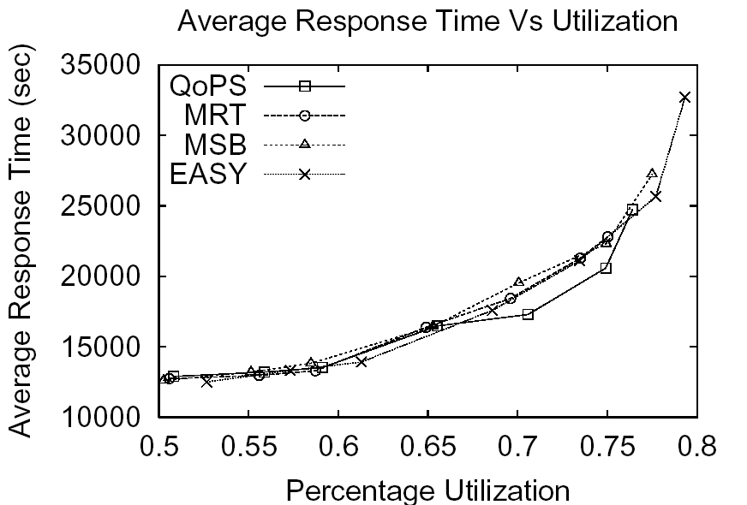
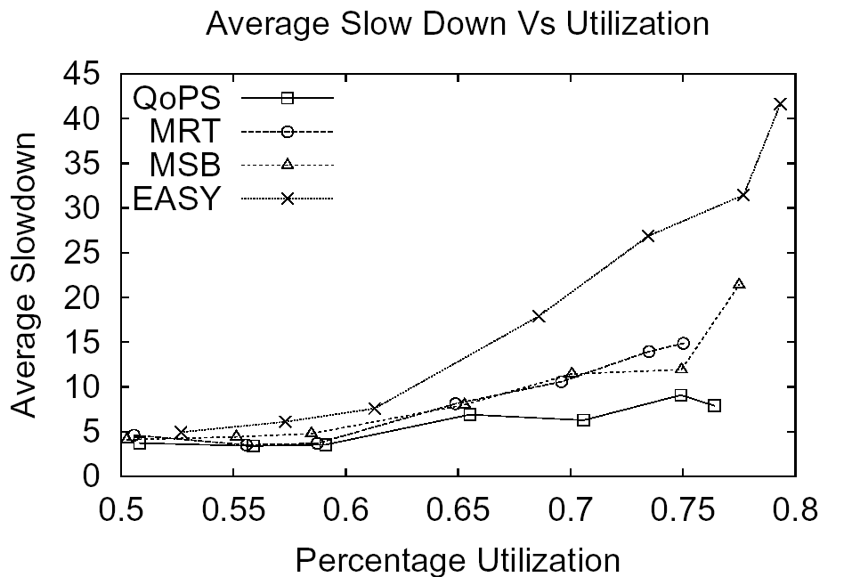
Response Time and Slow Down Vs Utilization
20% jobs have deadlines; Stringency Factor = 0.2; CTC Trace
Fairer Comparison; QoPS still performs better in most cases, especially Slow Down

Slide 25
Overview
Related Work
The QoPS Algorithm
Simulation Approach
Experimental Results
Conclusions and Future Work

Slide 26
Conclusions
“Deadline-based” scheduling is desirable
No such scheme for parallel jobs
Previous schemes can be extended, but…
Not proposed for this kind of scheduling
Might not fit in perfectly
Proposed the QoPS algorithm
Allows jobs to specify required deadlines
Admission control checks admissibility
Job Scheduler schedules admitted jobs
Outperforms extended previous schemes (MSB and MRT)
But, the main idea is not performance
Deadline Scheduling is a necessity and QoPS is an effort to meet it

Slide 27
Future Work
Cost Metric component in QoS
Currently using a first fit mechanism
Best fit is expected to do much better
Job Shedding Vs Non Job Shedding
If deadline can’t be met
Should we reject the job (will the user try again?)
Should we give it the best available deadline
Grid based extensions to QoPS

Slide 28
Thank You !

Slide 29
Backup Slides

Slide 30
Admittance Capacity for SDSC trace
All jobs have deadlines; Stringency Factor = 0.2; CTC Trace
QoPS admits the most number of jobs (and Processor Seconds)

Slide 31
Admittance Capacity with Job Expansion
All jobs have deadlines; Stringency Factor = 0.2; CTC Trace
QoPS admits the most number of jobs (and Processor Seconds)

Slide 32
Impact of Relaxation Factor
80% jobs have deadlines; Stringency Factor = 0.2; CTC Trace
With low “R”, Longer jobs perform better (reflects in Resp. Time)

