Slide 1
Sockets Direct Protocol Over InfiniBand in Clusters: Is it Beneficial?
P. Balaji, S. Narravula, K. Vaidyanathan, S. Krishnamoorthy, J. Wu and D. K. Panda
Network Based Computing Laboratory
The Ohio State University

Slide 2
Presentation Layout
Introduction and Background
Sockets Direct Protocol (SDP)
Multi-Tier Data-Centers
Parallel Virtual File System (PVFS)
Experimental Evaluation
Conclusions and Future Work

Slide 3
Introduction
Advent of High Performance Networks
Ex: InfiniBand, Myrinet, 10-Gigabit Ethernet
High Performance Protocols: VAPI / IBAL, GM, EMP
Good to build new applications
Not so beneficial for existing applications
Built around Portability: Should run on all platforms
TCP/IP based Sockets: A popular choice
Performance of Application depends on the Performance of Sockets
Several GENERIC optimizations for sockets to provide high performance
Jacobson Optimization: Integrated Checksum-Copy [Jacob89]
Header Prediction for Single Stream data transfer
[Jacob89]: “An analysis of TCP Processing Overhead”, D. Clark, V. Jacobson, J. Romkey and H. Salwen. IEEE Communications

Slide 4
Network Specific Optimizations
Generic Optimizations Insufficient
Unable to saturate high performance networks
Sockets can utilize some network features
Interrupt Coalescing (can be considered generic)
Checksum Offload (TCP stack has to modified)
Insufficient!
Can we do better?
High Performance Sockets
TCP Offload Engines (TOE)

Slide 5
High Performance Sockets
Traditional Berkeley Sockets
High Performance Sockets
User Space
Application or Library
Application or Library
User Space
Pseudo sockets layer
Sockets
Network
Native Protocol
Kernel
TCP
IP
Kernel
Sockets
OS Agent
Hardware
NIC
Hardware
High Performance Network

Slide 6
InfiniBand Architecture Overview
Industry Standard
Interconnect for connecting compute and I/O nodes
Provides High Performance
Low latency of lesser than 5us
Over 840MBps uni-directional bandwidth
Provides one-sided communication (RDMA, Remote Atomics)
Becoming increasingly popular

Slide 7
Sockets Direct Protocol (SDP*)
IBA Specific Protocol for Data-Streaming
Defined to serve two purposes:
Maintain compatibility for existing applications
Deliver the high performance of IBA to the applications
Two approaches for data transfer: Copy-based and Z-Copy
Z-Copy specifies Source-Avail and Sink-Avail messages
Source-Avail allows destination to RDMA Read from source
Sink-Avail allows source to RDMA Write to the destination
Current implementation limitations:
Only supports the Copy-based implementation
Does not support Source-Avail and Sink-Avail
*SDP implementation from the Voltaire Software Stack

Slide 8
Presentation Layout
Introduction and Background
Sockets Direct Protocol (SDP)
Multi-Tier Data-Centers
Parallel Virtual File System (PVFS)
Experimental Evaluation
Conclusions and Future Work

Slide 9
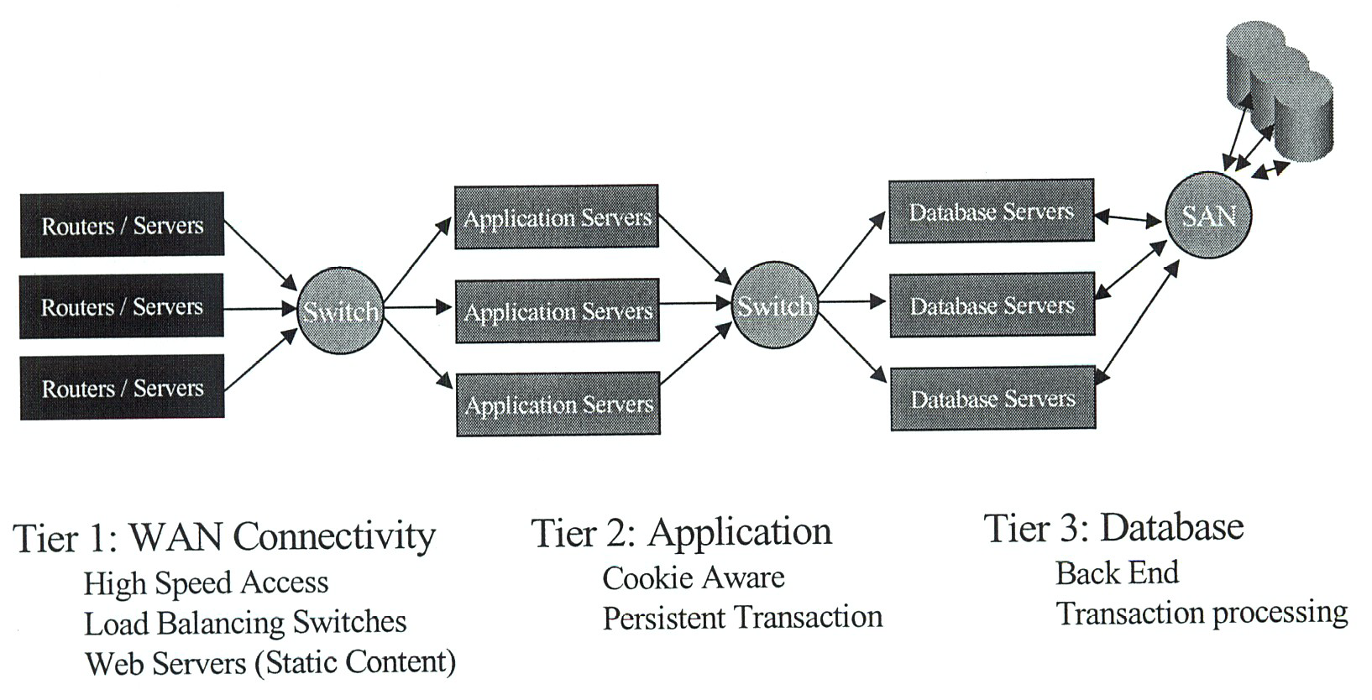
Multi-Tier Data-Centers
(Courtesy Mellanox Corporation)
Client Requests come over the WAN (TCP based + Ethernet Connectivity)
Traditional TCP based requests are forwarded to the inner tiers
Performance is limited due to TCP
Can we use SDP to improve the data-center performance?
SDP is not compatible with traditional sockets: Requires TCP termination!

Slide 10
3-Tier Data-Center Test-bed at OSU
Apache
Caching
Web Servers
Tier 0
Tier 2
Database Servers
Clients
Proxy Nodes
MySQL
or
DB2
WAN
Tier 1
Application Servers
Generate requests for both web servers and database servers
File System evaluation Caching Schemes
TCP Termination Load Balancing Caching
PHP
Apache
Dynamic Content Caching Persistent Connections

Slide 11
Presentation Layout
Introduction and Background
Sockets Direct Protocol (SDP)
Multi-Tier Data-Centers
Parallel Virtual File System (PVFS)
Experimental Evaluation
Conclusions and Future Work

Slide 12
Parallel Virtual File System (PVFS)
Compute
Node
Network
Meta-Data
Manager
Meta
Data
Compute
Node
I/O Server
Node
Data
Compute
Node
I/O Server
Node
Data
Compute
Node
I/O Server
Node
Data
Relies on Striping of data across different nodes
Tries to aggregate I/O bandwidth from multiple nodes
Utilizes the local file system on the I/O Server nodes

Slide 13
Parallel I/O in Clusters via PVFS
Applications
…
Applications
Posix
MPI-IO
Posix
MPI-IO
libpvfs
libpvfs
Control
Data
Network
iod
…
iod
mgr
Local file systems
Local file systems
PVFS: Parallel Virtual File System
Parallel: stripe/access data across multiple nodes
Virtual: exists only as a set of user-space daemons
File system: common file access methods (open, read/write)
Designed by ANL and Clemson
“PVFS over InfiniBand: Design and Performance Evaluation”, Jiesheng Wu, Pete Wyckoff and D. K. Panda. International Conference on Parallel Processing (ICPP), 2003.

Slide 14
Presentation Layout
Introduction and Background
Sockets Direct Protocol (SDP)
Multi-Tier Data-Centers
Parallel Virtual File System (PVFS)
Experimental Evaluation
Micro-Benchmark Evaluation
Data-Center Performance
PVFS Performance
Conclusions and Future Work

Slide 15
Experimental Test-bed
Eight Dual 2.4GHz Xeon processor nodes
64-bit 133MHz PCI-X interfaces
512KB L2-Cache and 400MHz Front Side Bus
Mellanox InfiniHost MT23108 Dual Port 4x HCAs
MT43132 eight 4x port Switch
SDK version 0.2.0
Firmware version 1.17

Slide 16
Latency and Bandwidth Comparison
SDP achieves 500MBps bandwidth compared to 180MBps of IPoIB
Latency of 27us compared to 31us of IPoIB
Improved CPU Utilization

Slide 17
Hotspot Latency
SDP is more scalable in hot-spot scenarios

Slide 18
Data-Center Response Time
SDP shows very little improvement: Client network (Fast Ethernet) becomes the bottleneck
Client network bottleneck reflected in the web server delay: up to 3 times improvement with SDP

Slide 19
Data-Center Response Time (Fast Clients)
SDP performs well for large files; not very well for small files

Slide 20
Data-Center Response Time Split-up
IPoIB
SDP

Slide 21
Data-Center Response Time without Connection Time Overhead
Without the connection time, SDP would perform well for all file sizes

Slide 22
PVFS Performance using ramfs

Slide 23
PVFS Performance with sync (ext3fs)
Clients can push data faster to IODs using SDP; de-stage bandwidth remains the same

Slide 24
Conclusions
User-Level Sockets designed with two motives:
Compatibility for existing applications
High Performance for modern networks
SDP was proposed recently along similar lines
Sockets Direct Protocol: Is it Beneficial?
Evaluated it using micro-benchmarks and real applications
Multi-Tier Data-Centers and PVFS
Benefits in environments it’s good for
Communication intensive environments such as PVFS
Demonstrate environments it’s yet to mature for
Connection overhead involving environments such as Data-Centers

Slide 25
Future Work
Connection Time bottleneck in SDP
Using dynamic registered buffer pools, FMR techniques, etc
Using QP pools
Power-Law Networks
Other applications: Streaming and Transaction
Comparison with other high performance sockets

Slide 26
Thank You!
For more information, please visit the
http://nowlab.cis.ohio-state.edu
Network Based Computing Laboratory,
The Ohio State University
NBC
Home Page
Notes:
That’s all about the presentation. I would like to take any questions you might be having.

Slide 27
Backup Slides

Slide 28



TCP Termination in SDP
Personal Notebook/Computer
Network Service Tier
Blade Servers
Browser
HTTP
HTTP
Web Server
HTML
HTML
Sockets
Proxy
Sockets
TCP
SDP
TCP
SDP
IP
IP
OS by pass
Ethernet
Ethernet
Infiniband HW
Infiniband HW
Ethernet Communication
InfiniBand Communication

