Slide 1
A Case for UDP Offload Engines in LambdaGrids
Venkatram Vishwanath, Jason Leigh Electronic Visualization Laboratory, University of Illinois at Chicago
Pavan Balaji, Dhabaleshwar Panda
Ohio State University
Wu-chun Feng
Virginia Tech

Slide 2
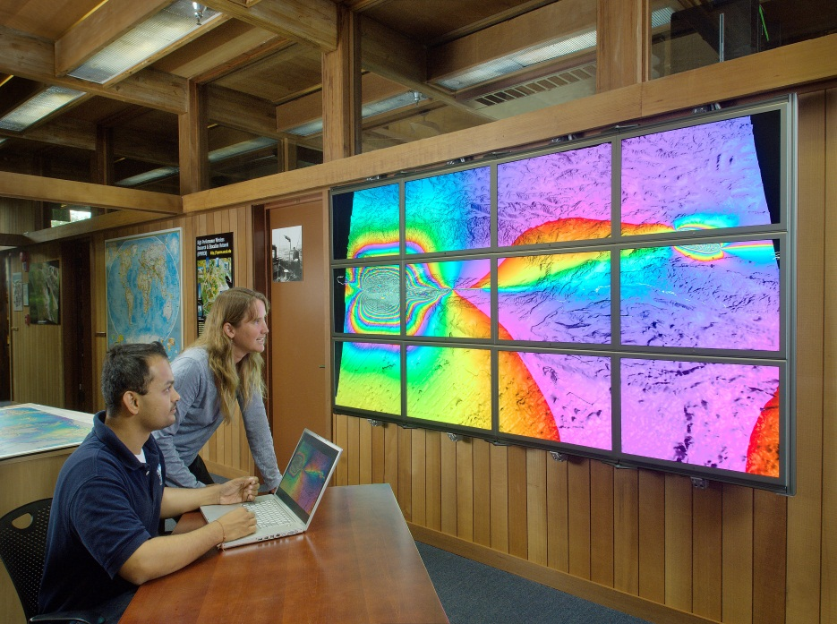
Motivation
Real-time interactive scientific visualization and high-definition video conferencing require high-throughput, low latency and low jitter data delivery.
UDP is commonly used for transporting real-time streaming media.
Trend in large-scale viz is to give users thin low-maintenance clients and have the high resolution visualizations streamed to them from remote supercomputers. E.g. TeraGrid, OptIPuter, IBM Deep Computing Visualization, Sun Ray.
Scripps Institution of Oceanography
Notes:
In the consumer space the biggest bandwidth hogs are video and music, not web surfing.
Driver for high resolution displays is not web browsing or word processing, it’s 8 Megapixel cameras
Movie editing.

Slide 3
Motivation
Reliable UDP-based transport protocols (LambdaStream, RBUDP, UDT, Tsunami) have found a home on the LambdaGrid where network paths can be provisioned by applications for sole use.
But these protocols are CPU intensive.
While TCP offload is available commercially, equivalent for UDP is not.

Slide 4
High Performance Sockets and Protocol Offload Engines
Sockets Application
Offload the processing of Protocols from CPU to the Network Adaptors
Similar to a GPU (NPU)
Currently only TCP Off-load Engines (TOE) are available.
TCP/IP Sockets Interface
Sockets
High Performance Sockets
TCP/IP
Device Driver
Offloaded Transport Protocol
Network Adapter
Notes:
Basic architecture of offloading engines
Infiniband Chelsio Myrinet

Slide 5
Converting a TCP Off-Load Engine (TOE) to a UDP Off-Load Engine (UOE)
Disable Congestion Control.
Change the driver to allow for out of order packets- whereas default TOE will compensate for it.
Seamlessly hijack an application’s UDP calls to use this “alternative”:
Implement a Connection Management Layer to turn a connectionless protocol (such as UDP) into a connection-oriented protocol (ie TOE).
Implement our own Data Management Layer to deal with out of order packets.
Eliminate TCP’s need for Acknowledgments. Not able to completely disable this on Chelsio T110.
Temporary workaround by setting very large window sizes.

Slide 6
Experiment Test Bed
Local Area Network
Dual Opterons 2.4 Ghz
1MB L2 Cache.
4GB 200Mhz DDR SDRAM.
Vanilla 2.6.6 – SMP kernel.
Chelsio T110
Chelsio Driver version 2.1.1

Slide 7
Throughput - UOE vs Traditional Host-based UDP
Initial Iperf results:
7.4 Gbps Maximum throughput.
35% improvement over Host based UDP.

Slide 8
CPU Utilization - UOE vs Host-based UDP
Up to 50% improvement in CPU utilization.
Important because in real applications, CPU has other work to do NOT just move the data. E.g. Decode or decrypt the images / data.
Notes:
UOE Normalized means: Normalized relative to UDP’s achieveable sending rate.
E.g. If standard host-based UDP implementation achieves T thruput, then what is the CPU
Utilization of UOE at that same thruput?

Slide 9
Latency
17% improvement in Latency.

Slide 10
Conclusion
There is a case for them for applications.
There are real benefits in terms of performance by doing it.
Especially useful for streaming visualization / high definition video.
Message from Venkat to Michael Chen :^)
I want: T210s - replacement for T110s. It is the lower power version and much smaller.
When will PCI-Express NICs be available? Netereon is already available.
Would like to correspond more deeply with Chelsio engineers to resolve ACK issues.

Slide 11
Future Work
Compare with Partial Offload and quantify / identify what is the most useful part of a stack to offload. E.g. offload checksum of packet rather than the entire UDP stack.
Conduct MAN and WAN Area trials.
Compare with other Partial offload NICs such as Neterion.
Implementation & Comparison on Myrinet 10G.
Apply UOE implementation to a currently existing UDP-based transport protocol like LambdaStream, RBUDP, UDT, Tsunami, etc..

Slide 12
Thank You
Chelsio Engineers
National Science Foundation:
CNS-0224306 Research Resources: Matching Visualization & Intelligent Data Mining to Experimental Networks
CNS-0420477 LambdaVision (Major Research Instrumentation)
OCI-0229642 StarLight: Strategic Technologies for Internet Discovery and Development (STI)
OCI-0441094 TransLight/StarLight
OCI-0225642 The OptIPuter
National Institutes of Health, the State of Illinois, the Office of Naval Research
NTT Optical Network Systems Laboratory in Japan

