Slide 1
High Performance MPI over iWARP: Early Experiences
S. Narravula, A. Mamidala, A. Vishnu, G. Santhanaraman, and D. K. Panda
Network Based Computing Laboratory (NBCL)
Computer Science and Engineering, Ohio State University
Presented by Pavan Balaji, Argonne National Laboratory

Slide 2
High-performance Parallel Computing with Ethernet
Most widely used network infrastructure today
Used by 41.2% of the Top500 supercomputers
Traditionally notorious for performance issues
Large performance gap compared to IB, Myrinet
Key: Reasonable performance at low cost
TCP/IP over Gigabit Ethernet (GE) saturates the network
Several local stores give out GE cards free of cost ! ☺
10-Gigabit Ethernet (10GE) recently introduced
10-fold (theoretical) increase in performance while retaining existing features

Slide 3
10GE: Technology Trends
Broken into three levels of technologies
Regular 10GigE adapters
Software TCP/IP stack
TCP Offload Engines (TOEs)
Hardware TCP/IP stack
iWARP Offload Engines
Standardized by the RDMAC and IETF
Hardware TCP/IP stack
More features: Remote Direct Memory Access (RDMA), Asynchronous communication, Zero-copy data transfer
[feng03:hoti, feng03:sc, balaji03:rait]
[feng05:hoti, balaji05:cluster]
[jinhy05:hpidc, wyckoff05:rait]

Slide 4
Message Passing Interface
Message Passing Interface (MPI)
De-facto standard for message passing communication
Traditional implementations over Ethernet
Relied on TCP/IP (e.g., MPICH2)
Reasonable for traditional Ethernet networks (e.g., GE)
Advent of iWARP over 10GE
Provides hardware offload capabilities and scalability features
Traditional TCP/IP based implementations not sufficient
Need a high-performance MPI over iWARP !!

Slide 5
Presentation Outline
Introduction
10GE and iWARP Background
Designing MPI over iWARP
Performance Evaluation
Conclusions and Future Work

Slide 6
10-Gigabit Ethernet and iWARP
10 fold increase in Ethernet performance
40G and 100G speeds in development
Hardware offloaded TCP/IP Stack
RDMA Capability
Asynchronous communication
Zero copy data transfers
One-sided interface
WAN capability
Existing iWARP enabled Interconnects
Chelsio, NetEffect, NetXen
Notes:
WAN compatability linked to cluster-of-clusters

Slide 7
iWARP Architecture and Components
iWARP Offload Engines
RDMA Protocol (RDMAP)
Feature-rich interface
Security Management
Remote Direct Data Placement (RDDP)
Data Placement and Delivery
Multi Stream Semantics
Connection Management
Marker PDU Aligned (MPA)
Middle Box Fragmentation
Data Integrity (CRC)
User
Application or Library
RDMAP
RDDP
MPA
SCTP
Hardware
TCP
IP
Device Driver
Network Adapter
(e.g., 10GigE)
Courtesy iWARP Specification

Slide 8
iWARP Software Stack
OFED Gen2 verbs support
Open Fabrics Alliance – http://www.openfabrics.org
RDMA CM for connection setup
ibverbs for communication
Queue pair (QP) based communications
Post Work Queue Entries (WQEs)
WQE describes the buffer to be sent from/received into
Connection
Needs an underlying TCP/IP connection
Connection setup: Client/Server like mechanism

Slide 9
Presentation Outline
Introduction
10GE and iWARP Background
Designing MPI over iWARP
Performance Evaluation
Conclusions and Future Work

Slide 10
Designing MPI over iWARP
MPI Design Components
Protocol
Mapping
Flow
Control
Communication
Progress
Multirail
Support
Buffer
Management
Connection
Management
Collective
Communication
One-sided
Active/Passive
Substrate
QoS
RDMA
Operations
Out-of-order
Placement
Multi-Pathing
VLANs
Send /
Receive
Shared
Receive Queues
Dynamic
Rate Control
iWARP/Ethernet Features

Slide 11
Design Components
Several components similar to other MPI designs
E.g., MVAPICH and MVAPICH2
This paper deals only with a few of them:
Connection Semantics
Semantics mismatch between iWARP and MPI
Multi-channel requirements
Multi-rail and direct one-sided communication
RDMA Fast Path optimization for small messages
Message completion with RDMA
Correctness depends on iWARP implementation

Slide 12
Connection Management
MPI assumes fully-connected model
Communication between multiple peers without explicit connections
Any node can start communicating with any other node
Peer-to-peer semantics
iWARP assumes client/server model
Client initiates connection and server accepts it
TCP/IP like semantics
Message initiation restrictions (client has to initiate)
Need to establish pairs of clients/servers for connection setup

Slide 13
Basic Connection Management
MPI processes divided into client/servers pairs
(Pi, Pj): i is the server if (i < j)
Exchange ports/IPs
Resolve addresses
Initiate connection request
MPI level communication
Not yet ready
Listen
Exchange
IPs/Ports
Barrier
Resolve Address
And Route
Accept
Connection
Established
Connection
Established
Process i
(i < j)
Process j
Notes:
Connection will be ready to use once the dummy message is sent from client to server. Explained in the next slide.

Slide 14
Client->Server Message Initiation
Listen
Exchange
IPs/Ports
Dummy message is created and sent from client to server
MPA requirement
NOOP packet used
Barrier
Resolve Address
And Route
Accept
Connection
Established
Connection
Established
Initiate Dummy
Data Transfer
MPI peers ready
to communicate
Process i
(i < j)
Process j

Slide 15
Implementation Details
Integrated into MVAPICH2
High Performance MPI-1/MPI-2 implementation over InfiniBand and iWARP
Has powered many supercomputers in TOP500 supercomputing rankings
Currently being used by more than 545 organizations (academia and industry worldwide)
http://mvapich.cse.ohio-state.edu/
The iWARP design is available with current MVAPICH2 release

Slide 16
Presentation Outline
Introduction
10GE and iWARP Background
Designing MPI over iWARP
Performance Evaluation
Conclusions and Future Work

Slide 17
Experimental Testbed
Quad core Intel Xeon 2.33Ghz, 4 GB memory
Chelsio T3B 10GE PCIe RNICs, 24 port Fulcrum switch
OFED 1.2 rc4 software stack, RH4 U4
MPIs
MPICH2 1.0.5p3 → TCP/IP based
MVAPICH2-R → RDMA based
MVAPICH2-SR → Send/Recv based
MVAPICH2-1SC → RDMA one-sided enabled
Notes:
MVAPICH2-SR is essentially MVAPICH2 without the RDMA fast path optimization

Slide 18
Experiments Performed
Basic MPI two sided benchmarks
Latency and Bandwidth
MPI one sided benchmarks
Get and Put
MPI collectives
Barrier, Allreduce and Allgather
NAS parallel benchmarks
IS and CG

Slide 19
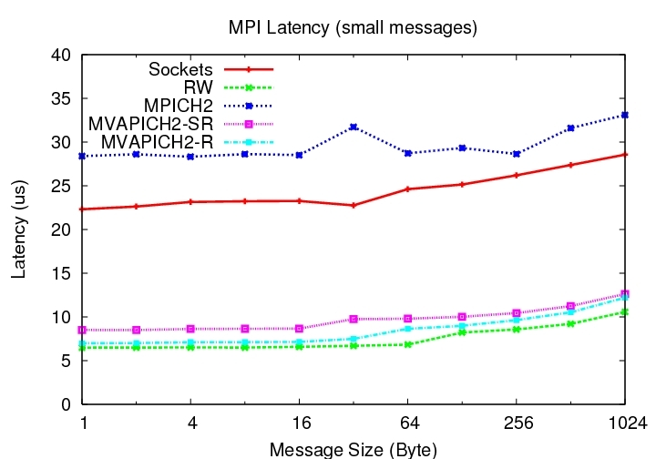
Latency
MVAPICH2-R supports a low latency of about 7 us

Slide 20
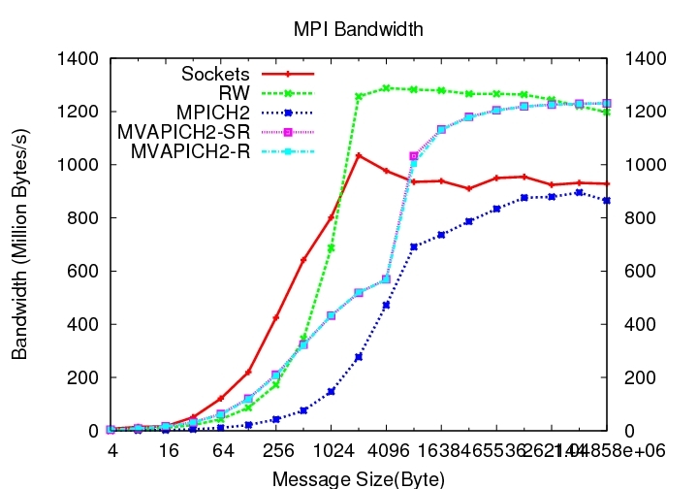
Bandwidth
MVAPICH2 achieves a peak bandwidth of 1231 MB/s

Slide 21
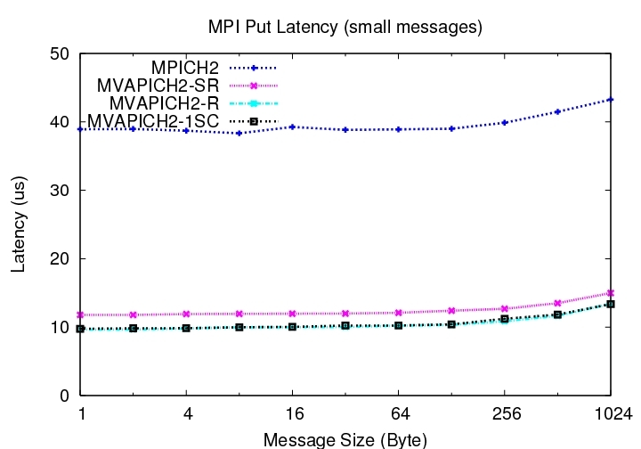
MPI Put Latency
MVAPICH2 shows an improvement of about 4 times in latency
over MPICH2

Slide 22
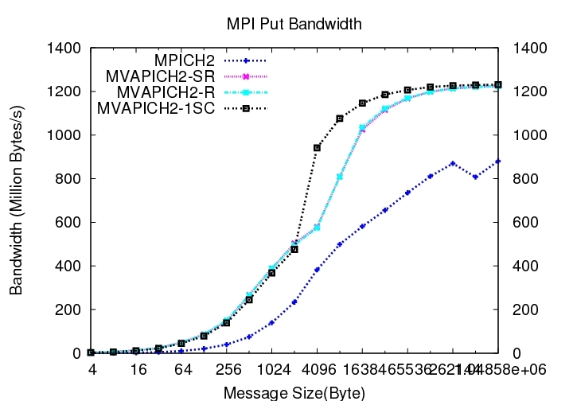
MPI Put Bandwidth
MVAPICH2 shows an improvement in bandwidth of up to 40%
over MPICH2

Slide 23
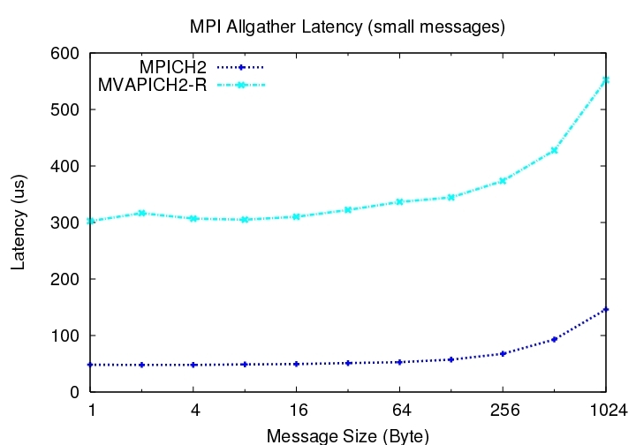
MPI Allgather
MVAPICH performs up to 84% better for Allgather for 32 processes

Slide 24
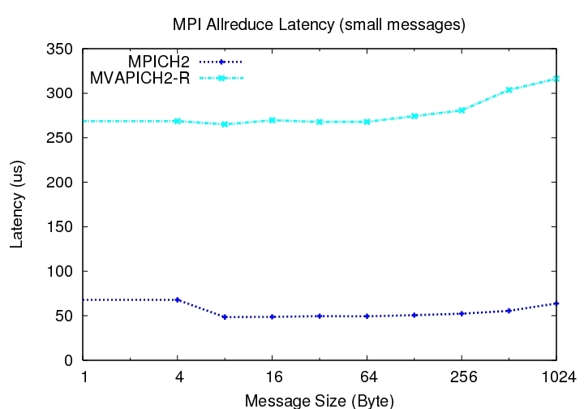
MPI Allreduce
MVAPICH performs up to 80% better for Allreduce for 32 processes

Slide 25
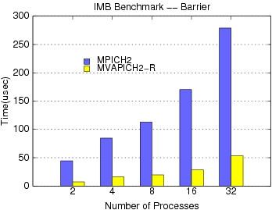
MPI Barrier
MVAPICH2 performs up to 80% better for barrier for 32 processes

Slide 26
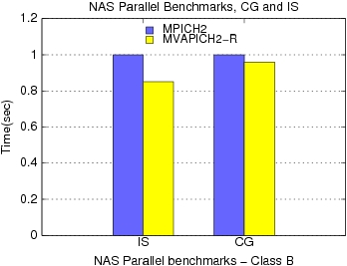
NAS
MVAPICH2 performs up to 16% better than MPICH2 for IS

Slide 27
Presentation Outline
Introduction
10GE and iWARP Background
Designing MPI over iWARP
Performance Evaluation
Conclusions and Future Work

Slide 28
Conclusions and Future Work
High performance MPI design over iWARP
First Native iWARP capable MPI
Significant performance gains over TCP/IP based implementations
Integrated into MVAPICH2 release 0.9.8 onwards
Future Work
Utilize iWARP capabilities like SRQ’s, multi-pathing VLANs, etc to further optimize MPI-iWARP
Optimize and evaluate MPI-iWARP in emerging cluster-of-cluster scenarios

Slide 29
Questions?
Web Pointers
http://mvapich.cse.ohio-state.edu
{narravul, mamidala, vishnu, santhana, panda}
@ cse.ohio-state.edu

Slide 30
Backup Slides

Slide 31
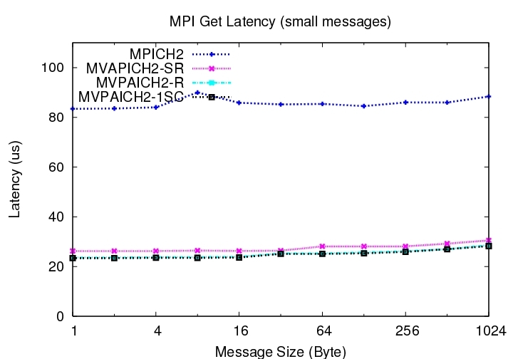
MPI Get Latency
MVAPICH2 shows a latency improvement of about 3.6 times over MPICH2

Slide 32
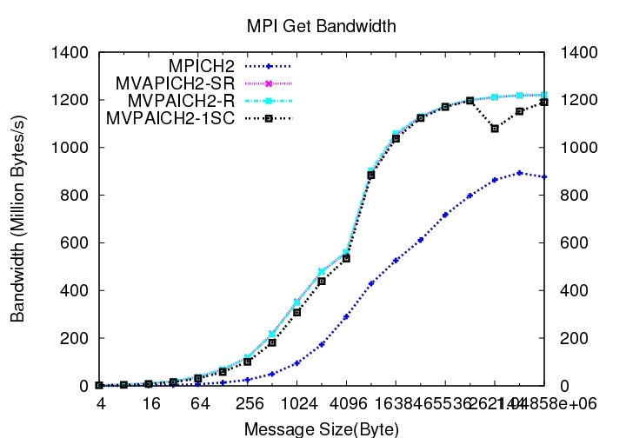
MPI Get Bandwidth

Slide 33
iWARP Capabilities
Features | iWARP capability
Hardware offloaded Protocol | Supported
RDMA | Supported
Atomic Operations | Not supported
Multicast | Not supported by current implementations
QoS | Not supported by current implementations
Data Placement | Out-of-order
Data Rate-control | Dynamic and Fine-grained

