Slide 1
Designing Efficient Systems Services and Primitives for Next-Generation Data-Centers
K. Vaidyanathan, S. Narravula, P. Balaji and D. K. Panda
Network Based Computing Laboratory (NBCL)
Computer Science and Engineering
Ohio State University

Slide 2
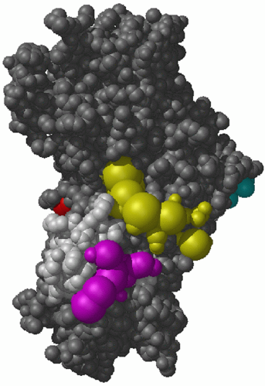
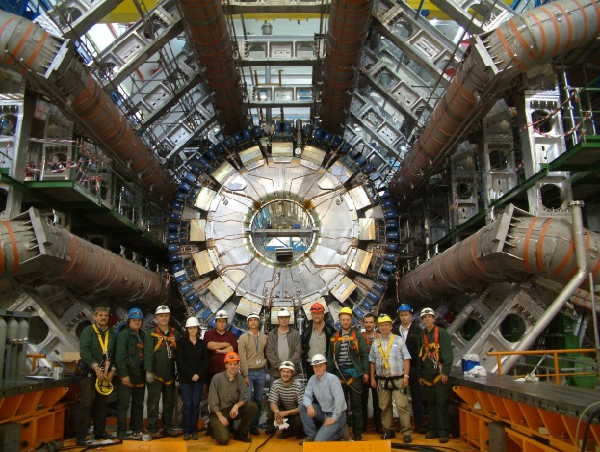
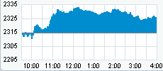
Introduction and Motivation
Interactive Data-driven Applications
Scientific as well as Enterprise/Commercial Applications
Static Datasets: Medical Imaging Modalities
Dynamic Datasets: Stock value datasets, E-commerce, Sensors
Need for interacting, synthesizing and visualizing large datasets
Data-centers enable such capabilities
Clients initiate queries (over the web) to process specific datasets
Data-centers process data and reply to queries

Slide 3
Typical Multi-Tier Data-center Environment
Web-server (Apache)
Proxy Server
Clients
WAN
More Computation and Communication
Requirements
Storage
Database Server (MySQL)
Application Server (PHP)
Requests are received from clients over the WAN
Proxy nodes perform caching, load balancing, resource monitoring, etc.
If not cached, the request is forwarded to the next tiers → Application Server
Application server performs the business logic (CGI, Java servlets, etc.)
Retrieves appropriate data from the database to process the requests

Slide 4
Overview of Research
Propose a novel framework for next generation data-centers
Delivering performance and scalability
Providing advanced features such as active caching, fine-grain resource monitoring, dynamic resource adaptation, etc
Novel approaches using the advanced features of InfiniBand and other RDMA-enabled Networks
Resilient to the load on the back-end servers
Order of magnitude performance gain for several scenarios
Exploit features like RDMA and remote atomic operations for new primitives and services
Three-layer Architecture
Advanced Communication Protocol Support
Data-Center Primitives
Data-Center Services

Slide 5
Proposed Architecture
Existing Data-Center Components
Dynamic Content Caching
Active Resource Adaptation
Advanced System Services
Active Caching
Active Caching
Cooperative Caching
Cooperative Caching
Dynamic Reconfiguration
Dynamic Reconfiguration
Resource Monitoring
Resource Monitoring
Distributed Data Sharing Substrate
Distributed Data Sharing Substrate
Data-Center
Service
Primitives
Soft
Shared
State
Soft
Shared
State
Point
To
Point
Distributed
Lock
Manager
Distributed
Lock
Manager
Global
Memory
Aggregator
Sockets Direct Protocol
Advanced
Communication Protocols and Subsystems
Packetized
Flow-control
Async. Zero-copy
Communication
Async. Zero-copy
Communication
Protocol
Offload
RDMA
Atomic
Multicast
Network

Slide 6
Publications (So Far)
Architecture for Caching Responses with Multiple Dynamic Dependencies in Multi-Tier Data-Centers over InfiniBand, CCGrid 2005
On the Provision of Prioritization and Soft QoS in Dynamically Reconfigurable Shared Data-Centers over InfiniBand, ISPASS 2005
Asynchronous Zero-copy Communication for Synchronous Sockets in the Sockets Direct Protocol (SDP) over InfiniBand, CAC 2006
Designing Efficient Cooperative Caching Schemes for Multi-Tier Data-Centers over RDMA-enabled Networks, CCGrid 2006
Exploiting RDMA operations for Providing Efficient Fine-Grained Resource Monitoring in Cluster-Based Servers, RAIT 2006
DDSS: A Low-Overhead Distributed Data Sharing Substrate for Cluster-Based Data-Centers over Modern Interconnects, HiPC 2006
High Performance Distributed Lock Management Services using Network-based Remote Atomic Operations, CCGrid 2007
http://nowlab.cse.ohio-state.edu/projects/data-centers/index.html

Slide 7
Sockets Direct Protocol: Throughput and Overlap
Asynchronous Zero-copy Communication for Synchronous Sockets in the Sockets Direct Protocol (SDP) over InfiniBand, P. Balaji, S. Bhagvat, H. –W. Jin and D. K. Panda. Workshop on Communication Architecture for Clusters (CAC); with IPDPS ‘06.

Slide 8
Presentation Layout
Introduction and Motivation
Cooperative Caching Services
Resource Monitoring Services
Conclusions and Ongoing Work

Slide 9
Cooperative Caching Services
Aggregate cache benefits – well known!!
Performance considerations
Two-sided operation vs. One-sided RDMA operations
Placement of data ( Local Vs. Remote)
Controlling data redundancy
Utilize available remote memory
Load sensitive Protocols
Objective
Can we design efficient cooperative caching schemes utilizing the idle resources in the Data-Centers and the RDMA capabilities in networks and eliminate redundancy to optimize available system cache size?

Slide 10
Data-Center Throughput with Cooperative Caching
8-Proxy nodes
T
P
S
Our schemes achieve significant performance gain over basic Apache Caching (AC)
Designing Efficient Cooperative Caching Schemes for Multi-Tier Data-Centers over RDMA-enabled Networks, S. Narravula, H. -W. Jin, K. Vaidyanathanand D. K. Panda. In International Symposium on Cluster Computing and the Grid (CCGrid), 2006

Slide 11
Presentation Layout
Introduction and Motivation
Data-center Service Primitives
Cooperative Caching Services
Resource Monitoring Services
Conclusions and Ongoing Work

Slide 12
Resource Monitoring Services
Traditional approaches
Coarse-grained in nature
Assume resource usage is consistent throughout the monitoring granularity (in the order of seconds)
This assumption is no longer valid
Resource usage is becoming increasingly divergent
Fine-grained monitoring is desired but has additional overheads
High overheads, less accurate, slow in response
Can we design fine-grained resource monitoring scheme with low overhead and accurate resource usage?

Slide 13
Synchronous Resource Monitoring using RDMA (RDMA-Sync)
CPU
CPU
App Threads
App Threads
Front-end Monitoring Process
Front-end
Node
Back-end
Node
Memory
Memory
User Space
User Space
/proc
RDMA
Kernel Space
Kernel Space
Kernel Data Structures

Slide 14
Impact of Fine-grained Monitoring with Applications
Our schemes (RDMA-Sync and e-RDMA-Sync) achieve significant performance
gain over existing schemes
Exploiting RDMA operations for Providing Efficient Fine-Grained Resource Monitoring in Cluster-Based Servers, K. Vaidyanathan, H. –W. Jin and D. K. Panda. Workshop on Remote Direct Memory Access (RDMA): Applications, Implementations and Technologies, 2006

Slide 15
Work-in-Progress
Data-Center Primitives
Efficient Global Memory Aggregator Mechanisms
Advanced Communication Protocol Mechanisms
Efficient Packetized Flow-Control
Detailed Data-Center Evaluation with the proposed framework
Software release of several data-center components
Have received multiple requests from organizations for such a release including a large financial company

Slide 16
Conclusions
Proposed new protocols, primitives and services for next generation data-centers
Use advanced features of InfiniBand and other RDMA-Enabled interconnects
Significant performance gains and scalability for several scenarios
Potential for designing next generation scalable and high performance data-center architectures

Slide 17
Future Challenges
Challenges
Benefits of all these components and services in an integrated manner for handling
Terabytes of data and Multi-thousand users
Redesigning middleware and applications on next generation data-centers
Significance to the SMA and PDOS components of the program
Discussion Bullet
How to re-architect next generation data-center architectures, software services, middleware and applications with advances in modern networking technologies and capabilities?

Slide 18
Web Pointers
Network Based Computing
NBCL
Laboratory
Website: http://www.cse.ohio-state.edu/~panda
Group Homepage: http://nowlab.cse.ohio-state.edu
Email: panda@cse.ohio-state.edu

