Slide 1
ParaMEDIC: Parallel Metadata Environment for Distributed I/O and Computing
SC|07 Storage Challenge
P. Balaji, Argonne National Laboratory
W. Feng and J. Archuleta, Virginia Tech
H. Lin, North Carolina State University

Slide 2
Overview
Biological Problems of Significance
Discover missing genes via sequence-similarity computations (i.e., mpiBLAST, http://www.mpiblast.org/)
Generate a complete genome sequence-similarity tree to speed-up future sequence searches
Our Contributions
Worldwide Supercomputer
Compute: ~12,000 cores across six U.S. supercomputing centers
Storage: 0.5-petabyte at the Tokyo Institute of Technology
ParaMEDIC: Parallel Metadata Environment for Distributed I/O and Computing
Decouples computation and I/O and drastically reduces I/O overhead
Delivers 90% storage bandwidth utilization
A 100x improvement over (vanilla) mpiBLAST
Notes:
Addressing Biological Problems
Requires 263 trillion sequence-searches and generates more than 1 PB of data
Problem: Need large-scale computational and storage resources that cannot be found at any given supercomputing site.
Our Contributions
HW Infrastructure
SW Infrastructure

Slide 3
Outline
Motivation
Problem Statement
Approach
Results
Conclusion

Slide 4

Motivation
Importance of Sequence Search
Why sequence search is so important …
Notes:
What is Sequence Search?
Search for a particular sequence in a database of known sequences.
***** Grab verbiage from SC|06 paper and other sources, e.g., mpiBLAST proposal. ****

Slide 5
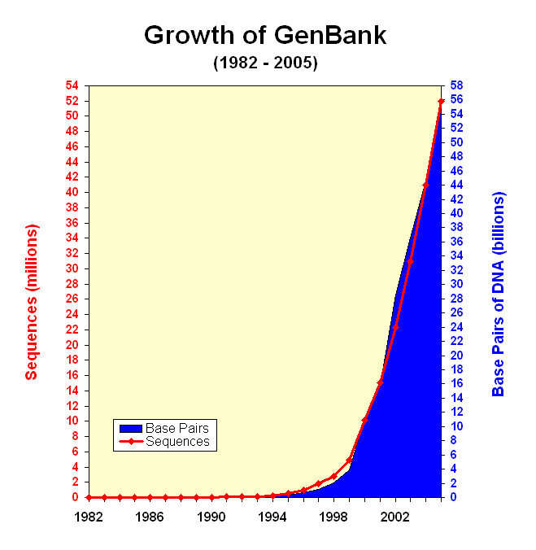
Challenges in Sequence Search
Observations
Overall size of genomic databases doubles every 12 months
Processing horsepower doubles only every 18-24 months
Consequence
The rate at which genomic databases are growing is outstripping our ability to compute (i.e., sequence search) on them.

Slide 6
Problem Statement #1
The Case of the Missing Genes
Problem
Most current genes have been detected by a gene-finder program, which can miss real genes
Approach
Every possible location along a genome should be checked for the presence of genes
Solution
All-to-all sequence search of all 567 microbial genomes that have been completed to date
… but requires more resources than can be traditionally found at a single supercomputer center 2.63 x 10¹⁴ sequence searches!
Notes:
To make computation more efficient, gene-finding programs use approximation techniques, and thus, may miss real genes.

Slide 7
Problem Statement #2
The Search for a Genome Similarity Tree
Problem
Genome databases are stored as an unstructured collection of sequences in a flat ASCII file
Approach
Completely correlate all sequences by matching each sequence with every other sequence
Solution
Use results from all-to-all sequence search to create genome similarity tree
… but requires more resources than can be traditionally found at a single supercomputer center
Level 1: 250 matches; Level 2: 250² = 62,500 matches; Level 3: 250³ = 15,625,000 matches …
Notes:
No correlation between different sequences --> Increasingly longer search times as databases grow
In summary,
Solutions are restricted by compute and storage constraints.

Slide 8
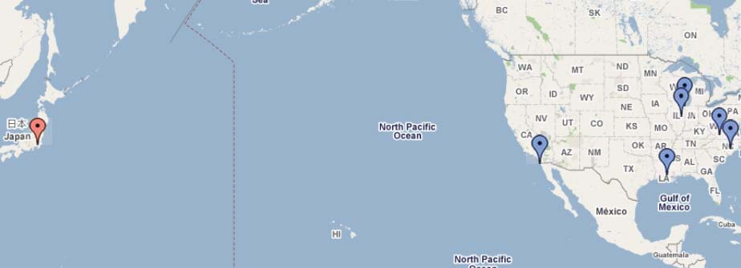
Approach: Hardware Infrastructure
Worldwide Supercomputer
Six U.S. supercomputing institutions (~12,000 processors) and one Japanese storage institution (0.5 petabytes), ~10,000 kilometers away
Notes:
Storage is located over 10000 kilometers away

Slide 9
Approach: ParaMEDIC Architecture
ParaMEDIC API (PMAPI)
ParaMEDIC Data Tools
Encryption
Data
Data
Integrity
ParaMEDIC: Parallel Metadata Environment for Distributed I/O and Computing
Notes:
ParaMEDIC to the Rescue!
ParaMEDIC is a generic framework that supports compute- and I/O-intensive applications such as mpiBLAST and remote visualization.
It provides a number of data management tools and utilities (e.g., data compression), including metadata creation functionality such as basic compression (gzip, bzip2) as well as application-specific metadata structures.
Depending on the output format, basic compression will provide up to an order-of-magnitude improvement in I/O performance while application-specific metadata structure as in mpiBLAST will provide up to four orders-of-magnitude improvement.
In this project, we only used the latter.

Slide 10
Approach: ParaMEDIC Framework
The ParaMEDIC Framework
Notes:
Description
Framework to decouple computation and I/O in distributed environments
Approach
Compute workers convert actual output to orders-of-magnitude smaller metadata
Compute workers push the metadata out to remote storage servers
Storage servers convert the metadata back to actual output

Slide 11
Preliminary Results: ANL-VT Supercomputer
Notes:
Has shown promise on “smaller” WAN FS

Slide 12
Preliminary Results: Teragrid Supercomputer

Slide 13
Storage Challenge: Compute Resources
2200-processor System X cluster (Virginia Tech)
2048-processor BG/L supercomputer (Argonne)
5832-processor SiCortex supercomputer (Argonne)
700-processor Intel Jazz cluster (Argonne)
320+60 processors on TeraGrid (U. Chicago & SDSC)
512-processor Oliver cluster (CCT at LSU)
A few hundred processors on Open Science Grid (RENCI)
128-processors on the Breadboard cluster (Argonne)
Total: ~12,000 Processors

Slide 14
Storage Challenge: Storage Resources
Clients
10 quad-core SunFire X4200
Two 16-core SunFire X4500 systems.
Object Storage Servers (OSS)
20 SunFire X4500
Object Storage Targets (OST)
140 SunFire X4500 (each OSS has 7 OSTs)
RAID configuration for OST
RAID5 with 6 drives
Network: Gigabit Ethernet
Kernel: 2.6
Lustre Version: 1.6.2
Notes:
840 disks in parallel
Throttled by Gigabit Ethernet

Slide 15
Storage Utilization with Lustre
Notes:
Over the WAN filesystem
mpiBLAST: WAN dominates
ParaMEDIC: Lustre / Local I/O dominates
MPI-IO-Test: Peak achievable BW
ParaMEDIC achieves 90% of MPI-IO-Test (or peak). 100x better than mpiBLAST

Slide 16
Storage Utilization Breakdown with Lustre
Notes:
As the # of I/O compute threads increase, I/O dominates … this should SCALE to faster I/O subsystems.

Slide 17
Storage Utilization (Local Disks)
Notes:
Removes Lustre from the equation … the trends are the same, performance is better.

Slide 18
Storage Utilization Breakdown (Local Disks)
Notes:
As the # of compute threads increase, I/O dominates … this should SCALE to faster I/O subsystems.

Slide 19
Conclusion: Biology
Biological Problems Addressed
Discovering missing genes via sequence-similarity computations 2.63 x 10¹⁴ sequence searches!
Generating a complete genome sequence-similarity tree to speed-up future sequence searches.
Status
Missing Genes
Now possible!
Ongoing with biologists
Complete Similarity Tree
Large % of chromosomes do not match any other chromosomes
Notes:
If completely matched, should be 0% , not as high as 90%
Of the 1028^2 chromosome links, 25% are missing.
Chromosome is a type of replicon

Slide 20
Conclusion: Computer Science
Contributions
Worldwide supercomputer consisting of ~12,000 processors and 0.5-petabyte storage
Output: 1 PB uncompressed 0.3 PB compressed
ParaMEDIC: Parallel Metadata Environment for Distributed I/O and Computing
Decouples computation and I/O and drastically reduces I/O overhead.

Slide 21
Acknowledgments
Computational Resources
K. Shinpaugh, L. Scharf, G. Zelenka (Virginia Tech)
I. Foster, M. Papka (U. Chicago)
E. Lusk and R. Stevens (Argonne National Laboratory)
M. Rynge, J. McGee, D. Reed (RENCI)
S. Jha and H. Liu (CCT at LSU)
Storage Resources
S. Matsuoka (Tokyo Inst. of Technology)
S. Ihara, T. Kujiraoka (Sun Microsystems, Japan)
S. Vail, S. Cochrane (Sun Microsystems, USA)

