Slide 1
Are Nonblocking Networks Needed for High-End Computing Workloads? N. Desai, P. Balaji, P. Sadayappan, M. Islam
Narayan Desai
desai@mcs.anl.gov
Cluster '08
September 29th, 2008

Slide 2
Switch-based Interconnect Networks
Provide high-performance communication to parallel jobs
Low latency
High bandwidth
Constructed from non-blocking switch ASICs into multi-stage switch complexes
Clos Networks
Fat Trees
Dominant interconnect architecture
Except for high-end systems (Blue Gene, Cray)
Bisection bandwidth cost grows non-linearly with port count
Is this cost justified?
What is the impact of reduced bisection bandwidth?

Slide 3
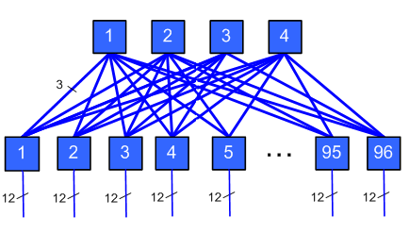
Multi-stage Switch Networks

Slide 4
Approach
Build a demand model for bisection bandwidth
Worst case (100% communication)
Probabilistic model
Reduce available uplink capacity
Model performance impact on jobs
Process real-world workloads using these models
Jazz (production system at ANL)
Atlas (capability system at LLNL)
Thunder (capacity system at LLNL)

Slide 5
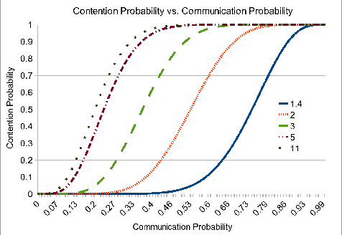
Probabilistic View of Contention

Slide 6
Demand Model
Assumption: nodes only communicate with other nodes in the same job
Demand computed on a per-switch ASIC basis
Each job has an uplink demand per ASIC
min (local job nodes, sum(remote job nodes))
Demand aggregated for simultaneous jobs
Yields a single uplink demand for each switch ASIC for each time interval
Describes which ASIC/time intervals would be impacted by uplink reduction

Slide 7
Uplink Reduction
Remove individual uplinks for each switch ASIC
Will reduce performance if uplink demand is higher than reduced supply
Reduced performance is the ratio of demand to supply
i.e., if demand is 6 and supply is 4, interval runtime is extended by 50%
Jobs are slowed down at a uniform pace
Factor depends on most contended switch
A workload can be analyzed in terms of individual job slowdowns
Can show overall system impact of uplink removal

Slide 8
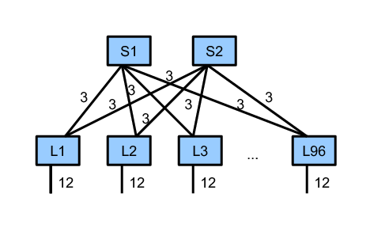
Contended Architecture

Slide 9
Input Workloads
Jazz system at Argonne
350 node production cluster
Capacity workload
1 core per node
Atlas system at Livermore
1152 nodes
Capability workload
8 cores per node
Thunder system at Livermore
1024 nodes
Capacity workload
4 cores per node

Slide 10
Analysis
Contention as uplinks are removed
System-wide impact
Impact on jobs experiencing contention
Impact of multicore nodes on workloads
Impact of increasing switch size

Slide 11
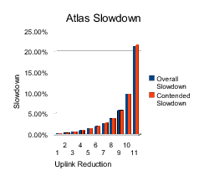
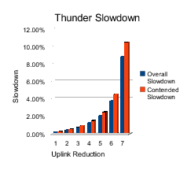
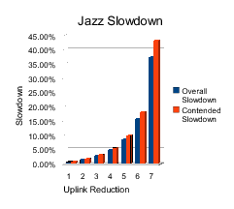
System Slowdowns

Slide 12
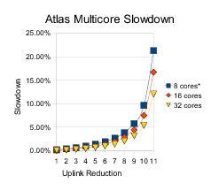
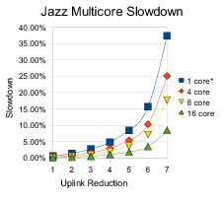
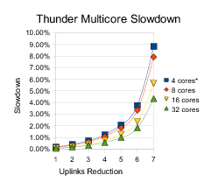
Impact of Multi-core Growth

Slide 13
Conclusions and Future Work
Most workloads don't show much sensitivity to bisection bandwidth reduction
Most workloads show modest (< 5%) aggregate performance penalty for substantial bisection bandwidth reduction
Even counting worst-case communication
As switch sizes increase, this penalty decreases on a per-uplink basis
Multi-core systems result in fatter nodes, spreading jobs across fewer nodes and hence fewer network ports
All of these trends suggest that bisection bandwidth will decrease in importance for common workloads over time
Future Work
Need to take I/O into consideration

Slide 14
Questions?

