Slide 1
Toward Efficient Support for Multithreaded MPI Communication
Pavan Balaji¹, Darius Buntinas¹, David Goodell¹, William Gropp², and Rajeev Thakur¹
¹ Argonne National Laboratory ² University of Illinois at Urbana-Champaign

Slide 2
Motivation
Multicore processors are ubiquitous
Heading towards 10's or 100's of cores per chip
Programming models for multicore clusters
Pure message-passing
Across cores and nodes
Leads to large process count
Problem may not scale to that many processes
Resource constraints
Memory per process
TLB entries
Hybrid
Shared-memory across cores & message passing between nodes
Fewer processes
Use threads: POSIX threads, OpenMP
MPI functions can be called from multiple threads

Slide 3
Motivation (cont'ed)‏
Providing thread support in MPI is essential
Implementing this is non-trivial
At larger scale, just providing thread support is not sufficient
Providing efficient thread support is critical
Concurrency within the library
We describe our efforts to optimize performance of threads in MPICH2
Four approaches
Decreasing critical-section granularity
Increasing concurrency
Send side
Evaluate each approach using message-rate benchmark

Slide 4
Outline
Thread Support in MPI
Lock Granularity
Levels of Granularity
Analyzing Impact of Granularity on Message Rate
Conclusions and Future Work

Slide 5
Thread Support in MPI
User specifies what level of thread safety is desired
MPI_THREAD_SINGLE, _FUNNELED, _SERIALIZED or _MULTIPLE
_FUNNELED and _SERIALIZED
Trivial to implement once you have _SINGLE*
No performance overhead over _SINGLE*
MPI_THREAD_MULTIPLE
MPI library implementation needs to be thread safe
Serialize access to shared structures, avoid races
Typically done using locks
Locks can have a significant performance impact
Lock overhead can increase latency of each call
Locks can impact concurrency
*usually

Slide 6
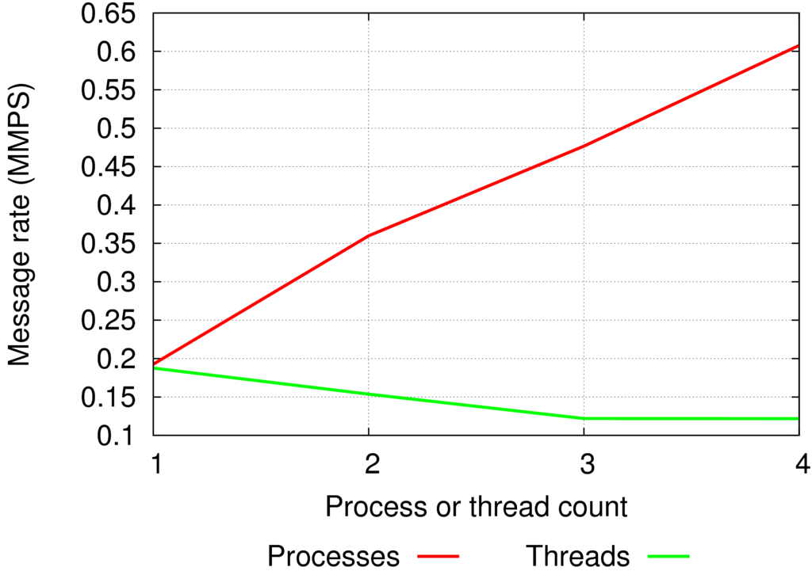
Coarse Grained Locking
Single global mutex
Mutex is held between entry and exit of most MPI_ functions
No concurrency in communication

Slide 7
Lock Granularity
Using mutexes can affect concurrency between threads
Coarser granularity → less concurrency
Finer granularity → more concurrency
Fine grained locking
Decreasing size of critical sections increases concurrency
Only hold mutex when you need it
Using multiple mutexes can also increase concurrency
Use separate mutexes for different critical sections
Acquiring and releasing mutexes has overhead
Increasing granularity increases overhead
Shrinking CS, using multiple mutexes increases complexity
Checking for races is more difficult
Need to worry about deadlocks

Slide 8
Levels of Granularity
Global
Use a single global mutex, held from function enter to exit
Existing implementation
Brief Global
Use a single global mutex, but reduce the size of the critical section as much as possible
Per-Object
Use one mutex per data object: lock data not code sections
Lock-Free
Use no mutexes
Use lock-free algorithms
Future work

Slide 9
Analyzing Impact of Granularity on Message Rate
Measured message rate for multithreaded sender to single-threaded receivers
100,000 times:
Sender: MPI_Send() 128 messages, MPI_Recv() ack
Receiver: MPI_Irecv() 128 messages, MPI_Send() ack
Threads
Processes

Slide 10
Global Granularity
Single global mutex
Mutex is held between entry and exit of most MPI_ functions
This prevents any thread concurrency in communication

Slide 11
Global Granularity
MPI_Send()‏
Access data structure 1
Access data structure 2
Holding mutex
Waiting for mutex

Slide 12
Brief Global Granularity
Single global mutex
Reduced the size of the critical section
Acquire mutex just before first access to shared data
Release mutex just after last access to shared data
If no shared data is accessed, no need to lock
Sending to MPI_PROC_NULL accesses no shared data
Reduced time mutex is held
Still using global mutex

Slide 13
Brief Global Granularity: Sending to MPI_PROC_NULL
MPI_Send()‏
Access data structure 1
Holding mutex
Waiting for mutex

Slide 14
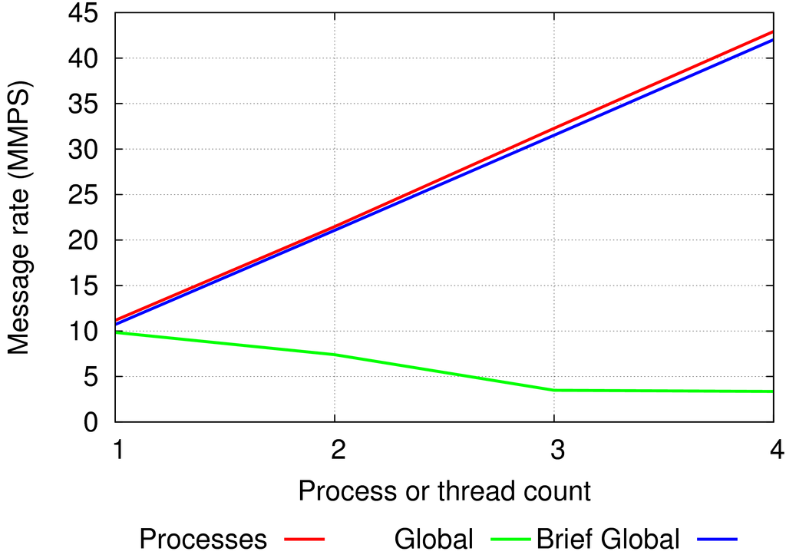
Sending to MPI_PROC_NULL
No actual communication performed
No shared data is accessed  No need to lock mutex
Brief global avoids locking unnecessarily
Performs as well as Processes

Slide 15
Brief Global Granularity: Real Communication
MPI_Send()‏
Access data structure 1
Access data structure 2
Holding mutex
Waiting for mutex

Slide 16
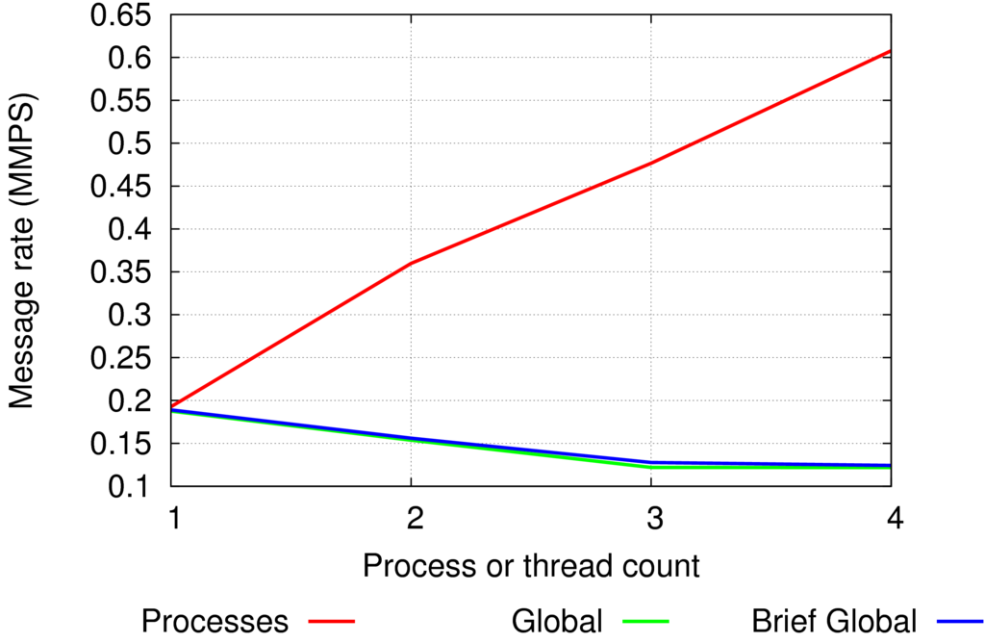
Blocking Send: Real Communication
Perform real communication
Shared data accessed
Brief global still uses global lock
Performs poorly

Slide 17
Per-Object Granularity
Multiple mutexes
Lock data objects not code sections
One mutex per object
Threads can access different objects concurrently
Different data object for each destination
Further reduced time mutex is held
Acquire data object's mutex just before accessing it
Then immediately release it
Reduced time mutex is held
Concurrent access to separate data
Increased lock overhead
Can still contend on globally accessed data structures

Slide 18
Per-Object Granularity
MPI_Send()‏
Access data structure 1
Access data structure 2
Holding mutex 1
Holding mutex 2
Waiting for mutex

Slide 19
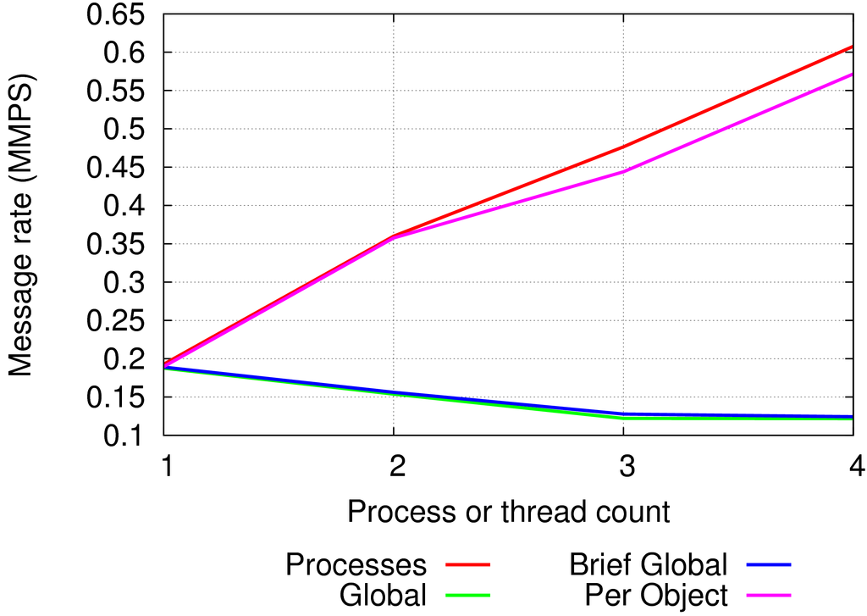
Blocking Sends
Perform real communication
Shared data is accessed, but not concurrently
Brief global performs as poorly as global: contention on single lock
Per-Object: one mutex per VC  no contention on mutex

Slide 20
What About Globally Shared Objects?
Per-Object can still have contention on global structures
Allocate from global request pool
MPI_COMM_WORLD ref counting
Use thread-local request pool
Each thread allocates and frees from a private pool of requests
Also use atomic asm instructions for updating reference counts
Ref count updates are short but frequent
Atomic increment
Atomic test-and-decrement

Slide 21
Per-Object Granularity: Non-Blocking Sends
MPI_Isend()‏
Access data structure 1
Access data structure 2
Access data structure 3
Holding mutex 1
Holding mutex 2
Holding mutex 3
Waiting for mutex

Slide 22
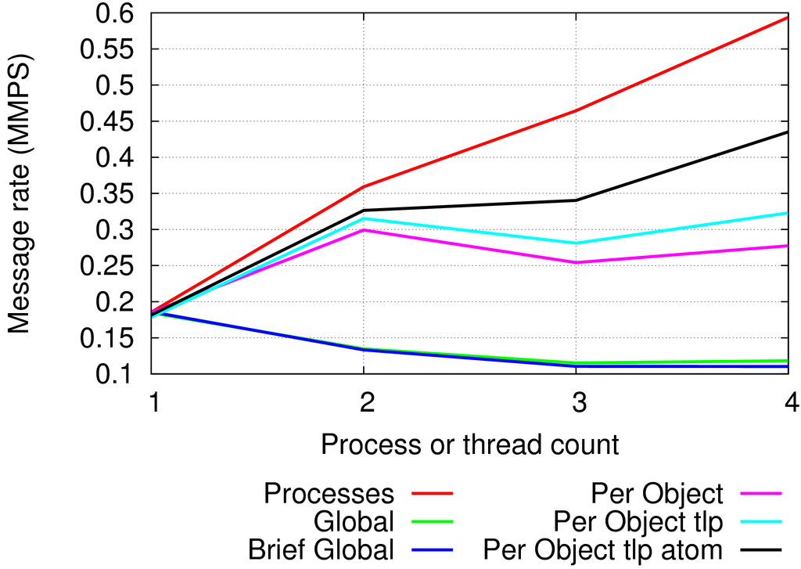
Non-Blocking Sends
Non-blocking sends access global data
Requests are allocated from a global request pool
Alloc and free of req requires updating reference count on communicator
Per-object tlp: thread-local request pool
Per-object tlp atom: use tlp and atomic ref count updates
Still some contention exists

Slide 23
Conclusion
We implemented and evaluated different levels of lock granularity
Finer granularity levels allow more concurrency
Finer granularity increases complexity
Per-object uses multiple locks
Hard to check we're holding the right lock
Deadlocks
With Global, a routine might always have been called with a lock held
With Per-object, not always true
Recursive locks
Can't check for double locking
Lock-free solutions are critical for performance
Global objects must be accessed
Atomic ref count updates

Slide 24
Future Work
Address receive side
Receive queues
Atomically “search unexpected queue then enqueue on posted”
Lock free or speculative approaches
Per source receive queues
Multithreaded receive
Only one thread can call poll() or recv()‏
How to efficiently dispatch incoming messages to different threads?
Ordering
Lock free
Eliminate locks altogether
Increases complexity
Eliminate locks but increase instruction count
Verification
We have started work on a portable atomics library

Slide 25
For more information...
http://www.mcs.anl.gov/research/projects/mpich2
{balaji, buntinas, goodell, thakur}@mcs.anl.gov
wgropp@illinois.edu

