Slide 1
Communication Analysis of Parallel 3D FFT for Flat Cartesian Meshes on Large Blue Gene Systems
A. Chan, P. Balaji, W. Gropp, R. Thakur
Math. and Computer Science, Argonne National Lab
University of Illinois, Urbana Champaign

Slide 2
Fast Fourier Transform
One of the most popular and widely used numerical methods in scientific computing
Forms a core building block for applications in many fields, e.g., molecular dynamics, many-body simulations, monte-carlo simulations, partial differential equation solvers
1D, 2D, 3D data grids FFTs are all used
Represents the dimensionality of the data being operated on
2D process grids are popular
Represents the logical layout of the processes
E.g., Used by P3DFFT

Slide 3
Parallel 3D FFT with P3DFFT
Relative new implementation of 3DFFT from SDSC
Designed for massively parallel systems
Reduces synchronization overheads compared to other 3D FFT implementations
Communicates along row and column in the 2D process grid
Internally utilizes sequential 1D FFT libraries and performance data grid transforms to collect the required data

Slide 4
P3DFFT for Flat Cartesian Meshes
Lot of prior work to improve 3D FFT performance
Mostly focuses on regular 3D cartesian meshes
All sides of the mesh are of (almost) equal size
Flat 3D cartesian meshes are becoming popular
Good tool for studying quasi-2D systems that occur during the transition of 3D systems to 2D systems
E.g., superconducting condensate, Quantum-Hall effect, and Turbulence theory in geophysical studies
Failure of P3DFFT for such systems is a known problem
Objective: Understand the communication characteristics of P3DFFT, especially with respect to flat 3D meshes

Slide 5
Presentation Layout
Introduction
Communication overheads in P3DFFT
Experimental Results and Analysis
Concluding Remarks and Future Work

Slide 6
BG/L Network Overview
BG/L has five different networks
Two of them (1G Ethernet and 100M Ethernet with JTAG interface) are used for file I/O and system management
3D Torus: Used for point-to-point MPI communication (as well as collectives for large message sizes)
Global Collective Network: Used for collectives using small messages and regular communication patterns
Global Interrupt Network: Used for barrier and other process synchronization routines
For Alltoallv (in P3DFFT), the 3D Torus network is used
175MB/s bandwidth per link per direction (total 1.05 GB/s)

Slide 7
Mapping 2D Process Grid to BG/L
A 512 process system:
By default broken into a 32x16 logical process grid (provided by MPI_Dims_create)
Forms a 8x8x8 physical process grid on the BG/L

Slide 8
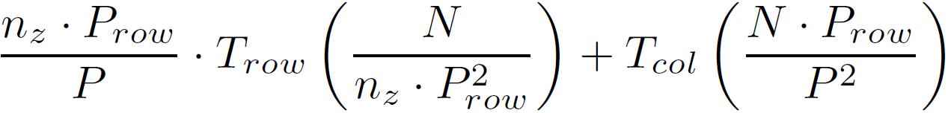
Communication Characterization of P3DFFT
Consider a process grid of P = P_{row} x P_{col} and a data grid of N = n_{x} x n_{y} x n_{z}
P3DFFT performs a two-step process (forward transform and reverse transform)
The first step requires n_{z} / P_{col} Alltoallv’s over the row sub-communicator with message size m_{row} = N / (n_{z} x P_{row}²)
The second step requires one Alltoallv over the column sub-communicator with message size m_{col} = N . P_{row} / P²
Total time =

Slide 9
Trends in P3DFFT Performance
Total communication time impacted by three variables:
Message size
Too small message size implies network bandwidth is not fully utilized
Too large message size is “OK”, but that implies the other communicator’s message size will be too small
Communicator size
The lesser the better
Communicator topology (and corresponding congestion)
This part increases quadratically with communicator size, so will have a large impact on large-scale systems

Slide 10
Presentation Layout
Introduction
Communication overheads in P3DFFT
Experimental Results and Analysis
Concluding Remarks and Future Work

Slide 11
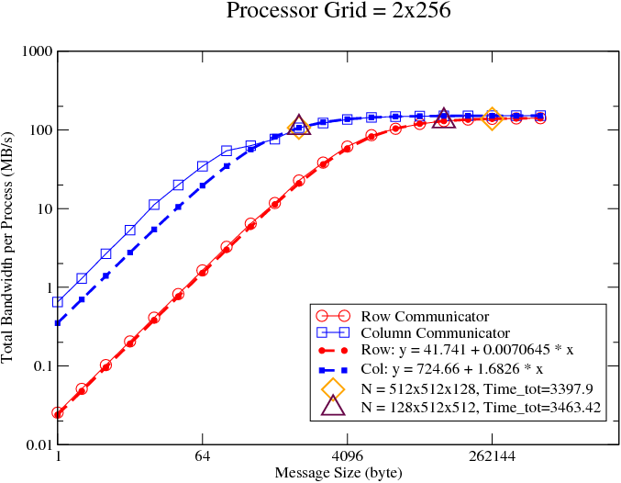
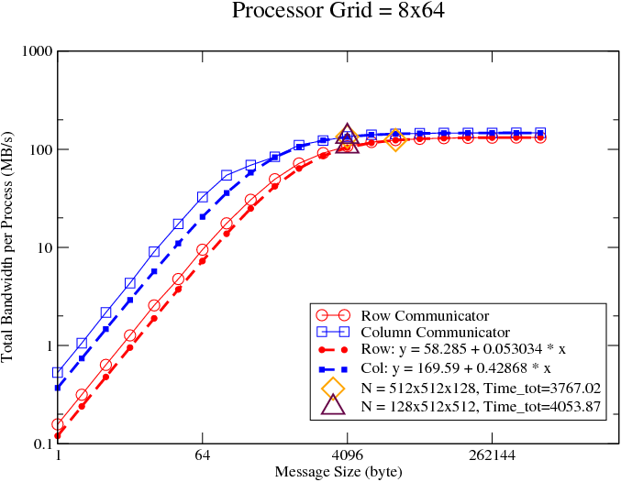
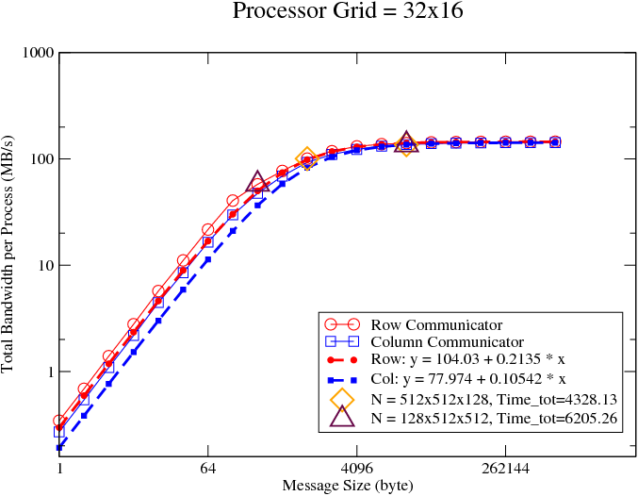
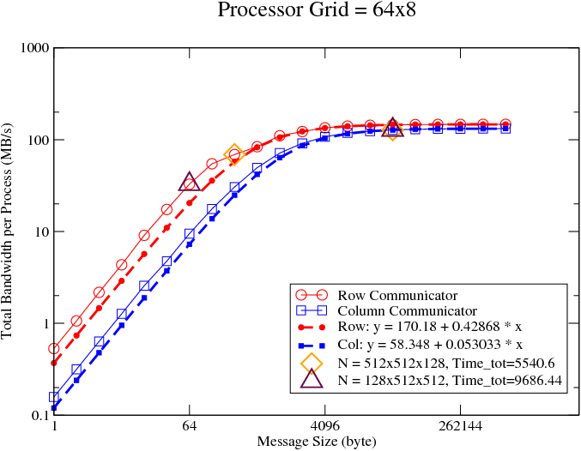
Alltoallv Bandwidth on Small Systems

Slide 12
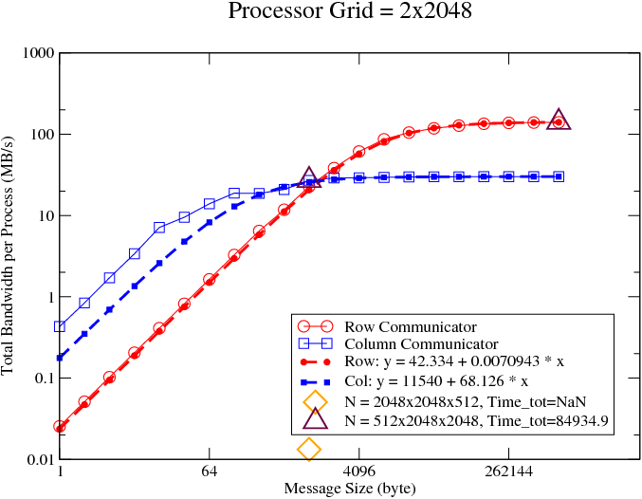
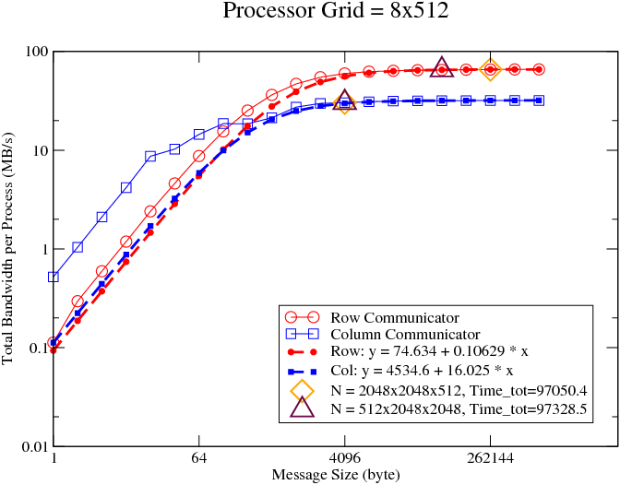
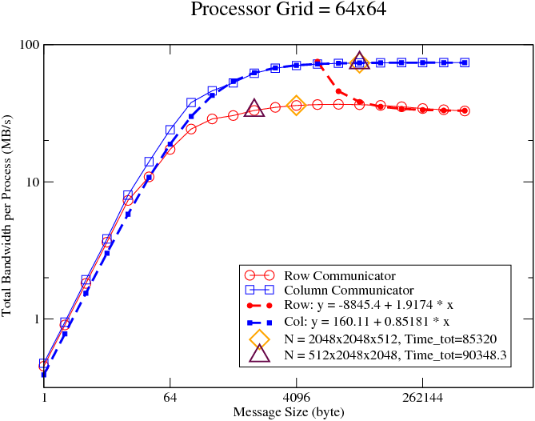
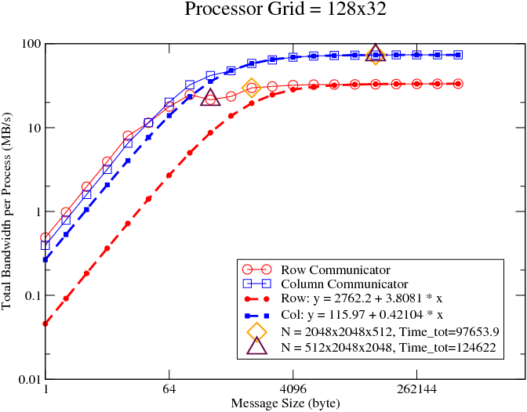
Alltoallv Bandwidth on Large Systems

Slide 13
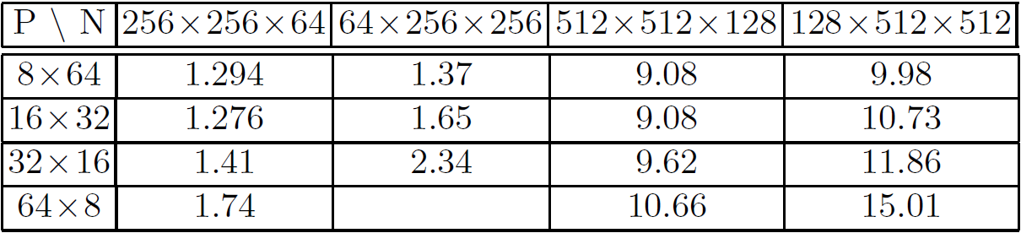
Communication Analysis on Small Systems
Small P_{row} and small n_{z} provide the best performance for small-scale systems
This is the exact opposite of MPI’s default behavior !
It tries to keep P_{row} and P_{col} as close as possible; we need them to be as far away as possible
Difference of up to 10%

Slide 14
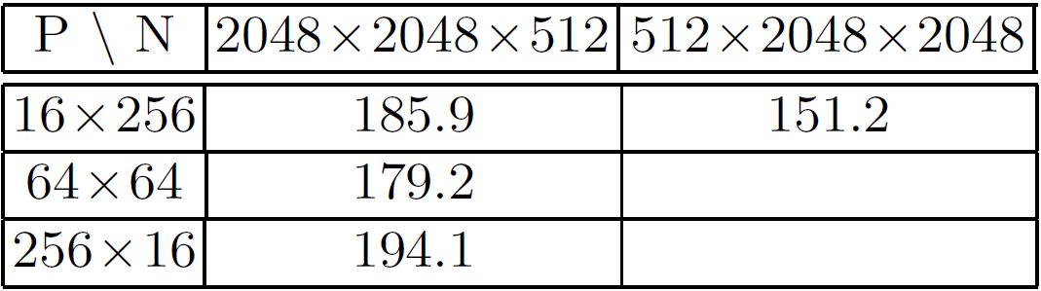
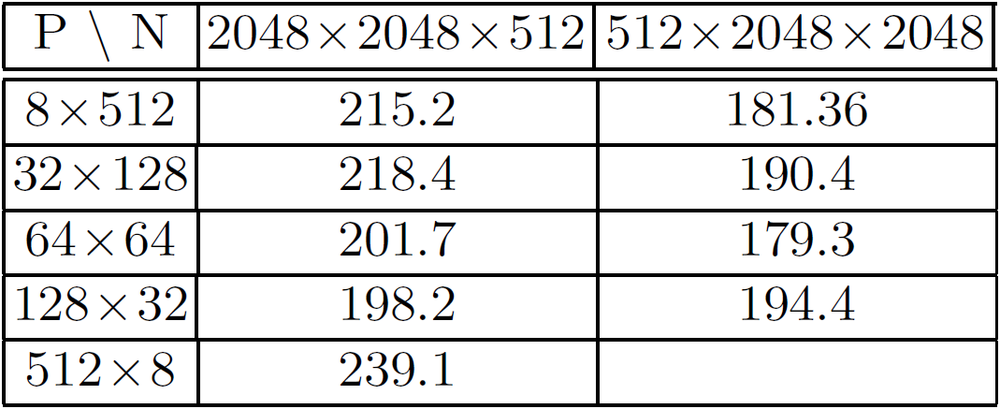
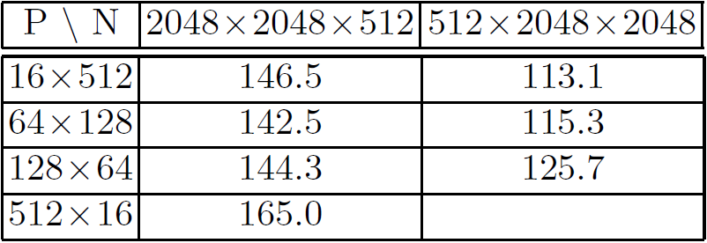
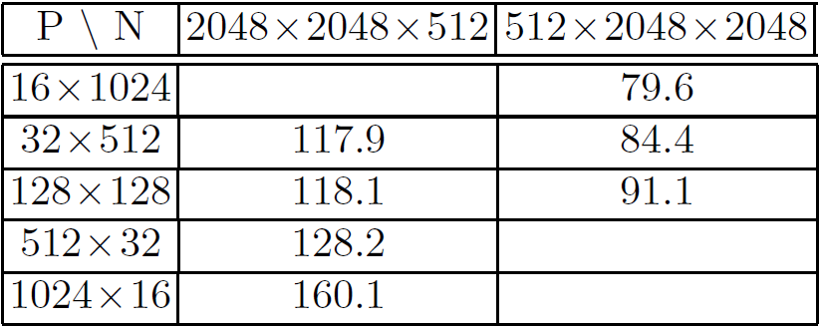
Evaluation on Large Systems (16 racks)
Small P_{row} still performs the best
Unlike small systems, large n_{z} is better for large systems
Increasing congestion plays an important role
Difference as much as 48%

Slide 15
Presentation Layout
Introduction
Communication overheads in P3DFFT
Experimental Results and Analysis
Concluding Remarks and Future Work

Slide 16
Concluding Remarks and Future Work
We analyzed the communication in P3DFFT on BG/L and identified the parameters that impact performance
Evaluated the impact of the different parameters and identified trends in performance
Found that while uniform process grid topologies are ideal for uniform 3D data grids, for flat cartesian grids, non-uniform process grid topologies are ideal
Shown up to 48% improvement in performance by utilizing our understanding to tweak parameters
Future Work: Intend to do this on Blue Gene/P (performance counters make this a lot more interesting)

Slide 17
Thank You!
Contacts:
Emails: {chan, balaji, thakur}@mcs.anl.gov
wgropp@illinois.edu
Web Link:
http://www.mcs.anl.gov/research/projects/mpich2

