Slide 1
Making a Case for Proactive Flow Control in Optical Circuit-switched Networks
M. Kumar, V. Chaube, P. Balaji, W. Feng and H.-W. Jin
Department of Computer Science, Virginia Tech
Mathematics and Computer Science, Argonne National Laboratory
Department of Computer Science and Engg., Konkuk University

Slide 2
Lambda Grids: Trends and Promises
Lambda Grids
A new paradigm in distributed computing
High-bandwidth optical networks allowing for globally distributed compute, storage and visualization systems to work together as one large planetary-scale supercomputer
Realizing the lambda grid comprises of two parts:
Creating an environment to enable Lambda Grids, i.e., several globally distributed nodes bundled together with fast optical networks → this is mostly a reality today !
Networking capability to utilize the Lambda Grid, i.e., networking protocols that allow us to harness its potential

Slide 3
Protocols for the Lambda Grid
TCP/IP on the Lambda Grid
High overhead of congestion control and flow-control
Not the best protocol for networks with ‘zero’ congestion
UDP-based approaches offer better performance
Light weight
Additions such as flow-control can be added on-demand
Rate controlled reliable UDP variants widely accepted
Basic idea: sender sends at a pre-negotiated rate
Examples: RBUDP, RAPID, RBUDP+, RAPID+, UDT

Slide 4
Issues with Rate-controlled UDP protocols
While the basic idea of rate-controlled UDP protocols is good, the current implementations are naïve
Problems:
Coarse-grained control
Most rate-controlled protocols are not adaptive, i.e., rate not varied through the life time of the data transfer
Others vary at a very coarse-grained level
E.g., after each round of data transfer
Reactive approach to packet drops
Rate is varied “after” the packet drop has occurred
Understanding receiver host behavior to proactively predict packet drops is not trivial !

Slide 5
Our Approach
We take a two-phase approach
Design a fine-grained rate-control approach with an asynchronous feedback mechanism
Analyze the issues related to reactive rate control as compared to proactive rate control

Slide 6
Presentation Overview
Introduction
Asynchronous Fine-grained Rate Control
A Case for Proactive Rate Control
Concluding Remarks

Slide 7
Problems with Fine-grained Rate Control
Why is fine-grained rate control difficult?
Rate-controlled UDP protocols send data one packet at a time (i.e., 1500 bytes)
Data sent over a UDP channel and rate-adaptation feedback received over a TCP control channel
For fine-grained rate control, both the UDP and TCP channels have to be continuously monitored
Additional system call for every 1500 bytes of data transfer
Can cause performance degradation
Common Solution: Perform coarse-grained rate control
Monitor the TCP channel after a large amount of data is sent

Slide 8
ASYNCH: Basic Idea
ASYNCH: Asynchronous, fine-grained reactive rate control
Rate-adaption feedback is infrequent as compared to the data transfer → continuous monitoring is wasted system calls !
Our approach:
Allow a separate thread to “wait” on the TCP/IP control channel while the main thread sends data out at the negotiated rate
When a rate adaptation feedback arrives, the control thread sends a signal to the main thread
Main thread adapts its rate on receiving this signal
Advantages:
All the benefits of coarse-grained rate control

Slide 9
Experimental Understanding
We evaluate ASYNCH and RAPID+ for various receiver end-host conditions
Test-bed: Attempt to emulate a real-world dedicated circuit switched network
3 node sender receiver setup; middle node emulating a WAN
File size: 1GB, RTT: 56ms
Dual-core AMD Opteron 2218; with 1MB cache, 4 GB RAM
Myrinet 10GB adapter
Linux kernel: 2.6.18
We bind receive process to same core

Slide 10
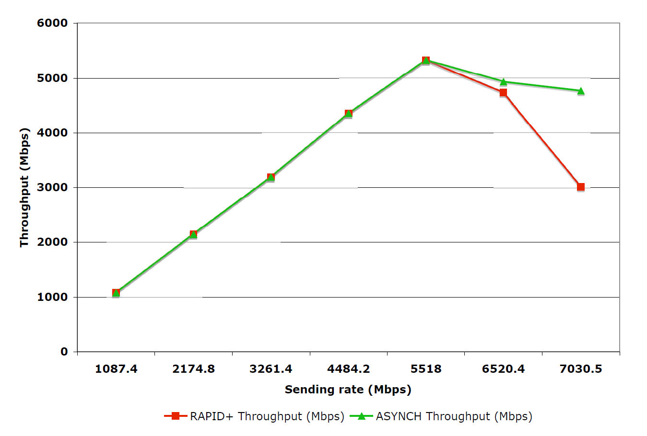
Basic Performance Comparison
Sharp rise in packet loss rate beyond 5.5Gbps
ASYNCH’s fine-grained feedback mechanism helps adapt to packet loss quickly; resulting in 50% better throughput

Slide 11
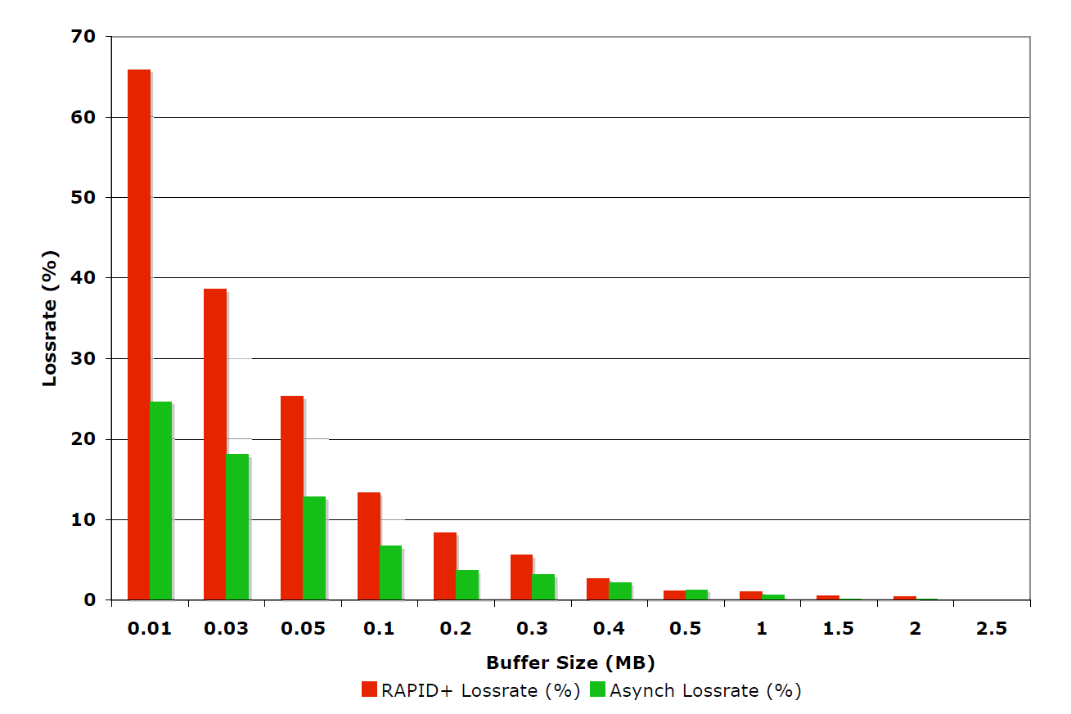
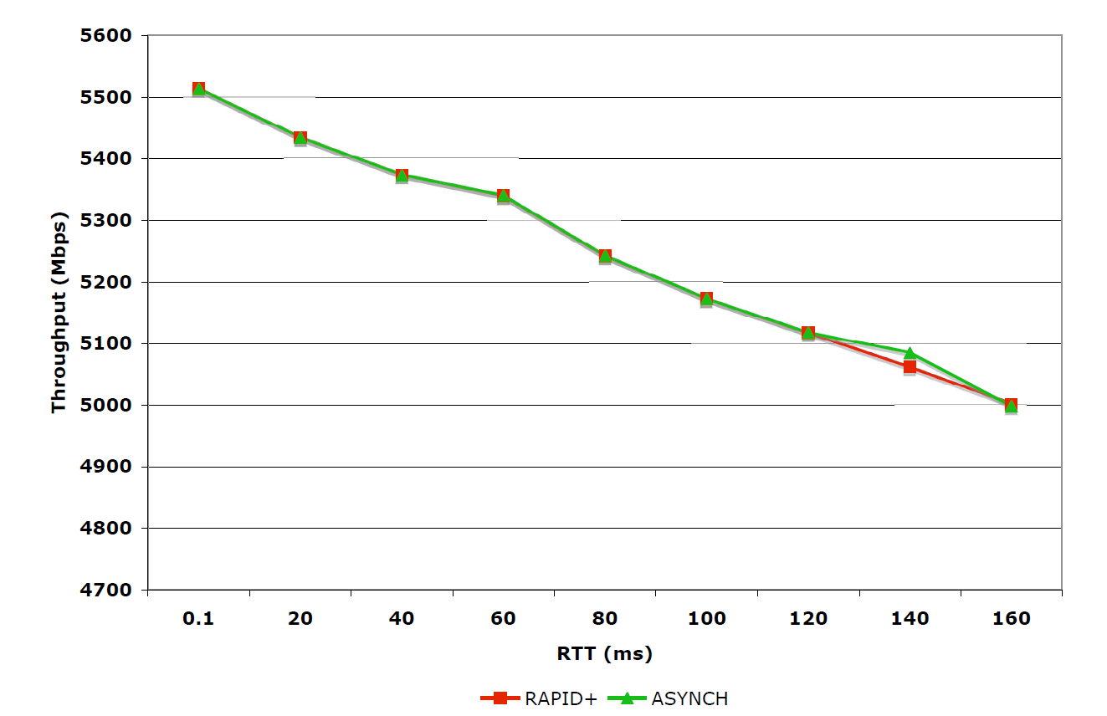
Impact of Socket Buffers and RTT
Data at receiver is stored in socket buffers
ASYNCH shows much smaller loss rate compared to RAPID+ for all buffer sizes
Both ASYNCH and RAPID+ use a TCP control channel for reliability (RTT sensitive)

Slide 12
Presentation Overview
Introduction
Asynchronous Fine-grained Rate Control
A Case for Proactive Rate Control
Concluding Remarks

Slide 13
A Case for Proactive Rate Control
Can proactive rate control help?
Why does packet loss occur?
Can this loss be predicted?

Slide 14
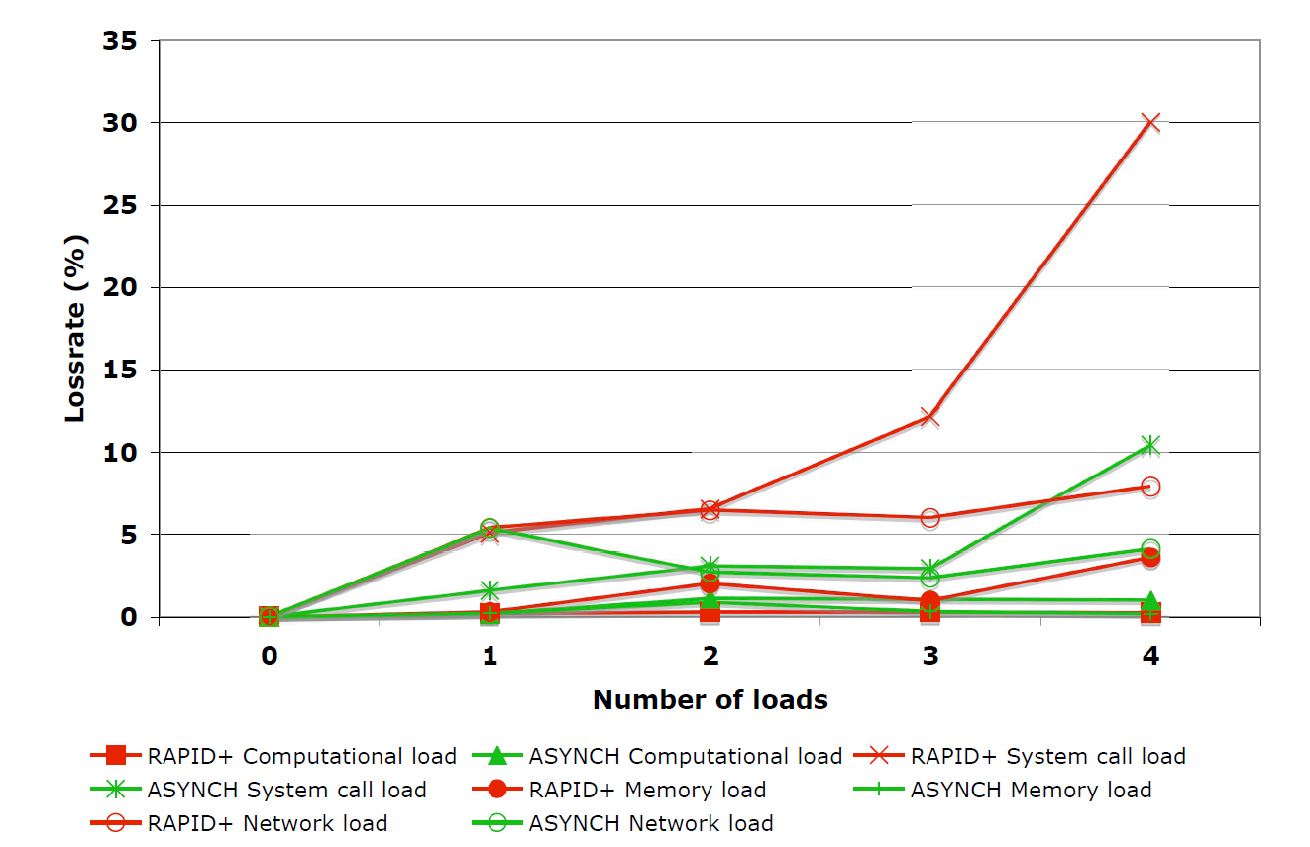
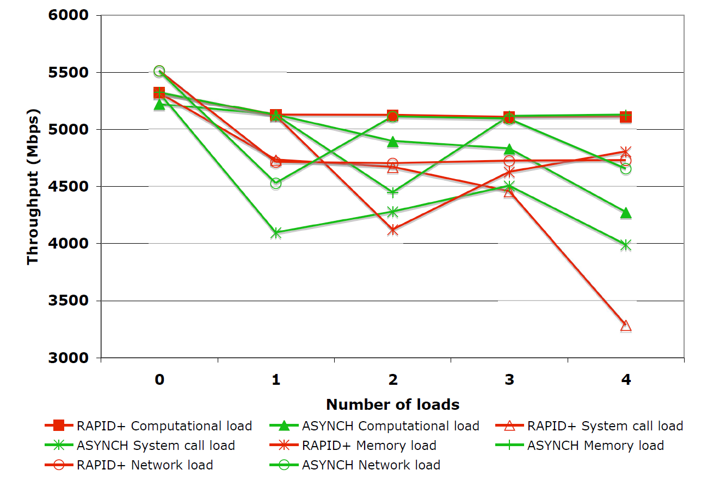
Effect of Load on Receiver End-host
Figures 4 and 5
On an average, ASYNCH shows lower drop in throughout as compared to RAPID+, for increasing number of various loads

Slide 15
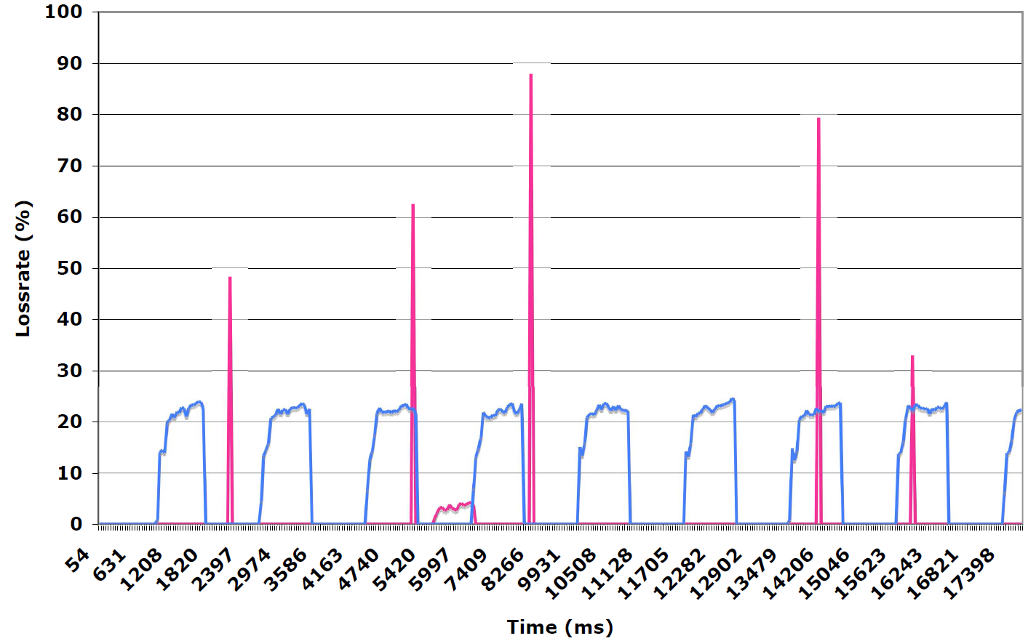
Loss Patterns

Slide 16
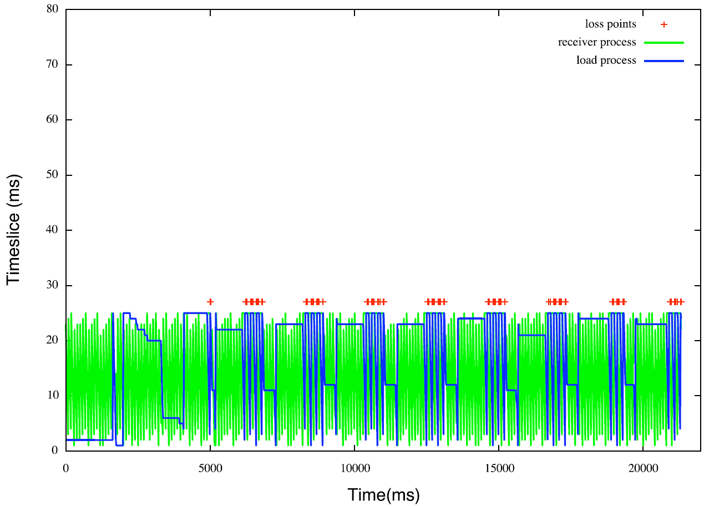
Packet Loss vs. Process Scheduling
Packet loss concentrated around the region where the network process has no access to the CPU

Slide 17
Presentation Overview
Introduction
Asynchronous Fine-grained Rate Control
A Case for Proactive Rate Control
Concluding Remarks

Slide 18
Concluding Remarks
This paper presented ASYNCH – an asynchronous, feedback-based, reactive, rate-control protocol
Protocol effectively solves problems faced by current rate-based protocols
Provides improved and more accurate rate adaptation
Higher throughput
We also highlight the need and the feasibility of implementing a proactive protocol
Case solidified based on analysis and observations of end-host behavior in dynamic environments

Slide 19
Thank You!
Contacts:
M. Kumar: mithil@cs.vt.edu
V. Chaube: vineetac@cs.vt.edu
P. Balaji: balaji@mcs.anl.gov
W. Feng: feng@cs.vt.edu
H.-W. Jin: jinh@konkuk.ac.kr
Web links:
http://www.mcs.anl.gov/~balaji
http://synergy.cs.vt.edu

