Slide 1
Semantics-based Distributed I/O with the ParaMEDIC Framework
P. Balaji, W. Feng, H. Lin
Math. and Computer Science, Argonne National Laboratory
Computer Science and Engg., Virginia Tech
Dept. of Computer Sci., North Carolina State University

Slide 2
Distributed Computation and I/O
Growth of combined compute and I/O requirements
E.g., Genomic sequence search, Large-scale data mining, data visual analytics and communication profiling
Commonality: Require a lot of compute power and use and generate a lot of data
Data has to be managed for later processing or archival
Managing large data volumes: Distributed I/O
Non-local access to large compute systems
Data generated remotely and transferred to local systems
Resource locality: Applications need compute and storage
Data generated at one site and moved to another

Slide 3
Distributed I/O: The Necessary Evil
Lot of prior research tries to improve distributed I/O
Continues to be the elusive holy grail
Difficult to achieve high performance for “real data” [1]
Bandwidth is not everything
Real software requires synchronization (milliseconds)
High-speed TCP eats up memory – slows down applications
Data encryption or endianness conversion required in some cases
Not everyone has a lambda grid
Scientists run jobs on large centers from their local system
There is just too much data!
Solution: FEDEX !
[1] “Wide Area Filesystem Performance Using Lustre on the Teragrid”, S. Simms, G. Pike, D. Balog. Teragrid Conference, 2007

Slide 4
Case Study: mpiBLAST on the TeraGrid
85% of the time is spent on I/O
On a local-area network, mpiBLAST I/O time is less than 5%

Slide 5
Presentation Outline
Distributed I/O on the WAN
ParaMEDIC: Framework to Decouple Compute and I/O
Case Studies with mpiBLAST and MPE
Experimental Results
Glimpses of Follow-on Work
Concluding Remarks

Slide 6
ParaMEDIC Overview
Parallel Meta-data Environment for Distributed I/O and Computing
New way of “programming” distributed I/O
Application generates output data
ParaMEDIC takes over:
Transforms output to (orders-of-magnitude smaller) “application-specific meta-data” at the compute site
Transports meta-data over the WAN to the storage site
Transforms meta-data back to the original data at the storage site (host site for the global file-system)
Similar to compression, yet different
Deals with data as abstract objects, not as a byte-stream

Slide 7
The ParaMEDIC Framework
Applications
mpiBLAST
Communication
Profiling
Remote
Visualization
ParaMEDIC API (PMAPI)
ParaMEDIC Data Tools
Application Plugins
Data
Encryption
Data
Integrity
mpiBLAST
Plugin
Communication
Profiling Plugin
Basic
Compression
Communication Services
Other Utilities
Direct
Network
Global
Filesystem
Column Parsing
Data Sorting

Slide 8
Tradeoffs in the ParaMEDIC Framework
Trading Computation and I/O
More computation: Converting output to meta-data and back requires extra work
Lesser I/O: Only meta-data is transferred over the WAN, so lesser bandwidth usage on the WAN
But, computation is free; I/O is not !
Trading Portability and Performance
Utility functions help develop application plugins, but will always need non-zero effort
Data is dealt has high-level objects: Better chance of improved performance

Slide 9
Presentation Outline
Distributed I/O on the WAN
ParaMEDIC: Framework to Decouple Compute and I/O
Case Studies with mpiBLAST and MPE
Experimental Results
Glimpses of Follow-on Work
Concluding Remarks

Slide 10
Sequence Search with mpiBLAST
Output
Output
Query
Sequences
Query
Sequences
Database
Sequences
Database
Sequences
Sequential Search of Queries
Parallel Search of Queries

Slide 11
mpiBLAST Meta-Data
Alignment of two sequences is independent of the remaining sequences
Meta-data (IDs of matched sequences)
Output
Communicate over the WAN
Query
Sequences
Alignment information for a bunch of sequences
Query
Sequences
Temporary Database
Sequences
Database
Sequences

Slide 12
ParaMEDIC-powered mpiBLAST
The ParaMEDIC Framework
Compute Sites
WAN
Storage Site

Slide 13
MPE: A Profiling Library for MPI
MPE: MPI Profiling Environment
Suite of performance analysis tools and libraries
Shipped as a part of the MPICH2 implementation of MPI
Relies on the MPI Profiling Interface
Application is run regularly, MPE automagically logs communication calls and time taken
Generates lots of data
A large-scale application such as FLASH can generate about 2.5MB of data per second per process
A 16K process run for an hour generates 150 TB of data

Slide 14
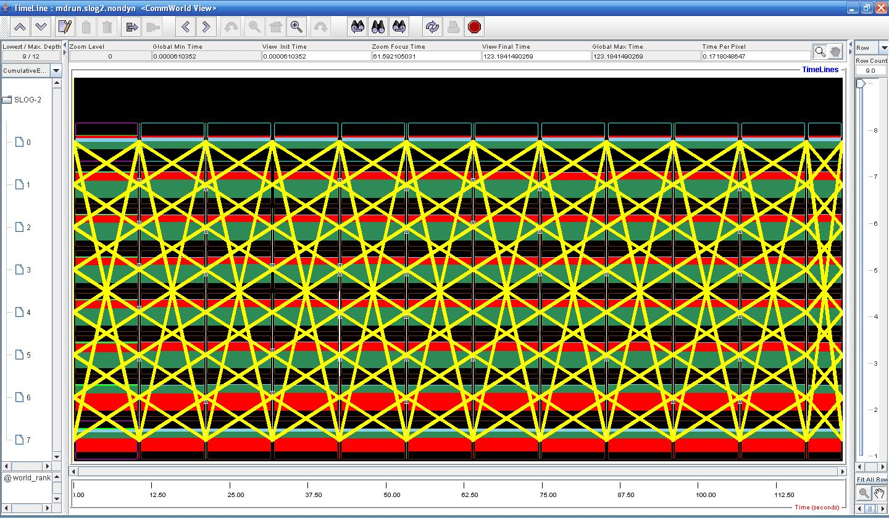
Example MPE Profiling Log (GROMACS)
Identify periodicity using Fourier transforms and only store the “diffs” in each period
Can give about 3-5X improvement

Slide 15
Presentation Outline
Distributed I/O on the WAN
ParaMEDIC: Framework to Decouple Compute and I/O
Case Studies with mpiBLAST and MPE
Experimental Results
Glimpses of Follow-on Work
Concluding Remarks

Slide 16
LAN Emulating a 10Gbps WAN

Slide 17
Performance on Real Systems

Slide 18
Performance Breakup on the TeraGrid

Slide 19
Presentation Outline
Distributed I/O on the WAN
ParaMEDIC: Framework to Decouple Compute and I/O
Case Studies with mpiBLAST and MPE
Experimental Results
Glimpses of Follow-on Work
Concluding Remarks

Slide 20
Evaluation on a Worldwide Supercomputer

Slide 21
Microbial Genome Database Search
Semantic-aware metadata gives scientists 2.5*10¹⁴ searches at their finger-tips
All metadata results from all searches can fit on iPod Nano
“Semantically compressed” 1 PB into 4 GB (10⁶X)
Usual compression results in 1 PB into 300 TB (3X)
Semantic Compression
“ParaMEDIC: Parallel Metadata Environment for Distributed I/O and Computing”, P. Balaji, W. Feng, J. Archuleta and H. Lin. Storage Challenge Award, SC 2007.
“Distributed I/O with ParaMEDIC: Experiences with a Worldwide Supercomputer”, P. Balaji, W. Feng, H. Lin, J. Archuleta, S. Matsuoka, A. Warren, J. Setubal, E. Lusk, R. Thakur, I. Foster, D. S. Katz, S. Jha, K. Shinpaugh, S. Coghlan and D. Reed. Best Paper Award, ISC 2008.

Slide 22
Presentation Outline
Distributed I/O on the WAN
ParaMEDIC: Framework to Decouple Compute and I/O
Case Studies with mpiBLAST and MPE
Experimental Results
Glimpses of Follow-on Work
Concluding Remarks

Slide 23
Concluding Remarks
Distributed I/O is a necessary evil
Difficult to get high performance for “real data”
Traditional approaches deal with data as a stream of bytes (allows for portability across any type of data)
We propose ParaMEDIC
Semantics-based meta-data transformation of data
Trade Portability for Performance
Evaluated on emulated and real systems
Order-of-magnitude benefits in performance

Slide 24
Thank You!
Contact Information
Email: balaji@mcs.anl.gov
Web: http://www.mcs.anl.gov/~balaji

