Slide 1
Impact of Network Sharing in Multi-core Architectures
G. Narayanaswamy, P. Balaji and W. Feng
Dept. of Comp. Science
Virginia Tech
Mathematics and Comp. Science
Argonne National Laboratory

Slide 2
Multi-core Systems: Revolutionizing HEC
Significant driving force in the growing scale of High-End Computing (HEC) systems
Low-cost, Low-power usage
Quad-core systems are commodity today (Intel, AMD)
Future processors have many more cores (Intel Xscale)
General purpose computing processing elements
X86, PPC, MIPS and other general purpose instruction sets
OS exposes each core as a different processor
Can schedule a process on each core
Applications just run !

Slide 3
Communication in Multi-core Systems
Immediate Adoption is simple, performance tuning is not
E.g., communication tuning (memory tuning is another)
Moore’s law driving the number of cores per die up !
Processes sharing network link doubling every 18-24 months
Intra-node traffic increasing as well
Increases with increasing number of cores as well
More network requirement or lesser?
More network sharing, but more intra-node traffic as well
Application communication is critical to whether multi-cores help or hurt communication performance

Slide 4
Network Sharing in Multi-core Systems
More processes per node means more processes sharing the same network link
More processes per node means more intra-node communication, and potentially lesser network traffic
What kind of application patterns generate more traffic?
What kind of application patterns generate less traffic?
Does process reordering between cores help?

Slide 5
Presentation Outline
Introduction and Motivation
Experimental Evaluation of the NAS Benchmarks
Behavioral Analysis of the NAS Benchmarks
Concluding Remarks and Future Work

Slide 6
Experimental Setup
Myri-10G
Virtual Processor
Mode
Co-Processor
Mode
16-node dual-processor dual-core cluster
AMD Opteron 2.55GHz with DDR2 667MHz RAM
Definitions:
Co-processor Mode: Use one core per processor
Virtual Processor Mode: Use both cores per processor

Slide 7
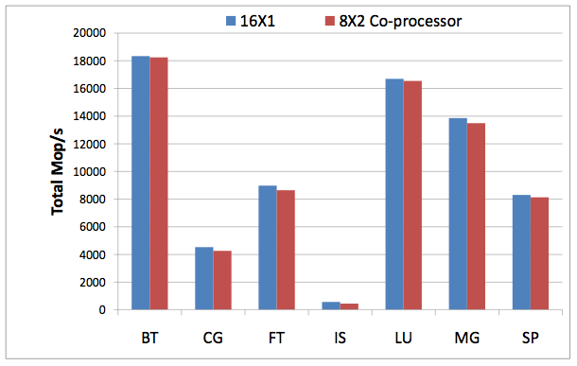
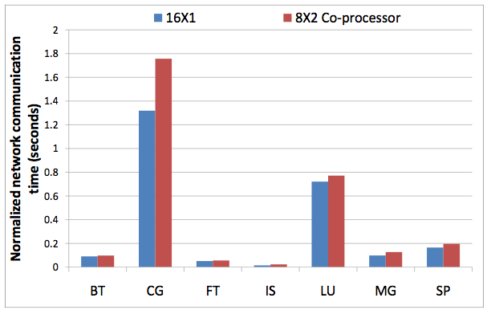
Impact of Network Sharing

Slide 8
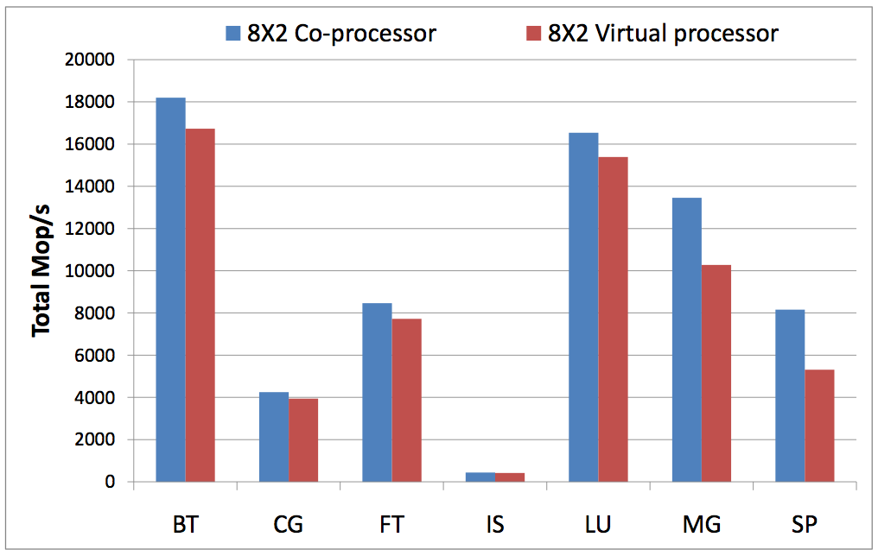
Impact of Processor Sharing

Slide 9
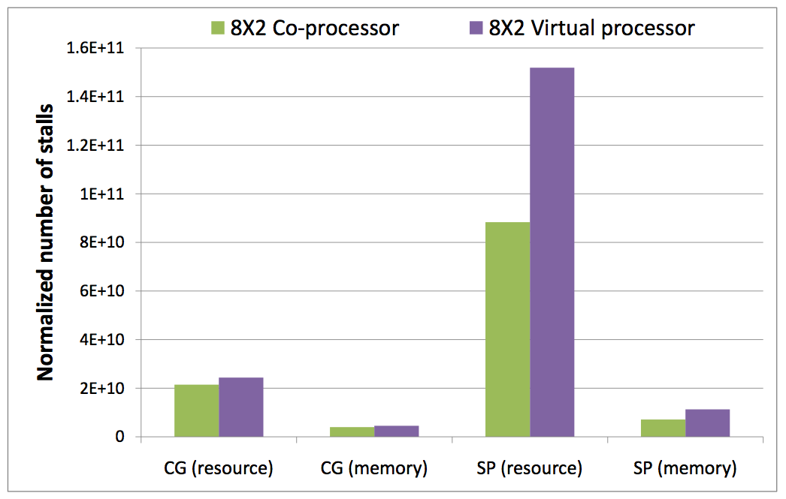
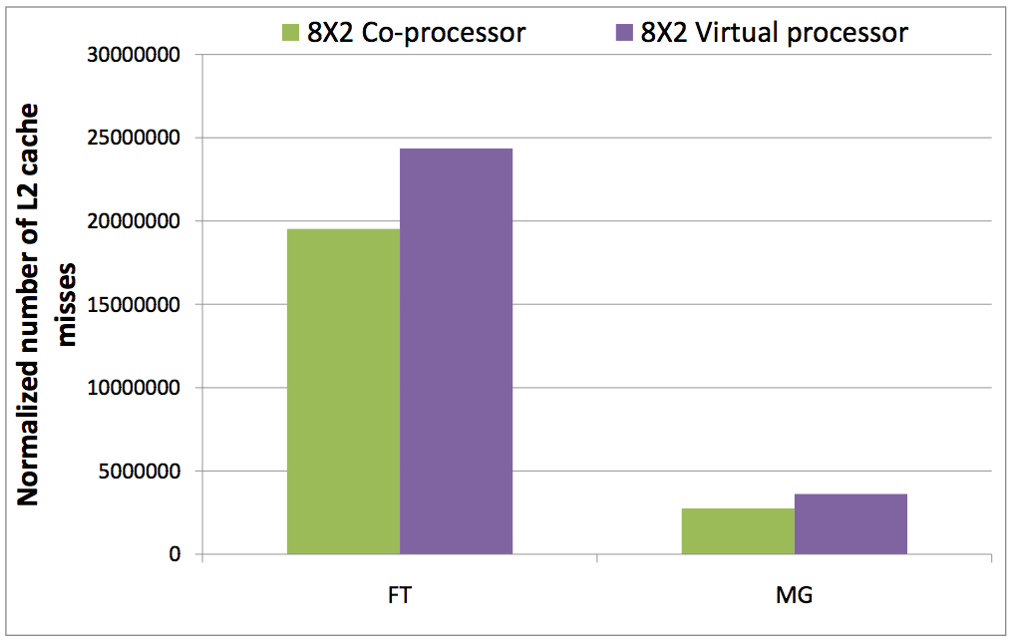
Resource Usage in Processor Sharing

Slide 10
Presentation Outline
Introduction and Motivation
Experimental Evaluation of the NAS Benchmarks
Behavioral Analysis of the NAS Benchmarks
Concluding Remarks and Future Work

Slide 11
Behavioral Analysis: CG
Forms sub-groups of processes which communicate mainly with each other
Clustering these groups together increases intra-node communication
Contiguous ranks cluster together; single dimension of clustering !
0
1
4
5
2
3
6
7
8
9
12
13
10
11
14
15

Slide 12
Behavioral Analysis: FT
After each step of communication, the data grid is transposed along one dimension (example: P3DFFT)
Communication is an Alltoallv for a sub-communicator (contains processes in one dimension)
Grouping processes in one dimension will cause the other dimension to suffer

Slide 13
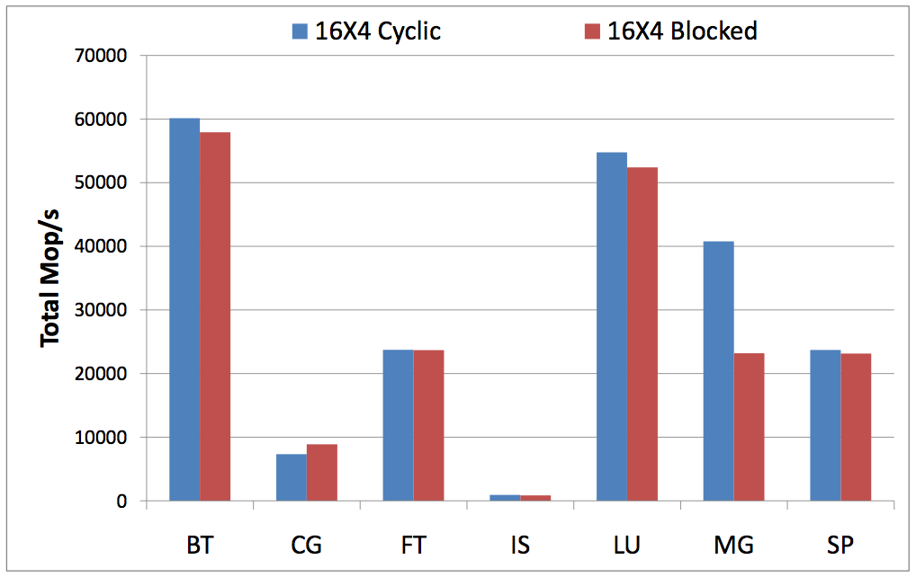
Impact of Process-Core Reordering

Slide 14
Presentation Outline
Introduction and Motivation
Experimental Evaluation of the NAS Benchmarks
Behavioral Analysis of the NAS Benchmarks
Concluding Remarks and Future Work

Slide 15
Concluding Remarks and Future Work
Multi-core systems are revolutionizing HEC
Low cost, low power
Applications just run !
Immediate adoption is simple, performance tuning is not
E.g., Communication patterns on multi-core systems are complex
Analyzed communication behavior
Case Study with the NAS benchmarks
Increased network and resource sharing hurts performance
Use application patterns and reorder process-core mappings – improves performance in some cases
Future Work: Incorporating application pattern information as hints to MPICH2 (through the process manager)

Slide 16
Thank You
Contacts:
Ganesh Narayanaswamy: cnganesh@cs.vt.edu
Pavan Balaji: balaji@mcs.anl.gov
Wu-chun Feng: feng@cs.vt.edu
For More Information:
http://synergy.cs.vt.edu
http://www.mcs.anl.gov/~balaji

