Slide 1
Distributed I/O with ParaMEDIC: Experiences with a Worldwide Supercomputer
P. Balaji, W. Feng, H. Lin, J. Archuleta, S. Matsuoka, A. Warren, J. Setubal, E. Lusk, R. Thakur, I. Foster, D. S. Katz, S. Jha, K. Shinpaugh, S. Coghlan, D. Reed
Math. and Computer Science, Argonne National Laboratory
Computer Science and Engg., Virginia Tech
Dept. of Computer Sci., North Carolina State University
Dept. of Math. And Computing Sci, Tokyo Inst. of Technology
Virginia Bioinformatics Institute, Virginia Tech
Center for Computation and Tech., Louisiana State University
Scalable Computing and Multicore Division, Microsoft Research

Slide 2
Distributed Computation and I/O
Growth of combined compute and I/O requirements
E.g., Genomic sequence search, Large-scale data mining, data visual analytics and communication profiling
Commonality: Require a lot of compute power and use and generate a lot of data
Data has to be managed for later processing or archival
Managing large data volumes: Distributed I/O
Non-local access to large compute systems
Data generated remotely and transferred to local systems
Resource locality: Applications need compute and storage
Data generated at one site and moved to another

Slide 3
Distributed I/O: The Necessary Evil
Lot of prior research tries to improve distributed I/O
Continues to be the elusive holy grail
Not everyone has a lambda grid
Scientists run jobs on large centers from their local system
There is just too much data!
Very difficult to achieve high performance for “real data” [1]
Bandwidth is not everything
Real software requires synchronization (milliseconds)
High-speed TCP eats up memory – slows down applications
Data encryption or endianness conversion required in some cases
Solution: FEDEX !
[1] “Wide Area Filesystem Performance Using Lustre on the Teragrid”, S. Simms, G. Pike, D. Balog. Teragrid Conference, 2007

Slide 4
Presentation Outline
Distributed I/O on the WAN
Genomic Sequence Search on the Grid
ParaMEDIC: Framework to Decouple Compute and I/O
ParaMEDIC on a Worldwide Supercomputer
Experimental Results
Concluding Remarks

Slide 5

Why is Sequence Search So Important?

Slide 6
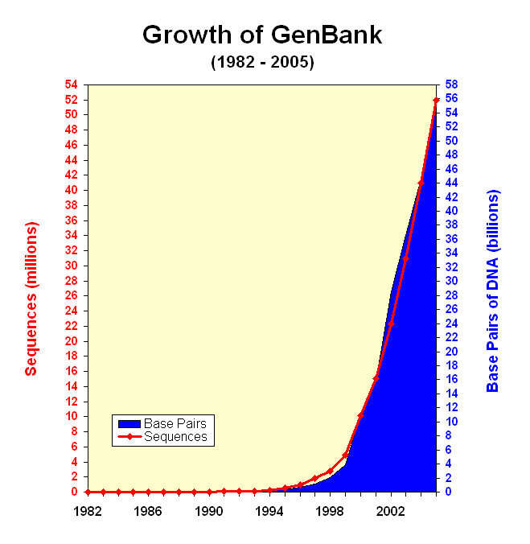
Challenges in Sequence Search
Genome database size doubles every 12 months
Compute power doubles 18-24 months
Consequence:
Compute time to search this database increases
Amount of data generated increases
Parallel Sequence search helps with computational requirements
E.g., mpiBLAST, ScalaBLAST

Slide 7
Large-scale Sequence Search: Reason 1
The Case of the Missing Genes
Problem: Most current genes have been detected by a gene-finder program, which can miss real genes
Approach: Every possible location along a genome should be checked for the presence of genes
Solution:
All-to-all sequence search of all 567 microbial genomes that have been completed to date
… but requires more resources than can be traditionally found at a single supercomputer center 2.63 x 10¹⁴ sequence searches!

Slide 8
Large-scale Sequence Search: Reason 2
The Search for a Genome Similarity Tree
Problem: Genome databases are stored as an unstructured collection of sequences in a flat ASCII file
Approach: Correlate sequences by matching each sequence with every other
Solution
Use results from all-to-all sequence search to create genome similarity tree
… but requires more resources than can be traditionally found at a single supercomputer center
Level 1: 250 matches; Level 2: 250² = 62,500 matches; Level 3: 250³ = 15,625,000 matches …

Slide 9
Genomic Sequence Search on the Grid
All-to-all sequence search for microbial genomes
Potential to solve many unsolved problems
Resource requirements shoots out of the roof top
Compute: 263 trillion sequence searches
Storage: Can generate more than a petabyte of data
Plan:
Use a distributed supercomputer taking compute resources from multiple supercomputing centers
Store output data in a storage center for later processing
Using distributed compute resources is easy (relatively)
Storing a petabyte of data remotely?

Slide 10
Presentation Outline
Distributed I/O on the WAN
Genomic Sequence Search on the Grid
ParaMEDIC: Framework to Decouple Compute and I/O
ParaMEDIC on a Worldwide Supercomputer
Experimental Results
Concluding Remarks

Slide 11
ParaMEDIC Overview
ParaMEDIC: Parallel Meta-data Environment for Distributed I/O and Computing [2]
Transforms output to application-specific “meta-data”
Application generates output data
ParaMEDIC takes over:
Transforms output to (orders-of-magnitude smaller) application-specific meta-data at the compute site
Transports meta-data over the WAN to the storage site
Transforms meta-data back to the original data at the storage site (host site for the global file-system)
Similar to compression, yet different
Deals with data as abstract objects, not as a byte-stream
[2] “Semantics-based Distributed I/O with the ParaMEDIC Framework”, P. Balaji, W. Feng and H. Lin. IEEE International Conference on High Performance Distributed Computing (HPDC), 2008

Slide 12
The ParaMEDIC Framework
Applications
mpiBLAST
Communication
Profiling
Remote
Visualization
ParaMEDIC API (PMAPI)
ParaMEDIC Data Tools
Application Plugins
Data
Encryption
Data
Integrity
mpiBLAST
Plugin
Communication
Profiling Plugin
Basic
Compression
Communication Services
Other Utilities
Direct
Network
Global
Filesystem
Column Parsing
Data Sorting

Slide 13
Tradeoffs in the ParaMEDIC Framework
Trading Computation and I/O
More computation: Converting output to meta-data and back requires extra work
Lesser I/O: Only meta-data is transferred over the WAN, so lesser bandwidth usage on the WAN
But, well, computation is free; I/O is not !
Trading Portability and Performance
Utility functions help develop application plugins, but will always need non-zero effort
Data is dealt has high-level objects: Better chance of improved performance

Slide 14
Sequence Search with mpiBLAST
Output
Output
Query
Sequences
Query
Sequences
Database
Sequences
Database
Sequences
Sequential Search of Queries
Parallel Search of Queries

Slide 15
mpiBLAST Meta-Data
Alignment of two sequences is independent of the remaining sequences
Meta-data (IDs of matched sequences)
Output
Communicate over the WAN
Query
Sequences
Alignment information for a bunch of sequences
Query
Sequences
Temporary Database
Sequences
Database
Sequences

Slide 16
ParaMEDIC-powered mpiBLAST
The ParaMEDIC Framework
Compute Sites
WAN
Storage Site

Slide 17
Presentation Outline
Distributed I/O on the WAN
Genomic Sequence Search on the Grid
ParaMEDIC: Framework to Decouple Compute and I/O
ParaMEDIC on a Worldwide Supercomputer
Experimental Results
Concluding Remarks

Slide 18
Our Worldwide Supercomputer
Name | Location | Cores | Arch. | Memory (GB) | Network | Storage (TB) | Distance from Storage
SystemX | VT | 2200 | PPC 970FX | 4 | IB | NFS (30) | 11,000
Breadboard | Argonne | 128 | Opteron | 4 | 10GE | NFS (5) | 10,000
Blue Gene/L | Argonne | 2048 | PPC 440 | 1 | Proprietary | PVFS (14) | 10,000
SiCortex | Argonne | 5832 | MIPS | 3 | Proprietary | NFS (4) | 10,000
Jazz | Argonne | 700 | Xeon | 1-2 | GE | G/PVFS (20) | 10,000
TeraGrid (UC) | U. Chicago | 320 | Itanium2 | 4 | Myrinet 2000 | NFS (4) | 10,000
TeraGrid (SDSC) | San Diego | 60 | Itanium2 | 4 | Myrinet 2000 | GPFS (50) | 9,000
Oliver | LSU | 512 | Xeon | 4 | IB | Lustre (12) | 11,000
Open Science Grid | U.S. | 200 | Opteron + Xeon | 1-2 | GE | - | 11,000
TSUBAME | TiTech | 72 | Opteron | 16 | GE | Lustre (350) | 0

Slide 19
Dynamic Availability of Compute Clients
Two possible extremes:
Complete parallelism across all nodes --- single failure will lose all existing output
Sequential computation of tasks (using different processors to do each task) --- out-of-core computation !
Hierarchical computation with small-scale parallelism
Clients maintain very little state
Each client set (a few processors) runs a separate instance of mpiBLAST
Each client set gets a task, computes on it and sends the output to the storage system

Slide 20
Performance Optimizations
Architectural Heterogeneity
Data to be converted to architecture independent format
Trouble for vanilla mpiBLAST; not so much for ParaMEDIC
Utilizing Parallelism on Processing Nodes
ParaMEDIC I/O has three parts
Compute clients, Post-processing servers and I/O servers
Post-processing: Each server handles a different stream
Simple, but only effective when there are enough streams
Disconnected or Cached I/O
Clients cache output from multiple tasks locally
Allows data aggregation for better bandwidth and merging

Slide 21
Presentation Outline
Distributed I/O on the WAN
Genomic Sequence Search on the Grid
ParaMEDIC: Framework to Decouple Compute and I/O
ParaMEDIC on a Worldwide Supercomputer
Experimental Results
Concluding Remarks

Slide 22
I/O Time Measurements

Slide 23
Storage Bandwidth Utilization (Lustre)

Slide 24
Storage Bandwidth Utilization (ext3fs)

Slide 25
Microbial Genome Database Search
Semantic-aware metadata gives scientists 2.5*10¹⁴ searches at their finger-tips
All metadata results from all searches can fit on iPod Nano
“Semantically compressed” 1 Petabyte into 4 Gigabytes (10⁶X)
Usual compression results in 1 PB into 300 TB (3X)
Semantic Compression

Slide 26
Preliminary Analysis of the Output
Analysis of the Similarity Tree
Expect that replicons (i.e., chromosomes) will match other replicons reasonably well
But many replicons do not match many other replicons
25% of all replicon-replicon searches do not match at all!

Slide 27
Presentation Outline
Distributed I/O on the WAN
Genomic Sequence Search on the Grid
ParaMEDIC: Framework to Decouple Compute and I/O
ParaMEDIC on a Worldwide Supercomputer
Experimental Results
Concluding Remarks

Slide 28
Concluding Remarks
Distributed I/O is a necessary evil
Difficult to get high performance for “real data”
Traditional approaches deal with data as a stream of bytes (allows for portability across any type of data)
We proposed ParaMEDIC
Semantics-based meta-data transformation of data
Trade Portability for Performance
Evaluated on a World-wide Supercomputer
Self Sequence searched all completed microbial genomes
Generated a petabyte of data that was stored half-way around the world

Slide 29
Thank You!
Acknowledgments:
U. Chicago: R. Kettimuthu, M. Papka and J. Insley
Argonne National Lab: N. Desai and R. Bradshaw
Virginia Tech: G. Zelenka, J. Lockhart, N. Ramakrishnan, L. Zhang, L. Heath, and C. Ribbens
Renaissance Computing Institute: M. Rynge and J. McGee
Tokyo Institute of Technology: R. Fukushima, T. Nishikawa, T. Kujiraoka, and S. Ihara
Sun Microsystems: S. Vail, S. Cochrane, C. Kingwood, B. Cauthen, S. See, J. Fragalla, J. Bates, R. Cagle, R. Gaines, and C. Bohm
Louisiana State University: H. Liu
Email: balaji@mcs.anl.gov
Web: http://www.mcs.anl.gov/~balaji

