Slide 1
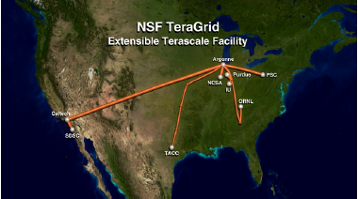
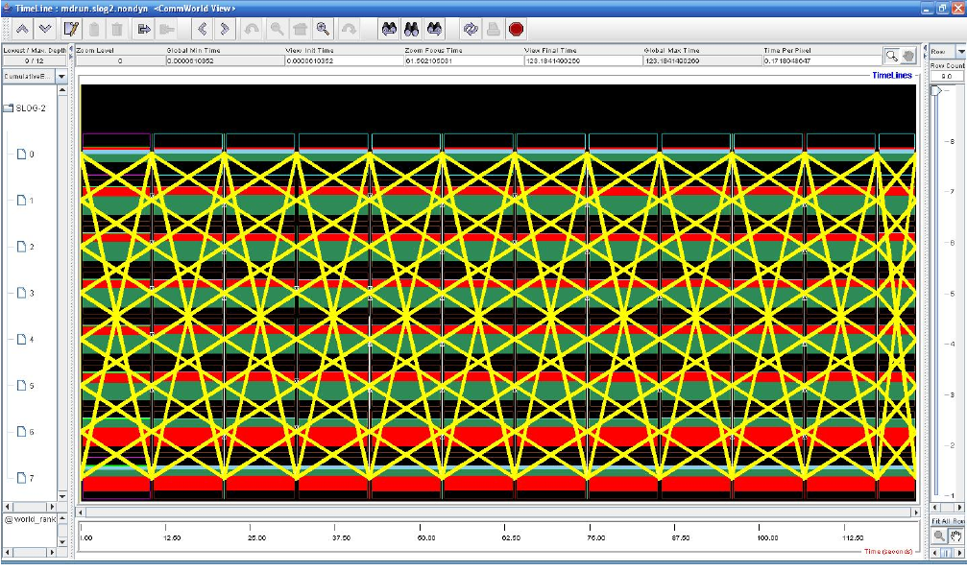
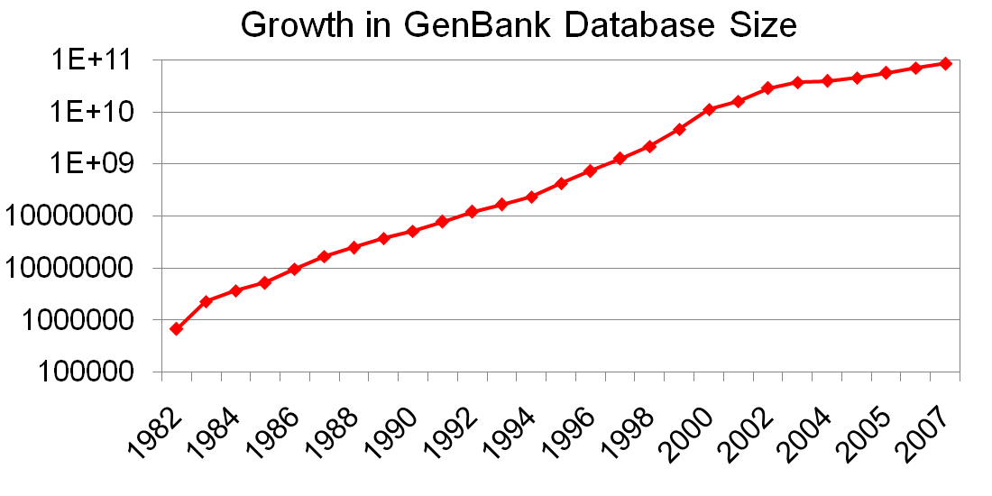
Semantics-based Distributed I/O for mpiBLAST
P. Balaji^{ά}, W. Feng^{β}, J. Archuleta^{β}, H. Lin^{δ}, R. Kettimuthu^{ά}, R. Thakur^{ά} and X. Ma^{δ}
^{ά} Argonne National Laboratory ^{β} Virginia Tech ^{δ} North Carolina State University
Traditional Distributed I/O
Sequence Search with mpiBLAST
Issues with Distributed I/O
NSF TeraGrid
mpiBLAST
Working Model
Distributed I/O
in mpiBLAST
High Latency
Synchronization operations heavily effected
Low Bandwidth
High-bandwidth links are not accessible to everyone
Data Encryption
Distributed I/O over the Internet might need to be encrypted in some environments
And yet distributed I/O is essential
Large-scale computations might require resources that are not available at a single site
Scientists may need to access remote large-scale supercomputers which are not available locally
s
Scatter
Search
Gather
Query
Output
Estimated Output of an All-to-All NT Search
Database
Query Size (KB) | 0-5 | 5-50 | 50-150 | 150-200 | 200-500 | >500 | Total
Number of Queries | 3,305,170 | 87,506 | 25,920 | 26,524 | 9,592 | 248 | 3,455,000
Estimated Output (GB) | 1,139 | 593 | 23,555 | 3,995 | ? | ? | >29,282
Workers
ParaMEDIC Framework
ParaMEDIC Architecture
Understanding ParaMEDIC
ParaMEDIC-powered
mpiBLAST
Applications
Primary Idea:
Data transformation, but not at the byte-level (unlike compression techniques)
Application specifies the appropriate description of the data → allows ParaMEDIC to process output as high-level objects, and not a stream of bytes
With respect to mpiBLAST
Overall output is just a concatenation of matches and other descriptive information for each query sequence
Match scores, alignment information, etc.
Finding the database matches for each sequence is the compute intensive portion → needs to be stored
Rest can be discarded and regenerated
mpiBLAST
Communication
Profiling
Remote
Visualization
I/O Servers
hosting file
system
ParaMEDIC Data Tools
ParaMEDIC API
PMAPI)
Compute Master
Processed Metadata
Generate Temp
Database
Data
Encryption
Data
Integrity
I/O Master
Query
Raw Metadata
Query
Read Temp
Database
Write Results
Communication Services
Application Plugins
Compute
Workers
mpiBLAST
Master
mpiBLAST
Master
I/O
Workers
Direct
Network
Global
File-System
Basic
Compression
mpiBLAST
plugin
Communication
Profiling Plugin
mpiBLAST
Worker
mpiBLAST
Worker
mpiBLAST
Worker
mpiBLAST
Worker
mpiBLAST
Worker
Impact of Network Latency
Network Delay: Performance Breakup
Trading Computation and IO
Impact of Encrypted File-Systems
Argonne-VT Distributed Setup
Performance on TeraGrid
Other Applications:
MPE Communication Profiler
Conclusion
Distributed I/O is a necessary evil
Large applications need resources from multiple centers
Scientists might need to use remote large-scale resources
Impacted by several issues
High Latency, Low Bandwidth, Encryption requirements
We propose the ParaMEDIC framework
Semantics-based Distributed I/O mechanism
ParaMEDIC uses application-specific plugins to “understand” what the output data means and process it
Output data converted to application-specific metadata, transported, and then converted back
Trades a small amount of additional computation for potentially large benefits in I/O
Scientific applications have periodic communication profiles
ParaMEDIC uses FFT to find periodicity and process output
Preliminary results show 2-5X reduction in output

