Slide 1






Massively Parallel Genomic Sequence Search on Blue Gene/P
Heshan Lin (NCSU)
Pavan Balaji (ANL)
Ruth Poole, Carlos Sosa (IBM)
Xiaosong Ma (NCSU & ORNL)
Wu Feng (VT)

Slide 2
Sequence Search
Fundamental tool in computational biology
Search similarities between a set of query sequences and sequence databases (DBs)
Analogous to web search engines
Example application: predict functions of newly discovered sequences
 | Web Search Engine | Sequence Search
Input | Keyword(s) | Query sequence(s)
Search space | Internet | Known sequence database
Output | Related web pages | DB sequences similar to the query
Sorted by | Closeness & rank | Similarity score

Slide 3
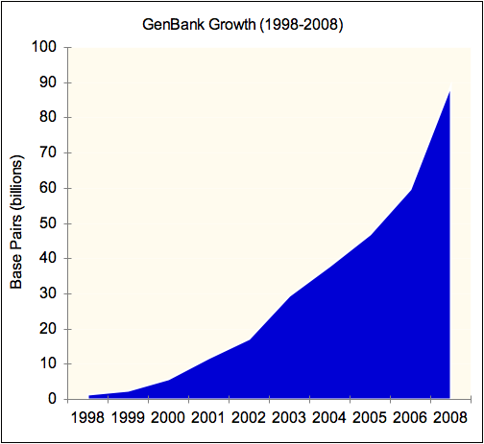

Demands of Large-scale Sequence Search
Genomic databases growing faster than compute capability of single CPU
CPU clock scaling hits the power wall
Many biological problems requiring large-scale sequence search
Example: “Finding Missing Genes”
Compute: 12,000+ cores across 7 supercomputer centers worldwide
WAN: Shared Gigabit Ethernet
Feat: Completed in 10 days what would normally take years to finish
Exponentially Growing
Storage Challenge Award

Slide 4
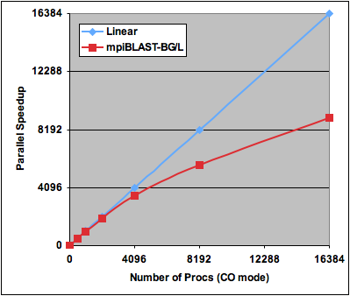
Challenge: Scaling of Sequence Search
Performance of a massively parallel sequence search tool – mpiBLAST BG/L prototype
Search 28,014 Arabidopsis thaliana against the NCBI NT DB
55%
70%
93%

Slide 5

Our Major Contributions
Identification of key design issues of scalable sequence search on next-generation massively parallel supercomputers
I/O and scheduling optimizations that allow efficient sequence searching across 10,000s of processors
An extended prototype of mpiBLAST on BG/P with up to 32,768 compute cores (93% efficiency).

Slide 6
Road Map
Introduction
Background
Optimizations
Performance Results
Conclusion

Slide 7
BLAST & mpiBLAST
BLAST (Basic Local Alignment Sequence Tool)
De facto standard tool for sequence search
Computationally intensive: O(n²) worst-case
Algorithm: Heuristics-based alignment
Execution time of a BLAST job hard to predic
mpiBLAST
Originally master-worker with database segmentation
Enhanced for large-scale deployments
Parallel I/O [Lin05, Ching06]
Hierarchical Scheduling [Gardner06]
Integrated I/O & Scheduling [Thorsen07]

Slide 8
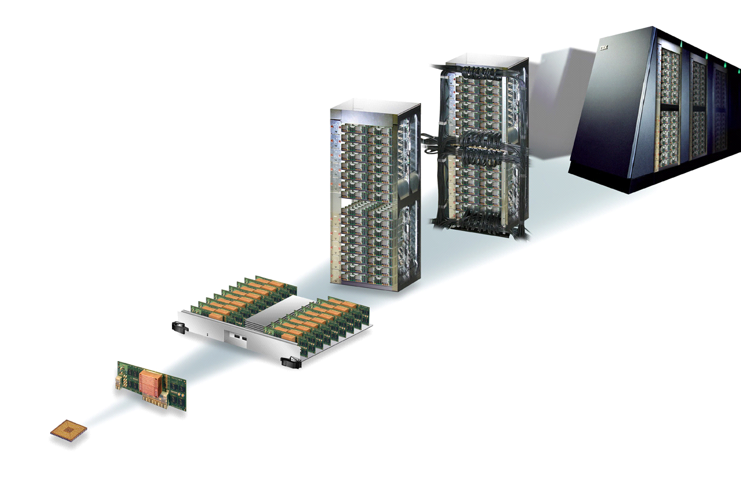
Blue Gene/P System Overview
1024 nodes, 4096 cores per rack
Compute node: Quad-core PowerPC 450, 2GB memory
Scalable I/O system
Compute and I/O nodes organized into PSET
Five networks
3D torus, global collective, global interrupt, 10-Gigabit Ethernet, control
Execution modes
SMP, DUAL, VN
72 Racks PetaFlops
1 Rack 32 Node Cards
Node Card 32 Nodes

Slide 9
Road Map
Introduction
Background
Optimizations
Performance Results
Conclusion

Slide 10
Current mpiBLAST Scheduling
Scheduling hierarchy
Limitations
Fixed worker-to-master mapping
High overhead with fine-grained load balancing
SuperMaster
Partition 1
Partition n
Master₁
Master₂
Master_{n-1}
Master_{n}
…
q_{i}
q_{i}
q_{j}
q_{j}
q_{k}
q_{k}
q_{l}
q_{l}
f₁
f₂
f₁
f₂
f₁
f₂
f₁
f₂
P_{1,1}
P_{1,2}
P_{2,1}
P_{2,2}
P_{n-1,1}
P_{n-1,2}
P_{n,1}
P_{n,2}

Slide 11
Scheduling Optimization Overview
Optimizations
Allow mapping arbitrary workers to a master
Hide balancing overhead with query prefetching
SuperMaster
prefetch
Partition 1
Partition n
Master₁
Master_{n}
…
q_{i}
q_{i}
q_{j}
q_{j}
q_{k}
q_{k}
q_{l}
q_{l}
f₁
f₂
f₁
f₂
f₁
f₂
f₁
f₂
P_{1,1}
P_{1,2}
P_{1,3}
P_{1,4}
P_{n,1}
P_{n,2}
P_{n,3}
P_{n,4}

Slide 12
Mapping on BG/P
DB frags cached in workers, queries streamed across
One output file per partition
Results merged and written to GPFS through I/O nodes
Partition i
q_{i}
q_{i}
…
q_{i}
q_{i+1}
q_{i+1}
q_{i+1}
Partition 1
Partition 2
Partition i
q_{i+2}
q_{i+2}
q_{i+2}
…
…
Compute Nodes
Compute Nodes
Compute Nodes
IO Node
IO Node
IO Node
Config example
PSize 128
4 DBs / partition
32768/128 = 256 partitions
File 1
File 2
q_{i}
File i
G P F S
q_{i+1}
Disk
Disk
Disk
Disk
Disk

Slide 13
I/O Characteristics
Irregularity
Output data from a process is unstructured and non-contiguous
I/O data distribution varies from query to query
Query search time are imbalanced across workers
…
…
Straightforward non-contiguous I/O bad for BG/P I/O systems
Too many requests create contention at I/O node
GPFS less optimized for small-chunk, irregular I/O [Yu06]

Slide 14
Existing Option 1: Collective I/O
Optimizes accesses from N processes
Two-phase I/O: Merge small, non-contiguous I/O requests into large, contiguous ones
Advantage
Excellent I/O throughput
Highly optimized on Blue Gene [Yu06]
Disadvantage
Synchronization between processes
Suitable applications
Synchronizations in the compute kernel
Balanced computation time between I/O phases

Slide 15
Option1 Implementation: WorkerCollective
Worker 1
Worker 2
Worker 3
Master
q_{i}
q_{i}
q_{i}
1
1
Merge blocks info
1
q_{i+1}
q_{i+1}
q_{i+1}
2
Calculate offsets of q_{i}
2
2
3
3
Search
Merge
Wait
q_{i+2}
q_{i+2}
q_{i+2}
1
Send evalue+size
2
Send offsets
4
3
Exchange data
4
4
4
Write data
Output File
Output of q_{i}

Slide 16
Existing Option2: Optimized Independent I/O
Optimized with data sieving
Read-modify-write: read in large chunks and only modify target regions
Advantages
Does not incur synchronizations
Performs well for dense non-contiguous requests
Disadvantages
Introduces redundant data accesses
Causes lock contentions with false sharing

Slide 17
Option2 Implementation: WorkerIndividual
Worker 1
Worker 2
Worker 3
Master
q_{i}
q_{i}
q_{i}
1
1
Merge blocks info
1
q_{i+1}
q_{i+1}
q_{i+1}
2
Calculate offsets of q_{i}
2
2
q_{i+2}
3
3
q_{i+2}
q_{i+2}
Search
Merge
1
Send evalue+size
3
3
2
Send offsets
3
Write data
Output File
Output of q_{i}

Slide 18
Our Design: Asynchronous Two-Phase I/O
Achieving high I/O throughput without forcing synchronization
Asynchronously aggregate small, non-contiguous I/O requests into large chunks
Current implementation
Master selects a write leader for each query
Write leader aggregates requests from other workers

Slide 19
Our Design Implementation: WorkerMerge
Worker 1
Worker 2
Worker 3
Master
q_{i}
q_{i}
q_{i}
1
1
Merge blocks info
1
q_{i+1}
q_{i+1}
q_{i+1}
2
Calculate offsets of q_{i}
2
3
2
q_{i+2}
3
q_{i+2}
q_{i+2}
Search
Merge
1
Send evalue+size
4
2
Offsets
3
Exchange data
4
Write data
Output File
Output of q_{i}

Slide 20
Discussion
WorkerMerge implementation concerns
Non-blocking MPI communications vs. threads
Incremental write to avoid memory overflow
Only a limited amount of data collected and written at a time
Will split-collective I/O help?
MPI_File_write_all_begin, MPI_File_write_all_end
MPI_File_set_view is synchronized by definition

Slide 21
Road Map
Introduction
Background
Optimizations
Performance Results
Conclusion

Slide 22
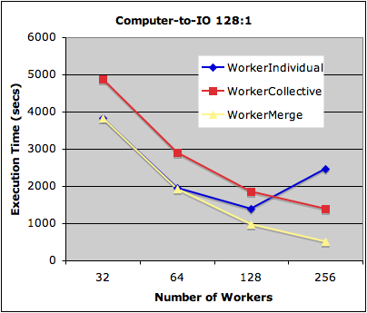
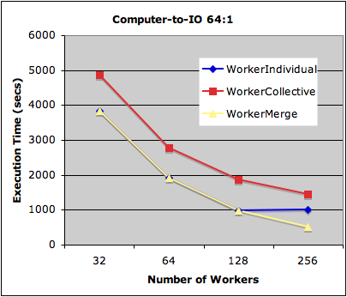
Compare I/O Strategies – Single Partition
Experimental setup
Database: NT (over 6 million seqs, 23 GB raw size)
Query: 512 sequences randomly sampled from the database
Metric: Overall execution time
WM outperforms WC and WI by a factor of 2.7 and 4.9

Slide 23
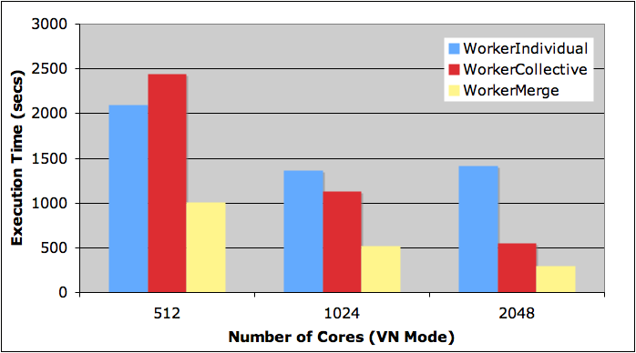
Compare I/O Strategies – Multi-Partitions
Experimental setup
Database: NT
Query: 2048 sequences randomly sampled from the database
Fixed partition size at 128, scale number of partitions

Slide 24
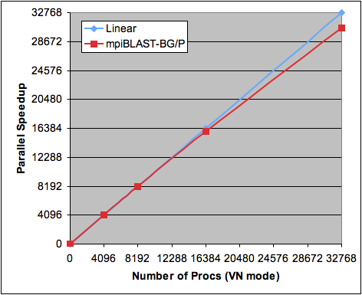
Scalability on A Real Problem
Discovering “missing genes”
Database: 16M microbial sequences
Query: 0.25M randomly sampled sequences
93% parallel efficiency
All to all search entire DB within 12 hours

Slide 25
Road Map
Introduction
Background
Optimizations
Performance Results
Conclusion

Slide 26
Conclusion
Blue Gene/P: Well-suited for massively parallel sequence search when designed properly
We proposed I/O and scheduling optimizations for scalable sequence searching across 10,000s processors
mpiBLAST prototype scales efficiently (93% efficiency) on 32,768 cores on BG/P
For non-contiguous I/O with imbalanced compute kernels, collective I/O without synchronization is desirable

Slide 27
References
O. Thorsen, K. Jiang, A. Peters, B. Smith, H. Lin, W. Feng and C. Sosa, "Parallel Genomic Sequence-Search on a Massively Parallel System," ACM Int’l Conference on Computing Frontiers, 2007.
H. Yu, R. Sahoo, C. Howson, G. Almasi, J. Castanos, M. Gupta J. Moreira, J. Parker, T. Engelsiepen, R. Ross, R. Thakur, R. Latham, and W. Gropp, "High Performance File I/O for the BlueGene/L Supercomputer," 12th IEEE Int’l Symposium on High-Performance Computer Architecture (HPCA-12), 2006.
M. Gardner, W. Feng, J. Archuleta, H. Lin and X. Ma, "Parallel Genomic Sequence-Searching on an Ad-Hoc Grid: Experiences, Lessons Learned, and Implications," IEEE/ACM Int’l Conference for High-Performance Computing, Networking, Storage and Analysis (SC), Best Paper Finalist, 2006.
H. Lin, X. Ma, P. Chandramohan, A. Geist and N. Samatova, "Efficient Data Access for Parallel BLAST," IEEE Int’l Parallel and Distributed Processing Symposium (IPDPS), 2005.
A. Ching, W. Feng, H. Lin, X. Ma and A. Choudhary, "Exploring I/O Strategies for Parallel Sequence Database Search Tools with S3aSim," ACM Int’l Symposium on High Performance Distributed Computing (HPDC), 2006.

Slide 28
Thank You
Questions?

