Slide 1
Asymmetric Interactions in Symmetric Multicore Systems: Analysis, Enhancements, and Evaluation
Tom Scogland*
P. Balaji⁺
W. Feng*
G. Narayanaswamy*
Virginia Tech* Argonne National Laboratory⁺

Slide 2
Background
We are entering the era of multicore and manycore
4 cores are common
Multicore isn’t as simple as it seems
Homogeneous chips are still hierarchical in design
Manycore will be even more difficult
Future: 80+ cores per chip
Core 0
Core 1
Core 2
Core 3
L1 Cache
L1 Cache
L1 Cache
L1 Cache
L2 Cache
L2 Cache
Notes:
fix

Slide 3
Assumptions
Cores have equal computation and communication ability
A program running on Core #1 will behave the same as on Core #2
Caveat: maybe different cache effects, but overall the same
We assume that symmetric multicore has symmetric capabilities per core

Slide 4
Reality
Cores have unequal computation and communication capabilities
A program running on Core #1 will behave differently than on Core #2
Physical hardware can affect the capability
The OS can have an affect as well
The OS maps processes to cores without considering their capabilities
Cores do not have symmetric capabilities

Slide 5
Motivation Example
System level effects have performance consequences
We must understand & mitigate these effects
You could be here
… or here
10%
Notes:
This graph shows the real life difference core mappings can make. Higher is better here, and mappings 1-6 are some of the bad mappings for this particular program, whereas 7-12 are some of the nearly optimal mappings according to our static analysis

Slide 6
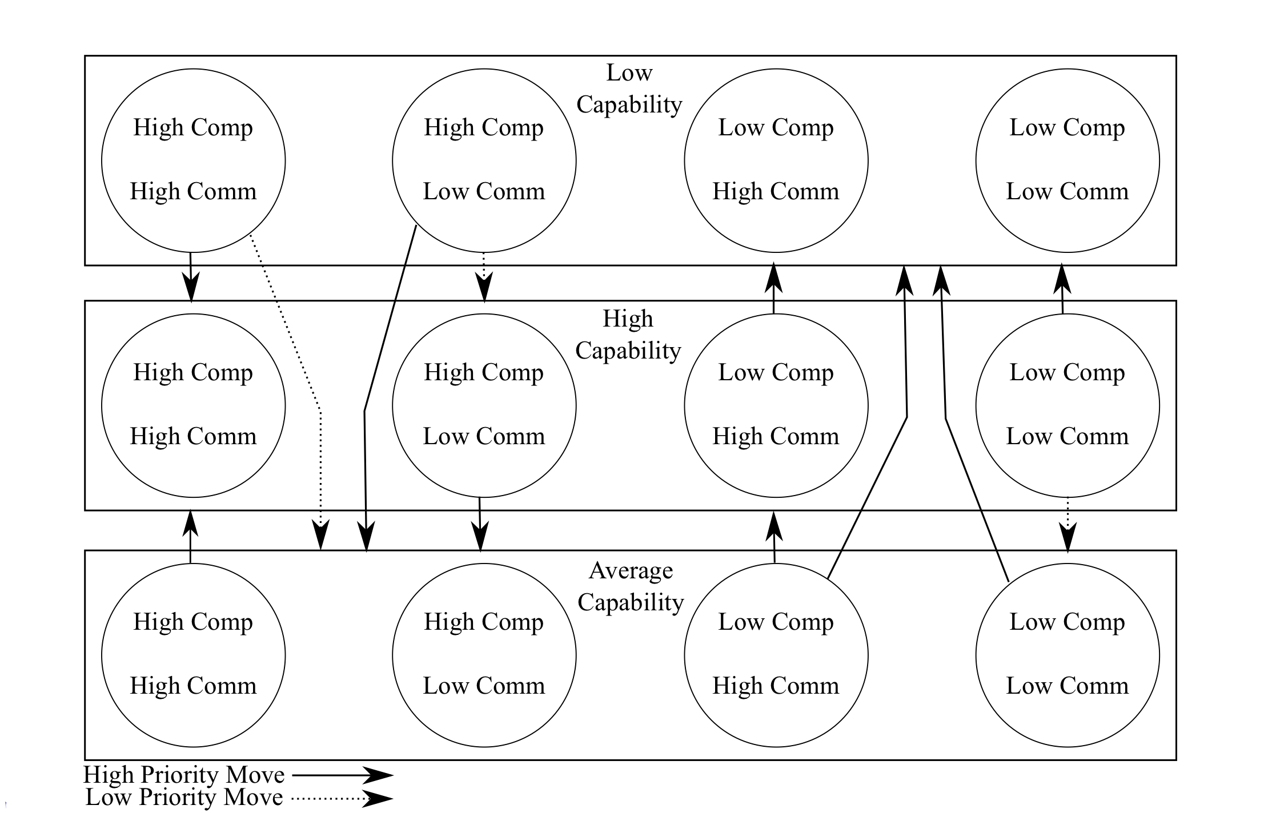
Solution
Dynamically map processes to “optimal” cores
Result
80% improvement in micro-benchmarks
10% improvement in real-world unmodified applications

Slide 7
Outline
Motivation & Problem Overview
Preliminary Work
SyMMer: Systems Mapping Manager
Overview
Design
Symptom Mitigation
Results
Micro-benchmarks
Applications
Summary and Future Work

Slide 8
Related Work
Auto-tuning (Williams et. al. SciDAC 08)
Automatically tunes programs for multicore
Works at the source level before compilation rather than runtime
Leaves scheduling up to the operating system
Processor Affinity
OS schedulers attempt to efficiently schedule processes on cores
Schedulers do not take enough factors into account

Slide 9
Prior Work
An Analysis of 10-Gigabit Ethernet Protocol Stacks in Multicore Environments (HotI 08)
Maps specific processes to specific cores
i.e., “process-to-core mapping”
Performs a brute force search for “best” static mapping
Result:
Identified symptoms of program behavior which correlate with low performance
Necessitates search of entire space to find “best” mapping

Slide 10
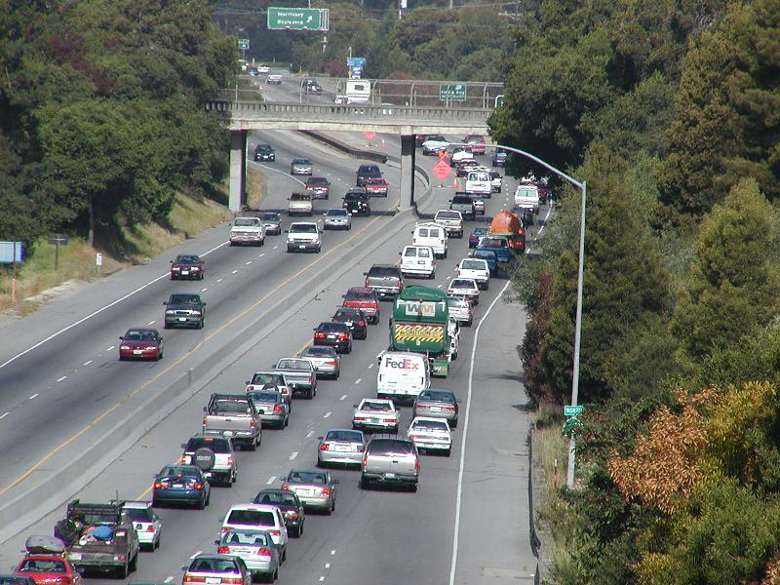

Static or Dynamic
Small office cluster
2 nodes X 4 cores
(4!)^2 = 576 combos
Ranger at TACC
3,936 nodes X 16 cores
(16!)^3,936 combinations
576 is tractable, (16!)^3,936 is not!
Notes:
TACC Ranger, the largest computer in the world for open science research at utexas
(Texas Advanced Computing Center)

Slide 11
Dynamic Mapping
Q: How can (16!)^3,936 become tractable?
A: Don’t compute all the combinations!
Course of action
Higher level symptoms are easier to detect
Work back from the symptom to the cause, and treat it
Multi node symptoms can occur, requiring communication
Monitoring
Symptom detection requires application information
System information also required
We need something that can do this for us

Slide 12
Requirements
Where?
Dynamic process mapping at runtime
Internal process information to make correct decisions
Ability to make multi core or multi node decisions
Low overhead
Application
Libraries
Kernel
Hardware
Notes:
Operating systems and programs are unaware of this asymmetry

Slide 13
Outline
Motivation & Problem Overview
Preliminary Work
SyMMer: Systems Mapping Manager
Overview
Design
Symptom Mitigation
Results
Micro-benchmarks
Applications
Summary and Future Work

Slide 14
SyMMer: Systems Mapping Manager
Complete process-to-core mapping system
Monitors all relevant sources
Uses distributed decision algorithms to detect and respond to symptoms
Changes process-to-core mapping dynamically
Exhibits Low overhead
Simply link in to use, no source modification necessary beyond use of MPI

Slide 15
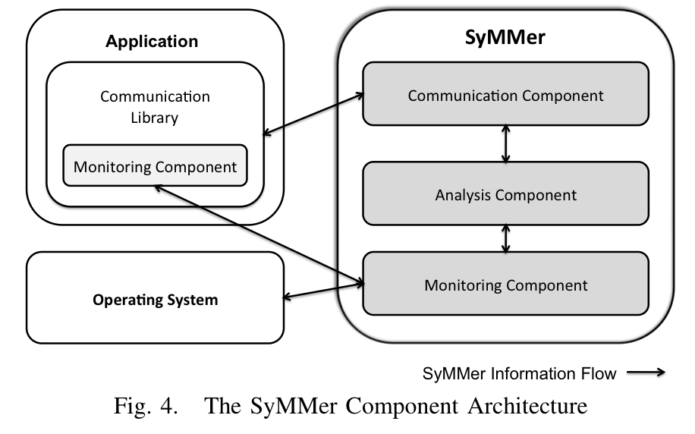
SyMMer: Conceptual Design
MPICH2
Linux
Notes:
Take your time here
List potential instances of each component

Slide 16
Symptoms
Communication Idleness
Out-of-Sync Communication
Cache Locality

Slide 17
Communication Idleness
Processes spend more time than necessary waiting on communication
Applications should be spending time computing or communicating, not waiting
Causes
Slow link
Imbalance between processes

Slide 18
Communication Idleness: Symptom
Processes waiting due to capability mismatch
Compute process on slow compute core
Communication process on slow communication core
All local to a single node

Slide 19
Communication Idleness: Solution
Swap the high communication and computation processes
Low computation core
Low communication core
Process computation time
Process communication time

Slide 20
Out-of-Sync Communication
Communication stalls when communicating processes get out of sync
A sender decides that the receiver isn’t taking more data, and decides to continue alone
The receiver stalls until the sender finally finishes the message

Slide 21
Out-of-Sync Communication: Symptom
Process waiting due to distributed core mismatch
Mismatched cores for processes which are communicating with one another across nodes
One lagging behind causes the other to stall
At least two processes notice the issue
System Mappings
Execution Flow

Slide 22
Out-of-Sync Communication: Solution
Remap two processes on one node
Process
Elect a leader
Leader determines which processes on which node to swap
Swap processes
System Mappings
Execution Flow

Slide 23
Cache Locality
The number of hops between cores determines the cost of transfers between them
The hierarchy of multi-processor multi-core design in full force
Communication over the network has to transfer the same way, just to an OS controlled core
Core 0 to Core 1, very efficient, Core 2 to 0 far worse
Core 0
Core 1
Core 2
Core 3
L1 Cache
L1 Cache
L1 Cache
L1 Cache
L2 Cache
L2 Cache

Slide 24
Cache Locality: Symptom
Higher than necessary L2 cache misses due to inter-core communication
PAPI with perfctr used to measure L2 cache misses
Frequently caused by network communication from distant cores
Cache 1
Cache 2

Slide 25
Cache Locality: Solution
Map communicating processes onto cores where they share a cache
At least to the same die
With the interrupted core if possible
Cache 1
Cache 2

Slide 26
Symptom Mitigation Recap
Communication Idleness
Problem: Local imbalance between processes and cores
Solution: Swap processes to better matched cores
Out-of-Sync Communication
Problem: Distributed capability mismatch, resulting in a stall in communications
Solution: Swap one end of the mismatched communicating pair
Cache Locality
Problem: Local communication across caches
Solution: Swap processes to nearer cores

Slide 27
Outline
Motivation & Problem Overview
Preliminary Work
SyMMer: Systems Mapping Manager
Overview
Design
Symptom Mitigation
Results
Micro-benchmarks
Applications
Summary and Future Work

Slide 28
Results
Experimental Setup
Micro-benchmarks
Communication Idleness
Out-of-sync Communication
Cache Locality
Applications
GROMACS
LAMMPS
FFTW
Notes:
WHY THESE APPLICATIONS: these are three relatively popular applications with which we’ve had previous experience which met the criteria of using MPI and being well tuned, but having the variances in communication and computation that give us room to make improvements

Slide 29
Experimental Setup
2 Dell PowerEdge 2950 servers
2 dual-core Intel Xeon 2.66GHz processors
4MB shared L2 cache
4GB 667MHz DDR2 SDRAM
NetEffect NE010 10-Gigabit Ethernet Adapter
Connected back-to-back
Fedora Core 6 with Linux kernel 2.6.18
MPICH2 v1.1.0a1 with SyMMer patches

Slide 30
Micro-Benchmark: Communication Idleness
32% improvement
Notes:
Describe: comm idleness MB is based on an MPI ping pong test, pairs of communicating processes, with various ratios of compute time to communication time. As the ratio varies past 1:1 it becomes beneficial to put certain processes on certain cores, and we see as much as a 32% performance improvement
Each point represents the average of at least 10 runs

Slide 31
Analysis: Communication Idleness
Vanilla
Unequal
SyMMer
Equal
Notes:
On the left, you will see a graph of compute time VS wait and communication time by process rank. These are all 8 ranks on both nodes, the goal is to balance out the times as much as possible, and reduce the overall wait time. On the right you can see the result of running the same test with symmer enabled MPICH2 where the wait time is far more balanced across the upper ranks and overall wait time is reduced
IN THE INTEREST OF TIME I WILL DRILL DOWN INTO THIS BENCHMARK TO HIGHLIGHT THE ACTUAL EFFECTS OF SYMMER. ANALYSIS OF OTHER BENCHMARKS CAN BE FOUND IN THE PAPER.

Slide 32
Micro-Benchmark: Out-of-Sync Communication
18% improvement
80% improvement
Notes:
Our out of sync benchmark is another set of intercommunicating processes, where the system is prone to stalls when the processes get out of sync. As the message size increases above trivial the chance of a stall becomes relevant, but past a certain point the cost of transferring that much data across the system outweighs the stalls causing the benefit found in symmer to decrease.

Slide 33
Analysis: Out-of-Sync Communication
52
96% improvement
2
Notes:
Communication Stalls as seen by rank 0: REMIND AUDIENCE WHAT COMM STALLS ARE
The stalls here, mean a difference between 38 seconds spent stalled doing no work, and 1.5 seconds stalled

Slide 34
Micro-Benchmark: Cache Locality
22% improvement
Notes:
Load factor is a measure of the work done per run, which is a generally linear measure, in that 8 is doing 8 times as much work as 1

Slide 35
Analysis: Cache Locality
623
146 (23%)
477
100
91
9 (9%)
Notes:
This one is rather self explanatory, it’s another communicating pairs test, where the pair is either on two nodes or on a single node but the processes are initially placed on unshared caches, causing large numbers of interrupts, now the inter-node test is interesting, because one wouldn’t normally think there could be a shared cache in that case, but when the cache is shared with the protocol stack, it makes a large difference in cache misses, and subsequently in performance

Slide 36
Applications
GROMACS
LAMMPS
FFTW

Slide 37
Application: GROMACS GROningen MAchine for Chemical Simulations
“…simulate[s] the Newtonian equations of motion for systems with hundreds to millions of particles.”
Exhibits the symptom of communication idleness
14.5
10%
13.3

Slide 38
Application: LAMMPS Large-scale Atomic/Molecular Massively Parallel Simulator
“A classical molecular dynamics code”
from Sandia National Laboratory
Version 21 released in May 2008
Exhibits the out-of-sync communication symptom
10
50%
5
Notes:
We observe the communication time because LAMMPS is somwhat unique in having constant communication regardless of overall time, and symmer only changes the communication time in this case, so the change is best observed by simply looking at communication time

Slide 39
Application: FFTW Fastest Fourier Transfrom in the West
“…library for computing the discrete Fourier transform (DFT)…”
Mainly cache misses
Sometimes out-of-sync communication
7.85
5%
7.45

Slide 40
Future Work
Build a performance model which predicts the best placement for processes
Investigate implementation of SyMMer in other communications libraries or standalone
OpenMPI
OpenMP
Standalone library
Add NUMA awareness and support for greater process migration flexibility
Notes:
We have recently become aware of some

Slide 41
Summary
Efficient and correct mapping of processes matters
A dynamic system is necessary
SyMMer makes mapping a tractable problem for large machines
For some real world applications up to a 10% performance improvement has been observed, 80% for microbenchmarks
Performance improvement over optimized code with no modification!

Slide 42



Thank You
Funding
SYNERGY lab at Virginia Tech
CHREC: Center for High-Performance Reconfigurable Computing
ANL: Argonne National Laboratory
More info
web: http://synergy.cs.vt.edu
email: tscogland@vt.edu

Slide 43
Overhead / False Positives

