Slide 1
MPI on a Million Processors
Pavan Balaji,¹ Darius Buntinas,¹ David Goodell,¹
William Gropp,² Sameer Kumar,³ Ewing Lusk,¹
Rajeev Thakur,¹ Jesper Larsson Träff ⁴
¹Argonne National Laboratory
²University of Illinois
³IBM Watson Research Center
⁴NEC Laboratories Europe

Slide 2
Introduction
Systems with the largest core counts in June 2009 Top500 list
Juelich BG/P 294,912 cores
LLNL BG/L 212,992 cores
Argonne BG/P 163,840 cores
Oak Ridge Cray XT5 150,152 cores
LLNL BG/P (Dawn) 147,456 cores
In a few years, we will have systems with a million cores or more
For example, in 2012, the Sequoia machine at Livermore will be an IBM Blue Gene/Q with 1,572,864 cores (~1.6 million cores)

Slide 3
MPI on Million Core Systems
Vast majority of parallel scientific applications today use MPI
Some researchers and users wonder (and perhaps even doubt) whether MPI will scale to large processor counts
In this paper, we examine the issue of how scalable is MPI
What is needed in the MPI specification
What is needed from implementations
We ran experiments on up to 131,072 processes on Argonne’s IBM BG/P (80% of the full machine)
Tuned MPI implementation to reduce memory requirements
We consider issues in application algorithmic scalability and using MPI in other ways to improve scalability in applications

Slide 4
Factors Affecting Scalability
Performance and memory consumption
A nonscalable MPI function is one whose time or memory consumption per process increase linearly (or worse) with the number of processes (all else being equal)
For example
If time taken by MPI_Comm_spawn increases linearly or more with the no. of processes being spawned, it indicates a nonscalable implementation of the function
If memory consumption of MPI_Comm_dup increases linearly with the no. of processes, it is not scalable
Such examples need to be identified and fixed (in the specification and in implementations)
The goal should be to use constructs that require only constant space per process

Slide 5
Scalability Issues in the MPI Specification
Some function parameters are of size O(nprocs)
e.g., irregular (or “v”) version of collectives such as MPI_Gatherv
Extreme case: MPI_Alltoallw takes six such arrays
On a million processes, that requires 24 MB on each process
On low-frequency cores, even scanning through large arrays takes time (see next slide)
MPI Forum is working to address this issue (proposal by Jesper and Torsten)

Slide 6
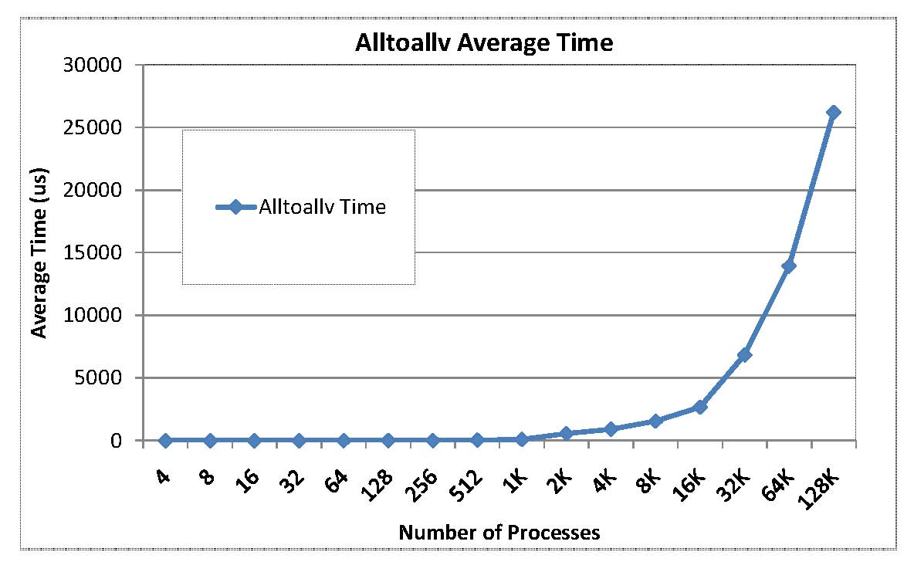
Zero-byte MPI_Alltoallv time on BG/P
This is just the time to scan the parameter array to determine it is all 0 bytes. No communication performed.

Slide 7
Scalability Issues in the MPI Specification
Graph Topology
In MPI 2.1 and earlier, requires the entire graph to be specified on each process
Fixed in MPI 2.2 – distributed graph topology
One-sided communication
Synchronization functions turn out to be expensive
Being addressed by RMA working group of MPI-3
Representation of process ranks
Explicit representation of process ranks in some functions, such as MPI_Group_incl and MPI_Group_excl
Concise representations should be considered

Slide 8
Scalability Issues in the MPI Specification
All-to-all communication
Not a scalable communication pattern
Applications may need to consider newer algorithms that do not require all-to-all
Fault tolerance
Large component counts will result in frequent failures
Greater resilience needed from all components of the software stack
MPI can return error codes, but need more support than that
Being addressed in the fault tolerance group of MPI-3

Slide 9
MPI Implementation Scalability
In terms of scalability, MPI implementations must pay attention to two aspects as the number of processes is increased:
memory consumption of any function, and
performance of all collective functions
Not just collective communiation functions that are commonly optimized
Also functions such as MPI_Init and MPI_Comm_split

Slide 10
Process Mappings
MPI communicators maintain mapping from ranks to processor ids
This mapping is often a table of O(nprocs) size in the communicator
Need to explore more memory-efficient mappings, at least for common cases
More systematic approaches to compact representations of permutations (research problem)

Slide 11
NEK5000: Communicator Memory Consumption
NEK5000 code failed on BG/P at large scale because MPI ran out of communicator memory. We fixed the problem by using a fixed buffer pool within MPI and provided a patch to IBM.

Slide 12
MPI Memory Usage on BG/P after 32 calls to MPI_Comm_dup
Using a buffer pool enables all collective optimizations and takes up only a small amount of memory

Slide 13
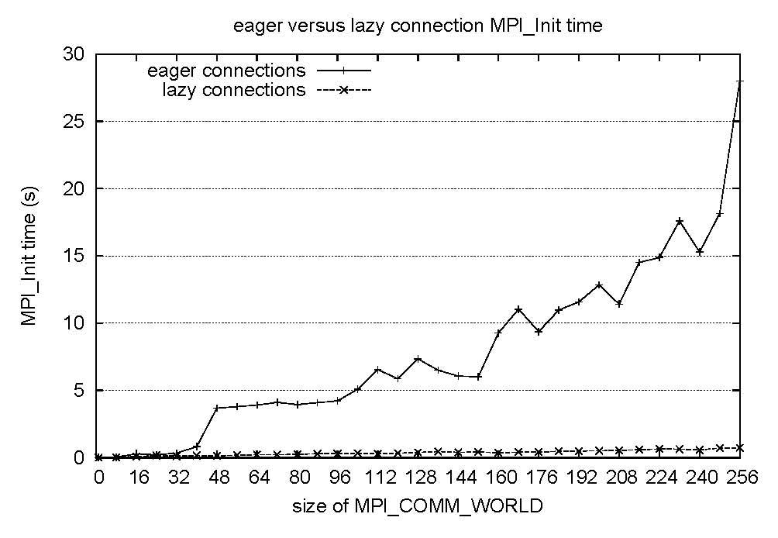
Scalability of MPI_Init
Cluster with 8 cores per node. TCP/IP across nodes
Setting up all connections at Init time is too expensive at large scale; must be done on demand as needed

Slide 14
Scalable Algorithms for Collective Communication
MPI implementations typically use
O(lg p) algorithms for short messages (binomial tree)
O(m) algorithms, where m=message size, for large messages
E.g., bcast implemented as scatter + allgather
O(lg p) algorithms can still be used on a million processors for short messages
However, O(m) algorithms for large messages may not scale, as the message size in the allgather phase can get very small
E.g., for a 1 MB bcast on a million processes, the allgather phase involves 1 byte messages
Hybrid algorithms that do logarithmic bcast to a subset of nodes, followed by scatter/allgather may be needed
Topology-aware pipelined algorithms may be needed
Use network hardware for broadcast/combine

Slide 15
Enabling Application Scalability
Applications face the challenge of scaling up to large numbers of processors
A basic question is
Is the parallel algorithm used by the application itself scalable (independent of MPI)?
Needs to be fixed by the application
Some features of MPI that may not be currently used by an application could play an important role in enabling the application to run effectively on more processors
In many cases, application code may not require much change

Slide 16
Higher Dimensional Decompositions with MPI
Many applications use 2D or 3D meshes, but parallel decomposition is only along one dimension
Results in contiguous buffers for MPI sends and receives
Simple, but not the most efficient for large numbers of processors
2D or 3D decompositions are more efficient
Results in noncontiguous communication buffers for sending and receiving edge or face data
MPI (or a library) can help by providing functions for assembling MPI datatypes that describe these noncontiguous areas
Efficient support for derived datatypes needed

Slide 17
Enabling Hybrid Programming
Million processors need not mean million processes
On future machines, as the amount of memory per core decreases, applications may want to use a shared-memory programming model on a multicore node, and MPI across nodes
MPI supports this transition by having clear semantics for interoperation with threads
Four levels of thread safety that can be required by an application and provided by an implementation
Works as MPI+OpenMP or MPI+Pthreads or other approaches
Hybrid programming working group in MPI-3 Forum exploring further enhancements to support efficient hybrid programming
See Marc Snir proposal on “end points”

Slide 18
Use of MPI-Based Libraries to Hide Complexity
MPI allows you to build higher-level libraries that provide extremely simple programming models that are both useful and scalable
Example:
Asynchronous Dynamic Load Balancing Library (ADLB)
Used in GFMC (Green’s Function Monte Carlo) code in UNEDF SciDAC project
GFMC used a nontrivial master-worker model with a single master; didn’t scale beyond 2000 processes on Blue Gene
Shared
Work queue
Master
Worker
Worker
Worker
Worker
Worker
Notes:
18

Slide 19
ADLB Library
Provides a scalable distributed work queue, with no one master
Application processes can simply put and get work units to the queue
Implemented on top of MPI, hence is portable
Enables GFMC application to scale beyond 30,000 processes
Worker
Worker
Worker
Worker
Worker
Shared
Work queue

Slide 20
Conclusions
MPI is ready for scaling to a million processors barring a few issues that can be (and are being) fixed
Nonscalable parts of the MPI standard include irregular collectives and virtual graph topology
Need for investigating systematic approaches to compact, adaptive representations of process groups
MPI implementations must pay careful attention to the memory requirements and eliminate data structures whose size grows linearly with the number of processes
For collectives, MPI implementations may need to become more topology aware or rely on global collective acceleration support
MPI’s support for building libraries and clear semantics for interoperation with threads enable applications to use other techniques to scale when limited by memory or data size

