Slide 1
Impact of Node Level Caching in MPI Job Launch Mechanisms
Jaidev Sridhar and D. K. Panda
{sridharj,panda}@cse.ohio-state.edu
Presented by Pavan Balaji, Argonne National Laboratory
Network-Based Computing Lab
The Ohio State University
Columbus, OH USA

Slide 2
Introduction
HPC Clusters continue to increase rapidly in size
Largest systems have hundreds of thousands of cores today
As clusters grow, there has been increased focus on the scalability of programming models and libraries
MPI, PGAS models
“First class citizens”
Job launch mechanisms have not received enough attention and have scaled poorly over the last few years
Traditionally ignored since the “percentage of time” for launching jobs on production runs is small
But increasingly becoming important, especially for extremely large-scale systems
Courtesy Intel Corp.

Slide 3
Multi-Core Trend
Largest InfiniBand cluster in 2006
Largest general purpose InfiniBand cluster
in 2008
Sandia Thunderbird
8,960 processing cores
4,480 compute nodes
TACC Ranger
62,976 processing cores
3,936 compute nodes
Courtesy Intel Corp.
The total number of compute cores has increased by a factor of 7, however, the number of compute nodes has remained flat
Job launchers must take advantage of multi-core compute nodes

Slide 4
Limitations
MPI Job launch mechanisms scale poorly over large multi-core clusters
Over 3 minutes to launch a MPI job over 10,000 cores (in the early part of 2008)
Unable to launch larger jobs
Exponential increase in job launch time
These designs run into system limitations
Limits on the number of open network connections
Delays due to simultaneous flooding of network

Slide 5
Job Launch Phases
Typical parallel job launch involves two phases
Spawning processes on target cores
Communication between processes to discover peers
In addition to spawning processes, job launcher must facilitate communication for job initialization
Point to point
Collective communication

Slide 6
Presentation Outline
Introduction and Motivation
ScELA Design
Impact of Node-Level Caching
Experimental Evaluation
Conclusions and Future Work

Slide 7
ScELA Design
Designed a Scalable, Extensible Launching Architecture (ScELA) that takes advantage of increased use of multi-core compute nodes in clusters
Presented at Int’l Symposium on High Performance Computing (HiPC ‘08)
Supports both PMGR and PMI
The design was incorporated into MVAPICH 1.0 and MVAPICH2 1.2
MVAPICH/MVAPICH2 - Popular MPI libraries for InfiniBand and 10GigE/iWARP, used by over 975 organizations worldwide
(http://mvapich.cse.ohio-state.edu)
Significant performance benefits on large-scale clusters
Many other MPI stacks have adopted this design for their job launching mechanisms
Courtesy Intel Corp.

Slide 8
Design: ScELA Architecture
Hierarchical launch
Central launcher launches Node Launch Agents (NLA) on target nodes
NLAs launch processes on cores
NLAs interconnect to form a k-ary tree to facilitate communication
Common communication primitives built on NLA tree
Libraries can implement their protocols (PMI, PMGR, etc.) over the basic framework
PMI
PMGR
… Communication
Protocols
Cache
Communication Primitives
Point to Point
Collective
Bulletin Board
NLA Interconnection Layer
Launcher
ScELA Architecture

Slide 9
Design: Launch Mechanism
Central Launcher starts NLAs on Target Nodes
NLAs launch Processes
Central
Launcher
NLA
Node 1
NLA
Node 2
NLA
Node 3
Process 1
Process 2
Process 3
Process 4
Process 5
Process 6

Slide 10
Evaluation: Large Scale Cluster
ScELA compared MVAPICH 0.9.9 on the TACC Ranger
3,936 nodes with four 2.0 GHz Quad-Core AMD “Barcelona” Opteron processors
16 processing cores per node
Time to launch a simple MPI “Hello World” program
Can scale at least 3X
Order of magnitude faster

Slide 11
Presentation Outline
Introduction and Motivation
ScELA Design
Impact of Node-Level Caching
Experimental Evaluation
Conclusions and Future Work

Slide 12
PMI Bulletin Board on ScELA
PMI is a startup communication protocol used by MVAPICH2, MPICH2, etc.
For process discovery, PMI defines a bulletin board protocol
PMI_Put (key, val) publishes a key, value pair
PMI_Get (key) fetches appropriate value
We define similar operations NLA_Put and NLA_Get to facilitate a bulletin board over the NLA tree
NLA level caches to speedup information access

Slide 13
Focus in this Paper
Is it beneficial to cache information in intermediate nodes in the NLA tree?
How these caches need to be designed?
What trade-offs exist in designing such caches?
How much performance benefits can be achieved with such caching?

Slide 14
Four Design Alternatives for Caching
Hierarchical Cache Simple (HCS)
Hierarchical Cache with Message Aggregation (HCMA)
Hierarchical Cache with Message Aggregation and Broadcast (HCMAB)
Hierarchical Cache with Message Aggregation, Broadcast with LRU (HCMAB-LRU)

Slide 15
PMI Bulletin Board on ScELA with HCS
PMI_Put (key, val)
NLA_Put (key, val)
PMI_Get (key)
NLA_Get (key)
Value
NLA
Node 1
Cache
Process 1
Process 2
NLA
Node 2
NLA
Node 3
Cache
Cache
Process 4
Process 3
Process 5
Process 6

Slide 16
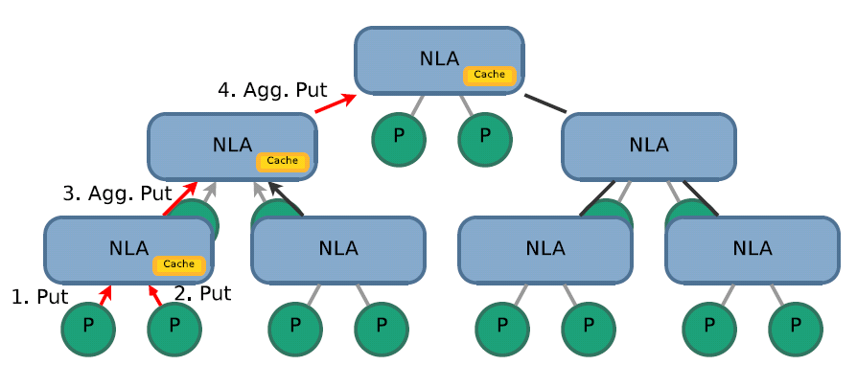
Better Caching Mechanisms
We’ve seen a simple Hierarchical Cache (HCS)
Slow, due to number of messages
Reduce number of messages with message aggregation – HCMA
PMI_Put (mykey, myvalue);
PMI_Barrier ();
...
val1 = PMI_Get (key1);
val2 = PMI_Get (key2);
...

Slide 17
Caching Mechanisms (contd)
HCMA still has lots of messages over network during GETs
Propose HCMAB
HCMA + Broadcast
HCS, HCMA, HCMAB are memory inefficient
Information exchange is in stages – discard old information
Propose HCMAB-LRU
Have a fixed size cache with LRU
HCMAB-LRU

Slide 18
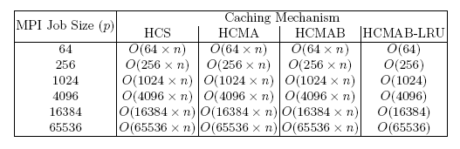
Comparison of Memory usage
For n (key, value) pairs exchanged by p processes

Slide 19
Presentation Outline
Introduction and Motivation
ScELA Design
Impact of Node-Level Caching
Experimental Evaluation
Conclusions and Future Work

Slide 20
Evaluation: Experimental Setup
OSU Cluster
512-core InfiniBand Cluster
64 compute nodes
Dual 2.33 GHz Quad-Core Intel “Clovertown”
Gigabit Ethernet adapter for management traffic
TACC Ranger (62,976-cores)
InfiniBand connectivity

Slide 21
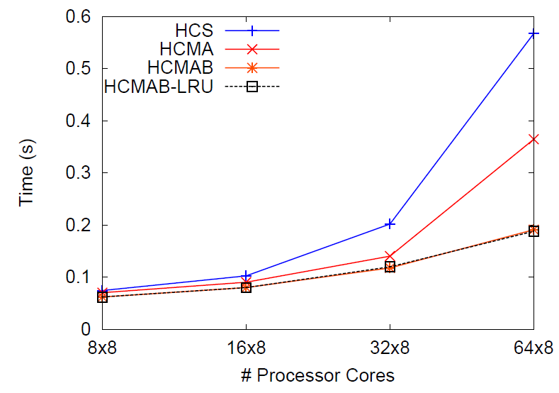
Simple PMI Exchange (1:2)
Each MPI process publishes one (key, value) pair using PMI_Put
Retrieves values published by two other MPI processes
HCMAB and HCMAB-LRU are the best

Slide 22
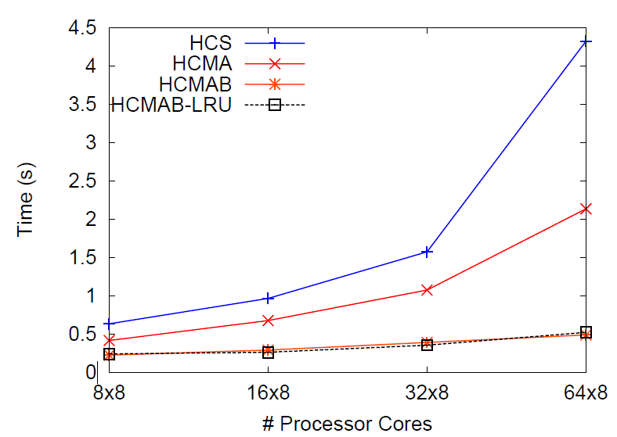
Heavy PMI Exchange (1:p)
Each MPI process publishes one (key, value) pair using PMI_Put
All p processes read values published by all other p processes
HCMAB and HCMAB-LRU are the best with significant performance improvement
HCMAB and HCMAB-LRU demonstrate good scalability with increase in
system size

Slide 23
Software Distribution
Both HCS and HCMAB have been integrated into MVAPICH2 1.2 and available to the MPI community for some time
Additional enhancements in terms of parallelizing the startup further have been carried out in MVAPICH2 1.4

Slide 24
Performance (Hello World) on TACC Ranger with MVAPICH2 1.4
MVAPICH21.4 (hierarchical) is far superior than MVAPICH2 1.2 (linear)
3 times faster for 2K processes and 5 times faster for 16K processes
Takes less than 20 seconds for 16K processes

Slide 25
Presentation Outline
Introduction and Motivation
ScELA Design
Impact of Node-Level Caching
Experimental Evaluation
Conclusions and Future Work

Slide 26
Conclusion and Future Work
Propose the impact of caching in scalable, hierarchical job launch mechanisms, especially for emerging multi-core clusters
Demonstrate design alternatives and their impact on performance and scalability
Integrated into the latest MVAPICH2 1.4 version
Basic enhancements are available in MVAPICH versions (1.0 and 1.1)
Parallelize the job launch phase even further for even larger clusters with a million of processes

Slide 27

Questions?
{sridharj, panda}@cse.ohio-state.edu
http://mvapich.cse.ohio-state.edu

