Slide 1
Understanding Network Saturation Behavior on Large-Scale Blue Gene/P Systems
Pavan Balaji (presenter), Harish Naik and Narayan Desai
Mathematics and Computer Science Division
Argonne National Laboratory

Slide 2
Massive Scale High End Computing
We have passed the Petaflop Barrier
Two systems over the Petaflop mark in the Top500: LANL Roadrunner and ORNL Jaguar
Argonne has a 163840-core Blue Gene/P
Lawrence Livermore has a 286720-core Blue Gene/L
Exaflop systems will out by 2018-2020
Expected to have about a hundred million processing elements
Might be processors, cores, SMTs
Such large systems pose many challenges to middleware trying to take advantage of these systems

Slide 3
Hardware Sharing at Massive Scales
At massive scales, number of hardware components cannot increase exponentially with system size
Too expensive (cost plays a major factor!)
E.g., Crossbar switches vs. Fat-tree networks
At this scale, most systems do a lot of hardware sharing
Shared caches, shared communication engines, shared networks
More sharing means more contention
The challenge is how do we deal with this contention?
More importantly: what’s the impact of such architectures?

Slide 4
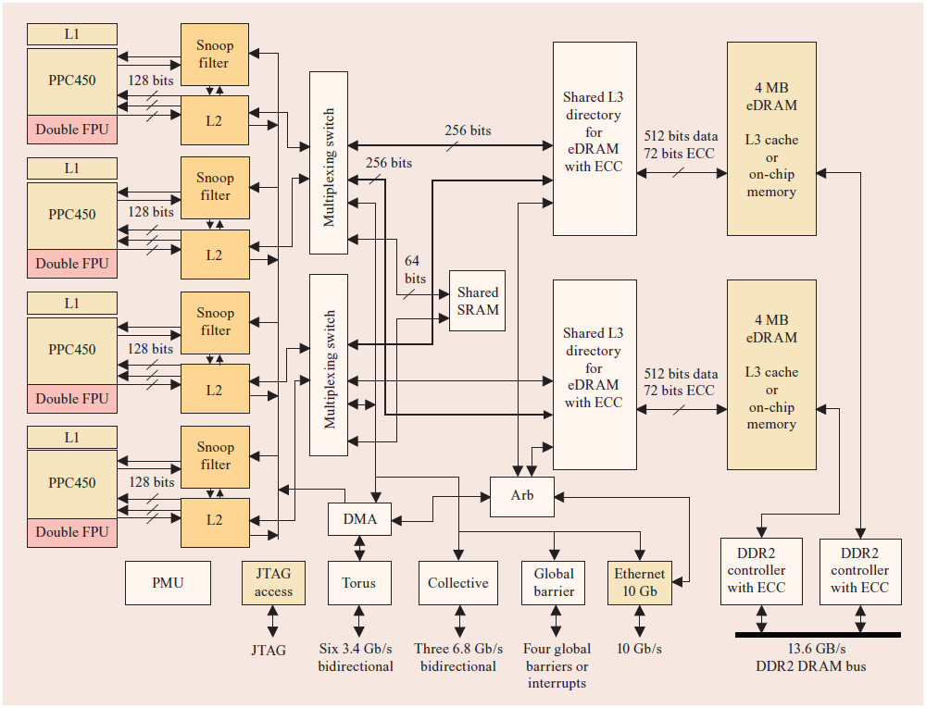
Blue Gene/P Overview
Second Generation of the Blue Gene supercomputers
Extremely energy efficient design using low-power chips
Four 850MHz cores on each PPC450 processor

Slide 5
BG/P Network Stack
Uses five specialized networks
Two of them (10G and 1G Ethernet) are used for File I/O and system management
Remaining three (3D Torus, Global collective network, Global interrupt network) are used for MPI communication
3D torus: 6 bidirectional links for each node (total of 5.1 GBps)
Y-Axis
Z-Axis
X-Axis

Slide 6
Presentation Roadmap
Introduction
Network Communication Behavior on BG/P
Measuring Network Congestion with Hardware Counters
Concluding Remarks and Future Work

Slide 7
Network Communication Behavior
Network communication between pairs would oftentimes have overlapping links
This can cause network congestion
Communication throttling is a common approach to avoid such congestion
On massive scale systems getting network congestion feedback to the source might not be very scalable
Approach: If a link is busy, backpressure applies to all of the remaining 5 inbound links
Each DMA engine verifies busy link before sending data
P0
P1
P2
P3
P4
P5
P6
P7

Slide 8
Network Congestion Behavior
P0
P1
P2
P3
P4
P5
P6
P7

Slide 9
Communication Behavior on Massive-scale Systems
Global communication on a torus network is not a good idea
With N processes, there will be N² communication flows, but only 3N network links
Too much over-subscription, even for small messages
Local communication models such as Cartesian grids (every process communicates with √N processes) or nearest neighbor are “expected” to be better
But Cartesian grids and nearest neighbors mostly rely on a logical view of the processes, not the physical view (bugs in the MPI standard!)
While the number of messages is not as bad as global communication, overlap of network flows is still possible

Slide 10
2D Nearest Neighbor: Process Mapping (XYZ)
Y-Axis
Z-Axis
X-Axis

Slide 11
2D Nearest Neighbor: Process Mapping (YXZ)
Y-Axis
Z-Axis
X-Axis

Slide 12
HALO: Modeling Ocean Modeling
NRL Layered Ocean Model (NLOM) simulates enclosed seas, major oceans basins, and the global ocean
HALO was initially developed as the communication kernel for NLOM
Gained popularity because of its similarity to other models as well (e.g., algebraic solvers)
Rough indication of the communication behavior of other models as well, including CFD and nuclear physics
Distributes data on a 2D logical process grid and performs a nearest neighbor exchange along the logical grid

Slide 13
Nearest Neighbor Performance

Slide 14
Presentation Roadmap
Introduction
Network Communication Behavior on BG/P
Measuring Network Congestion with Hardware Counters
Concluding Remarks and Future Work

Slide 15
BG/P Network Hardware Counters
Blue Gene/P provides various counters for measuring network activity
Flow control stall event (Torus Network)
When a packet needs to be sent out, it is queued in a DMA FIFO
The DMA engine checks if the link is free (no ongoing traffic) and if it is, tries to send out a packet
Each link uses a credit-based flow control; if a link has no credit available, a flow control stall event is generated
Collective network queue (Collective Network)
BG’s collective network can only have one ongoing operation
Other requests are queued; length of the queue gives an indication of congestion on the collective network

Slide 16
Network Congestion with Global Communication

Slide 17
Network Congestion with Cartesian Communication
Drop in congestion?
Reason: Impact of system layout

Slide 18
Impact of System Layout on Congestion
System size vs. congestion
In general larger system means more congestion, but not always true
Increasing system size can sometimes decrease congestion
BG/P is laid out as a 3D torus; doubling the system size does not have any implication on how the dimensions have changed
A possible 4096 CPU system can have a configuration of 8 x 8 x 64
A possible 8192 CPU system can have a configuration of 16 x 16 x 32
X and Y dimensions have increased, but Z dimension has decreased
Even if one dimension doubles and the remaining dimensions stay constant, it is not trivial to guess the amount of congestion
8 x 8 x 64 partition is more elongated (possibly more congestion)
16 x 16 x 32 partition is more cubic (possibly lesser congestion)

Slide 19
Network Congestion with NN Communication

Slide 20
Presentation Roadmap
Introduction
Network Communication Behavior on BG/P
Measuring Network Congestion with Hardware Counters
Concluding Remarks and Future Work

Slide 21
Concluding Remarks
Massive scale systems such as Blue Gene and Cray tend to use flat torus networks instead of fat tree networks
Lower cost (linearly increasing network cost, not super-linear)
Lower failure rate (lesser components)
This means that there is going to be significantly more communication interleaving as compared to earlier
This is obvious for global communication
While not obvious, this is true for more localized communication too
We studied network congestion characteristics with different benchmarks on a large-scale Blue Gene/P
… hopefully providing insights into what to expect at such scales

Slide 22
Future Work
Process mapping tends to have a large impact on performance
How do we determine process mapping up front without knowing what the application is going to do?
There are two dimensions of optimization for this:
MPI virtual topology functionality: not very well optimized, not multi-core aware in many cases, not network topology aware (we probably need to start with fixing the bugs in the MPI standard)
Communication description language (CDL)
MPI virtual topology functions might not be easily usable in many cases (e.g., when the application cannot allow for rank reordering)
CDL can allow applications to tell the process management system what the application communication characteristics are

Slide 23
Thank You!
Contacts:
Pavan Balaji: balaji@mcs.anl.gov
Harish Naik: hnaik@mcs.anl.gov
Narayan Desai: desai@mcs.anl.gov

