Slide 1


Evaluation of ConnectX Virtual Protocol Interconnect for Data Centers
Ryan E. Grant Ahmad Afsahi Pavan Balaji
Department of Electrical and Computer Engineering, Queen’s University
Mathematics and Computer Science, Argonne National Laboratory

Slide 2
Data Centers: Towards a unified network stack
High End Computing (HEC) systems proliferating into all domains
Scientific Computing has been the traditional “big customer”
Enterprise Computing (large data centers) is increasingly becoming a competitor as well
Google’s data centers
Oracle’s investment in high speed networking stacks (mainly through DAPL and SDP)
Investment from financial institutes such as Credit Suisse in low-latency networks such as InfiniBand
A change of domain always brings new requirements with it
A single unified network stack is the holy grail!
Maintaining density and power, while achieving high performance

Slide 3
InfiniBand and Ethernet in Data Centers
Ethernet has been the network of choice for data centers
Ubiquitous connectivity to all external clients due to backward compatibility
Internal communication, external communication and management are all unified on to a single network
There has also been a push for power to be distributed on the same channel as well (using Power over Ethernet), but that’s still not a reality
InfiniBand (IB) in data centers
Ethernet is (arguably) lagging behind with respect to some of the features provided by other high-speed networks such as IB
Bandwidth (32 Gbps vs. 10 Gbps today), features (scalability features such as shared queues while using zero-copy communication and RDMA)
The point of this paper is not about which is better, but to deal with the fact that data centers are looking for ways to converge both technologies

Slide 4
Convergence of InfiniBand and Ethernet
Researchers have been looking at different ways for a converged InfiniBand/Ethernet fabric
Virtual Protocol Interconnect (VPI)
InfiniBand over Ethernet (or RDMA over Ethernet)
InfiniBand over Converged Enhanced Ethernet (or RDMA over CEE)
VPI is the first convergence model introduced by Mellanox Technologies, and will be the focus of study in this paper

Slide 5
Virtual Protocol Interconnect (VPI)
Applications
Single network firmware to support both IB and Ethernet
Autosensing of layer-2 protocol
Can be configured to automatically work with either IB or Ethernet networks
Multi-port adapters can use one port on IB and another on Ethernet
Multiple use modes:
Data centers with IB inside the cluster and Ethernet outside
Clusters with IB network and Ethernet management
IB Verbs
Sockets
IB Transport
Layer
TCP
IB Network
Layer
IP
Hardware
TCP/IP support
IB Link Layer
Ethernet
Link Layer
IB Port
Ethernet Port

Slide 6
Goals of this paper
To understand the performance and capabilities of VPI
Comparison of VPI-IB with VPI-Ethernet with different software stacks
Openfabrics Verbs
TCP/IP sockets (both traditional and through the Sockets Direct Protocol)
Detailed studies with micro-benchmarks and a Enterprise Data center setup

Slide 7
Presentation Roadmap
Introduction
Micro-benchmark based Performance Evaluation
Performance Analysis of Enterprise Data Centers
Concluding Remarks and Future Work

Slide 8
Software Stack Layout
Sockets Application
Verbs Application
Sockets API
Verbs API
User
TCP/IP Sockets Provider
Sockets Direct Protocol
Kernel
(Possible) Kernel Bypass
TCP/IP Transport Driver
Zero-copy Communication
Driver
RDMA Semantics
VPI capable Network Adapter
Ethernet
InfiniBand

Slide 9
Software Stack Layout (details)
Three software stacks: TCP/IP, SDP and native verbs
VPI-Ethernet can only use TCP/IP
VPI-IB can use any one of the three
TCP/IP and SDP provide transparent portability for existing data center applications over IB
TCP/IP is more mature (preferable for conservative data centers)
SDP can (potentially) provide better performance:
Can internally use more of IB features than TCP/IP, since it natively utilizes IB’s hardware implemented protocol (network and transport)
But is not as mature: parts of the stack not as optimized as TCP/IP
Native verbs is also a possibility, but requires modifications to existing data center applications (studies by Panda’s group)

Slide 10
Experimental Setup
Four Dell PowerEdge R805 SMP servers
Each server has two quad-core 2.0 GHz AMD Opteron processors
12 KB instruction cache and 16 KB L1 data cache on each core
512 KB L2 cache for each core
2MB L3 cache on chip
8 GB DDR2 SDRAM on an 1800 MHz memory controller
Each node has one ConnectX VPI capable adapter (4X DDR IB and 10Gbps Ethernet) on a PCIe x8 bus
Fedora Core 5 (linux kernel 2.6.20) was used with OFED 1.4
Compiler: gcc-4.1.1

Slide 11
One-way Latency and Bandwidth

Slide 12
Multi-stream Bandwidth

Slide 13
Simultaneous IB/10GE Communication

Slide 14
Presentation Roadmap
Introduction
Micro-benchmark based Performance Evaluation
Performance Analysis of Enterprise Data Centers
Concluding Remarks and Future Work

Slide 15
Data Center Setup
Three-tier data center
Apache 2 web server for static content
JBoss 5 application server for server-side java processing
MySQL database system
Trace workload: TPC-W benchmark representing a real web-based bookstore
Client
10GE
Web Server
(Apache)
10GE/IPoIB/SDP
Application Server
(JBoss)
10GE/IPoIB/SDP
Database Server
(MySQL)

Slide 16
Data Center Throughput
Average
87.15
Average
85.08
Average
82.23

Slide 17
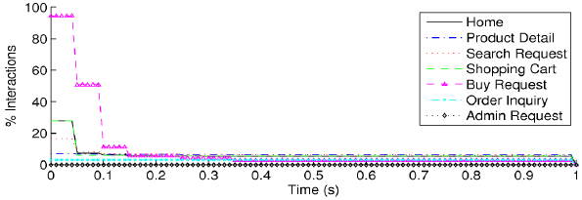
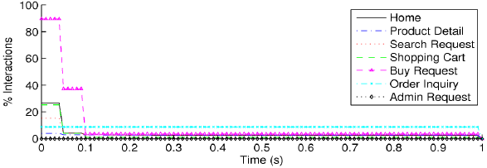
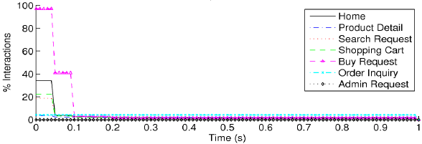
Data Center Response Time (Itemized)
10GE
10GE/IPoIB
10GE/SDP

Slide 18
Presentation Roadmap
Introduction
Micro-benchmark based Performance Evaluation
Performance Analysis of Enterprise Data Centers
Concluding Remarks and Future Work

Slide 19
Concluding Remarks
Increasing push for a converged network fabric
Enterprise data centers in HEC: power, density and performance
Different convergence technologies upcoming: VPI was one of the first such technology introduced by Mellanox
We studied the performance and capabilities of VPI with micro-benchmarks and an enterprise data center setup
Performance numbers indicate that VPI can give a reasonable performance boost to data centers without overly complicating the network infrastructure
What’s still needed? Self-adapting switches
Current switches either do IB or 10GE, not both
On the roadmap for several switch vendors

Slide 20
Future Work
Improvements to SDP (of course)
We need to look at other convergence technologies as well
RDMA over Ethernet (or CEE) is upcoming
Already accepted into the Open Fabrics Verbs
True convergence with respect to verbs
InfiniBand features such as RDMA will automatically migrate to 10GE
All the SDP benefits will translate to 10GE as well

Slide 21
Funding Acknowledgments
Natural Sciences and Engineering Research Council of Canada
Canada Foundation of Innovation and Ontario Innovation Trust
US Office of Advanced Scientific Computing Research (DOE ASCR)
US National Science Foundation (NSF)
Mellanox Technologies

Slide 22
Thank you!
Contacts:
Ryan Grant: ryan.grant@queensu.ca
Ahmad Afsahi: ahmad.afsahi@queensu.ca
Pavan Balaji: balaji@mcs.anl.gov

Slide 23
Backup Slides

Slide 24
Data Center Response Time (itemized)

