Slide 1
GePSeA: A General Purpose Software Acceleration Framework for Lightweight Task Offloading
Ajeet Singh Pavan Balaji Wu-chun Feng
Dept. of Computer Science, Virginia Tech
Math. and Computer Science, Argonne National Laboratory

Slide 2
Hardware Offload Engines
Specialized Engines
Widely used in High-End Computing (HEC) systems for accelerating task processing
Built for specific purposes
Not easily extendable or programmable
Serve a small niche of applications
Trends in HEC systems: Increasing size and complexity
Difficult for hardware to deal with complexity
Fault tolerance (understanding application and system requirements is complex and too environment specific)
Multi-path communication (optimal solution is NP-complete)

Slide 3
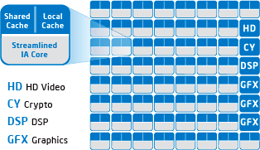
General Purpose Processors
Multi- and Manycore Processors
Quad- and hex-core processors are commodity components today
Intel Larrabee will have 16-cores; Intel Terascale will have 80-cores
Simultaneous Multi-threading (SMT or Hyperthreading) is becoming common
Expected future
Each physical node will have a massive number of processing elements (Terascale on the chip)
Future multicore systems

Slide 4
Benefits of Multicore Architectures
Cost
Cheap: Moore’s law will continue to drive costs down
HEC is a small market; Multicores != HEC
Flexibility
General purpose processing units
A huge number of tools already exist to program and utilize them (e.g., debuggers, performance measuring tools)
Extremely flexible and extendable

Slide 5
Multicore vs. Hardware Accelarators
Will multicore architectures eradicate hardware accelerators?
Unlikely: Hardware accelerators have their own benefits
Hardware accelerators provide two advantages:
More processing power, better on-board memory bandwidth
Dedicated processing capabilities
They run compute kernels in a dedicated manner
Do not deal with shared mode processing like CPUs
But more complex machines need dedicated processing for more things
More powerful hardware offload techniques possible, but decreasing returns!

Slide 6
GePSeA: General Purpose Software Acceleration
Hybrid hardware-software engines
Utilize hardware offload engines for low-hanging fruit
Where return for investment is maximum
Utilize software “onload” engines for more complex tasks
Can imitate some of the benefits of hardware offload engines, such as dedicated processing
Basic Idea of GePSeA
Dedicate a small subset of processing elements on a multi-core architecture for “protocol onloading”
Different capabilities added to GePSeA as plugins
Application interacts with GePSeA for dedicated processing

Slide 7
GePSeA: Basic Overview
Application or Software middleware
GePSeA
GePSeA
GePSeA
Advanced
hardware
acceleration
Basic
hardware
acceleration
No intelligent
hardware offload
GePSeA does not try to take over tasks performed well by hardware offload engines
It only supplements their capabilities

Slide 8
Previous Work: ProOnE
ProOnE was an initial design of GePSeA concentrating on communication onloading
Studied issues related to onloading MPI internal protocols on a dedicated core
Showed significant performance benefits
This paper extends this previous work for more general purpose onloading
Presents the design for such onloading and a case study application
“ProOnE: A General Purpose Protocol Onload Engine for Multi- and Many-core Architectures”, P. Lai, P. Balaji, R. Thakur and D. K. Panda, ISC 2009.

Slide 9
Presentation Roadmap
Introduction and Motivation
GePSeA: General Purpose Software Acceleration
Case Study: mpiBLAST
Experimental Results and Analysis
Conclusions and Future Work

Slide 10
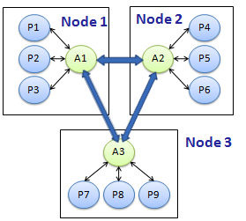
GePSeA Infrastructure
P -> Application Process
A -> Accelerator
Application-Accelerator interaction for a three-node cluster

Slide 11
GePSeA: Intra-node Infrastructure
Accelerator
Inter-node Service Queue
(Low Priority)
Registration Request 1
Application Process 1
Notify All
Registration Request 2
Application Process 2
Intra-node Service Queue
(Higher Priority)
Message Processing Block (Logical)
Notify All
GePSeA Communication Layer

Slide 12
Overview of GePSeA Capabilities
Application
Application Plug-ins Layer
Core Components
Data Management Component
Memory Management Component
Output Processing Component
Distributed Data Caching
Data Streaming Service
Distributed Data Sorting
Distributed Data Caching
Data Streaming Service
Reliable Advertising Service
Distributed
Lock
Management
Dynamic
Load
Balancing
Global Memory Aggregator
Directory Services
Distributed Data Sorting
Data Compression Engine
Global
Process-state Management
Bulletin
Board
Service
High-Speed Reliable UDP Data Transfer
High Speed Network

Slide 13
Data Management Core Components
Responsible for all data movement and the data processing associated with the application
GePSeA currently includes
Distributed Data Sorting
Data sorting service that is distributed across multiple nodes (incremental sorting and merging)
Data Compression Engine
Compress and Uncompress Data
Convert output data to meta-data and vice-versa
Distributed Data Streaming
Responsible for pre-fetching of data for the application from other nodes; Swap data

Slide 14
Memory Management Core Components
Allows processes to access entire system memory as a single aggregate memory space
GePSeA currently includes:
Global Memory Aggregator
Keeps track of cluster-wide memory
Maintains local-global address mappings
Store and retrieve data from global memory if local memory is committed
Database Directory Services
Maintains up-to-date information about various database fragments across the cluster

Slide 15
I/O Processing Core Components
Facilitates efficient output data processing
Coordinating and synchronization of output data
GePSeA currently includes:
Reliable Advertisement Service
Messaging Service, used by Communication Layer
Dynamic Load Balancing
Responsible for balancing the load among nodes
Global Process-state Management
Maintains current status of nodes in cluster at all time
High-Speed Connectionless Data Transfer
Provides high-speed UDP based data transfer

Slide 16
Presentation Roadmap
Introduction and Motivation
GePSeA: General Purpose Software Acceleration
Case Study: mpiBLAST
Experimental Results and Analysis
Conclusions and Future Work

Slide 17
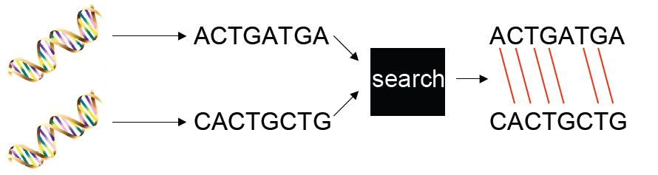
mpiBLAST- Introduction (1/2)
Parallel Genome Sequence Search Application
Identify regions of similarity between two sequences to discover functional, structural, or evolutionary relationships between the sequences.
Image Source: mpiblast.org
Notes:
Assigns, score and e-value

Slide 18
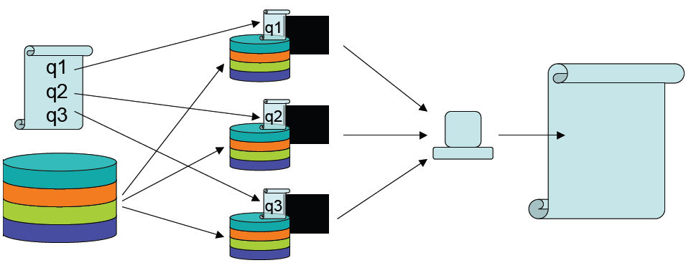
mpiBLAST- Introduction (2/2)
Database and Query Segmentation
Scatter-Search-Gather Approach
Input
Queries
Database Fragments

Slide 19
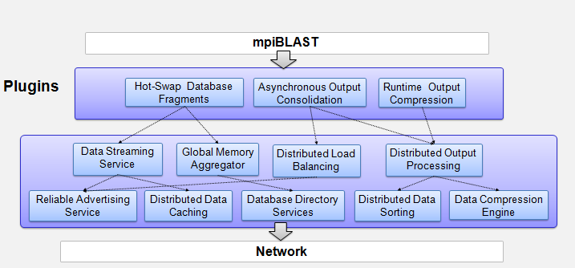
mpiBLAST over GePSeA

Slide 20
mpiBLAST Plug-ins
Asynchronous Output Consolidation
Utilizes accelerator capability to merge/sort the data distributed across all multiple nodes in parallel
Remove bottlenecks
Runtime Output Compression
Our results show that BLAST output can compressed be less than 10%
Significantly reduces output data transfer time over network
Hot-Swap Database Fragments
Swaps its DB fragment with the DB fragment on demand
Useful for load balancing
Notes:
1) Hot-Swap Database Fragments not used
2) Fragment size too small, total DB fits into node’s memory so no swapping required.

Slide 21
Presentation Roadmap
Introduction and Motivation
GePSeA: General Purpose Software Acceleration
Case Study: mpiBLAST
Experimental Results and Analysis
Conclusions and Future Work

Slide 22
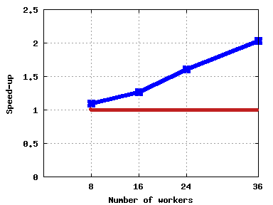
mpiBLAST over GePSeA: Committed Core
Running Accelerator on “Committed” Core
Speed-up over mpiBLAST
Core 1
Core 2
P1
P2
P3
P4
Core 3
Core 4
Core 1
Core 2
P1
P2
A1
P3
P4
Core 3
Core 4
mpiBLAST with Accelerator
mpiBLAST without Accelerator

Slide 23
Worker Search Time

Slide 24
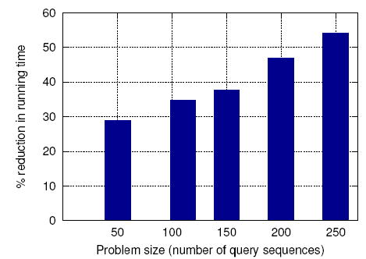
Output Consolidation

Slide 25
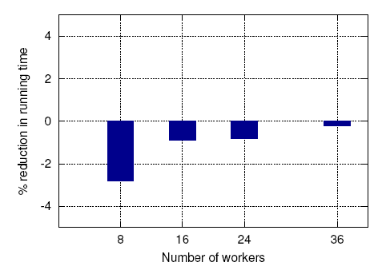
Output Compression

Slide 26
Presentation Roadmap
Introduction and Motivation
GePSeA: General Purpose Software Acceleration
Case Study: mpiBLAST
Experimental Results and Analysis
Conclusions and Future Work

Slide 27
Concluding Remarks and Future Work
Proposed, designed and evaluated a general purpose software accelerator (GePSeA)
Utilize a small subset of the cores to onload complex tasks
Presented detailed design of the GePSeA infrastructure
Onloaded mpiBLAST application as a case study
GePSeA-enabled mpiBLAST provides significant performance benefits
Future Work:
Study performance and scalability on large-scale systems

Slide 28
Thank You!
Contacts:
Pavan Balaji: balaji@mcs.anl.gov
Wu-chun Feng: feng@cs.vt.edu

