Slide 1
Toward Message Passing for a Million Processes: Characterizing MPI on a Massive Scale Blue Gene/P
P. Balaji, A. Chan, R. Thakur, W. Gropp and E. Lusk
Math. and Computer Sci., Argonne National Laboratory
Computer Science, University of Illinois, Urbana Champaign

Slide 2
Massive Scale High End Computing
We have passed the Petaflop Barrier
Two systems over the Petaflop mark in the Top500: LANL Roadrunner and ORNL Jaguar
Argonne has a 163840-core Blue Gene/P
Lawrence Livermore has a 286720-core Blue Gene/L
Exaflop systems will out by 2018-2020
Expected to have more than a million processing elements
Might be processors, cores, SMTs
Such large systems pose many challenges to middleware trying to take advantage of these systems

Slide 3
Hardware Sharing at Massive Scales
At massive scales, number of hardware components cannot increase exponentially with system size
Too expensive (cost plays a major factor!)
E.g., Crossbar switches, Fat-tree networks
At this scale, most systems do a lot of hardware sharing
Shared caches, shared communication engines, shared networks
More sharing means more contention
The challenge is how do we deal with this contention?
More importantly: what’s the impact of such architectures?

Slide 4
Presentation Layout
Introduction and Motivation
Blue Gene/P Architectural Overview
Performance Results and Analysis
Conclusions and Future Work

Slide 5
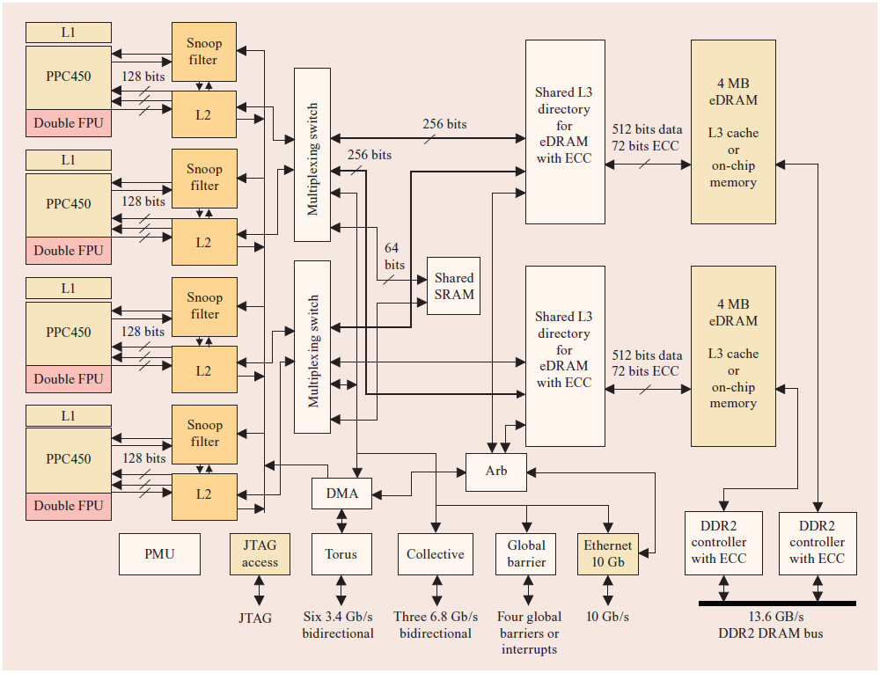
Blue Gene/P Overview
Second Generation of the Blue Gene supercomputers
Extremely energy efficient design using low-power chips
Four 850MHz cores on each PPC450 processor

Slide 6
BG/P Network Stack
Uses five specialized networks
Two if them (10G and 1G Ethernet) are used for File I/O and system management
Remaining three (3D Torus, Global collective network, Global interrupt network) are used for MPI communication
3D torus: 6 bidirectional links for each node (total of 5.1 GBps)
Y-Axis
Z-Axis
X-Axis

Slide 7
BG/P Communication Middleware
Three Software Stack Layers:
System Programming Interface (SPI)
Directly above the hardware
Most efficient, but very difficult to program and not portable!
Deep Computing Messaging Framework (DCMF)
Portability layer built on top of SPI
Generalized message passing framework
Allows different stacks to be build on top
MPI
Built on top of DCMF
Most portable of the three layers
Based off of MPICH2 (contributed back to Argonne as of 1.1a1)

Slide 8
BG/P OS Stack
Uses a lightweight kernel known as the Compute Node Kernel (CNK)
Better integration between the hardware and software stacks
No swap space
Equal virtual and physical address space
Static virtual to physical address translation
Easier for devices to access a “virtual address region”
(Mostly) Symmetric address space
Potential for direct memory access between processes
Similar to SMARTMAP on Cray

Slide 9
Presentation Layout
Introduction and Motivation
Blue Gene/P Architectural Overview
Performance Results and Analysis
Conclusions and Future Work

Slide 10
Performance Results
DMA Engine Behavior
Impact of System Scale
Network Congestion Characteristics
Parallel Collective Communication
Analysis of an Ocean Modeling Communication Kernel

Slide 11
Inter-node Performance

Slide 12
Intra-node Performance

Slide 13
Multi-Stream Communication

Slide 14
Fan Bandwidth Tests

Slide 15
Performance Results
DMA Engine Behavior
Impact of System Scale
Network Congestion Characteristics
Parallel Collective Communication
Analysis of an Ocean Modeling Communication Kernel

Slide 16
Impact of Number of Hops on Performance Degradation of One-way latency

Slide 17
Performance Results
DMA Engine Behavior
Impact of System Scale
Network Congestion Characteristics
Parallel Collective Communication
Analysis of an Ocean Modeling Communication Kernel

Slide 18
Network Communication Behavior
Network communication between pairs would oftentimes have overlapping links
This can cause network congestion
Communication throttling is a common approach to avoid such congestion
On massive scale systems getting network congestion feedback to the source might not be very scalable
Approach: If a link is busy, backpressure applies to all of the remaining 5 inbound links
Each DMA engine verifies busy link before sending data
P0
P1
P2
P3
P4
P5
P6
P7

Slide 19
Network Congestion Behavior

Slide 20
Parallel Collective Performance

Slide 21
Performance Results
DMA Engine Behavior
Impact of System Scale
Network Congestion Characteristics
Parallel Collective Communication
Analysis of an Ocean Modeling Communication Kernel

Slide 22
HALO: Modeling Ocean Modeling
NRL Layered Ocean Model (NLOM) simulates enclosed seas, major oceans basins, and the global ocean
HALO was initially developed as the communication kernel for NLOM
Gained popularity because of its similarity to other models as well (e.g., algebraic solvers)
Rough indication of the communication behavior of other models as well, including CFD and nuclear physics
Distributes data on a 2D logical process grid and performs a nearest neighbor exchange along the logical grid

Slide 23
Process Mapping (XYZ)
Y-Axis
Z-Axis
X-Axis

Slide 24
Process Mapping (YXZ)
Y-Axis
Z-Axis
X-Axis

Slide 25
Nearest Neighbor Performance

Slide 26
Presentation Layout
Introduction and Motivation
Blue Gene/P Architectural Overview
Performance Results and Analysis
Conclusions and Future Work

Slide 27
Concluding Remarks and Future Work
Increasing system scales are leading to large amounts of hardware sharing
Shared caches, shared communication engines, shared networks
More sharing means more contention
What’s the impact of such shared hardware on performance?
We performed an analysis with Blue Gene/P
Identified and characterized several performance issues
Documented different areas where behavior is different from cluster-like systems
Future work: Description language for process mapping

Slide 28
Thank You!
Contacts:
{balaji, chan, thakur, lusk} @ mcs.anl.gov
wgropp @ illinois.edu
Web Links:
MPICH2: http://www.mcs.anl.gov/research/projects/mpich2

