Slide 1
Hybrid Parallel Programming with MPI and Unified Parallel C
James Dinan*, Pavan Balaji†, Ewing Lusk†, P. Sadayappan*, Rajeev Thakur†
*The Ohio State University †Argonne National Laboratory

Slide 2

MPI Parallel Programming Model
#include <mpi.h>
int main(int argc, char **argv) {
int me, nproc, b, i;
MPI_Init(&argc, &argv);
MPI_Comm_rank(WORLD,&me);
MPI_Comm_size(WORLD,&nproc);
// Divide work based on rank …
b = mxiter/nproc;
for (i = me*b; i < (me+1)*b; i++)
work(i);
// Gather and print results …
MPI_Finalize();
return 0;
}
0
1
N
Send(buf, N)
Recv(buf, 1)
SPMD exec. model
Two-sided messaging

Slide 3
Unified Parallel C
X[M][M][N]
X
X[1..9]
[1..9][1..9]
get(…)
Unified Parallel C (UPC) is:
Parallel extension of ANSI C
Adds PGAS memory model
Convenient, shared memory -like programming
Programmer controls/exploits locality, one-sided communication
Tunable approach to performance
High level: Sequential C → Shared memory
Medium level: Locality, data distribution, consistency
Low level: Explicit one-sided communication
Notes:
Add in SPMD figure

Slide 4
Why go Hybrid?
Extend MPI codes with access to more memory
UPC asynchronous global address space
Aggregates memory of multiple nodes
Operate on large data sets
More space than OpenMP (limited to one node)
Improve performance for locality-constrained UPC codes
Use multiple global address spaces for replication
Groups apply to static arrays
Most convenient to use
Provide access to libraries like PETSc and SCALAPACK

Slide 5
Why not use MPI-2 One-Sided?
MPI-2 provides one-sided messaging
Not quite the same as a global address space
Does not assume coherence: Extremely portable
No access to performance/programmability gains on machines with coherent memory subsystem
Accesses must be locked using coarse grain window locks
Can only access a location once per epoch if written to
No overlapping local/remote accesses
No pointers, window objects cannot be shared, …
UPC provides fine-grain asynchronous global addr. space
Makes some assumptions about memory subsystem
Assumptions fit most HPC systems

Slide 6
Hybrid MPI+UPC Programming Model
Flat
Nested-Funneled
Nested-Multiple
Hybrid MPI+UPC Process
UPC Process
Many possible ways to combine MPI
Focus on:
Flat: One global address space
Nested: Multiple global address spaces (UPC groups)

Slide 7
Flat Hybrid Model
UPC Threads ↔ MPI Ranks 1:1
Every process can use MPI and UPC
Benefit:
Add one large global address space to MPI codes
Allow UPC programs to use MPI libs: ScaLAPACK, etc
Some support from Berkeley UPC for this model
“upcc -uses-mpi” tells BUPC to be compatible with MPI

Slide 8
Nested Hybrid Model
Launch multiple UPC spaces connected by MPI
Static UPC groups
Applied to static distributed shared arrays (e.g. shared [bsize] double x[N][N][N];)
Proposed UPC groups can’t be applied to static arrays
Group size (THREADS) determined at launch or compile time
Useful for:
Improving performance of locality constrained UPC codes
Increasing the storage for MPI groups (multilevel parallelism)
Nested: Only thread 0 performs MPI communication
Multiple: All threads perform MPI communication

Slide 9
Experimental Evaluation
Software setup:
GCCUPC compiler
Berkeley UPC runtime 2.8.0, IBV conduit
SSH bootstrap (default is MPI)‏
MVAPICH with MPICH2's Hydra process manager
Hardware setup:
Glenn cluster at the Ohio Supercomputing Center
877 Node IBM 1350 cluster
Two dual-core 2.6 GHz AMD Opterons and 8GB RAM per node
Infiniband interconnect

Slide 10
Random Access Benchmark
Threads access random elements of distributed shared array
UPC Only: One copy distribute across all procs. No local accesses.
Hybrid: Array is replicated on every group. All accesses are local.
shared double data[8]:
Affinity
0
1
2
3
0
1
2
3
P₀
P₁
P₂
P₃
shared double data[8]:
shared double data[8]:
0
1
0
1
0
1
0
1
0
1
0
1
0
1
0
1
P₀
P₁
P₂
P₃
Notes:
Array replication into UPC groups increases the number of local references. At the top, 1 reference hits a local data element. At bottom, all 4 hit a local element.

Slide 11
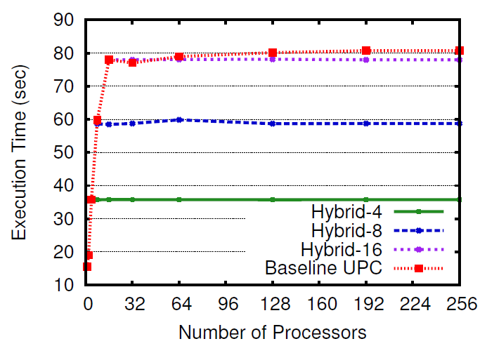
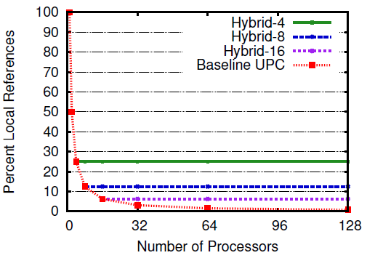
Random Access Benchmark
Performance decreases with system size
Locality decreases, data is more dispersed
Nested-multiple model
Array is replicated across UPC groups

Slide 12
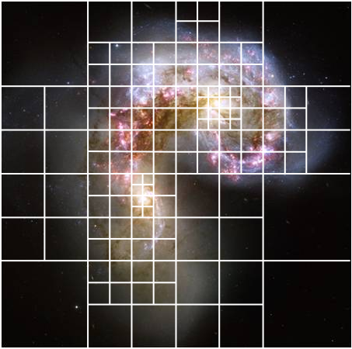
Barnes-Hut n-Body Simulation
Simulate motion and gravitational interactions of n astronomical bodies over time
Represents 3-d space using an oct-tree
Space is sparse
Summarize distant interactions using center of mass
Colliding Antennae Galaxies
(Hubble Space Telescope)

Slide 13
Hybrid Barnes-Hut Algorithm
UPC
for i in 1..t_max
t <- new octree()‏
forall b in bodies
insert(t, b)‏
summarize_subtrees(t)‏
forall b in bodies
compute_forces(b, t)‏
forall b in bodies
advance(b)‏
Hybrid UPC+MPI
for i in 1..t_max
t <- new octree()‏
forall b in bodies
insert(t, b)‏
summarize_subtrees(t)
‏
our_bodies <-
partion(group id, bodies)‏
forall b in our_bodies
compute_forces(b, t)‏
forall b in our_bodies
advance(b)‏
Allgather(our_bodies, bodies)‏

Slide 14
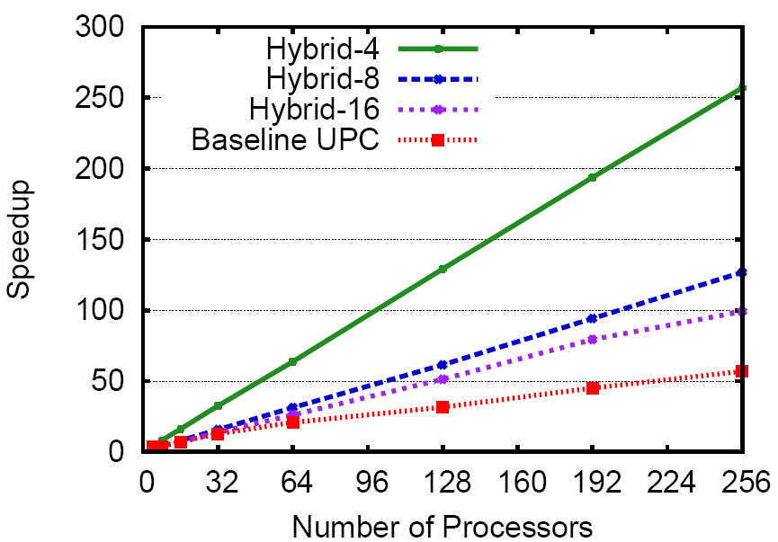
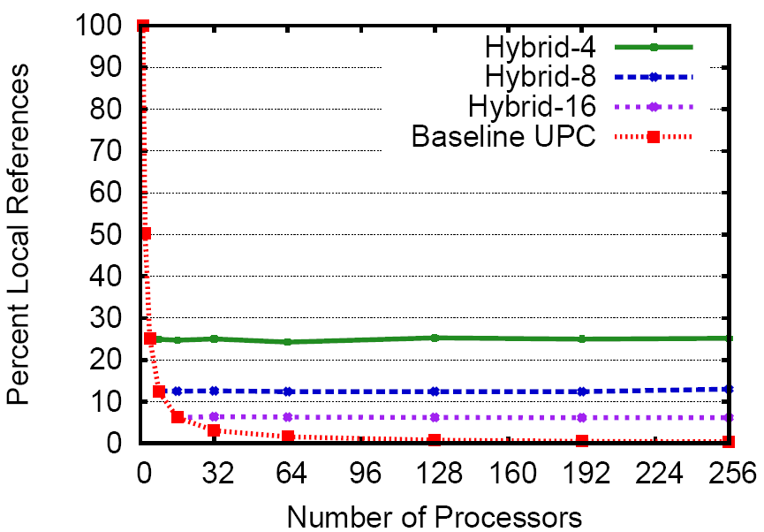
Hybrid MPI+UPC Barnes-Hut
Nested-funneled model
Tree is replicated across UPC groups
51 new lines of code (2% increase)
Distribute work and collect results
Notes:
Replicas are not kept in-sync. Programmer must explicitly do this.

Slide 15
Conclusions
Hybrid MPI+UPC offers interesting possibilities
Improve locality of UPC codes through replication
Increase storage space MPI codes with UPC’s GAS
Random Access Benchmark:
1.33x performance with groups spanning two nodes
Barnes-Hut:
2x performance with groups spanning four nodes
2% increase in codes size
Contact: James Dinan <dinan@cse.ohio-state.edu>

Slide 16
Backup Slides

Slide 17
The PGAS Memory Model
Proc₀ Proc₁ Proc_{n}
X[M][M][N]
Shared
Global address space
X[1..9]
[1..9][1..9]
Private
X
Global Address Space
Aggregates memory of multiple nodes
Logically partitioned according to affinity
Data access via one-sided get(..) and put(..) operations
Programmer controls data distribution and locality
PGAS Family: UPC (C), CAF (Fortran), Titanium (Java), GA (library)
Notes:
Explain one-sided operations:
- Can’t operate in-place on data in the global address space
- One-sided get to copy into local address space
- Compute
- One-sided put to copy result back into global address space

Slide 18
Who is UPC
UPC is an open standard, latest is v1.2 from May, 2005
Academic and Government Institutions
George Washington University
Laurence Berkeley National Laboratory
University of California, Berkeley
University of Florida
Michigan Technological University
U.S. DOE, Army High Performance Computing Research Center
Commercial Institutions
Hewlett-Packard (HP)‏
Cray, Inc
Intrepid Technology, Inc.
IBM
Etnus, LLC (Totalview)‏

Slide 19
Why not use MPI-2 one-sided?
Problem: Ordering
A location can only be accessed once per epoch if written to
Problem: Concurrency in accessing shared data
Must always lock to declare an access epoch
Concurrent local/remote accesses to the same window are an error even if regions do not overlap
Locking is performed at (coarse) window granularity
Want multiple windows to increase concurrency
Problem: Multiple windows
Window creation (i.e. dynamic object allocation) is collective
MPI_Win objects can't be shared
Shared pointers require bookkeeping

Slide 20
Mapping UPC Thread Ids to MPI Ranks
How to identify a process?
Group ID
Group rank
Group ID = MPI rank of thread 0
Group rank = MYTHREAD
Thread IDs not contiguous
Must be renumbered
MPI_Comm_split(0, key)‏
Key = MPI rank of thread 0 * THREADS + MYTHREAD
Result: contiguous renumbering
MYTHREAD = MPI rank % THREADS
Group ID = Thread 0 rank = MPI rank/THREADS

Slide 21
Launching Nested-Multiple Applications
Example: launch hybrid app with two UPC groups of size 8
MPMD-style launch
$ mpiexec -env HOSTS=hosts.0 upcrun -n 8 hybrid-app : -env HOSTS=hosts.1 upcrun -n 8 hybrid-app
Mpiexec launches two tasks
Each MPI task runs UPC's launcher
Provide different arguments (host file) to each task
Under nested-multiple model, all processes are hybrid
Each instance of hybrid_app calls MPI_Init(), requests a rank
Problem: MPI thinks it launched a two-task job!
Solution: Flag: --ranks-per-proc=8
Added to Hydra process manager in MPICH2

Slide 22
Dot Product – Flat
#include <upc.h>
#include <mpi.h>
#define N 100*THREADS
shared double v1[N], v2[N];
int main(int argc, char **argv) {
int i, rank, size;
double sum = 0.0, dotp;
MPI_Comm hybrid_comm;
MPI_Init(&argc, &argv);
MPI_Comm_split(MPI_COMM_WORLD, 0,
MYTHREAD, &hybrid_comm);
MPI_Comm_rank(hybrid_comm, &rank);
MPI_Comm_size(hybrid_comm, &size);
upc_forall(i = 0; i < N; i++; i)
sum += v1[i]*v2[i];
MPI_Reduce(&sum, &dotp, 1, MPI_DOUBLE,
MPI_SUM, 0, hybrid_comm);
if (rank == 0) printf("Dot = %f\n", dotp);
MPI_Finalize();
return 0;
}

Slide 23
Dot Product – Nested Funneled
#include <upc.h>
#include <mpi.h>
#define N 100*THREADS
shared double v1[N], v2[N];
shared double our_sum = 0.0;
shared double my_sum[THREADS];
shared int me, np;
int main(int argc, char **argv) {
int i, B;
double dotp;
if (MYTHREAD == 0) {
MPI_Init(&argc, &argv);
MPI_Comm_rank(MPI_COMM_WORLD,(int*)&me);
MPI_Comm_size(MPI_COMM_WORLD,(int*)&np);
}
upc_barrier;
B = N/np;
my_sum[MYTHREAD] = 0.0;
upc_forall(i=me*B;i<(me+1)*B;i++; &v1[i])
my_sum[MYTHREAD] += v1[i]*v2[i];
upc_all_reduceD(&our_sum,&my_sum[MYTHREAD],
UPC_ADD, 1, 0, NULL,
UPC_IN_ALLSYNC | UPC_OUT_ALLSYNC);
if (MYTHREAD == 0) {
MPI_Reduce(&our_sum,&dotp,1,MPI_DOUBLE,
MPI_SUM, 0, MPI_COMM_WORLD);
if (me == 0) printf("Dot = %f\n", dotp);
MPI_Finalize();
}
return 0;
}

Slide 24
Dot Product – Nested Multiple
#include <upc.h>
#include <mpi.h>
#define N 100*THREADS
shared double v1[N], v2[N];
shared int r0;
int main(int argc, char **argv) {
int i, me, np;
double sum = 0.0, dotp;
MPI_Comm hybrid_comm
MPI_Init(&argc, &argv);
MPI_Comm_rank(MPI_COMM_WORLD, &me);
MPI_Comm_size(MPI_COMM_WORLD, &np);
if (MYTHREAD == 0) r0 = me;
upc_barrier;
MPI_Comm_split(MPI_COMM_WORLD, 0,
r0*THREADS+MYTHREAD, &hybrid_comm);
MPI_Comm_rank(hybrid_comm, &me);
MPI_Comm_size(hybrid_comm, &np);
int B = N/(np/THREADS); // Block size
upc_forall(i=me*B;i<(me+1)*B;i++; &v1[i])
sum += v1[i]*v2[i];
MPI_Reduce(&sum, &dotp, 1, MPI_DOUBLE,
MPI_SUM, 0, hybrid_comm);
if (me == 0) printf("Dot = %f\n", dotp);
MPI_Finalize();
return 0;
}

