Slide 1
Enabling Concurrent Multithreaded MPI Communication on Multicore Petascale Systems
Gabor Dozsa¹, Sameer Kumar¹, Pavan Balaji², Darius Buntinas²,
David Goodell², William Gropp³, Joe Ratterman⁴, and Rajeev Thakur²
1 IBM T. J. Watson Research Center, Yorktown Heights, NY 10598
2 Argonne National Laboratory, Argonne, IL 64039
3 University of Illinois, Urbana, IL 61801
4 IBM Systems and Technology Group, Rochester, MN 55901
Joint Collaboration between Argonne and IBM

Slide 2
Outline
Motivation
MPI Semantics for multi-threading
Blue Gene/P overview
Deep computing messaging framework (DCMF)
Optimize MPI thread parallelism
Performance results
Summary

Slide 3
Motivation
Multicore architectures with many threads per node
Running MPI processes on each core results in
Less memory per process
Higher TLB pressure
Problem may not scale to as many processes
Hybrid Programming
Use MPI across nodes
Use shared memory within nodes (posix threads, OpenMP)
MPI library accessed concurrently from many threads
Fully concurrent network interfaces that permit concurrent access from multiple threads
Thread optimized MPI library critical for hybrid programming

Slide 4
MPI Semantics for Multithreading
MPI defines four thread levels
Single
Only one thread will execute
Funneled
The process may be multi-threaded, but only the main thread will make MPI calls
Serialized
The process may be multi-threaded, and multiple threads may make MPI calls, but only one at a time: MPI calls are not made concurrently from two distinct threads
Multiple
Multiple threads may call MPI, with no restrictions

Slide 5
Blue Gene/P Overview

Slide 6
BlueGene/P Interconnection Networks
3 Dimensional Torus – DMA responsible for handing packets
Interconnects all compute nodes
Virtual cut-through hardware routing
3.4 Gb/s on all 12 node links (5.1 GB/s per node)
0.5 µs latency between nearest neighbors, 5 µs to the farthest 100 ns
Communications backbone for computations
Collective Network – core responsible for handling packets
One-to-all broadcast functionality
Reduction operations functionality
6.8 Gb/s (850 MB/s) of bandwidth per link
Latency of one way network traversal 1.3 µs
Low Latency Global Barrier and Interrupt
Latency of one way to reach all 72K nodes 0.65 µs, MPI 1.2 µs

Slide 7
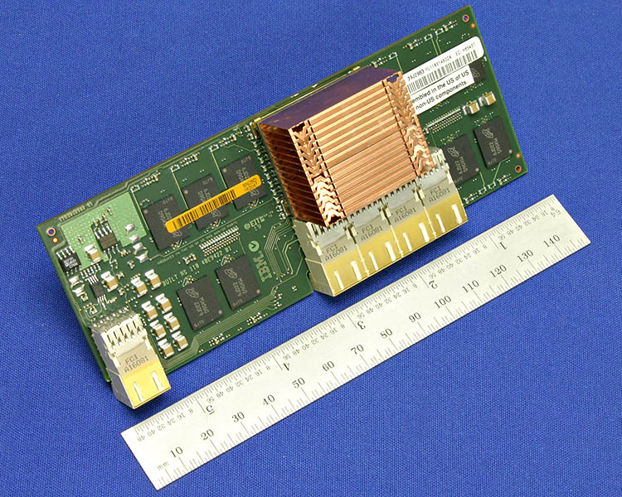
BG/P Torus network and the DMA
Torus network accessed via a direct memory access unit
DMA unit sends and receives data with physical addresses
Messages have to be in contiguous buffers
DMA performs cache injection on sender and receiver
Resources in the DMA managed by software
Blue Gene/P Compute Card

Slide 8
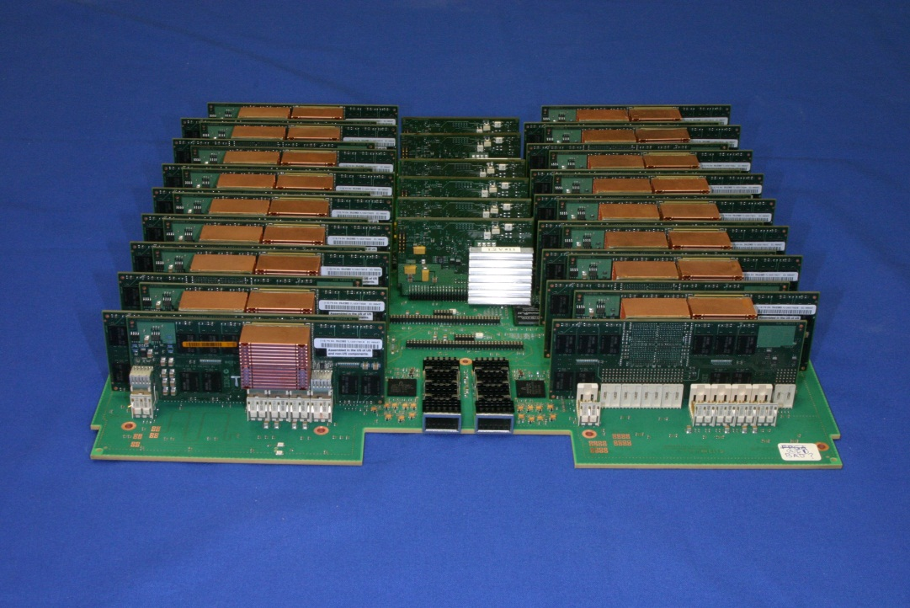
BG/P DMA
DMA Resources
Injection Memory FIFOs
Reception Memory FIFOs
Counters
A collection of DMA resources forms a group
Each BG/P node has four groups
Access to a DMA group can be concurrent
Typically used to support virtual node mode with four processes
Blue Gene/P Node Card

Slide 9
Message Passing on the BG/P DMA
Sender injects a DMA descriptor
Descriptor provides detailed information to the DMA on the actions to perform
DMA initiates intra-node or inter-node data movement
Memory FIFO send : results in packets in the destination reception memory FIFO
Direct put : moves local data to a destination buffer
Remote get : pulls data from a source node to a local (or even remote) buffer
Access to injection and reception FIFOs in different groups can be done in parallel by different processes and threads

Slide 10
Deep Computing Messaging Framework (DCMF)
Low level messaging API on BG/P
Supporting multiple paradigms on BG/P
Active message API
Good match for LAPI, Charm++ and other active message runtimes
MPI supported on this active message runtime
Optimized collectives

Slide 11
Extensions to DCMF for concurrency
Introduce the notion of channels
In SMP mode the four injection/reception DMA groups exposed as four DCMF channels
New DCMF API calls
DCMF_Channel_acquire()
DCMF_Channel_release()
DCMF progress calls enhanced to only advance acquired channel
Channel state stored in thread private memory
Pt-to-pt API unchanged
Channels are similar to the notion of enpoints proposal in the MPI Forum

Slide 12
Optimize MPI thread concurrency

Slide 13
MPICH Thread Parallelism
Coarse Grained
Each MPI call is guarded by an ALLFUNC critical section macro
Blocking MPI calls release the critical section enabling all threads to make progress
Fine grained
Decrease size of the critical sections
ALLFUNC macros are disabled
Each shared resource is locked
For example a MSGQUEUE critical section can guard a message queue
The RECVQUEUE critical section will guard the MPI receive queues
HANDLE mutex for allocating object handles
Eliminate critical sections
Operations such as reference counting can be optimized via scalable atomics (e.g. fetch-add)

Slide 14
Enabling Concurrent MPI on BG/P
Messages to the same destination always use the same channel to preserve MPI ordering
Messages from different sources arrive on different channels to improve parallelism
Map each source destination pair to a channel via a hash function
E.g. (srcrank + dstrank) % numchannels

Slide 15
Parallel Receive Queues
Standard MPICH has two queues for posted receives and unexpected messages
Extend MPICH to have
Queue of unexpected messages and posted receives for each channel
Additional queue for wild card receives
Each process posts receives to the channel queue in the absence of wild cards
When there is a wild card all receives are posted to the wild card queue
When a packet arrives
First the wild card queue is processed after acquiring WC lock
If its empty, the thread that receives the packet
acquires channel RECVQUEUE lock
Matches packet with posted channel receives or
If no match is found a new entry is created in the channel unexpected queue

Slide 16
Performance Results

Slide 17
Message Rate Benchmark
Message rate benchmark where each thread exchanges messages with a different node

Slide 18
Message Rate Performance
Zero threads = MPI_THREAD_SINGLE

Slide 19
Thread scaling on MPI vs DCMF
Absence of receiver matching enables higher concurrency in DCMF

Slide 20
Summary and Future work
We presented different techniques to improve throughput of MPI calls in multi-threaded architectures
Performance improves 3.6x on four threads
These techniques should be extendible to other architectures where network interfaces permit concurrent access
Explore lockless techniques to eliminate critical sections for handles and other resources
Garbage collect request objects

