Slide 1
Power and Performance Characterization of Computational Kernels on the GPU
Yang Jiao, Heshan Lin, Pavan Balaji (ANL), Wu-chun Feng

Slide 2
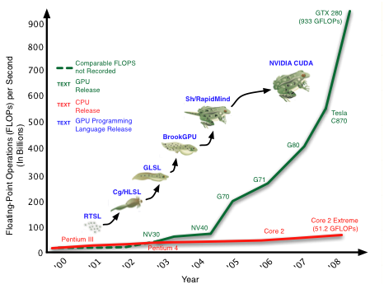
Graphic Processing Units (GPU) are Powerful
* Data and image source, http://people.sc.fsu.edu/~jburkardt/latex/ajou_2009_parallel/ajou_2009_parallel.html
Notes:
Graphic processing units are traditionally used for gaming and image processing. Recently with the introduction of high-level languages such as CUDA and Brook+, GPU has evolved
into accelerators with capability of general purpose computing. Compared to traditional CPUs, performance of GPUs increases at a much faster rate. For instance, the difference of the peak float-point operations per second (FLOPS) between the NVIDIA GPU and the Intel CPU is about 500 giga FLOPS (GFLOPS) in Nov 2006, and this difference increases to more than 800 GFLOPs in Jun 2008.

Slide 3
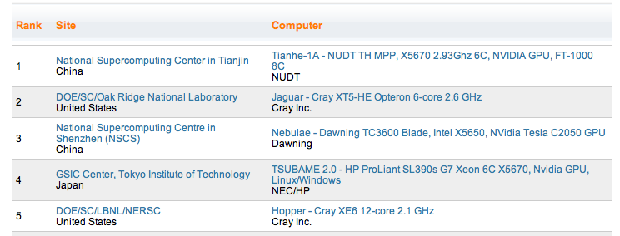

GPU is Increasingly Popular in HPC
Three out of top five supercomputers are GPU-based
Notes:
As a consequence, GPU is increasing popular in HPC. For instance, three out of top five supercomputers are GPU accelerated according to the most recent Top500 list.

Slide 4
GPUs are Power Hungry
It is imperative to investigate Green GPU computing
Notes:
Although GPU can offer massive amounts of compute power, it is also power hungry. This figure compares the thermal design power of a multi-core CPU and two modern GPUs.

Slide 5
Green Computing with DVFS on CPUs
Mechanism
Minimizing performance impact
Lower voltage and frequency when CPU not in critical path
What about GPUs?
Power ∝ Voltage² × Frequency
Notes:
Green computing on CPUs have been extensively studied in the past a couple of years. Dynamic voltage and frequency scaling is an important mechanism to improve the energy efficiency on CPUS. Basically,

Slide 6
What is this Paper about?
Characterize performance and power for various kernels on GPUs
Kernels with different compute and memory intensiveness
Various core and memory frequencies
Contributions
Reveal unique frequency scaling behaviors on GPUs
Provide useful hints for green GPU computing

Slide 7
Outline
Introduction
GPU Overview
Characterization Methodology
Experimental Results
Conclusion & Future Work

Slide 8
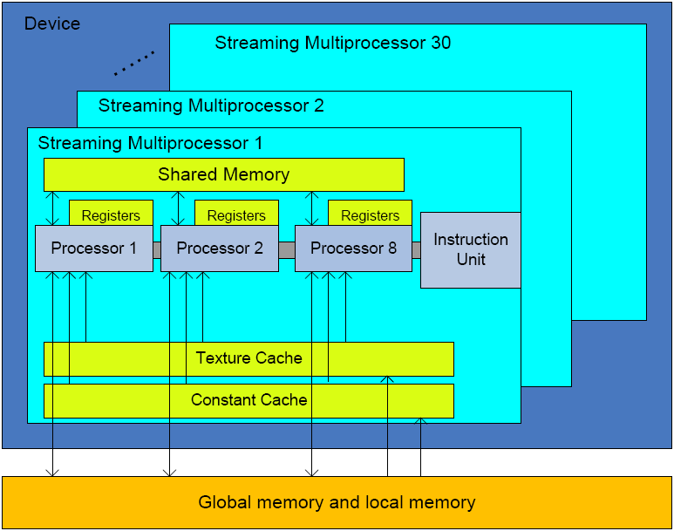
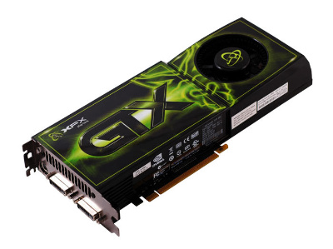
NVIDIA GTX280 Architecture
On-chip memory
Small sizes
Fast access
Off-chip memory
Large size
High access latency
Device (Global) Memory
Notes:
30 SM, with each one having 8 streaming processors
Each SM 16384 registers, 16kB shared memory
Global memory 1GB, average on each SM is 34MB.
On-chip memory access latency is several cycles, but that of global memory is several hundred cycles.

Slide 9
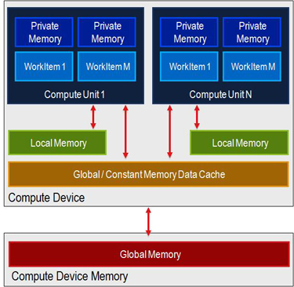
OpenCL
Write once, run on any GPUs
Allow programmer to fully exploit power of GPUs
Compute kernel: function executed on a GPU
OpenCL
Device Abstraction
Notes:
OpenCL is a programming language created to unify the programming efforts on GPUs from various vendors. At a high level, the OpenCL design is similar to Java. The user only need to write xxx The abstraction provided by OpenCL is high enough to capture the architectural features of GPUs from different vendors. The abstraction is also low enough so that the programmers will have the flexibility to fully tune the codes on a specific GPU. All programs in our study
The device model in OpenCL maps well on GPUs such as GTX280, giving programmers the flexibility to fully exploit the power. All applications in our study are written in OpenCL.

Slide 10
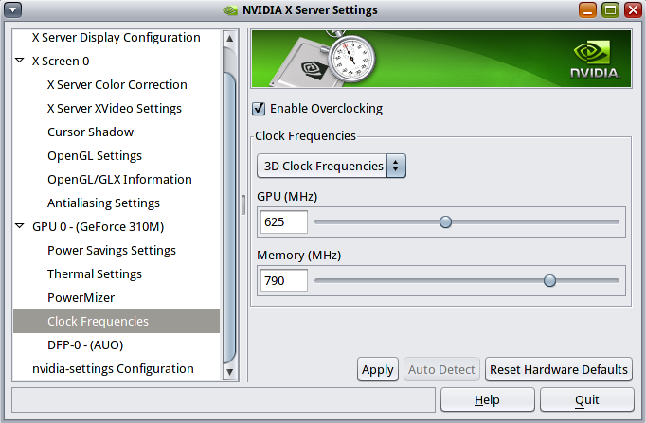
GPU Frequency Scaling
Two dimensional
Compute core frequency and memory frequency
Semi-automatic
Dynamic configuration not supported
User can only control peak frequencies
Automatically switch to idle mode when no computation
Details not available to public
Notes:
On GTX280, frequencies can be adjusted through NVIDIA’s powermiser energy management solution. There are several unique features on GPU frequency scaling compared to CPU. First two dimensional …, give programmers the flexibility of allocating power to either computation or memory access according to the applications characteristics. Second, semi-automatic, users can only statically configure the frequency before launching a kernel. The frequency cannot be changed during the kernel execution. Also, the users can only control the peak frequencies. Even the frequencies are configured, the device driver will still automatically scale the frequencies according to the device workloads. However, the details are not available to public.

Slide 11
Outline
Introduction
GPU Overview
Characterization Methodology
Experimental Results
Conclusion & Future Work

Slide 12
Kernel Selection
High performance of GPUs
Massive parallelism (e.g., 240 cores)
High memory bandwidth (e.g., 140GB/s)
Three kernels of computational diversity
Compute Intensive
Memory Intensive
Matrix Multiplication
Fast Fourier Transform (FFT)
Matrix Transpose
Notes:
Put a scale here, one end compute intensive, the other end memory intensive

Slide 13
Kernel Characteristics
Memory to compute ratio
Instruction throughput
Notes:
To quantify diversity of kernels, we measure two metrics. The first one is memory to compute ratio, which is approximated by using the number of computation instructions to divide. #global_memory_transactions. The second one is instruction throughput.

Slide 14
Kernel Profile
 | Matrix Multiplication | Matrix Transpose | FFT
R_{mem} | 5.6% | 53.7% | 8.3%
R_{ins} | 203215711 | 12095895 | 145165788
Notes:
Matrix transpose has much higher memory to compute ratio. While this ration is similar for Matrix multiplication and FFT, the instruction throughput of mm is 40% higher …

Slide 15
Measurement
Performance
Matrix multiplication, FFT: GFLOPS
Matrix transpose: MB/s
Energy
Whole system when executing the kernel on the GPU
Power
Reported using the average power
Energy Efficiency
Performance / power

Slide 16
Outline
Introduction
GPU Overview
Characterization Methodology
Experimental Results
Conclusion & Future Work

Slide 17
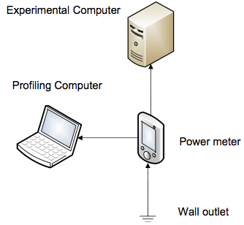
Experimental Setup
System
Intel Core 2 Quad Q6600
NVIDIA GTX280
1GB memory
Power Meter
Watts Up? Pro ES

Slide 18
Matrix Multiplication - Performance
Mostly affected by core frequency, almost not affected by memory frequency

Slide 19
Matrix Multiplication - Power
Mostly affected by core frequency, slightly affected by memory frequency

Slide 20
Matrix Multiplication - Efficiency
Best efficiency achieved at highest core frequency and relatively high memory frequency

Slide 21
Matrix Transpose - Performance
Performance dominated by memory frequency

Slide 22
Matrix Transpose - Power
Higher core frequency increase power consumption (not performance)

Slide 23
Matrix Transpose - Efficiency
Best efficiency achieved at highest memory frequency and lowest core frequency

Slide 24
FFT - Performance
Affected by both core and memory frequencies

Slide 25
FFT - Power
Affected by both core and memory frequencies

Slide 26
FFT - Efficiency
Best efficiency at highest core and memory frequencies
Notes:
Finally, the energy efficiency. Clearly, the energy efficiency bounded by both core and memory frequencies.
When the memory frequency is low, changing the core frequency does not affect the efficiency much. First a few lines, increase, then become plateau,

Slide 27
FFT – Two Dimensional Effect
7%
Notes:
Remember I said earlier that one unique feature of GPU frequency scaling is that it is two-dimensional. This gives users the flexibility of allocating power to different components according to the application characteristics. For example, we picked three different configurations that consume almost the same amounts of power.

Slide 28
Power and Efficiency Range

Slide 29
Conclusion & Future Work
To take away
Green computing on GPUs are important
GPU frequency scaling considerably different than CPUs
Next
Finer-grained level of characterization (e.g., different types of operations)
Experiments on Fermi and AMD GPUs

Slide 30
Acknowledgment
NSF Center for High Performance Reconﬁgurable Computing (CHREC) for their support through NSF I/UCRC Grant IIP-0804155;
National Science Foundation for their support partialy through CNS-0915861 and CNS-0916719.

Slide 31

Questions?

