Slide 1
Understanding Power Measurement Implications in the Green500 List
Balaji Subramaniam and Wu-chun Feng*

Slide 2
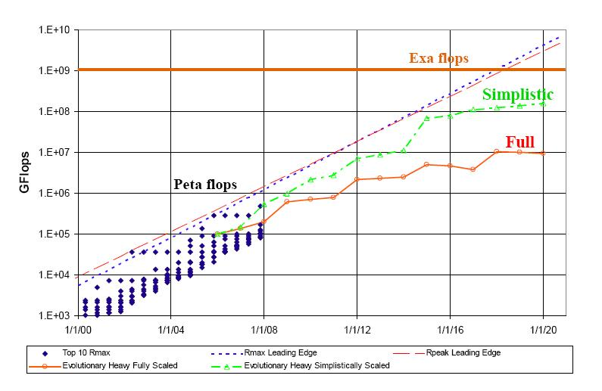
Future of High-Performance Computing
Source: DARPA IPTO

Slide 3
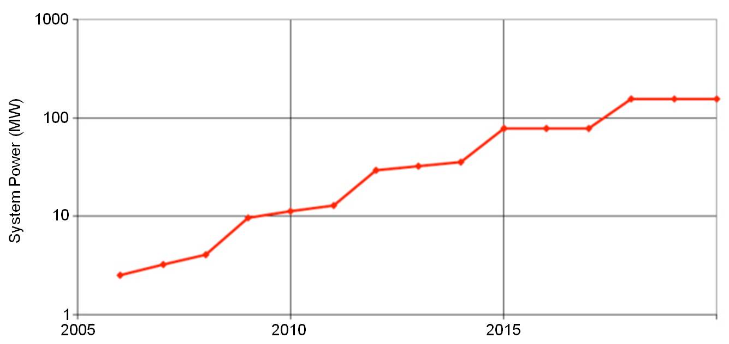
Future of High-Performance Computing
HPC is energy/power limited

Slide 4
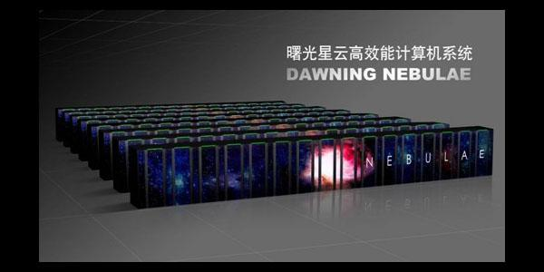
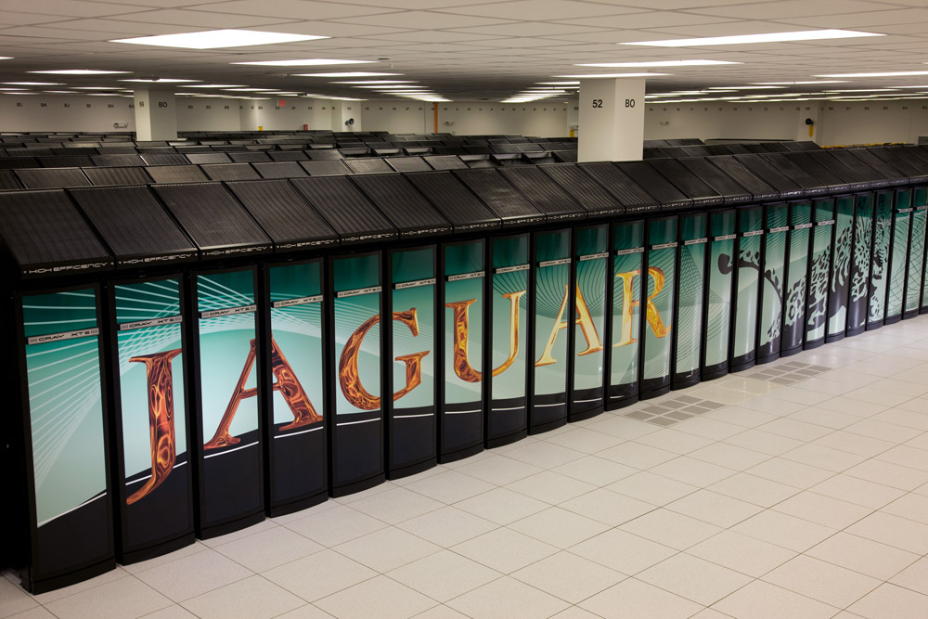

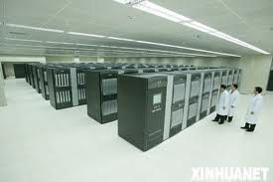
Notes:
All the supercomputers are huge and draw a lot of power (e.g. Jaguar = 6.9MW power).

Slide 5
Energy Awareness in HPC
Green500 List
Benchmark: high-performance LINPACK (HPL)¹
Metric: FLOPS²/Watt
Energy efficiency as a first order design constraint
Portable implementation of the LINPACK benchmark for distributed memory systems
Floating point operations per second

Slide 6
Motivation(1)
Power Measurement in HPC
Cannot measure the power of entire supercomputer
Currently lack such infrastructure
Cannot measure power for the entire benchmark run
Jaguar runs HPL for 18 hrs¹
Roadrunner takes 2 hrs¹
Caveat:
Cannot improve/manage what we cannot measure
Source: J. Dongarra, LINPACK Benchmark with Time Limits on Multicore & GPU Based Accelerators, ISC’10

Slide 7
Motivation (2)
Solution
Measure only fraction of the benchmark run
Extrapolate system power from a sub-component power

Slide 8
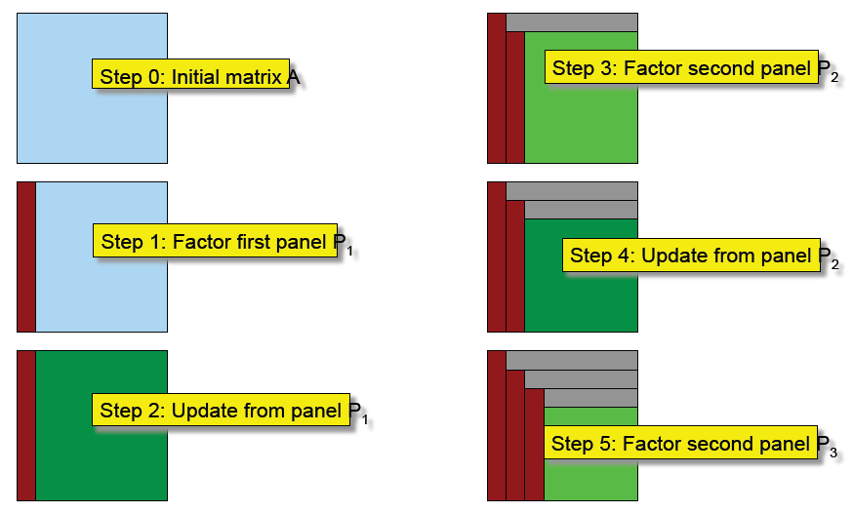
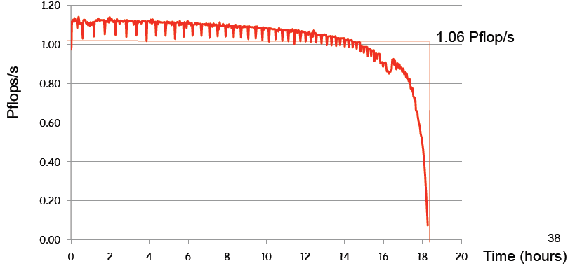
Motivation (3)
Caveats
HPL run on Jaguar supercomputer
Source: J. Dongarra, LINPACK Benchmark with Time Limits on Multicore & GPU Based Accelerators, ISC’10
Notes:
In LU factorization the number of computations done in each step varies as the number of elements to update each time reduces. Therefore performance varies a lot during LINPACK runs as shown in the jaguar figure

Slide 9
Motivation (4)
Unanswered question
What power consumption needs to be measured?
Ex: peak, minimum or average
When should the power be measured?
How should the power be measured?
Ex: extrapolation

Slide 10
Outline
Background and Motivation
Overview of HPL
Experimental Results
Summary and Future Work

Slide 11
HPL Overview
Solve linear system of equation of form Ax=b
Double precision arithmetic
Algorithm phases
Input matrix generation
Factorize and solve
Check for correctness
Floating point operations for second phase is given by:
FLOPS = 2/3*N³ + 3/2*N²

Slide 12
Experimental Setup
Armor (single node)
2 quad-core Intel Xeon E5405
4 GB memory
Ice (8 node)
2 dual-core AMD Opteron 2218
4 GB memory
HPL-2.0, BLAS: ATLAS
Power Meter: Watts Up? Pro ES
DVFS techniques are *not* used
Notes:
Systemg per node config… used gcc with –o3 but no need to stress as we are not comparing performance

Slide 13
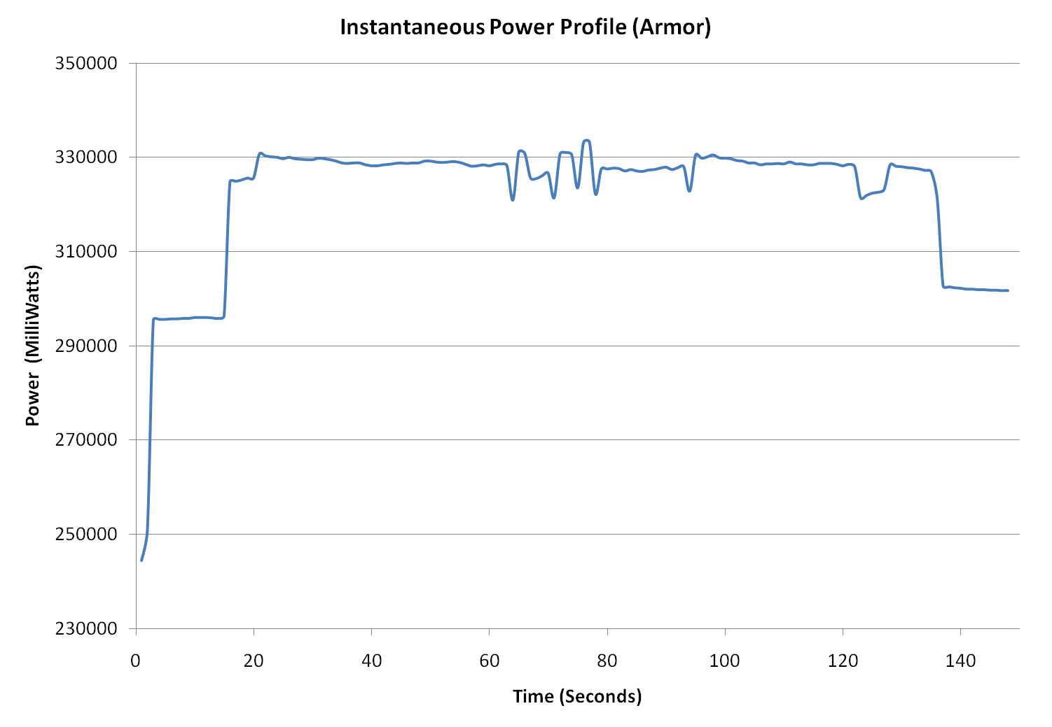
Experimental Results
Notes:
Matrix input generation
Factorize and solve
Check for correctness

Slide 14
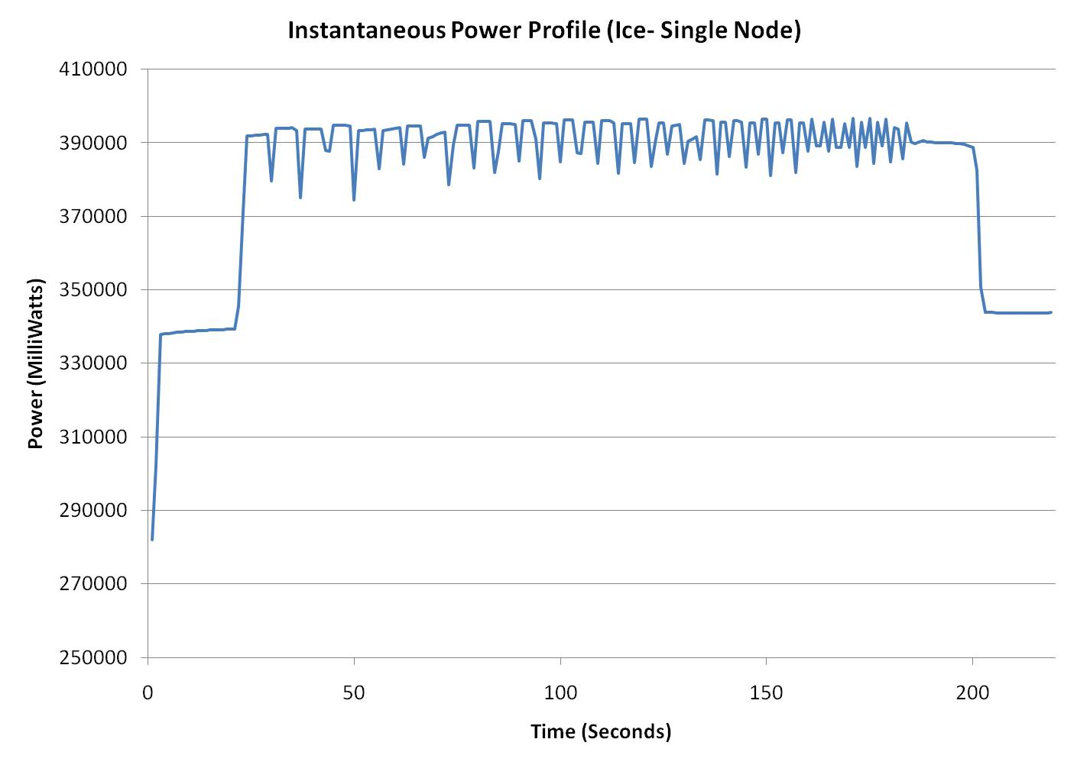
Experimental Results

Slide 15
Experimental Results
What to measure
Power consumed by second phase is stable
Average is the best estimate
When to measure?
Measuring from 50 to 70% of the execution time in HPL would give a good estimate

Slide 16
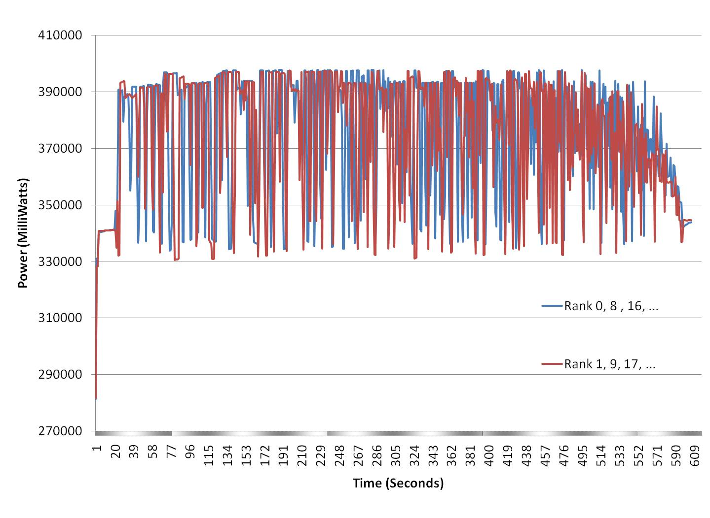
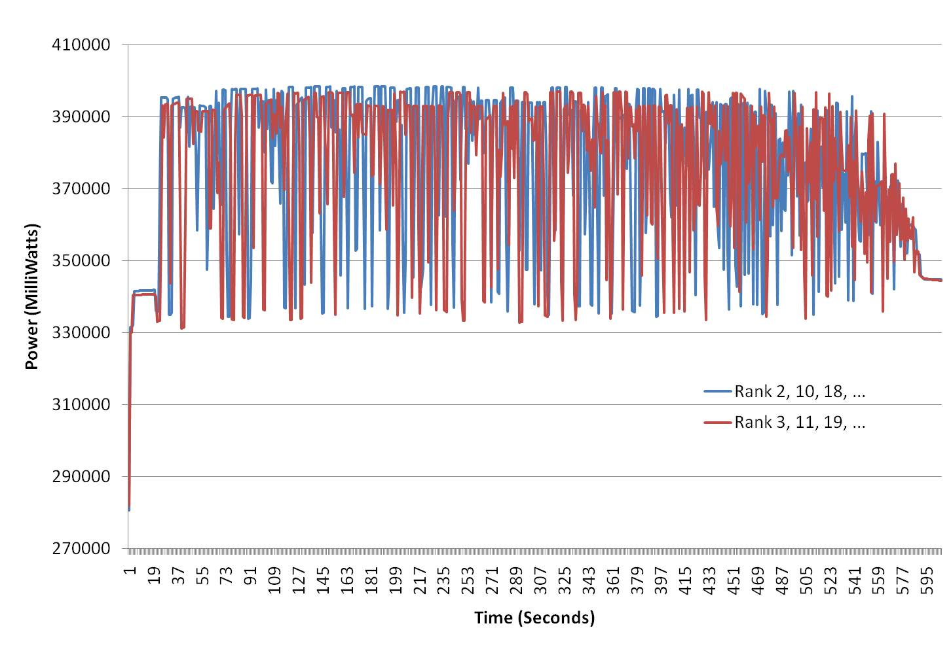
Experimental Results

Slide 17
Experimental Results
How to measure?
Similar power profiles for all nodes
Extrapolation is valid

Slide 18
Summary and Future Work
Cannot improve what we cannot manage
Power measurement methodology for Green500 list
What, when and how to measure
Future work
Refining run rules based on community feedback
Methodology to include network power

Slide 19
Experimental Setup
Armor (single node)
2 quad-core Intel Xeon E5405
4 GB memory
Ice (8 node)
2 dual-core AMD Opteron 2218
4 GB memory
Cuda
Intel Core 2 Duo + Tesla C2050
4GB Memory
HPL-2.0, BLAS: ATLAS
Power Meter: Watts Up? Pro ES
DVFS techniques are *not* used
Notes:
Systemg per node config… used gcc with –o3 but no need to stress as we are not comparing performance

Slide 20
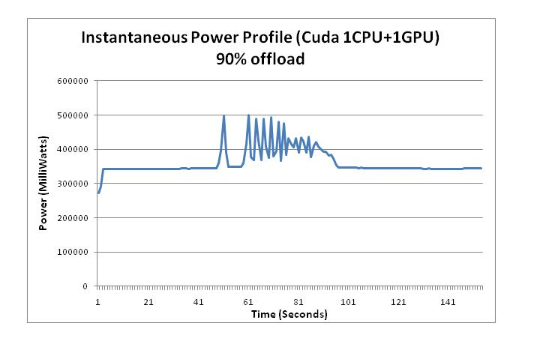
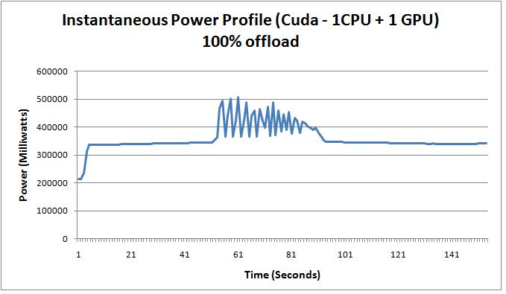
Notes:
The matrix generation and check phase are on CPU and we see a longer execution time for first and third phase than CPU. We can also see the power in the second phase reducing over time. This is because the required computations for LU reduces overtime.
When to measure power: With heterogeneous systems the computations take less time than the matrix generation and check for correctness phase. But it is safe to assume that the LU computation would have started at 40% of execution. So it would be better if we start at 40% and end our measurement at 50%

Slide 21
Tianhe 1A (Top500 rank =1)
Peak Power = 4.46 MW
Power Consumed = 4.04 MW
Jaguar (Top500 rank =2)
Peak Power = 9.03 MW
Power Consumed = 6.90 MW
Nebulae (Top500 rank =3)
Peak Power = 3.04 MW
Power Consumed = 2.58 MW
Hopper (Top500 rank =5)
Peak Power = 3.62 MW
Power Consumed = 2.91 MW
Notes:
Tianhe – GPU based - from processor and GPU TDP * 1.5
Jaguar – CPU based - from cabinet power
Nebulae - GPU based - from processor and GPU TDP * 1.5
Hopper – CPU based - from cabinet power

